Slide 1
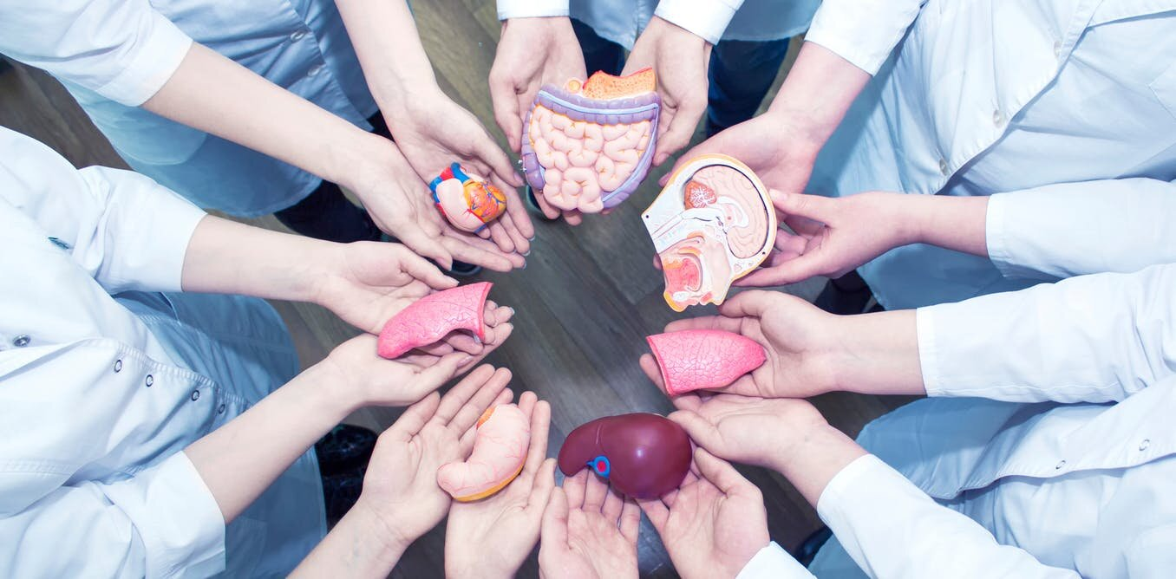
Organ Donation Android Application
Group Id: 220
Batch : IT

Slide 2
01
TABLE OF CONTENTS
02
.
Introduction
02
Objectives
03
Use Case Diagram
04
Development Methodology
05
Future Scope
06
Technologies Used
07
Work Distribution
08
Conclusion

Slide 3

INTRODUCTION
Organ Donation is an extremely noble and honorable act that a person can do to contribute from his/her share of duty to benefits the society and make this world a beautiful place to live.
Our android based application is a very small step from our side to facilitate this noble cause of organ donation and to make the whole process more efficient and transparent.
This app will bring organ donors, organ recipient, doctors all at a same platform and create a healthy environment for them to help each other.

Slide 4
OBJECTIVES
To decrease the communication gap between organ donors and organ recipients.
To create an efficient solution for smooth and convenient way to find and connect organ donor and organ recipient in the specified time frame.
To make the search of organs or organ donors easy and fast.
To make a common platform where organ donor & organ recipients can take consultation of a doctor simultaneously.

Slide 5
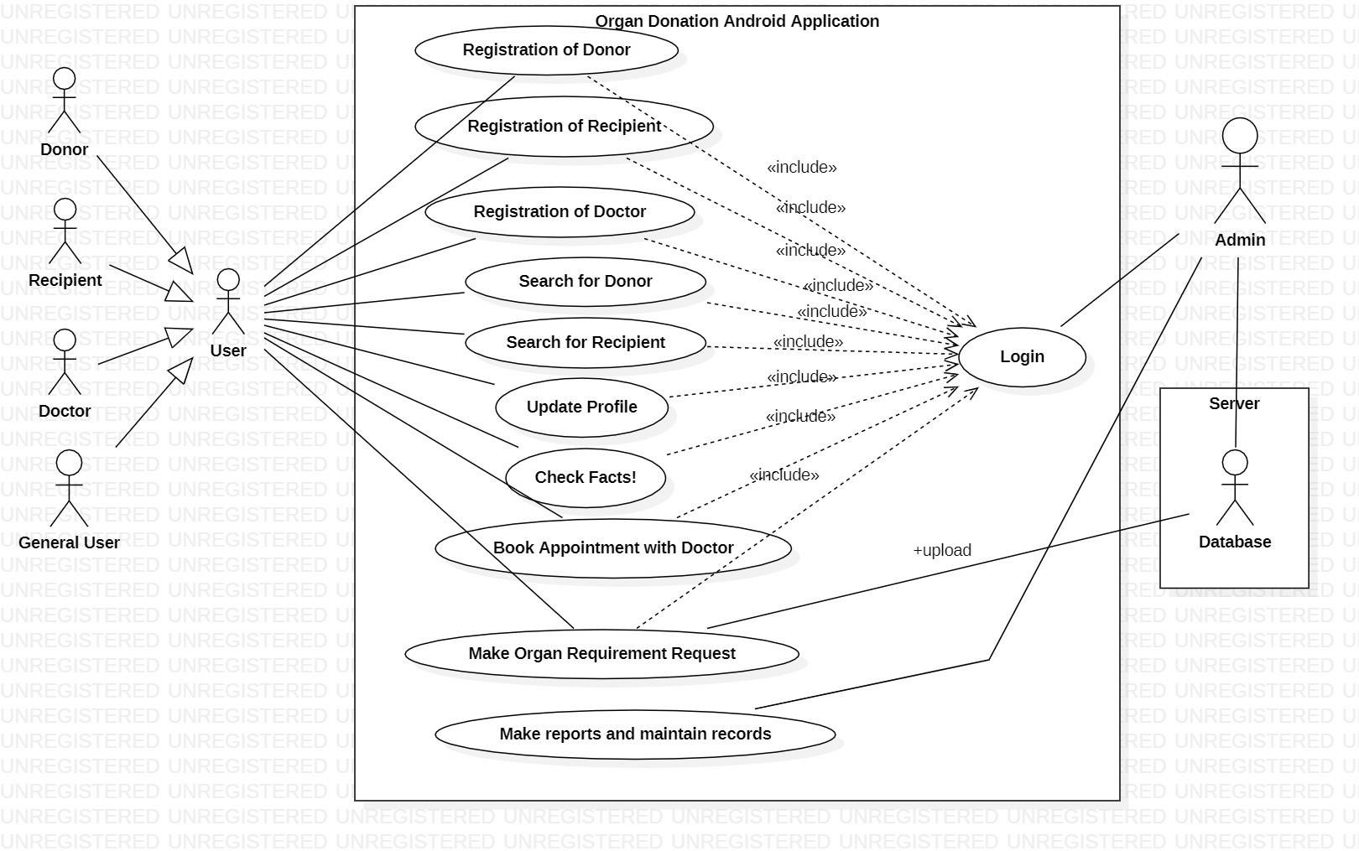
Use Case Diagram:-

Slide 6
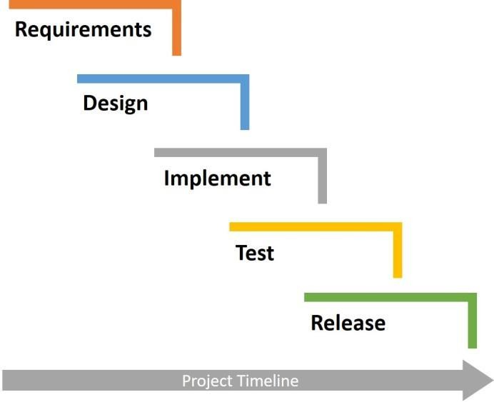
Development Methodology
The system would be developed using the Sashimi Model.
The main idea behind the model is that we allow to overlap the different phases of software development lifecycle.
It is adaptive model.
Sashimi Model

Slide 7
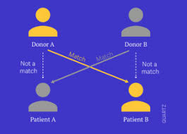
1. Organ Matcher:-
FUTURE SCOPE:-
We will be going to develop organ donation service with accurate matching of organs with receivers using Machine Learning and Computational Algorithm.
This would help recipients make a better decision about whether to accept the organ that is offered by donor by matching organ which is best suitable for them.
To accurately match potential organ by the use of machine learning and some algorithms. We will be going to develop a tool that is able to match organs to transplantation recipients.

Slide 8
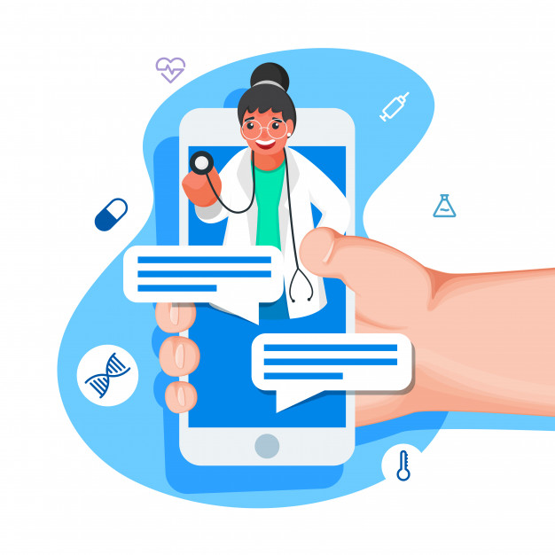
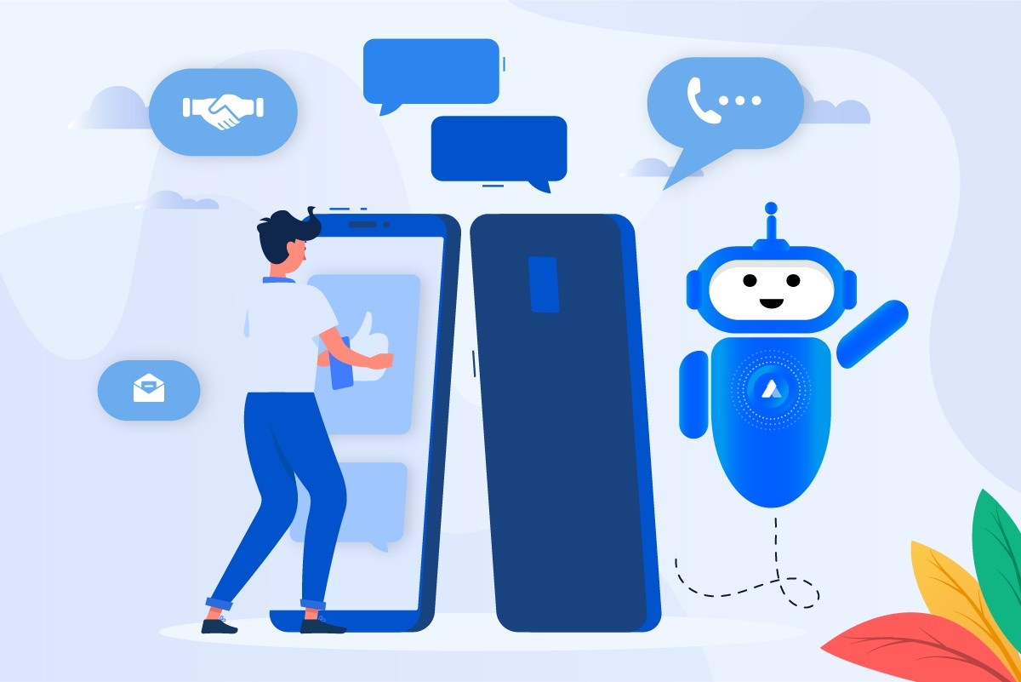
.
FUTURE SCOPE
2. Chatting:-
.
We will be going to provide chatting option between donors, recipients and doctors.
.
3. Chat Bot for FAQ section:-
.
.
We will be going to implement Chat Bot for fAQ section in our app

Slide 9





TECHONOGIES USED:-
Android Studio
Java
IDE for App Development
Programming Language
Git
Firebase
For Version Control
For Realtime Database

Slide 10
Work Distribution
Pranjal Sagar : Front End and Back End
Yash Mudgal : Front End and Report
Vikrant Chaudhary: Research and Report

Slide 11
CONCLUSIONS
We have also tried to decrease the communication gap between donors and recipients.
This app is very flexible android-based app. In this app, donor can easily search for recipients easily in critical situations and can contact to them directly through our app.
In this project, we have tried to bridge the gap between donors and recipients by providing donor, recipient and doctor a single platform
Patients can also book appointments with doctor through our app.

Slide 12
THANK YOU

