Slide 1
Currys plc: Strategic & Capital Allocation Intelligence
Independent analyst project | September 2026
Is Currys allocating its resources and capital optimally?
Evaluating organic investment, customer/digital initiatives, M&A, balance-sheet management and shareholder distributions — without starting from a predetermined answer.
FY26 revenue
£9.254bn
Reported
Adjusted EBIT
£255m
Reported
Free cash flow
£157m
Reported
Year-end net cash
£176m
Reported
Primary source: Currys Annual Report & Accounts 2025/26.
1

Slide 2
Executive answer
The evidence supports optimisation, not a forced strategic reset.
Retain Currys’ current strategic architecture: FY26 shows genuine recovery in earnings, cash generation and balance-sheet strength.
Tilt incremental capital toward measurable organic initiatives in Services/Customer Core and B2B, but only where KPI evidence demonstrates incremental cash returns.
Continue iD Mobile growth with explicit working-capital and payback discipline.
Preserve the ≥£100m year-end net-cash floor before optional shareholder returns or M&A.
Keep bolt-on M&A conditional on target-specific economics; return genuine residual surplus via dividends and valuation-sensitive buybacks.
Protect liquidity
1
2
Fund measurable organic growth
3
Manage iD on cash economics
4
Return genuine surplus
5
M&A only with target proof
Analyst conclusion generated from the linked Excel model; not a management recommendation.
2

Slide 3
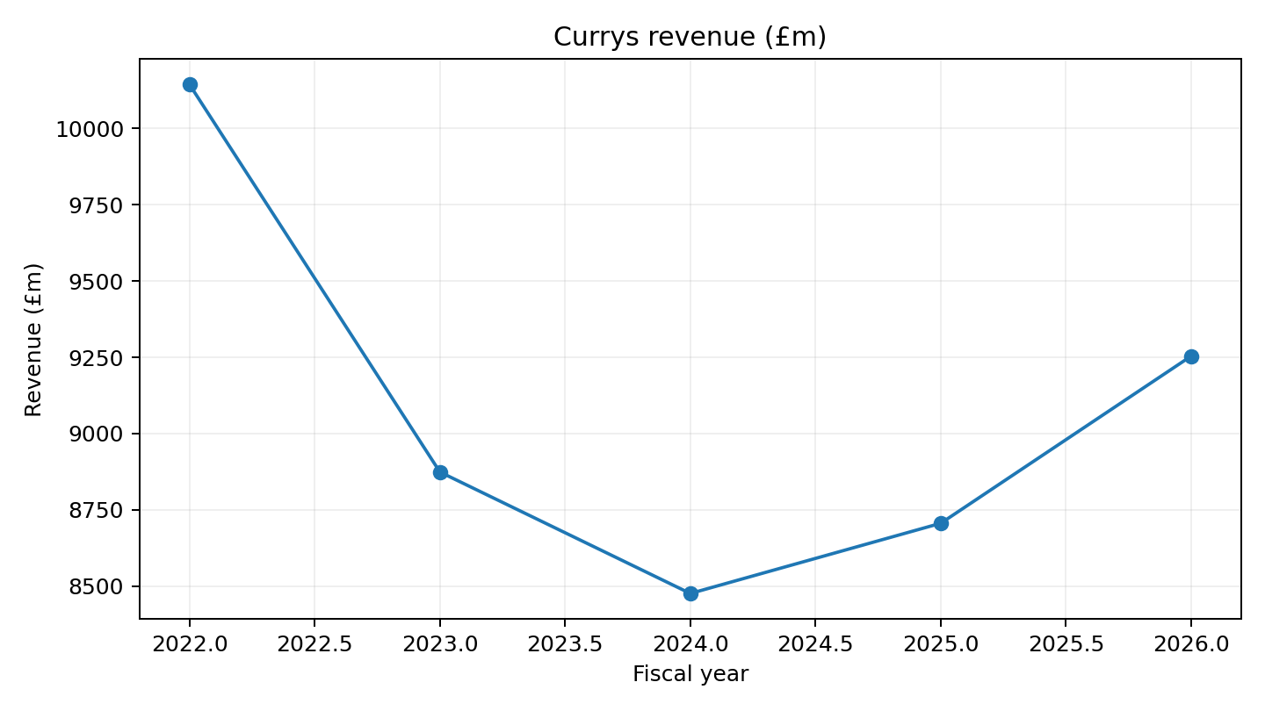
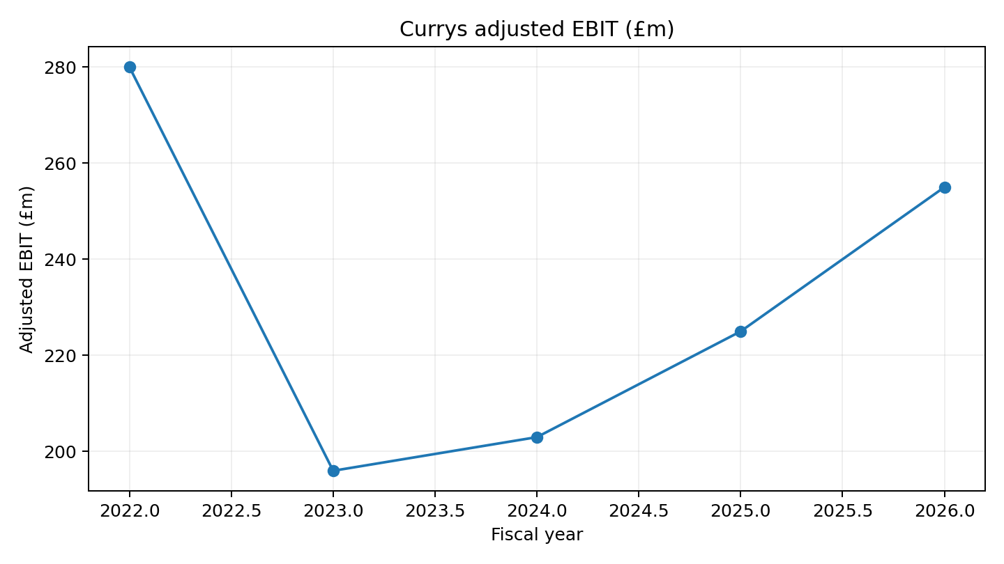
Historical performance
Recovery is visible — but not enough to justify aggressive extrapolation.
Revenue fell materially from FY22 before recovering in FY25–FY26.
Adjusted EBIT recovered from £196m in FY23 to £255m in FY26.
The model therefore uses fading growth and only modest margin improvement rather than extrapolating the recovery mechanically.
Source: Currys Annual Report 2025/26 five-period record; calculations in 03_Historical.
3

Slide 4
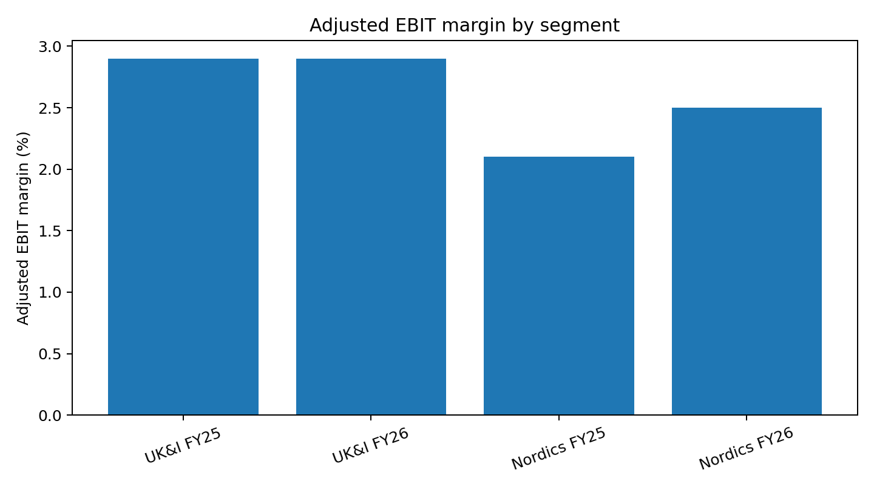
Segment economics
UK&I and Nordics create different capital-allocation questions.
UK&I FY26: £5.438bn revenue, £158m adjusted EBIT, 2.9% margin and £105m segmental FCF.
Nordics FY26: £3.816bn revenue, £97m adjusted EBIT, 2.5% margin and £73m segmental FCF.
Nordics has more recovery runway; UK&I is already near management’s ≥3% margin target.
Capital should be judged on cash conversion and incremental returns, not revenue growth alone.
Source: Currys Annual Report 2025/26 segment review; model calculations in 04_Segments.
4

Slide 5
What management already says — and what this project adds
The project deliberately avoids claiming management disclosures as original discoveries.
Services
Management: recurring / higher-margin
Project test: does incremental spend beat alternatives?
Customer Core
Management: unified customer view / personalisation
Project test: what measurable KPI hurdle justifies more capital?
iD Mobile
Management: subscriber growth + working-capital outflow
Project test: does payback justify the cash burden?
B2B
Management: explicit growth priority
Project test: does it deserve more capital than buybacks/M&A?
Nordics
Management: turnaround is progressing
Project test: how much recovery is sustainable?
Source discipline mirrored in 13_Insight_Log.
5

Slide 6
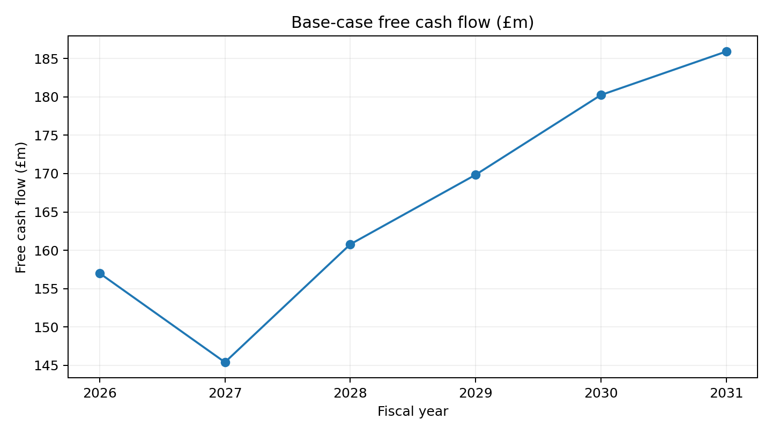
Base-case forecast
The forecast is driver-led and intentionally conservative on margin expansion.
FY27E–FY31E group revenue rises from £9.57bn to £10.58bn.
Adjusted EBIT increases from £272m to £331m as UK&I and Nordics margins move only gradually above 3%.
Free cash flow rises from ~£145m in FY27E to ~£186m in FY31E.
Key cash assumptions are separated from reported data: capex, network receivable, cash tax, cash interest and shareholder returns are all explicit.
Model: 06_Assumptions, 07_Forecast, 17_Cash_Flow and 18_Three_Statement.
6

Slide 7
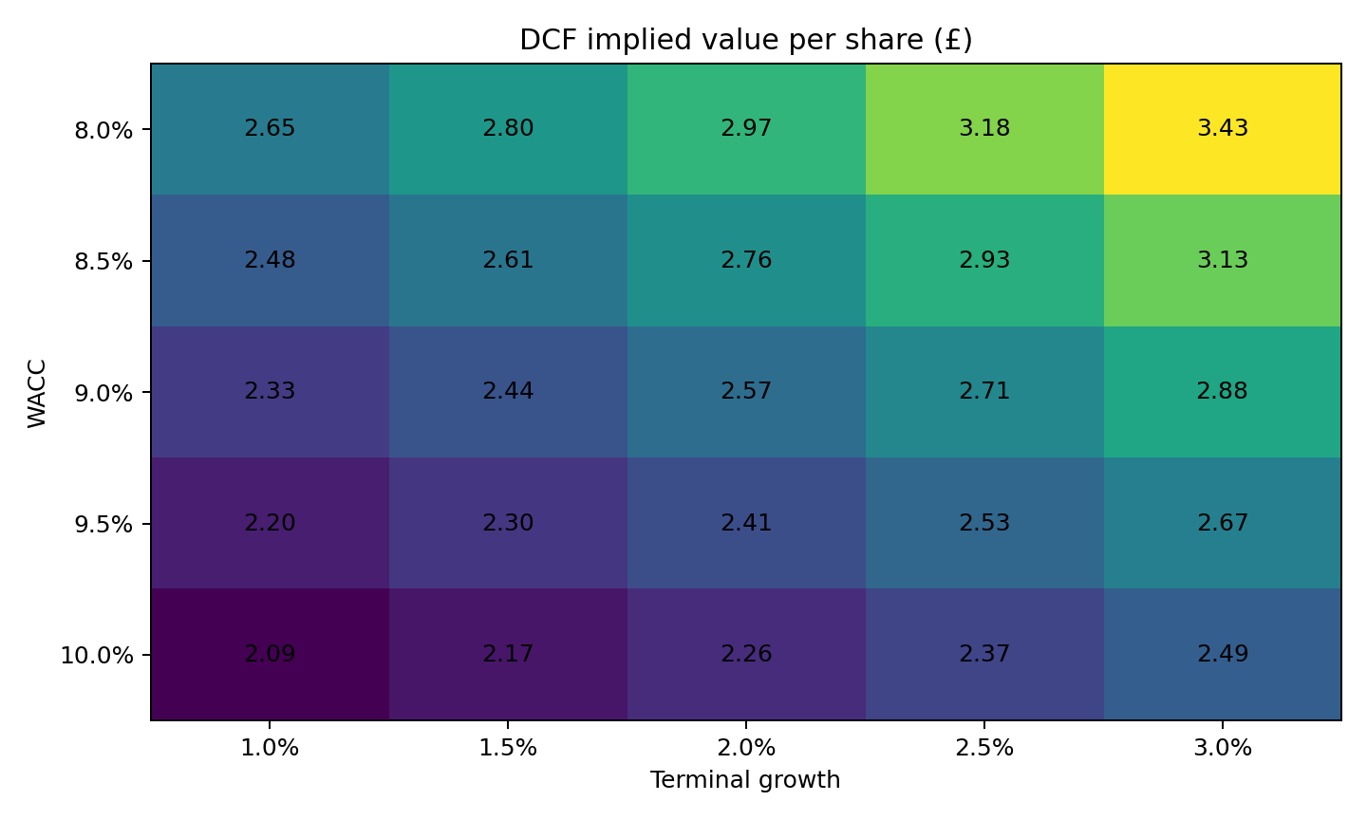
Valuation
DCF suggests upside in the base case, but the sensitivity range matters more than one point estimate.
Base DCF
£2.57/share
9.0% WACC / 2.0% terminal growth
Market snapshot
£1.51/share
9 Sep 2026 reference
Base implied equity value: ~£2.74bn.
Sensitivity range shown: roughly £2.09–£3.43/share across 8–10% WACC and 1–3% terminal growth.
Implication: buybacks may be attractive if the operating thesis survives, but they still compete with organic projects for scarce capital.
Model: 08_DCF. Valuation is illustrative and assumption-sensitive.
7

Slide 8
Capital allocation
Every option competes against the same cash and risk constraints.
Cash buffer
Protect
High evidence
≥£100m year-end net cash
Services / Customer Core
Prioritise selectively
Medium-high evidence
Incremental gross profit / retention / cash return
B2B
Selective acceleration
Medium evidence
Positive NPV / ROIC above hurdle
iD Mobile
Continue with discipline
Medium evidence
LTV/payback must exceed WC burden
Buybacks / dividend
Residual
High evidence
Only after liquidity + project hurdles
Bolt-on M&A
Conditional only
Low until target chosen
Target return must beat organic alternatives
Decision framework: 09_Capital_Allocation.
8

Slide 9
M&A discipline
Not recommending a deal is a valid outcome if no target-specific evidence clears the hurdle.
Strategic fit: target must strengthen an existing adjacency such as Services, B2B, customer/data capability, connectivity or repair.
Financial quality: durable revenue, EBITDA and FCF matter before strategic storytelling.
Valuation: purchase price must remain below a documented walk-away ceiling.
Synergies: only evidence-backed incremental synergies count, net of implementation risk.
Financing: downside liquidity must preserve the ≥£100m cash floor.
Decision: a transaction proceeds only if its risk-adjusted return exceeds organic alternatives and shareholder returns.
Model: 10_MA_Framework. No target-specific acquisition is claimed as completed.
9

Slide 10
Credit and downside lens
Liquidity comes before optional capital returns.
FY26 net cash
£176m
Reported
Lease liabilities
£952m
Reported
Cash floor
£100m
Management policy
FCF
£157m
Reported
Headline net cash is strong, but lease liabilities and working-capital seasonality remain economically important.
Mild downside: reduce buybacks first.
Severe downside: suspend optional buybacks, reassess dividend growth and avoid M&A.
iD cash stress: slow growth if working-capital payback deteriorates.
Model: 11_Credit_Risk and 12_Scenarios.
10

Slide 11
What would change the recommendation?
A strong recommendation should be falsifiable.
Services / Customer Core fail to deliver measurable conversion, retention, gross-profit or cost benefits.
B2B growth requires disproportionate working capital or produces weak economics.
Nordics margin recovery reverses as competition or promotional intensity worsens.
iD subscriber growth consumes more cash than its lifetime economics justify.
Currys’ share price rises above a level where buybacks beat organic reinvestment.
A specific acquisition target demonstrates superior risk-adjusted returns with credible synergies and downside financing.
Model: 12_Scenarios and 13_Insight_Log.
11

Slide 12
Monday-morning actions
Translate the analysis into management decisions.
1. One capital hurdle
Compare organic projects, M&A and shareholder distributions using the same cash-return discipline.
2. Customer Core scorecard
Track conversion, repeat purchase, service attachment and incremental gross profit.
3. iD cash economics
Track working capital per net add, cash payback, churn and ARPU.
4. B2B disclosure
Report absolute revenue, margin and capital intensity as the business scales.
5. M&A walk-away rule
Require a target-specific walk-away price and downside liquidity case before approving a deal.
These are independent analyst recommendations, not statements from Currys management.
12

Slide 13
Final answer
Disciplined continuation beats a forced transformation thesis.
Currys should not radically change direction.
The stronger decision is to continue the strategy that has repaired earnings and cash flow, while applying tighter return hurdles to incremental capital.
Organic recurring/customer and B2B initiatives currently rank ahead of unsupported M&A.
M&A remains a tool, not the answer; shareholder distributions remain the residual use of genuinely surplus cash.
The recommendation changes if the evidence changes.
Independent educational analysis using public information.
13

