Slide 1
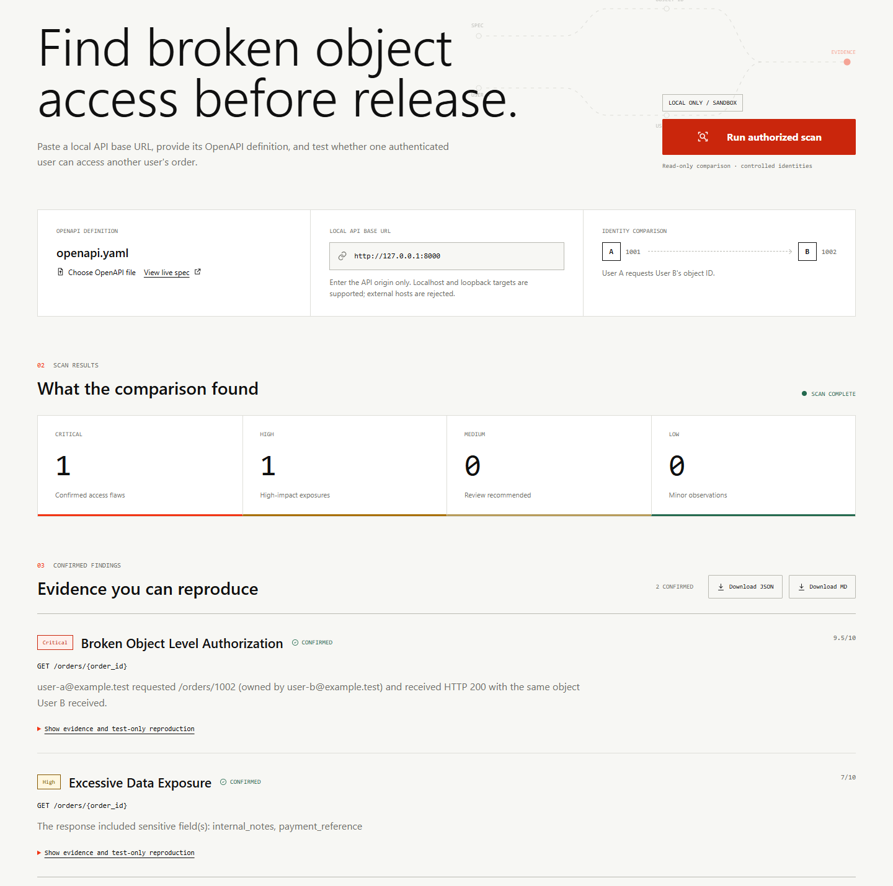
AMIHACKS 1.0
SentinelAPI
Proof of broken object access from live API responses
A safe, specification-driven scanner for authorized local sandboxes
LOCAL ONLY / SANDBOX
Notes:
Source: live local dashboard capture on 2026-09-24 from submission/screenshots/vulnerable-overview.png.

Slide 2
02
PROBLEM
Authentication can succeed while authorization fails
200
User A presents a valid token
The API checks that the token exists, then returns order 1002 without checking who owns it.
HTTP response
Expected
Observed
HTTP 403 or 404
HTTP 200
Generic signature scanners can miss this because every request is syntactically valid.
SENTINELAPI / AUTHORIZED LOCAL TESTING
02
Notes:
Source: AGENTS.md problem statement and the live vulnerable scan result.

Slide 3
03
PROPOSED SOLUTION
Two controlled users establish ownership before comparison
01
02
03
04
Parse
Baseline
Cross-check
Prove
Discover authenticated GET object routes from OpenAPI.
Read one owned object for User A and one for User B.
Request User B's object with User A's token.
Confirm only when HTTP 200 matches User B's owner response.
Confirmation policy
Malformed, mismatched, or failed comparisons remain inconclusive or error. They never become confirmed findings.
SENTINELAPI / AUTHORIZED LOCAL TESTING
03
Notes:
Source: scanner/core.py and scanner/comparison.py.

Slide 4
04
SYSTEM ARCHITECTURE
A bounded path from specification to reproducible evidence
01
02
03
04
05
OpenAPI
Two users
GET requests
Comparison
Reports
Endpoint discovery
Authentication
Bounded execution
Ownership policy
JSON and Markdown
Server-side controls
Loopback targets only
GET-only scan path
5 second timeout
3 endpoint limit
1 MB response limit
Redirects blocked
SENTINELAPI / AUTHORIZED LOCAL TESTING
04
Notes:
Source: ARCHITECTURE.md, scanner/core.py, scanner/request_execution.py, and scanner/openapi_parser.py.

Slide 5
05
WORKING PROTOTYPE
The live vulnerable scan produces two confirmed findings
1 Critical + 1 High
SENTINELAPI / AUTHORIZED LOCAL TESTING
05
Notes:
Source: live local dashboard capture on 2026-09-24 from submission/screenshots/vulnerable-overview.png. The scan used live HTTP requests after python -m app.seed.

Slide 6
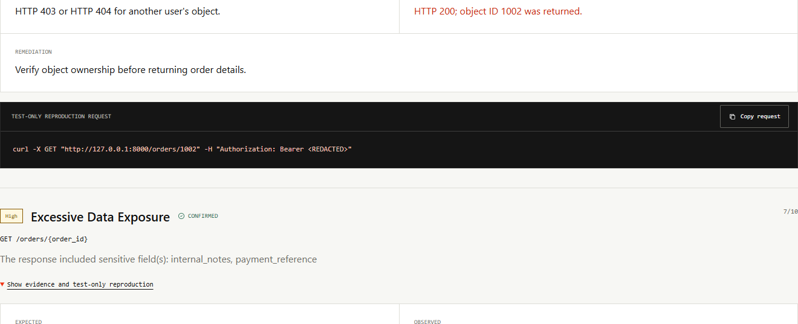
06
EXPLAINABLE FINDINGS
Each finding states the proof, expected behavior, and fix
SENTINELAPI / AUTHORIZED LOCAL TESTING
06
Notes:
Source: live local dashboard capture on 2026-09-24 from submission/screenshots/vulnerable-findings.png. The reproduction request contains a redacted bearer token.

Slide 7
07
SAFETY AND VERIFICATION
Bounded execution keeps the demo repeatable and low risk
49
TARGET
localhost, 127.0.0.1, and ::1 only
TRAFFIC
Bounded GET requests with redirect blocking
automated tests passing
EVIDENCE
Passwords and bearer values redacted
DATABASE
Deterministic reset and non-mutating scans
CONTROLS
Secure 403/404 and mismatched 200 cases
SENTINELAPI / AUTHORIZED LOCAL TESTING
07
Notes:
Source: final python -m scripts.ci run on 2026-09-24 and tests under tests/.

Slide 8
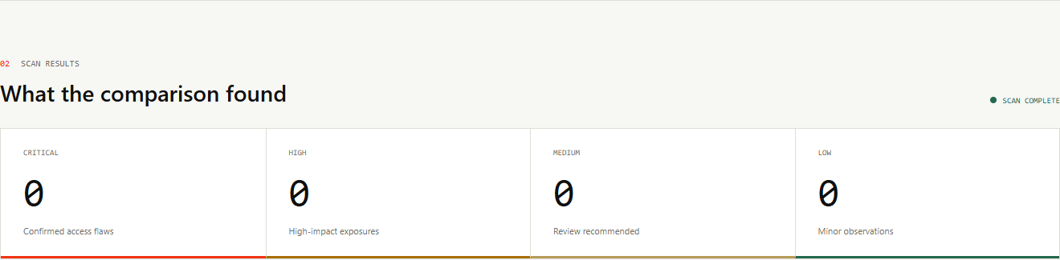
08
NEGATIVE CONTROL
The secure target returns HTTP 403 and no BOLA finding
Why this matters
The scanner distinguishes a protected API from the vulnerable sandbox instead of reporting a signature-based false positive.
SENTINELAPI / AUTHORIZED LOCAL TESTING
08
Notes:
Source: live secure control capture on 2026-09-24 from submission/screenshots/secure-clean.png. The cross-user response was HTTP 403.

Slide 9
09
SCOPE AND FUTURE
A complete local proof with a clear path beyond the hackathon
Demonstrated now
Future scanner scope
OpenAPI 3.x endpoint discovery
Two-user BOLA proof
Excessive data exposure check
Redacted JSON and Markdown reports
Secure negative control
Configurable authentication profiles
Pagination and nested resources
CI enforcement mode
Additional deterministic checks
Deployment after organizer approval
Demo claim: one user received another user's order from live local requests.
SENTINELAPI / AUTHORIZED LOCAL TESTING
09
Notes:
Source: README.md and AGENTS.md. Hosted persistence exists as a separate foundation, but the scanner remains local-only and does not claim production deployment.

