Slide 1
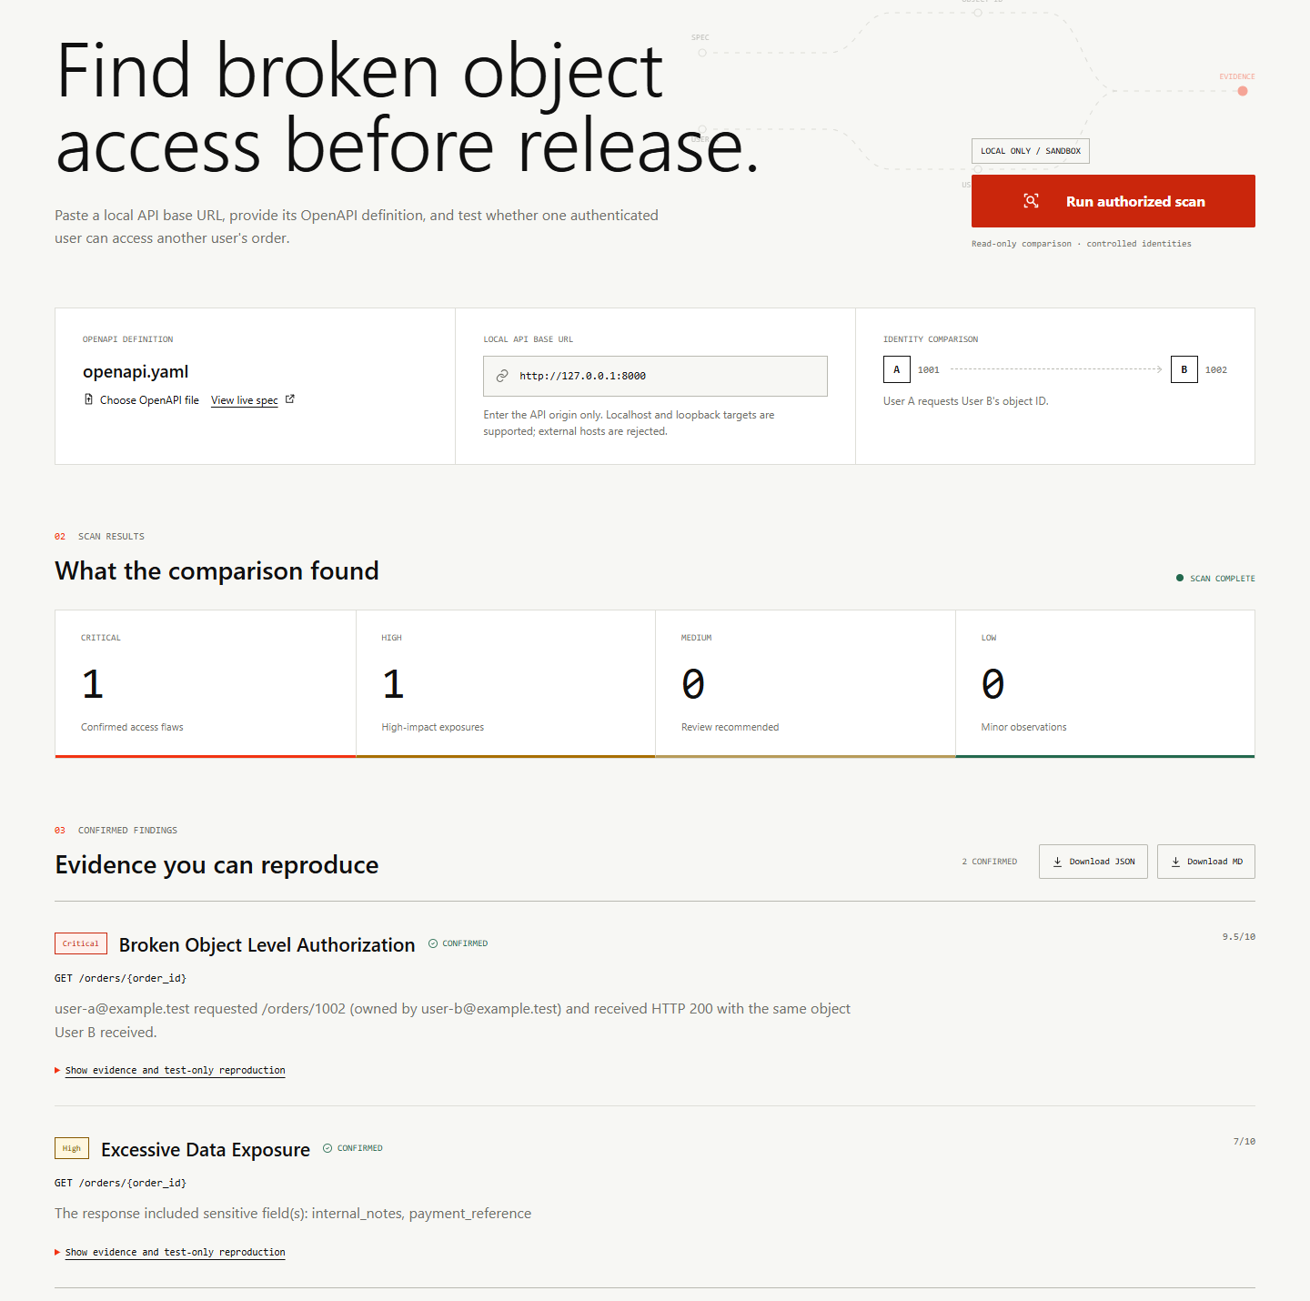
AMIHACKS 1.0
SentinelAPI
Live proof of broken object access
Core functionality, user journey, and technical implementation
LOCAL ONLY / SANDBOX
Notes:
Source: live local dashboard capture on 2026-09-24 from submission/screenshots/vulnerable-overview.png.

Slide 2
02
CORE FUNCTIONALITY
Two identities turn a valid request into authorization proof
200
User A requests User B's order
SentinelAPI first records each user's owned object. It then sends User A's valid token to User B's object route.
cross-user HTTP response
Secure behavior
Vulnerable behavior
HTTP 403 or 404
HTTP 200
Confirmation requires the returned object to match User B's owner baseline.
SENTINELAPI / AUTHORIZED LOCAL TESTING
02
Notes:
Source: AGENTS.md and scanner/comparison.py. The vulnerable fixture returns order 1002 to User A with HTTP 200.

Slide 3
03
END-TO-END USER JOURNEY
One scan moves from an OpenAPI file to reproducible evidence
01
02
03
Select
Discover
Authenticate
Choose the local API origin and OpenAPI 3.x file.
Find a supported authenticated collection and detail route.
Sign in as two controlled sandbox users.
04
05
06
Baseline
Compare
Review
Read one owned object for each identity.
Request User B's object with User A's token.
Inspect evidence and download the redacted report.
LIVE PROOF
User A owns 1001. User B owns 1002. User A receives 1002 from the vulnerable route.
SENTINELAPI / AUTHORIZED LOCAL TESTING
03
Notes:
Source: scanner/core.py, app/seed.py, and the deterministic demo data described in README.md.

Slide 4
04
KEY FEATURES
The MVP prioritizes reliable proof over broad vulnerability claims
01
OpenAPI discovery
02
Two-user comparison
Finds supported authenticated object routes from the supplied specification.
Establishes ownership before testing cross-user access.
03
Exposure detection
04
Explainable findings
Flags internal_notes and payment_reference in an owner's response.
Shows expected behavior, observed evidence, reproduction, and remediation.
05
Safe reporting
06
Negative control
Produces redacted JSON and Markdown reports without bearer values.
Recognizes HTTP 403 or 404 as correct authorization enforcement.
SENTINELAPI / AUTHORIZED LOCAL TESTING
04
Notes:
Source: README.md, SOLUTION_OVERVIEW.md, scanner/checks.py, scanner/report_generator.py, and scanner/redaction.py.

Slide 5
05
TECHNICAL IMPLEMENTATION
Typed components keep parsing, execution, comparison, and reporting separate
01
02
03
04
05
OpenAPI parser
Two-user auth
HTTP executor
Comparator
Reporter
Discover up to 3 GET detail routes
Obtain controlled user tokens
Enforce target and response bounds
Match cross-user and owner objects
Rank, redact, and export evidence
Execution boundaries
Loopback HTTP only
Read-only GET scan path
5 second request timeout
1 MB response limit
Redirects blocked
Secrets redacted
SENTINELAPI / AUTHORIZED LOCAL TESTING
05
Notes:
Source: ARCHITECTURE.md and the typed interfaces implemented under scanner/. FastAPI orchestrates the scan and serves the dashboard and report endpoints.

Slide 6
06
LIVE DEMONSTRATION
The vulnerable scan produces one Critical and one High finding
1 Critical + 1 High
SENTINELAPI / AUTHORIZED LOCAL TESTING
06
Notes:
Source: live local dashboard capture from submission/screenshots/vulnerable-overview.png. The scan used live HTTP requests after python -m app.seed.

Slide 7
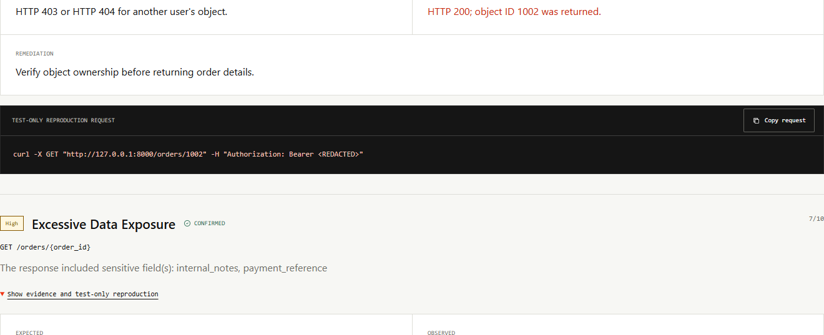
07
EXPLAINABLE EVIDENCE
Each finding shows what happened, how to reproduce it, and how to fix it
SENTINELAPI / AUTHORIZED LOCAL TESTING
07
Notes:
Source: live local dashboard capture from submission/screenshots/vulnerable-findings.png. The reproduction request redacts the bearer token.

Slide 8
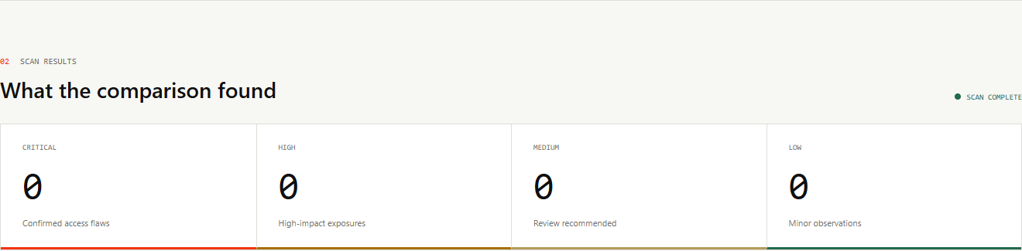
08
VERIFICATION
The secure target stays clean while the same scanner runs unchanged
70
automated tests passing
HTTP 403
secure cross-user response
Verified behavior
Secure 403 and 404 responses produce no BOLA finding. Mismatched HTTP 200 responses remain inconclusive.
SENTINELAPI / AUTHORIZED LOCAL TESTING
08
Notes:
Source: submission/screenshots/secure-clean.png and python -m scripts.ci on 2026-09-25. The test run completed with 70 passing tests.

Slide 9
09
SCOPE AND FUTURE
A complete local proof with a clear path beyond the hackathon
Demonstrated now
Future scanner scope
OpenAPI 3.x endpoint discovery
Two-user BOLA proof
Excessive data exposure check
Redacted JSON and Markdown reports
Secure negative control
Configurable authentication profiles
Pagination and nested resources
CI enforcement mode
Additional deterministic checks
Deployment after organizer approval
Demo claim: one user received another user's order from live local requests.
SENTINELAPI / AUTHORIZED LOCAL TESTING
09
Notes:
Source: README.md and AGENTS.md. Hosted persistence exists as a separate foundation, but the scanner remains local-only and does not claim production deployment.

