Slide 1
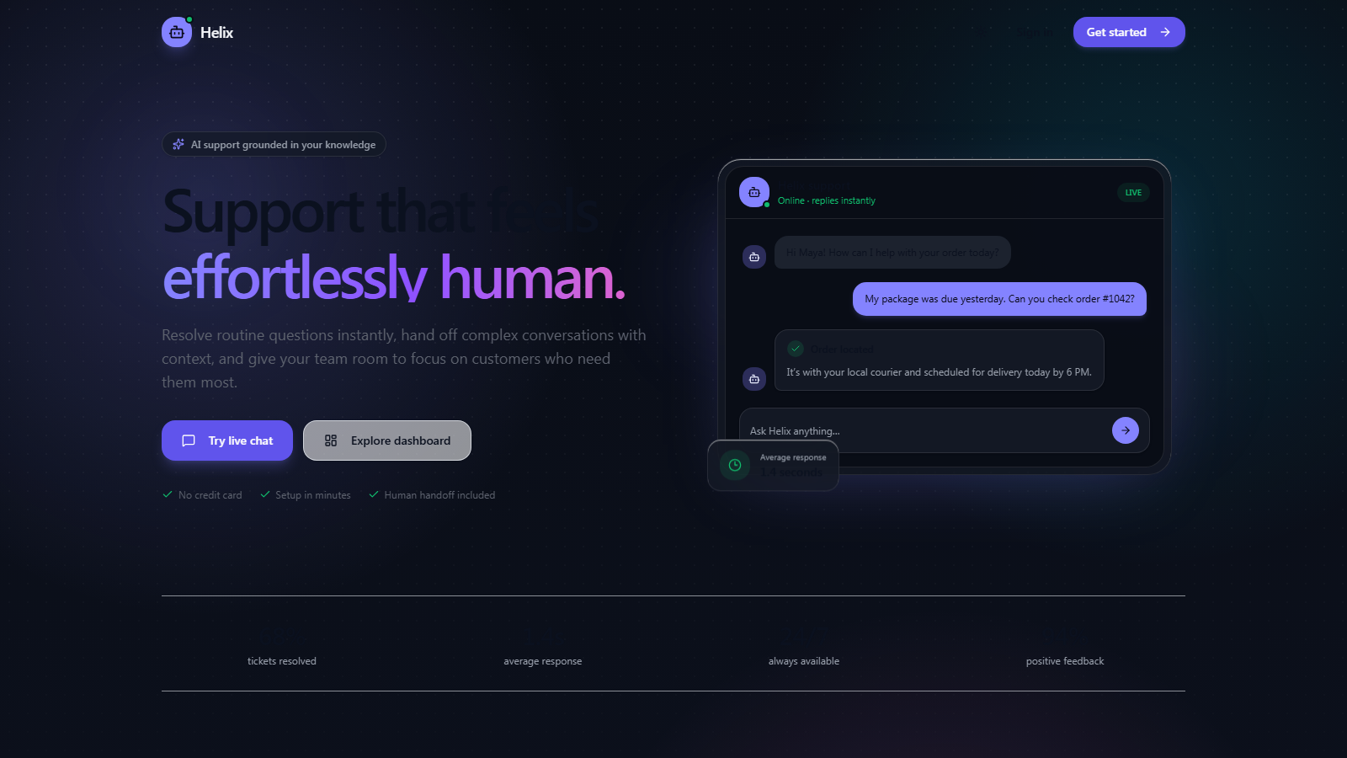
Industrial Training Presentation
MERN + LANGCHAIN + GEMINI
AI Customer
Support Chatbot
A RAG-powered support platform that answers policy questions, performs account actions, and hands complex cases to human agents.
Project presentation
Source: working codebase and verified unit tests
Notes:
Heading style reference: Industrial Training Presentation Template [Autosaved].pptx.
Project sources: README.md and client/server source files.

Slide 2
02
Project Overview
THE PROBLEM
Support teams repeat the same policy answers while order actions and difficult conversations still require secure access to business data.
4
14
purpose-built agent tools
documented API endpoints
This project combines grounded answers with controlled tool use so one conversation can move from information to action and, when needed, to a human agent.
2
1
databases with distinct roles
live human handoff channel
Scope
Customer chat, knowledge ingestion, authentication, refunds, tickets, analytics, and audit trails.
AI Customer Support Chatbot
2
Notes:
Source: README.md API and Agent Tools tables.
Counts are derived from the documented routes and tool exports.

Slide 3
03
Core Support Use Cases
One conversation supports both informational questions and account-specific actions.
01
02
03
04
Policy questions
Order status
Refund request
Human escalation
Hybrid retrieval returns the most relevant knowledge-base chunks.
The agent queries PostgreSQL for items, tracking, and status timestamps.
Eligibility comes first. The system creates a refund only after explicit confirmation.
A high-priority ticket carries recent conversation context to the admin workspace.
The same session ID links the chat, tool calls, and escalation context.
AI Customer Support Chatbot
3
Notes:
Source: server/rag/tools.js, server/rag/agent.js, and README.md.

Slide 4
04
Technology Stack
Experience
React 19, Vite, Tailwind CSS, TanStack Router
Application
Node.js, Express, Socket.io, LangChain
Intelligence
Gemini chat model and 768-dimensional embeddings
Data
PostgreSQL, MongoDB Atlas Vector Search, Cloudinary
Protection
JWT, refresh tokens, Helmet, rate limiting, PII masking
The stack separates interface, orchestration, retrieval, business data, and operational controls.
AI Customer Support Chatbot
4
Notes:
Source: README.md Stack section and package manifests.

Slide 5
05
System Architecture
Client
API layer
Agent loop
Response
Chat UI
Admin workspace
REST routes
Socket.io gateway
Gemini model
Tool execution
Answer or
handoff
CONNECTED SERVICES
PostgreSQL
MongoDB Atlas
Cloudinary
Audit log
Users, orders, refunds, tickets
Sessions, document chunks, vectors
Uploaded knowledge documents
PII-masked tool events
AI Customer Support Chatbot
5
Notes:
Source: README.md architecture diagram and server implementation.

Slide 6
06
Hybrid RAG Pipeline
Semantic retrieval and exact-term matching run in parallel before rank fusion and reranking.
Vector search
Semantic similarity
RRF fusion
Term-overlap reranker
User query
Merge ranked lists
Top 4 chunks
Keyword search
Exact terms
Why hybrid retrieval matters
Vector search handles paraphrases. Keyword search protects exact matches such as order IDs, SKUs, and product names.
AI Customer Support Chatbot
6
Notes:
Source: server/rag/vectorStore.js.
The implementation retrieves two times the target candidate count, applies RRF, then returns the top four reranked chunks.

Slide 7
07
Agent Tools and Workflow
EXECUTION LOOP
check_order_status
Reads order items, tracking, and lifecycle timestamps.
1
Build system prompt and session context
initiate_refund
2
Ask Gemini for a response or tool call
Checks eligibility, requests confirmation, then creates a refund.
search_knowledge_base
3
Execute the selected tool and audit the event
Returns grounded context from hybrid retrieval.
4
Return the final answer within six tool rounds
escalate_to_human
Creates a ticket with recent conversation context.
AI Customer Support Chatbot
7
Notes:
Source: server/rag/agent.js and server/rag/tools.js.

Slide 8
08
Security and Guardrails
6
01
Authentication
04
Agent scope
Short-lived JWT access tokens and refresh-token rotation
System prompt rules for domain limits and prompt-injection attempts
layers of operational protection
02
Authorization
05
Safe refunds
The controls protect access, limit abuse, constrain tool use, and reduce sensitive data exposure in logs.
Admin-only ingestion, analytics, and ticket routes
Two-step confirmation plus duplicate-refund prevention
03
Rate limiting
06
Audit privacy
Separate limits for chat, authentication, and other endpoints
Email, phone, card, and address patterns masked before logging
AI Customer Support Chatbot
8
Notes:
Source: server/middleware/auth.js, rateLimit.js, auditLogger.js, and server/rag/agent.js.

Slide 9
09
Data and API Design
STORAGE RESPONSIBILITIES
PostgreSQL
Transactional records
MongoDB Atlas
Conversation and retrieval data
Users and refresh tokens
Orders and order items
Refunds, tickets, and feedback
Chat sessions and messages
Embedded document chunks
Vector and text-search indexes
API SURFACE
4 routes
3 routes
3 routes
4 routes
Authentication
Chat and feedback
Knowledge ingestion
Analytics and tickets
Cloudinary stores source documents while MongoDB stores extracted chunks and embeddings.
AI Customer Support Chatbot
9
Notes:
Source: README.md API Endpoints, server/seed.js, server/models/Session.js, and server/routes.

Slide 10
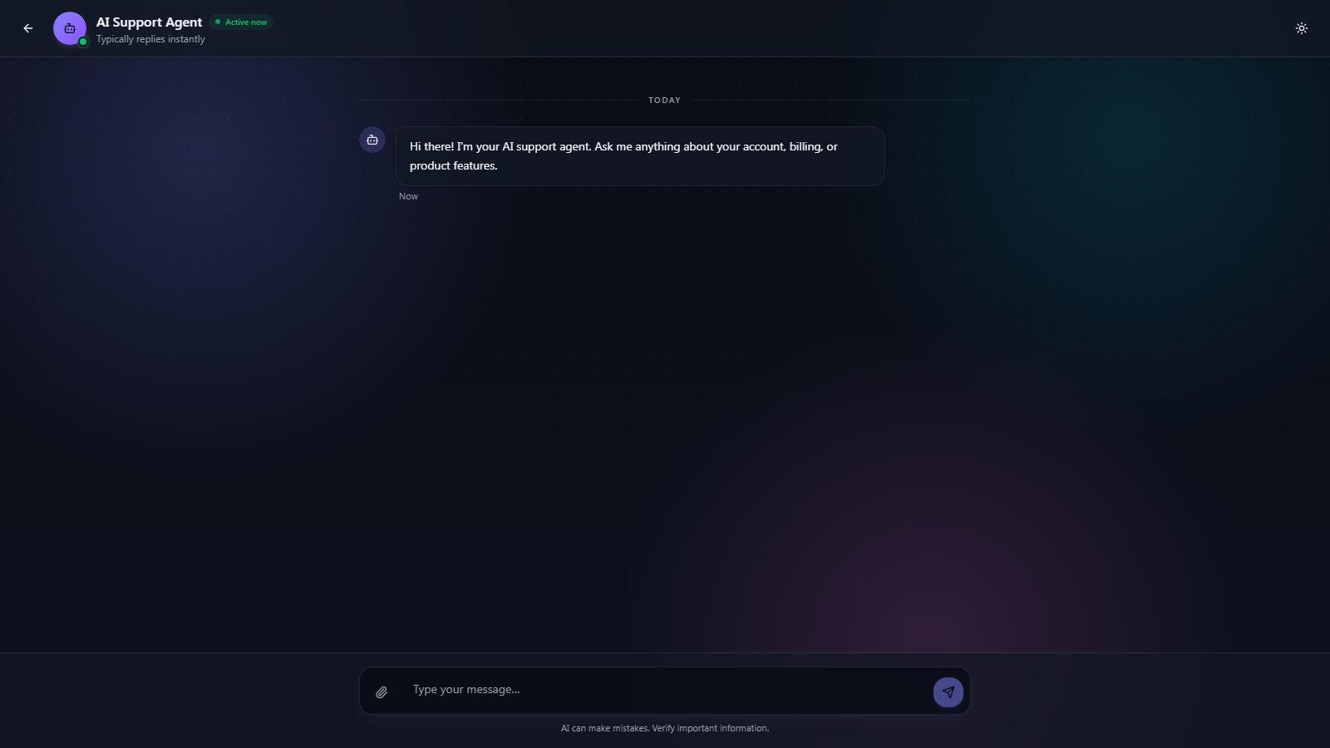
10
User and Admin Experience
Landing and product positioning
Focused conversation workspace
Responsive dark and light themes with accessible input controls
Socket.io updates switch the conversation to a human agent
Admin pages manage tickets, knowledge documents, and operational analytics
AI Customer Support Chatbot
10
Notes:
Screenshots captured from the local project on 2026-09-29.
Source: client/src/routes and client/src/styles.css.

Slide 11
11
Testing and Evaluation
11
✓
Unit tests
Verified passing
unit tests passed
✓
Integration runner
Available, requires live databases
2 suites verified on 29 September 2026
✓
Prompt-injection runner
Available, requires configured services
Coverage includes the agent loop, order lookup, refund checks, duplicate prevention, escalation, and error handling.
✓
RAG evaluation
30-query recall and precision script
The deck reports only the unit suite as executed and passing.
AI Customer Support Chatbot
11
Notes:
Unit command executed: npm test in server directory.
Result: 2 suites passed and 11 tests passed.
Other runners exist in server/package.json but were not executed because they require configured external services.

Slide 12
12
Limitations and Future Scope
CURRENT TRADEOFFS
RECOMMENDED NEXT STEPS
Agent memory lives in one server process
Chat responses return only after the full tool loop
Reranking uses exact term overlap instead of a learned model
Knowledge ingestion currently accepts PDF files
Rate limits reset when the server restarts
Refund confirmation still depends on model behavior
Move session memory and rate counters to Redis
Stream partial responses through SSE or WebSockets
Add a cross-encoder reranker and retrieval telemetry
Support DOCX, TXT, JSON, and CSV ingestion
Add a deterministic approval gate for refunds
Summarize long conversations before the context limit
Priority: make state and policy enforcement deterministic before scaling traffic.
AI Customer Support Chatbot
12
Notes:
Source: README.md Known Limitations & Design Tradeoffs section.

Slide 13
13
Project Outcome
A working support system that connects grounded answers to real customer-service actions.
Grounded
Actionable
Supervised
Observable
Hybrid RAG searches store-specific knowledge.
Tools query orders and create refund records.
Complex cases carry context into human support.
Tests, analytics, feedback, and audit logs expose behavior.
Thank you
AI Customer Support Chatbot
13
Notes:
Closing summary based on implemented features in the project repository.

