Slide 1
PHP LinkedInR
Sagar, Tyler, Yash

Slide 2
100,000 ft Goal
LinkedIn
Companies can create profiles and post jobs
Employee can have profiles and apply to jobs
Users can connect with others

Slide 3
Class Goal
LinkedIn
Authentication
Session
Dynamic webpages (employeeProfile and companyProfile)
Complex code to help engrain SESSION, GET, IF, and others

Slide 4
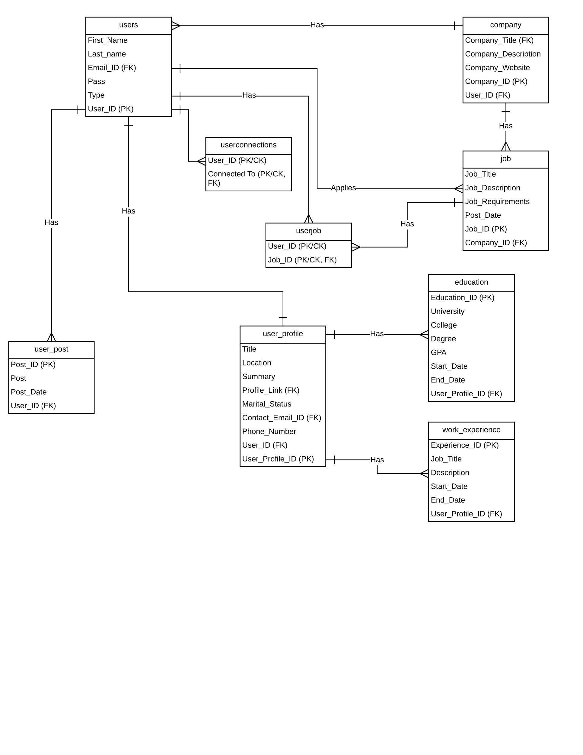
Data Flow Diagram

Slide 5
Demo
Team Application Demonstration

