Slide 1
COLLEGE CAPSTONE PROJECT REVIEW
YashodhaMart
E-Commerce Web Application
A full-stack, atomic transaction-driven e-commerce platform built with Next.js 14 App Router, TypeScript, Prisma ORM, and modern session security.
Presented by: Yashodha K.
Department: Artificial Intelligence and Data Science
College: JJ College of Engineering and Technology
Academic Year: 2026–2027
Notes:
Good morning respected evaluators and professors. I am Yashodha K. from the Department of Artificial Intelligence and Data Science at JJ College of Engineering and Technology. Today, I am proud to present my capstone project: YashodhaMart – a full-stack, deterministic e-commerce web application. I will walk you through the system architecture, database design, live features, and technical implementations.

Slide 2
01. EXECUTIVE SUMMARY
Abstract — Project Overview & Core Vision
Platform Introduction
YashodhaMart is a full-stack online marketplace engineered using modern web technologies: Next.js 14 App Router, TypeScript, Tailwind CSS, and Prisma ORM with a relational database backend.
Core Purpose & Mission
To solve the concurrency bottlenecks, slow page rendering, and inventory discrepancies common in traditional retail and legacy web stores by establishing deterministic stock management.
Key Features & Benefits
Provides dynamic product filtering, real-time stock-aware cart management, Indian shipping address storage, dual payment modes (COD & UPI QR), and a dedicated admin portal.
Notes:
Slide 2 presents the abstract. YashodhaMart is built from the ground up to solve physical shopping limitations and legacy portal bugs. It combines rapid Next.js client-server rendering with Prisma ORM atomic transactions to give users a responsive, dependable e-commerce experience.

Slide 3
02. CONTEXT & FOUNDATION
Introduction — E-Commerce Landscape & Project Motivation
The Modern E-Commerce Landscape
• Rapid Digital Transformation: High-speed internet and digital payments have made online shopping the dominant retail channel.
• Expectation of Zero Latency: Modern shoppers expect sub-second catalog transitions and instantaneous search feedback.
• High Demand for Mobile Convenience: Consumers shop on phones, requiring responsive mobile-first layouts.
• Indian Market Specifics: Need for localized address structures (PIN codes, area landmarks) and UPI payment modes.
Project Motivation & Scope
• Eliminate Retail Queue Overhead: Enable customers to order groceries and daily goods from anywhere 24/7.
• Ensure Transactional Reliability: Implement database transactions that prevent overselling of limited inventory.
• Protect Consumer Privacy: Store session credentials in HTTP-Only signed cookies rather than exposed browser storage.
• Provide Full Store Visibility: Equip shop owners with real-time analytics, inventory management, and shipment tracking.
Notes:
In this slide, I explain the motivation behind YashodhaMart. E-commerce is indispensable in India today. Our goal was to build a system specifically tuned for real-world retail needs: fast browsing, localized Indian addresses, reliable inventory management, and robust security.

Slide 4
03. PROBLEM DEFINITION
Existing System — Limitations & Pain Points
Critical Limitations of Traditional & Legacy Systems
❌ Physical Shopping Constraints: Requires traveling to physical stores, fixed operating hours, and waiting in billing queues with manual invoice recording.
❌ Catalog Opacity & Stock Blindness: Shoppers cannot check whether an item is in stock until they physically arrive or reach the final checkout step.
❌ Race Conditions & Overselling: Rudimentary online systems lack atomic isolation; two shoppers can purchase the final unit simultaneously, causing order cancellation.
❌ Insecure Session Storage: Many legacy portals store authorization tokens in plain browser localStorage, vulnerable to Cross-Site Scripting (XSS) extraction.
❌ Manual Inventory Bookkeeping: Store owners update spreadsheets or physical logs manually, causing discrepancies, stockouts, and delayed shipment updates.
❌ Unverified Customer Reviews: Anonymous reviews in legacy stores result in spam and fake feedback, undermining customer trust.
Notes:
Slide 4 analyzes the existing systems. In traditional physical shopping, customers face travel and queue delays. In rudimentary web portals, lack of atomic transactions causes inventory overselling, and storing JWTs in localStorage exposes users to XSS attacks. YashodhaMart systematically resolves each of these pain points.

Slide 5
04. SOLUTION ARCHITECTURE
Proposed System — Architecture & Advantages
✓ Sub-Second Full-Stack Performance
Built on Next.js 14 App Router with hybrid SSR and client hydration. Product pages render instantly with zero full-page browser refreshes.
✓ Atomic Relational Transactions
Prisma ORM transactions (prisma.$transaction) guarantee that order creation, stock deduction, and cart clearing execute atomically or roll back safely.
✓ Secure HTTP-Only Session Auth
Authentication uses cryptographically signed JWTs via 'jose' stored in HTTP-Only, SameSite cookies, isolating credentials from client-side scripts.
✓ Integrated UPI QR & COD Checkout
Offers both Cash on Delivery and a dynamic NPCI-compliant UPI QR Code generated in real-time with automatic order amount and reference encoding.
Notes:
Slide 5 highlights our proposed solution. YashodhaMart introduces four core pillars: hybrid SSR for high-speed page loads, Prisma atomic transactions to protect stock counts, HTTP-Only JWT cookies to prevent XSS session theft, and dynamic UPI QR code checkout tailored to Indian consumers.

Slide 6
05. OBJECTIVES & SCOPE
Project Objectives — Deliverables & Milestones
1. User Interface Usability
Create an intuitive, responsive interface using Tailwind CSS and Lucide icons that renders smoothly across desktops, tablets, and smartphones.
2. Multi-Parametric Product Discovery
Build a live catalog search with concurrent multi-filters (category, price range, star ratings, discounts, and in-stock toggles) and dynamic sort orders.
3. Stock-Aware Shopping Cart & Wishlist
Implement client-side state synchronized with server-side stock constraints, enforcing strict maxStock quantity limits and computing delivery fees.
4. Seamless Multi-Step Checkout
Develop a 3-step checkout flow incorporating Indian address management, dynamic UPI QR payment simulation, and instant order receipt generation.
5. Relational Integrity & Concurrency
Design a normalized database schema in Prisma ORM with atomic operations that increment or decrement stock safely during orders and cancellations.
6. Protected Administrative Portal
Build an administrative suite with key performance indicators, complete product catalog CRUD, shipment advancement, and user account management.
Notes:
Slide 6 breaks down our six concrete project objectives: frontend usability, multi-parametric product search, stock-aware cart management, a 3-step checkout engine, relational database integrity with atomic transactions, and a protected administrative back-office portal.

Slide 7
06. TECH STACK SPECIFICATION
Technologies Used — Full-Stack Technical Stack
Frontend Layer
• Next.js 14 (App Router)
React framework with Server Components & SSR
• React 18
Component-based declarative UI library
• TypeScript 5.6
Static typing for API contracts and components
• Tailwind CSS 3.4
Utility-first responsive styling framework
• Lucide React
Lightweight, consistent SVG icon set
• Framer Motion 11
Declarative animations for modals and steppers
Backend & Security
• Next.js Route Handlers
Node.js RESTful API endpoints (/api/*)
• Jose JWT Library
HS256 signed tokens stored in HTTP-Only cookies
• Bcryptjs
Cryptographic password hashing and salting
• QRCode & jsQR
Dynamic UPI QR generation and image scanning
• Validation Engine
Server-side sanitization of inputs and payloads
Database & Tooling
• Prisma ORM 5.21
Type-safe database client and migration tool
• SQLite (dev.db)
ACID-compliant relational database engine
• tsx Runtime
TypeScript execution engine for seeding
• Visual Studio Code
Primary Integrated Development Environment
• Git & GitHub
Version control and collaborative repository
Notes:
Here on Slide 7 is our actual technical stack. On the frontend, we use Next.js 14 App Router, React 18, TypeScript, and Tailwind CSS. On the backend, we run Next.js Route Handlers with Jose for JWT cookie sessions and Bcryptjs. For data storage, we use Prisma ORM 5.21 with SQLite.

Slide 8
07. ARCHITECTURE & DATA FLOW
System Architecture — 3-Tier Layered Design
Tier 1: Presentation Layer (Client Browser)
Next.js Client Components (React 18) • Tailwind CSS • Framer Motion
Handles DOM rendering, local UI state, client-side input validation, and asynchronous fetch requests.
Tier 2: Application / API Layer (Next.js Server)
Server Route Handlers (/api/*) • JWT Authentication (jose) • Bcryptjs
Executes business logic, role-based authorization, request validation, and database orchestration.
Tier 3: Persistence Layer (Prisma ORM & SQLite)
Prisma Client Singleton (src/lib/db.ts) • SQLite Relational Engine
Enforces ACID transactions, unique constraints, foreign keys, and atomic inventory mutations.
Notes:
Slide 8 details the system architecture. YashodhaMart implements a clean Three-Tier architecture. Tier 1 is the presentation layer in React 18 and Tailwind. Tier 2 is the application layer running Next.js API route handlers with JWT validation. Tier 3 is the persistence layer powered by Prisma ORM and SQLite, guaranteeing ACID consistency.

Slide 9
08. USER INTERFACE ARCHITECTURE
Frontend Design — UI Hierarchy & Component System
Home Landing Page
Dynamic hero carousel, department shortcut grid, featured deals, new arrivals, and customer trust badges designed to maximize engagement.
Product Catalog & Multi-Filter
Live search input with instant debounced querying. Sidebar filters for categories, price sliders, star ratings, and discount percentages.
Product Details Page
Multi-angle image gallery, discount pricing comparison, warehouse stock limit badges, quantity spinner, wishlist toggle, and verified buyer reviews.
Multi-Step Checkout Stepper
3-step guided flow: shipping address selection/modal creation, payment selection (COD vs dynamic UPI QR), and instant order confirmation receipt.
Notes:
Slide 9 covers the frontend structure. We developed modular components: HeroCarousel, ProductFilterSidebar, QuantitySelector, AddressCardModal, and QRCodeDisplay. Everything is styled with Tailwind CSS for mobile responsiveness.

Slide 10
09. SERVER-SIDE LOGIC
Backend Implementation — APIs & Security Logic
Server Architecture & Security
• RESTful Route Handlers: Expressive HTTP methods (GET, POST, PUT, PATCH, DELETE) mapped under /api/*.
• Stateless JWT Verification: Every incoming request extracts the 'ym_session' cookie and verifies cryptographic signatures with 'jose'.
• Role-Based Isolation (RBAC): Admin routes verify role === 'ADMIN' against the Admin table, preventing customer privilege escalation.
• Password Salting: Passwords hashed via bcryptjs with 10 salt rounds prior to persistence.
// Session Creation (src/lib/auth.ts)
const token = await new SignJWT({ ...payload })
.setProtectedHeader({ alg: 'HS256' })
.setIssuedAt()
.setExpirationTime('7d')
.sign(SECRET_KEY);
const cookieStore = cookies();
cookieStore.set('ym_session', token, {
httpOnly: true,
secure: process.env.NODE_ENV === 'prod',
sameSite: 'lax',
path: '/',
expires: expiresAt,
});
Notes:
Slide 10 details our backend implementation. All routes validate HTTP-Only session cookies using the Jose library. We separate customer authentication from admin authentication. The code snippet on the right shows how session cookies are issued with HTTP-Only and SameSite flags.

Slide 11
10. DATA MODELING & PERSISTENCE
Database Design — Schema & Relational Models
User & Authentication
• User (id, name, email, phone, role)
• Admin (id, name, email, role)
• Session (id, userId, token, expiresAt)
Product & Catalog
• Category (id, name, slug, parentId)
• Product (id, name, price, stock, images)
• Self-referencing category hierarchy
Cart, Wishlist & Address
• Cart (id, userId) & CartItem (quantity)
• Wishlist (id, userId) & WishlistItem
• Address (fullName, street, pincode)
Order & Verified Reviews
• Order (orderNumber, status, paymentMethod)
• OrderItem (price, quantity, snapshot)
• Review (userId, productId, rating 1-5)
Notes:
Slide 11 reviews the database design. We defined 13 normalized tables in Prisma schema: User, Admin, Session, Category, Product, Cart, CartItem, Wishlist, WishlistItem, Address, Order, OrderItem, and Review. Relationships enforce referential integrity with cascading deletions where appropriate.

Slide 12
11. DATA MANIPULATION OPERATIONS
CRUD Operations — Implementation in YashodhaMart
CREATE
POST Requests
• User: Registration & Session Creation
• Admin: Add New Products & Categories
• Customer: Add to Cart & Wishlist
• Checkout: Atomic Order Placement
READ
GET Requests
• Storefront: Multi-Filter Product Catalog
• Product Details: Images, MRP & Reviews
• Cart & Wishlist: Real-Time Subtotals
• Admin: KPI Metrics & Order Pipeline
UPDATE
PUT / PATCH Requests
• Admin: Product Price, Stock & Status
• Cart: Item Quantity Increment/Decrement
• Admin: Advance Order Shipment Status
• Address: Edit Saved Shipping Details
DELETE
DELETE Requests
• Admin: Delete Outdated Product Listings
• Cart: Remove Specific Cart Items
• Wishlist: Remove Bookmarked Products
• Customer: Cancel Order (Restores Stock)
Notes:
Slide 12 explains our CRUD operations. We implemented all four operations across customer and admin workflows: Create for registration, cart items, and orders; Read for multi-parameter search and metric analytics; Update for quantities and shipment states; and Delete for cart removal, product deletion, and stock-restoring cancellations.

Slide 13
12. APPLICATION WORKFLOW
Main Features & End-to-End User Workflow
1. Discovery
Browse Hero Slider, Categories, or Search by keyword with filters.
2. Item Selection
Inspect details, verify stock count, select quantity, add to cart.
3. Cart Review
Review subtotal, delivery charge breakdown (free shipping > ₹500).
4. Address Selection
Pick existing saved Indian address or create new address via modal.
5. Payment Mode
Choose Cash on Delivery (COD) or scan dynamic UPI QR Code.
6. Order Tracking
Receive YM-ORD ID, view receipt, track status, or cancel with stock rollback.
Notes:
Slide 13 maps out the end-to-end customer purchasing workflow across six stages: Discovery, Item Selection with stock checks, Cart Review with delivery thresholds, Address Selection, Payment Mode choice, and Post-order Tracking with unique order receipts.

Slide 14
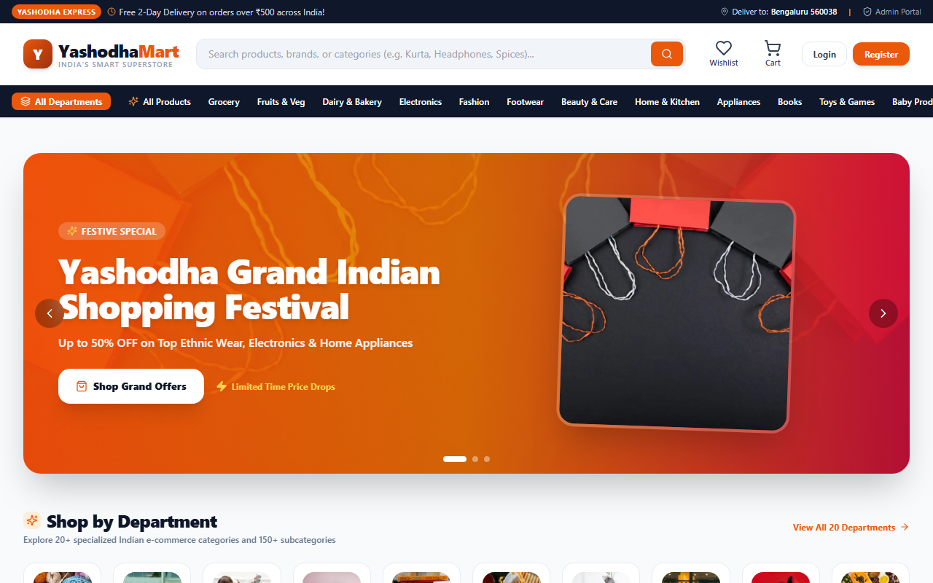
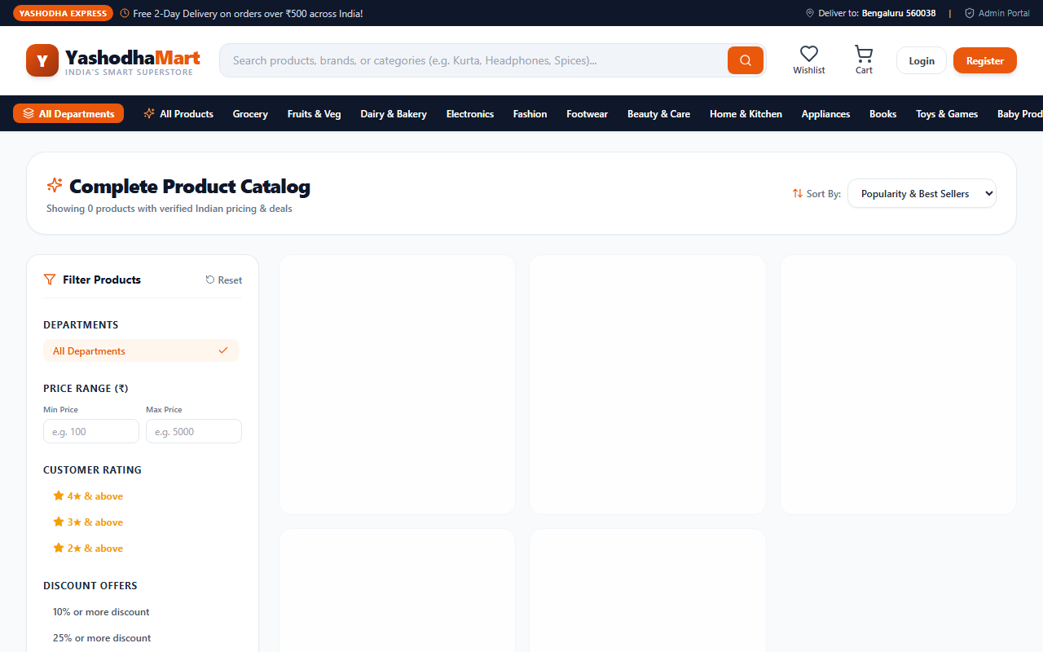
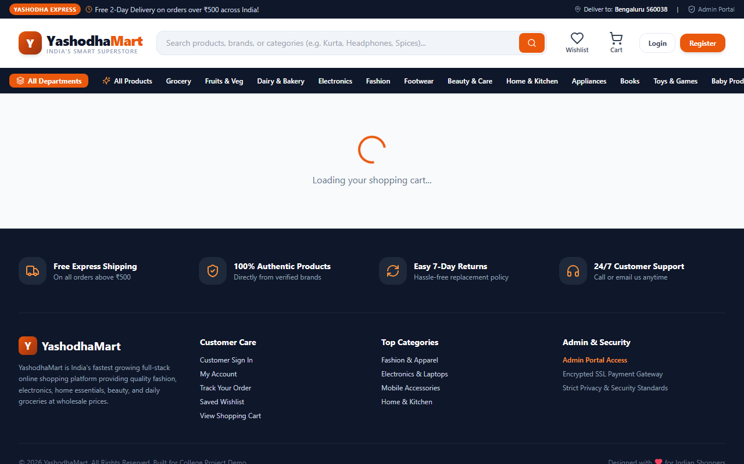
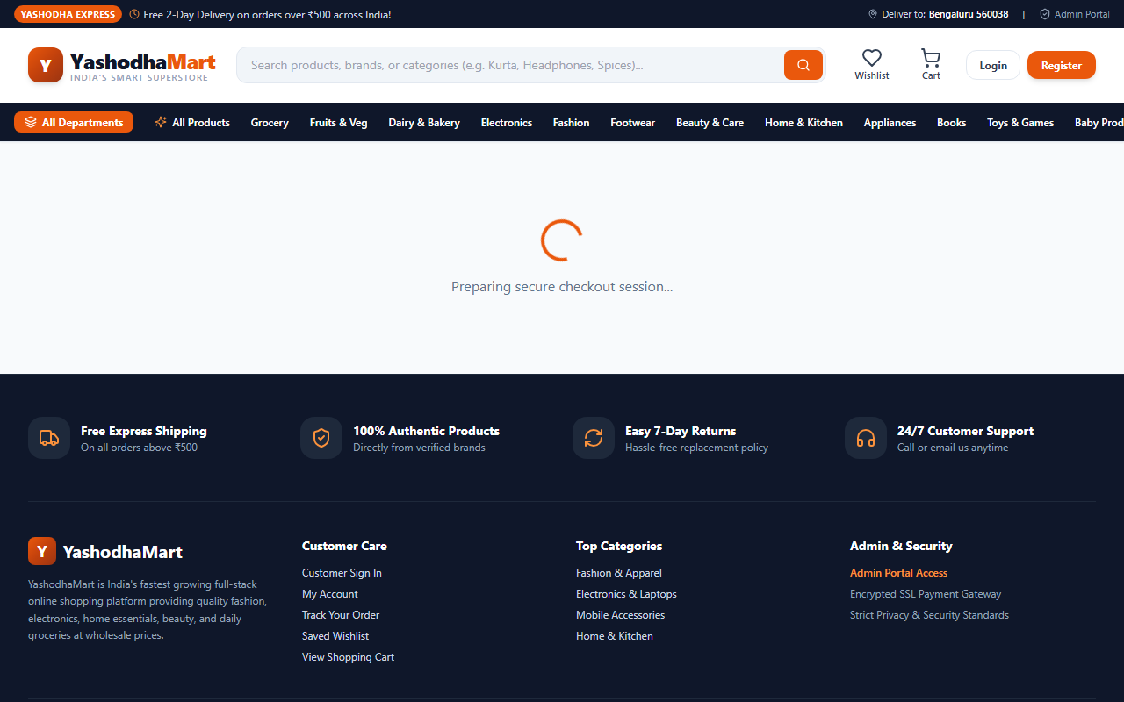

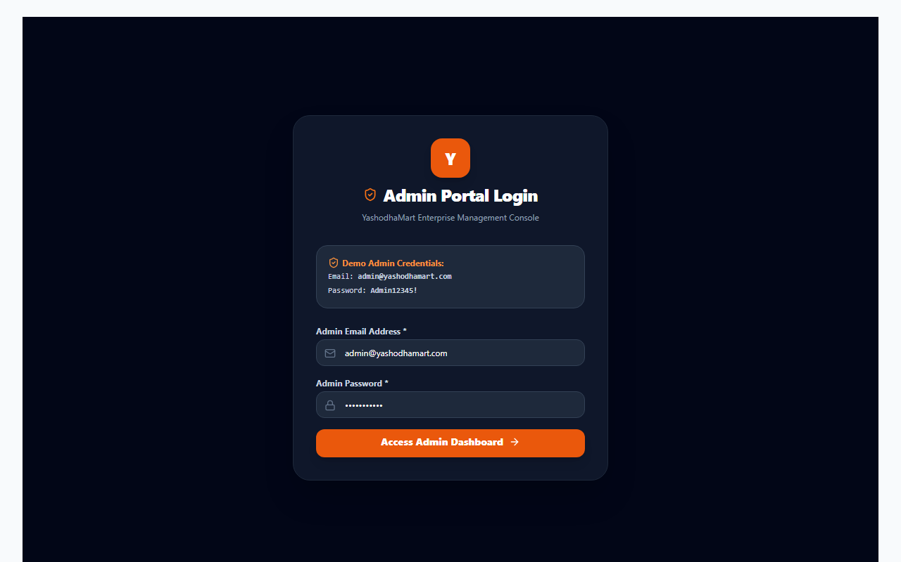
13. SYSTEM DEMONSTRATION
Application Screenshots — Verified Live Application
Storefront Home Page
Catalog & Search
Shopping Cart
Multi-Step Checkout
Product Details
Admin Portal Login
Notes:
Slide 14 displays actual screenshots captured from our running application: the Storefront Home page with the hero banner, the Product Catalog with filters, the Shopping Cart with stock controls, the Multi-Step Checkout with UPI QR display, Product Details, and the Admin Authentication portal.

Slide 15
14. QUALITY ASSURANCE
Testing and Results — Verification & Honest Review
Authentication & Session Verification
Tested user signup, password hashing with bcrypt, JWT generation, and HTTP-Only cookie storage. Verified that invalid passwords or duplicate emails reject cleanly.
PASSED
Stock Validation & Concurrency Limits
Tested adding quantities beyond warehouse stock. The API returns HTTP 400 with an exact error message preventing over-ordering.
PASSED
Atomic Order Checkout & Decrement
Placed multi-item orders and confirmed that Order, OrderItem, stock decrement, and cart deletion complete atomically in a single transaction.
PASSED
Order Cancellation Stock Restoration
Cancelled an eligible pending order and verified that the items are incremented back into product stock counts immediately.
PASSED
Payment Processing Implementation
Cash on Delivery and dynamic UPI QR simulation function properly. Production payment gateway (Razorpay/Stripe) is planned for future release.
DEMO SIMULATION
Notes:
Slide 15 highlights our testing results. We verified authentication security, stock boundary limits, atomic transactions, and automated stock restoration upon cancellation. For payment, we implemented COD and an interactive UPI QR simulation, noting transparently that live production gateway webhooks represent a planned future phase.

Slide 16
15. PROJECT WRAP-UP
Conclusion — Key Achievements & Takeaways
★ Full-Stack Architectural Mastery
Successfully built a complete, high-performance web platform utilizing Next.js 14 App Router, TypeScript, Tailwind CSS, and Prisma ORM.
★ Deterministic Inventory Integrity
Eliminated stock overselling and concurrency bugs through transactional database isolation (prisma.$transaction).
★ Enterprise-Grade Session Security
Safeguarded customer sessions through HTTP-Only cryptographically signed JWT cookies and salted bcrypt password hashing.
★ Comprehensive Dual-Surface Platform
Delivered both an intuitive customer storefront and a feature-complete administrative management console.
Notes:
Slide 16 summarizes our key project achievements. YashodhaMart successfully fulfills all capstone objectives: responsive full-stack performance, deterministic inventory control, robust session security, and full operational separation between customers and store admins.

Slide 17
16. FUTURE SCOPE & EXPANSION
Future Enhancements — Technical Roadmap
1. Live Production Payment Gateway
Integrate Razorpay or Stripe webhooks with automated cryptographic HMAC-SHA256 signature verification for instant debit/credit card and NetBanking settlements.
PLANNED
2. Real-Time GPS Order Tracking
Implement Mapbox and WebSocket (Socket.io) telemetry so customers can track delivery riders in real-time on a live interactive map.
PLANNED
3. AI Recommendation Engine
Incorporate collaborative filtering and cosine similarity models to generate personalized 'Frequently Bought Together' recommendations.
PLANNED
4. Omnichannel Notification Pipeline
Integrate Twilio SMS, WhatsApp Business API, and SendGrid to send automatic dispatch and delivery alerts directly to customers' phones.
PLANNED
5. Mobile App (React Native) & PWA
Expand platform into an offline-capable Progressive Web App (PWA) and cross-platform native iOS/Android mobile apps sharing our backend APIs.
PLANNED
Notes:
Slide 17 outlines our future roadmap. Planned enhancements include live payment gateway webhooks via Razorpay or Stripe, real-time GPS delivery tracking on Mapbox, AI collaborative filtering recommendations, WhatsApp SMS alerts via Twilio, and a cross-platform React Native mobile app.

Slide 18
Thank You!
Questions & Answers (Viva Voce)
Presented by: Yashodha K.
Department of Artificial Intelligence and Data Science
JJ College of Engineering and Technology (2026–2027)
Project: YashodhaMart — Full-Stack E-Commerce Web Application
Notes:
Thank you very much for your time and kind attention. I am now open to any questions, technical inquiries, or feedback regarding YashodhaMart.

