Slide 1
2D Billiards Physics Simulation
Simulating How Billiard Balls Move and Collide Using Python
Yash Patel | 100785833 | yash.patel14@ontariotechu.net
CSCI 3010U – Simulation and Modeling | Ontario Tech University | Winter 2026

Slide 2
What Is This Project?
A computer simulation of 8 billiard balls on a 2D table
Each ball moves, bounces off walls, and collides with other balls
Built on real physics principles — not just animation
Why billiards?
A clear, testable example of a multi-body physics system
Easy to observe energy and momentum conservation in action
What can you do with it?
Watch 8 balls bounce in real-time at 120 FPS
Adjust restitution — controls how bouncy collisions are
Adjust damping — controls how much friction slows the balls
CSCI 3010U | Yash Patel | 100785833

Slide 3
How Balls Move — The Euler Method
Each ball has: position (x, y) · velocity (vx, vy) · mass · radius
Euler Method — update position every tiny time step dt
x(t + dt) = x(t) + vx × dt
y(t + dt) = y(t) + vy × dt
Damping — simulates friction on the table
velocity = velocity × (1 − λ × dt)
Higher λ → balls slow down faster
CSCI 3010U | Yash Patel | 100785833

Slide 4
Ball–Wall Collisions
When a ball hits the edge of the table, it bounces back
Hit left or right wall → vx becomes −vx
Hit top or bottom wall → vy becomes −vy
Position correction — ball is nudged back inside the boundary
Prevents balls from tunnelling through the wall
Wall collisions are always elastic — no energy is lost at walls
Energy can only be lost during ball-ball collisions (via restitution)
CSCI 3010U | Yash Patel | 100785833

Slide 5
Ball–Ball Collisions — The Physics
Step 1 — Detect: distance between centres < r1 + r2
Step 2 — Respond: impulse using Newton's Law of Restitution
J = −(1 + e) × dvn ÷ (1/m1 + 1/m2)
e = restitution (elasticity parameter) · dvn = relative speed along normal
Step 3 — Separate: push balls apart to remove overlap
Restitution = 1.0 → Perfectly elastic (no kinetic energy lost)
Restitution = 0.0 → Perfectly inelastic (maximum energy lost)
CSCI 3010U | Yash Patel | 100785833

Slide 6
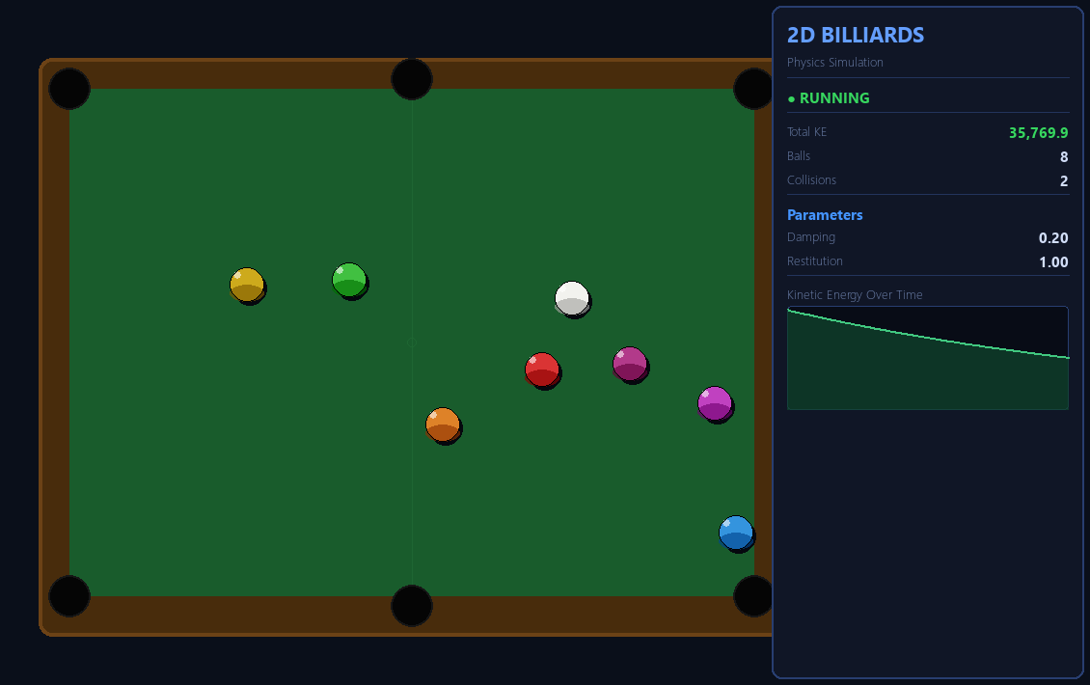
The Interactive Simulation (Live Demo)
Controls: ↑↓ change damping | ←→ change restitution | SPACE pauses | R resets | Running at 120 FPS
CSCI 3010U | Yash Patel | 100785833

Slide 7
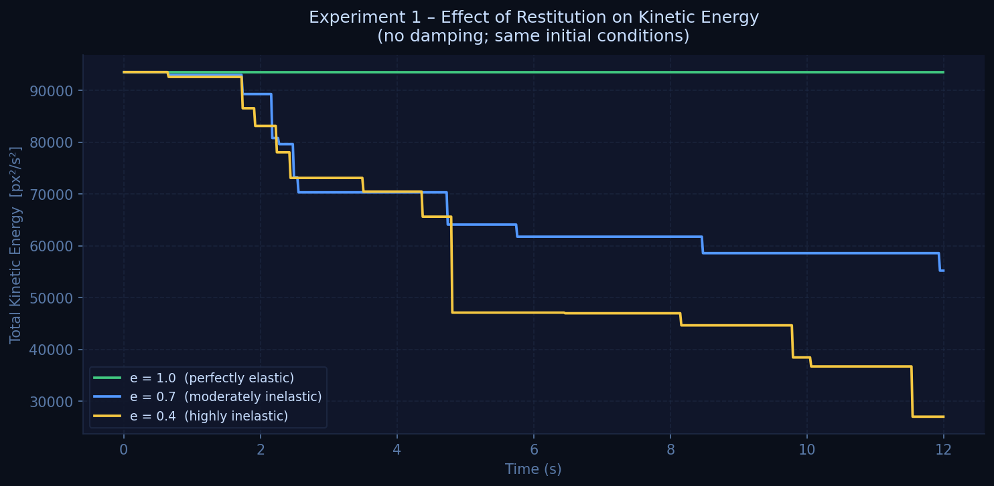
Experiment 1 — Effect of Restitution on Kinetic Energy
Restitution = 1.0 → energy stays constant | Lower restitution → energy drops at each collision
CSCI 3010U | Yash Patel | 100785833

Slide 8
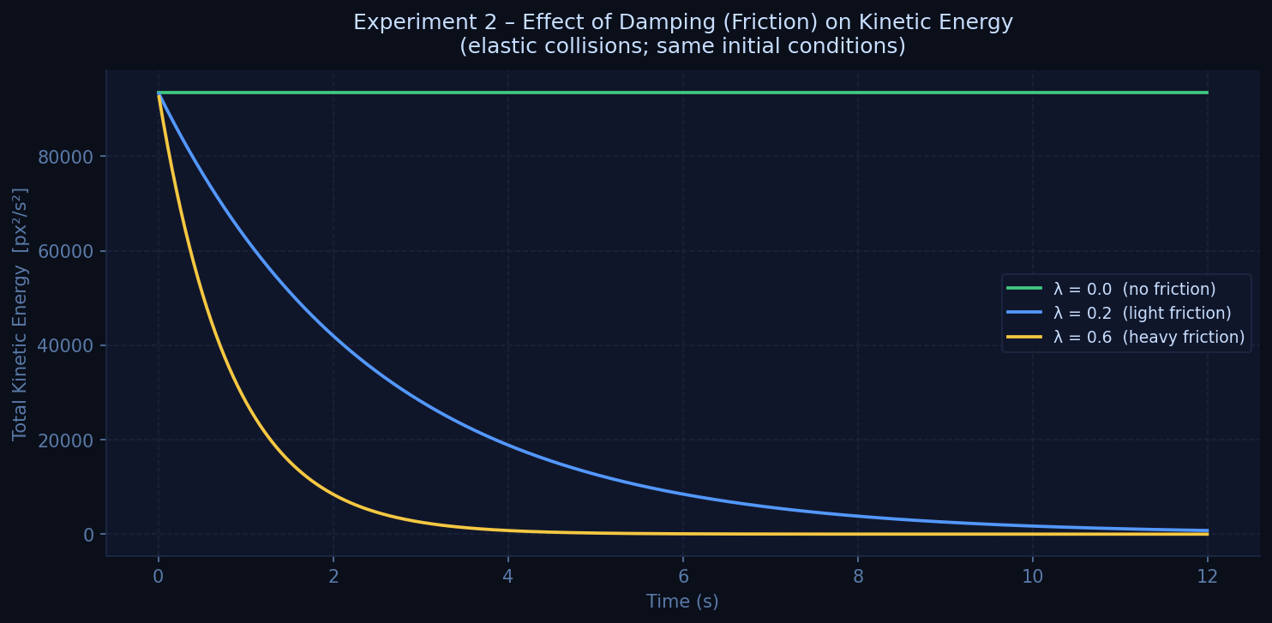
Experiment 2 — Effect of Damping (Friction) on Kinetic Energy
λ = 0 → energy conserved | λ = 0.2 → gradual decay | λ = 0.6 → balls stop within ~4 seconds
CSCI 3010U | Yash Patel | 100785833

Slide 9
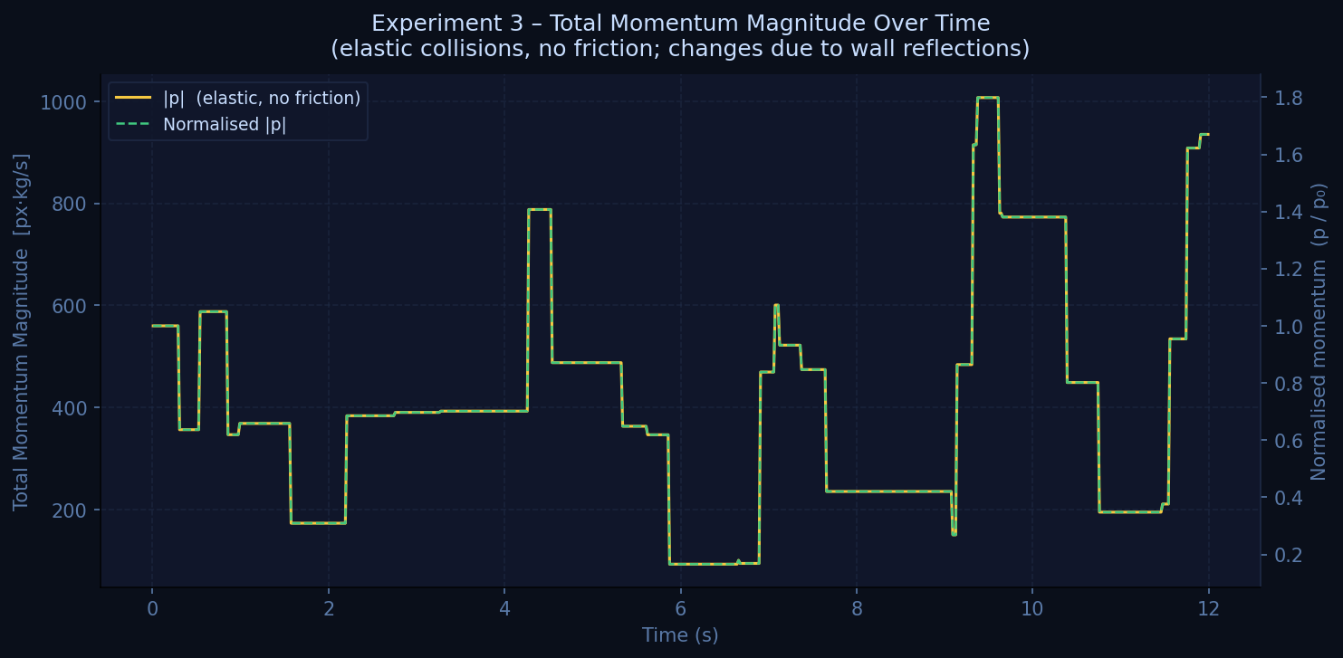
Experiment 3 — Total Momentum Over Time
Ball-ball collisions conserve momentum in the absence of external forces. Wall reflections change the system momentum.
CSCI 3010U | Yash Patel | 100785833

Slide 10
Key Findings
Restitution (elasticity parameter):
Restitution = 1.0 → kinetic energy stays perfectly constant
Restitution = 0.7 → energy drops in steps at each collision
Restitution = 0.4 → energy drops much faster after every hit
Damping (friction coefficient):
λ = 0.0 → balls never stop, energy is fully conserved
λ = 0.2 → balls slow down gradually over time
λ = 0.6 → balls come to rest within approximately 4 seconds
Momentum:
Ball-ball collisions conserve momentum in the absence of external forces
Wall reflections change the system momentum, as expected
CSCI 3010U | Yash Patel | 100785833

Slide 11
Project Goals — All Achieved ✓
✓ Euler method implemented and working correctly
Position updates match expected numerical integration output
✓ Realistic wall bouncing via elastic velocity reversal
✓ Ball-ball collisions using Newton's Law of Restitution
Energy and momentum formulas verified by all three experiments
✓ Damping (friction) produces exponential energy decay
Clearly confirmed in Experiment 2 graphs
✓ All 3 experiments completed — graphs match expected physics
CSCI 3010U | Yash Patel | 100785833

Slide 12
Conclusion
🎱 Built a working 2D billiards simulation using Python and Pygame
📐 Used the Euler method to update ball positions each frame
💥 Applied Newton's Law of Restitution for ball-ball collisions
🌊 Added damping to simulate friction and energy loss over time
📊 Ran 3 experiments — results confirmed the physics principles
✅ All project goals from the proposal were successfully completed
Thank You — Questions?

