Slide 1

Unpark
A Wearable Freeze Detection and Prevention System for Parkinson’s
Kalp Kansara, Yash Panchal, Ishpreet Bal
“Detect. Log. Predict. Empower.”

Slide 2


When movement freezes, life stops
Freezing of Gait
John, 58, loved craftsmanship and restoring motorcycles. But FoG made his hobbies difficult, garage unsafe, and being in public spaces terrifying.
A sudden, unpredictable inability to move the feet forward despite intent.
No widely available wearable that gives patients like John real-time awareness and data they can act on to improve their lifestyle and gain insights.

Slide 3
Research Summary
Parkinson’s strongly associated with fall risk, reduced mobility, and loss of independence [2].
Triggers include turning, physical activity, tight spaces, emotional stress, and dual-tasking [2].
Auditory, visual, and tactile cues have been shown to help “break” freezing episodes [3].
Most cueing devices are manual or not responsive to actual freeze events, and are typically bulky and operate offline [1].
Conclusion: Use non-invasive cues (vibrations) on foot to break out freezing episodes.

Slide 4
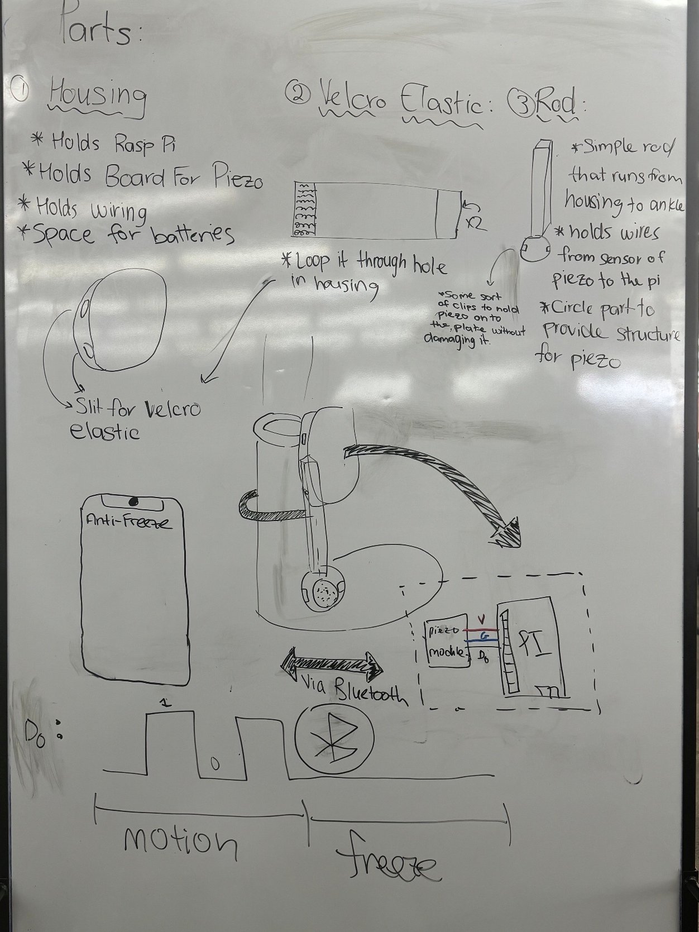
Initial Stage
Issues / Concerns
Rod Attached to Housing: Unnecessary weight, uncomfortable, and increased cost
Bluetooth Connection: Limited range, no long-term logging, no sync across platforms
Piezoelectric Sensor: Lacking ADC (Analog to Digital) module, inconsistent readings, no-reading if mounted

Slide 5
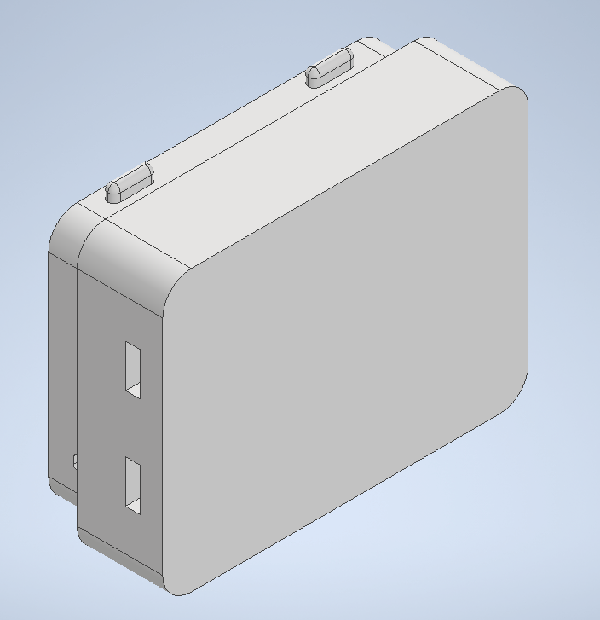
Final Design with Improvements
Improvements
Accelerometer: Easy to detect movement, uses protocol compatible with Raspberry Pi (I2C)
One Box: All components can be placed into one box after removing rod and adding accelerometer (no false positives from vibrations)
Cloud Connection Firebase: Long term storage, good compatibility with AI, easy to access and work with

Slide 6
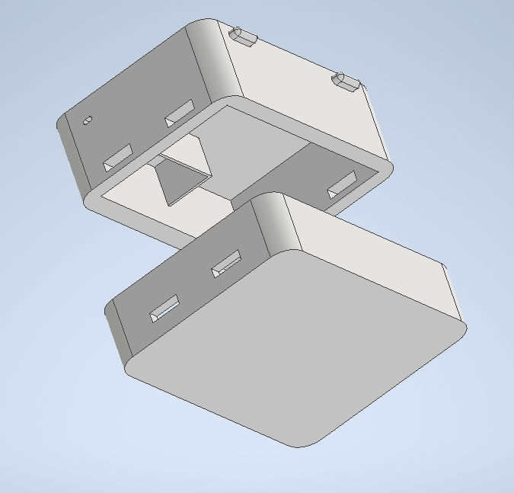
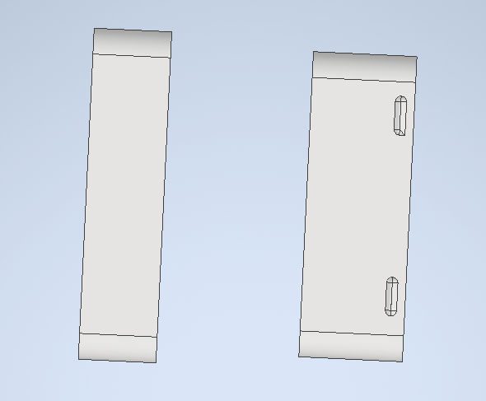
Contents in Box:
Accelerometer sensor
- Vibration Sensor
Battery pack
- Raspberry Pi 4

Slide 7
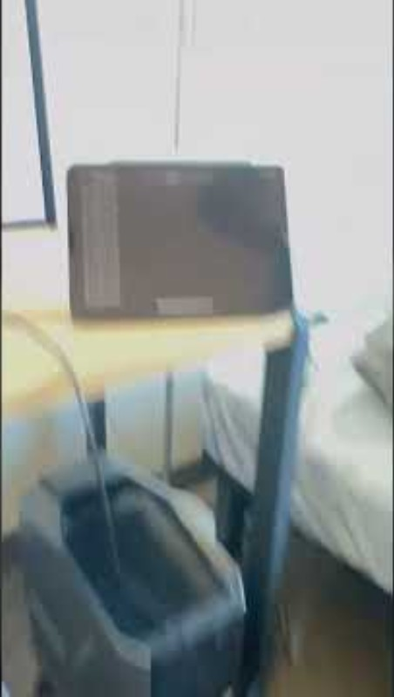
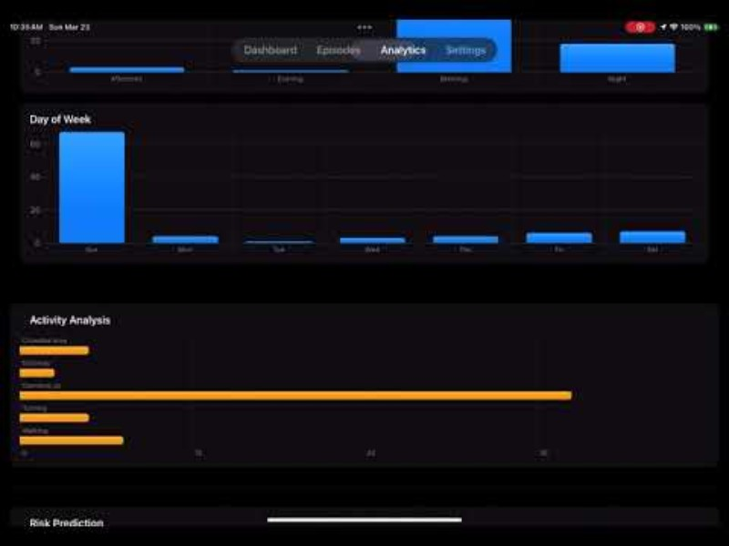
Demonstration
Raspberry Pi prototype syncing with phone
Unpark iOS walkthrough

Slide 8
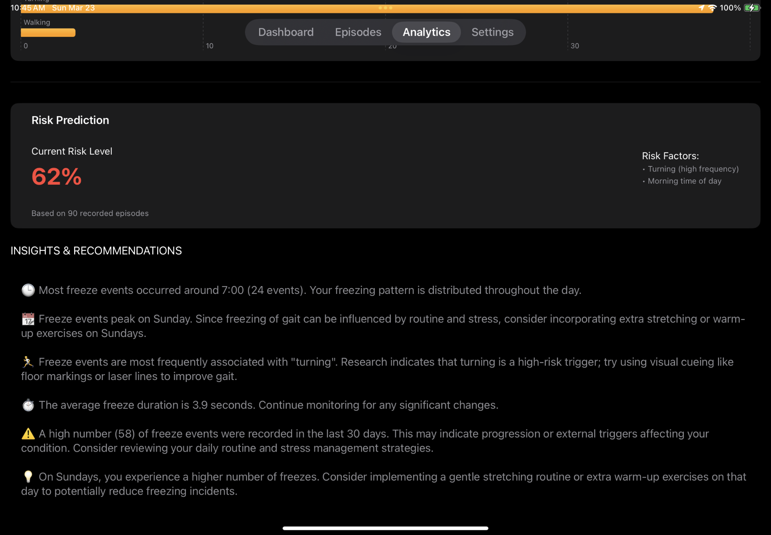
Mobile iOS App
Organizes Statistics into sleek UI to easily visualize and interpret data
Uses AI to make connections in the collected data to provide relevant insights with an aim to reduce symptoms
Auto logs and updates freeze episodes based on ankle device data using Firebase
Ability to export data as a .csv file to help healthcare professionals track progression of John’s symptoms

Slide 9
Why us?
What’s out there?
What did we do?
Ankle monitor using raspberry pi with two sensors (cost effective)
App that updates episodes seconds after they occur through Wi-Fi
AI-integration that offers insights into lifestyle and changes that can be made to reduce freezes
Export episodes into Excel files which can give meaningful information to healthcare providers, disease progression, drug effectiveness.
Ankle monitor using Audino with multiple sensors
App that requires manual logging of episodes and symptoms that can generate a report
Laser shoes that give visual cues

Slide 10
Significance to John
With instant feedback and logging, John will be able to learn his own patterns and allow him to make smart adjustments like avoiding high risk times
Since every freeze is logged, John would be able to communicate with his doctor more effectively about his disease progression and lifestyle
John can reconnect with his hobbies, being free to navigate his workshop without worry about tripping or falling, especially on dangerous items. The device gives him the chance to break the episode quick

Slide 11
References
[1] M. Bächlin, M. Plotnik, D. Roggen, I. Maidan, J. M. Hausdorff, N. Giladi, and G. Tröster, “Wearable assistant for Parkinson's disease patients with the freezing of gait symptom,” IEEE Trans. Inf. Technol. Biomed., vol. 14, no. 2, pp. 436–446, 2010, doi: 10.1109/TITB.2009.2036165.
[2] F. Wang, Y. Pan, M. Zhang, and K. Hu, “Predicting the onset of freezing of gait in Parkinson's disease,” BMC Neurol., vol. 22, no. 1, p. 213, 2022, doi: 10.1186/s12883-022-02713-2.
[3] F. Giorgi, D. Donati, and R. Tedeschi, “Cueing Interventions for Gait and Balance in Parkinson’s Disease: A Scoping Review of Current Evidence,” Appl. Sci., vol. 14, no. 24, p. 11781, 2024, doi: 10.3390/app142411781.

Slide 12
Unpark

