Slide 1

Finollama
Protect people from wrong financial content with Gen AI (RAG) based ratings

Slide 2
Problem Statement
Problem
  Rise of misleading financial articles are wasting precious time of people as well as distorting their financial decisions and also not letting the genuine articles rank in the search engine properly.
Solution
  Retrieval-Augmented Generation (RAG) based LLM Generative AI service (SaaS) can help us rate the articles according to the financial regulations of a particular country and improve it’s credibility.

Slide 3
What is Retrieval Augmented Generation (RAG) ?
Large Language Models (LLMs) can reason about wide-ranging topics, but their knowledge is limited to the public data up to a specific point in time that they were trained on. If you want to build AI applications that can reason about private data, you need to augment the knowledge of the model with the specific information it needs. The process of bringing inserting your private information into the model is known as Retrieval Augmented Generation (RAG).

Slide 4
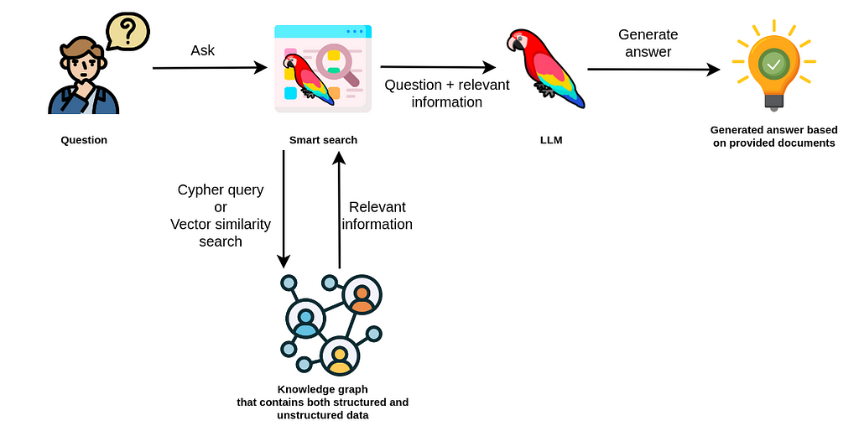
How Retrieval-Augmented Generation (RAG) works ?

Slide 5
Generative AI Startups in 2024
Approaching the Generative AI as simple S-a-a-S (Software-as-a-Service) product which perform queries without understanding the context properly and not utilizing the true potential of data.
Few examples
  Text : Lack of focus on specialization in the given domain for better data collection and lack of focus on data evaluation on frequent basis.
  Image : Lack of focus on understanding in what context image is needed.

Slide 6
Solutions
Generative AI should be approached primarily on the basis of “quality of data and it’s context”, not on the basis of amount of data.
Few examples
  Text : While storing the text data in vector database, data must be evaluated properly on frequent basis in order to avoid misleading results.
  Image : While designing say. UI/UX, it is really important to have images which align itself to the page background colors, texts and devices etc.

Slide 7

Product
Put your content URLs then our servers will crawl your content automatically on regular intervals and create a hash and query RAG only if content changes.
Get Content ratings with the help of our RAG based system about if content is misleading or not
People can use our chrome extension or query content url with our APIs.
Chrome Extension / SaaS

Slide 8
Total Addressable Market (TAM)
Current Market (TAM)
Generative AI
$ 66 billion (2024)
Growing faster than anything, could be $ 1 Trillion (2032)

Slide 9
Business Plan
Subscription Model
Personal Plan
1 Month = $ 10 (5 active articles, 4 times/day crawling per article)
Professional
1 Month = $ 50 (20 active articles, 1 crawl per hour per article)
Small Business
1 Month = $ 500 (200 active articles, 10 crawl per hour per article)

