Slide 1
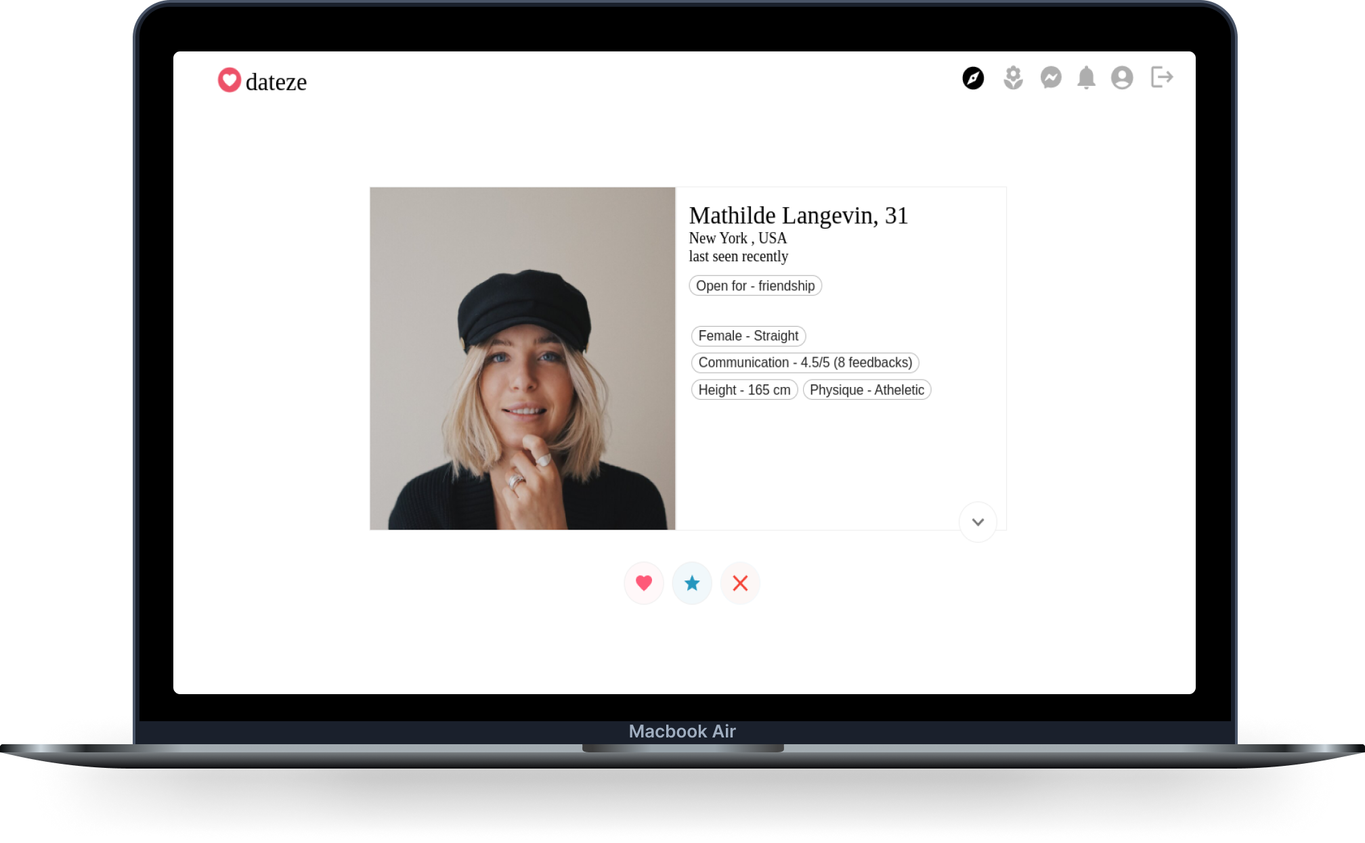
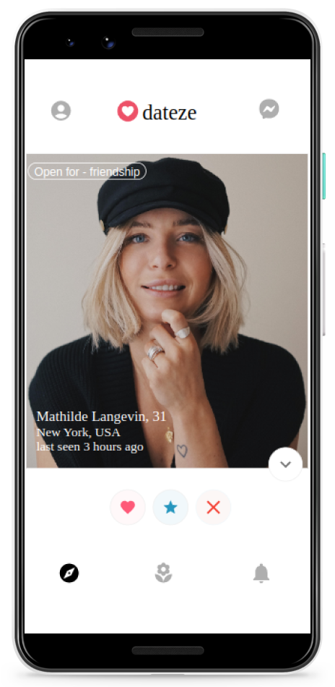
Dateze App
Improving match quality with communication and big 5 personality scores.

Slide 2
Dating apps in 2023
Lack of authenticity
  No substantial user generated activity
Poor quality of matches
  Wrong major selection criteria,
    Modern dating apps : “Liking similar thing” as main criteria is unsustainable as preferences kept changing with life exposure.
    Matrimonial apps : “same community” as main criteria has no real utility in modern urban social structure.

Slide 3
Solutions
Lack of authenticity
  We can improve authenticity with communication feedback.
Poor Quality of matches
  By making communication skills score as major criteria
  By making Big 5 personality score as major criteria

Slide 4
Product
Find matches according to your preferences.
Get feedback ratings on your communication skills.
Get your Big 5 scores and match according to your personality traits.
Website : https://dateze.in
Follow us on Instagram : @dateze.in

Slide 5
Total Addressable Market (TAM)
Current Market (TAM)
100 Million total users using various online dating apps
25 Million Authentic Users
8 Million Paid Users
(33% of Authentic Users)
$ 6.5 Billion USD

Slide 6
Business Plan
Subscription Model
Pricing, Paid User distribution & Revenue Predictions.
India/Asia Pricing
1 month = Rs. 1200 (30% people)
3 months = Rs. 2000 (40% people)
6 months = Rs. 3000 (20% people)
12 months = Rs. 4000 (10% people)
US/Europe Pricing = Price * 3
PPI, Purchase Parity Index Ratio with respect to India = 4,
We can reduce PP factor by 1 to increasing user base from US/Europe
If 80% from India/Asia and 20% from US/Europe out of total 3000 paid customers,
Potential Revenue = (1200*0.3 + 2000*0.4 + 3000*0.2 + 4000*0.1) * (0.8 + 3*0.2) * 3000 = 90 Lac.*
1 Month = Rs. 1200
3 Months = Rs. 2000
6 Months = Rs. 3000
12 Months = Rs. 4000

Slide 7
Team
Founders
  Yash Pratap
  Rakesh Pandey
Investors

Slide 8
Funding Plans
Stage : Seed Round
  Do the marketing and Get the 50,000+ downloads on Play Store
    If there exists 3000 paid users
      80% people from India/Asia
      20% from US/Europe
    Total Potential Revenue = Rs. 90 Lac.*
We are looking for Rs. X investment in exchange of
Y% equity

Slide 9
Future Plan for Big Tech
Mental Health Platforms
Big 5 Personality Traits database can act as a gateway for mental health platforms as it potentially helps psychologists diagnose and develop better strategies for treatment.
Mental Health industry will be $ 600 Billion USD by 2030 and it is currently valued at $ 300 Billion USD which means there are lot of problems which can be solved with technology.
Big 5 Personality Traits database
as pipeline
Dateze app
Mental Health platforms
($ 600 Billion USD+
by 2030)

Slide 10
Workoso App
Improving work availability and flexibility across geographies with blockchain.

Slide 11
Work apps in 2023
Lack of authentic work reviews
  Difficulty in recruitment across geography
Lack of work flexibility
  Difficult to keep people skilled due to lack of flexibility while picking the tasks.
  Difficult to keep people productive due to lack of flexibility in team formation.

Slide 12
Solutions
Lack of authentic work reviews
  We can improve recruitment across geography by publishing work reviews over blockchain.
Blockchain can help distribute data across geography without any mutation.
Lack of work flexibility
  We can improve flexibility in selection of tasks and team formation with the help of a small company made up of maximum 4 members (Pareto’s distribution limit) called “Service”

Slide 13
Product
Search, Post & Apply for Jobs.
Create Service/Company
Do the Job, Get work ratings/reviews & publish it over Blockchain in order to get work more easily.
Website : https://workoso.in
Follow us on Instagram : @workoso.in

Slide 14
Total Addressable Market (TAM)
Current Market (TAM)
300 Million total users on online recruitment platforms
150 Million Authentic Users
50 Million Paid Users
(33% of Authentic Users)
$ 48 Billion USD

Slide 15
Business Plan
Pricing, Paid User distribution & Revenue Predictions.
India/Asia Income distribution
3LPA + : 10LPA + = 15 : 1
Taking 10% commission per job transaction,
US/Europe distribution
$ 50K USD+ : $ 100K USD+ = 3 : 1
For 100 full time freelancers,
Potential Revenue = 90*0.3 + 6*3 + 3*4 +1*8 = 65 L
Ratio between full time vs part time = 1 : 10
So, we need 1000 part time freelancers to produce such revenue.
10% commission per Job Transaction

Slide 16
Team
Founders
  Yash Pratap
  Rakesh Pandey
Investors

Slide 17
Funding Plans
Stage : Seed Round
  Get the 20,000+ downloads on Play Store
    If there exists 1000 part time freelancers
      90% people from India/Asia
      10% from US/Europe
    Total Potential Revenue = Rs. 65 Lac.*
We are looking for Rs. X investment in exchange of
Y% equity

Slide 18
Future Plan for Big Tech
  Insurance :
  Work reviews deployed over blockchain helps companies recruit more people across geography and evaluate person’s financial capabilities in order to protect them financially from various kinds of catastrophic incidents by developing better insurance policies.
Work reviews on blockchain as pipeline
Workoso app
Insurance
($ 5 Trillion USD+ currently)

Slide 19
Linkhelp App
Improving availability of help across geography with blockchain based help coins and discussion forum.

Slide 20
Discussion apps in 2023
Difficulty in implementing new decision on the basis of knowledge gained by discussion due to no tangible incentive for helping others, especially if they are situated far away geographically.
Centralized censorship on discussion forum weaken the sense of freedom and public trust over platform.

Slide 21
Solutions
Difficulty in implementing decision can be reduced by giving “Help Coins” (deployed over blockchain) to helpful people in exchange of non-financial / financial help.
Blockchain can help distribute data across geography without any mutation.
Distributed censorship on discussion forum can be implemented by publishing important discussion threads over blockchain which makes the platform more democratic and trustworthy.

Slide 22
Product
Post Discussion threads.
  Normal : for discussion
  Help : for financial / non financial help
Create/Join Community.
Improve your social status based on your ability to help others with “Help Coins” and influence decisions making in communities.
Website : https://linkhelp.in
Follow us on Instagram : @linkhelp.in

Slide 23
Total Addressable Market (TAM)
Top Down Analysis
Current Market (TAM)
Social Sector & NGOs market size currently valued at $ 400 Billion USD

Slide 24
Business Plan
5% commission per financial transaction
Pricing, Paid User distribution & Revenue Predictions.
Total Users = 50,000
Active = 20,000
Financial help for NGOs, Trusts etc based Community
300 Communities : 37 NGOs only
5% service charge
10 Lac/year * 30 * 0.05 = 15 Lac.
20 Lac/year * 10 * 0.05 = 10 Lac.
50 Lac/year * 6 * 0.05 = 15 Lac.
1 Cr/year * 1 * 0.05 = 10 Lac.
Total Potential Revenue = 46 Lac.*

Slide 25
Team
Founders
  Yash Pratap
  Rakesh Pandey
Investors

Slide 26
Funding Plans
We are looking for Rs. X investment in exchange of
Y% equity
Stage : Seed Round
  Get the 50,000+ downloads on Play Store
    If there exists
      37 NGOs
      2000 answers
    Total Potential Revenue = Rs. 46 Lac.*

