Slide 1
Cyclist Bike-share Analysis

Slide 2
Table of contents
01
02
03
Business Task
Data Sources Used
Data Cleaning & Manipulation
04
05
06
Summary of Analysis
Supporting Visualizations & Key Findings
Recommendations

Slide 3
1. Business Task
Cyclistic wants to convert casual riders into annual members by understanding how their usage patterns differ. The goal of this analysis is to answer:
"How do annual members and casual riders use Cyclistic bikes differently?"
By identifying key behavioral differences between the rider type, Cyclistic can design targeted marketing campaigns to encourage casual riders to become members.

Slide 4
2. Data Sources Used
The analysis was conducted using 12 months of Cyclistic trip data, consisting of 12 individual CSV files, which were merged into a single dataset.
Key Columns in the Dataset
ride_id – Unique identifier for each ride.
rideable_type – Type of bike used (electric_bike, classic_bike, electric_scooter).
started_at / ended_at – Ride start and end timestamps with date.
start_station_name / end_station_name – Station names.
start_lat / start_lng / end_lat / end_lng – Location coordinates.
member_casual – Rider type (member or casual).

Slide 5
3. Data Cleaning & Manipulation
To prepare the dataset for analysis, the following data cleaning and transformation steps were performed:
Cleaning Steps:
Converted timestamps (started_at, ended_at) into proper datetime format.
Created new columns:
- Ride length (minutes) = ended_at - started_at.
- Weekday (1 = Monday, 7 = Sunday).
- Month (1 = January, 12 = December).
Removed anomalies:
- Dropped negative ride lengths (errors).
- Filtered out rides under 1 minute.
- Dropped rows containing null values.

Slide 6
4. Summary of Analysis
The analysis uncovered significant differences in how casual riders and members use Cyclistic bikes:
These patterns suggest that casual riders are primarily leisure riders, whereas members use bikes for daily commutes.
Aspect | Casual Riders | Members
Ride Duration | Longer rides (avg: 25 min) | Shorter rides (avg: 12 min)
Ride Days | Mostly ride on weekends | Ride consistently across weekdays
Bike Type Preference | Prefer electric bikes over classic bikes & scooters | More balanced usage of classic and electric bikes
Top Stations | Near parks & tourist areas | Near business districts
Peak Riding Hours | Afternoons | Commute hours (7-9 AM, 4-6 PM)
Seasonal Trend | Ride more in summer | Consistent ridership throughout the year

Slide 7
5. Supporting Visualizations & Key Findings

Slide 8
58,60,568
Total rides recorded in the year 2024

Slide 9
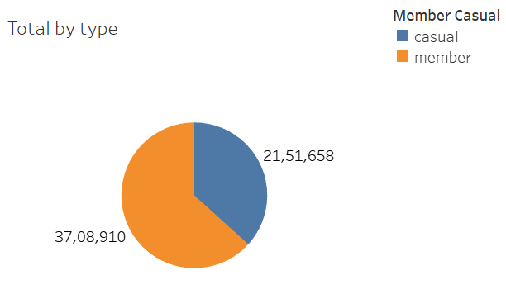
Total Rides by Member Type
Members contribute the majority of rides (~63%) .
Casual riders make up to ~37% of total rides.
📌 Insight: Cyclistic’s main user base consists of members, but casual riders still form a sizable portion.

Slide 10
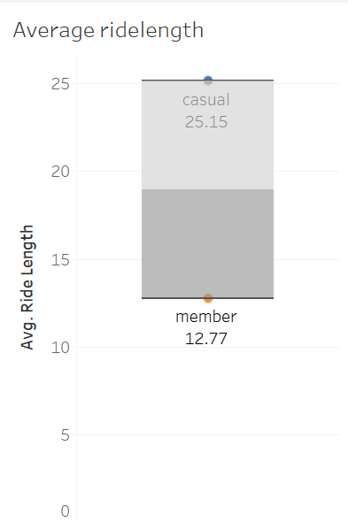
1. Ride Length Analysis
Casual riders take longer rides than members.
Members have more consistent ride lengths, indicating routine usage.
📌 Insight: Casuals ride for leisure, while members take short, frequent trips (likely commuting).

Slide 11
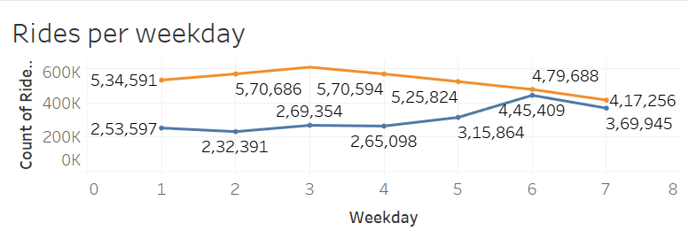
2. Rides by Weekday
Casual riders peak on weekends, while members ride evenly throughout the week.
Weekdays have a sharp rise in member rides at commute hours (morning/evening).
📌 Insight: Casuals ride for fun, while members use bikes for work-related commutes.

Slide 12
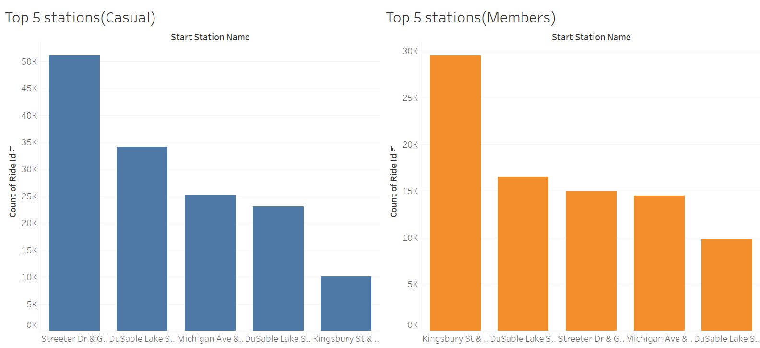
3. Top 5 Start Stations
Members’ top stations are in commercial/business areas.
Casual riders’ top stations are near parks, lakes, and tourist hotspots.
📌 Insight: Membership marketing should focus on popular casual rider stations.

Slide 13
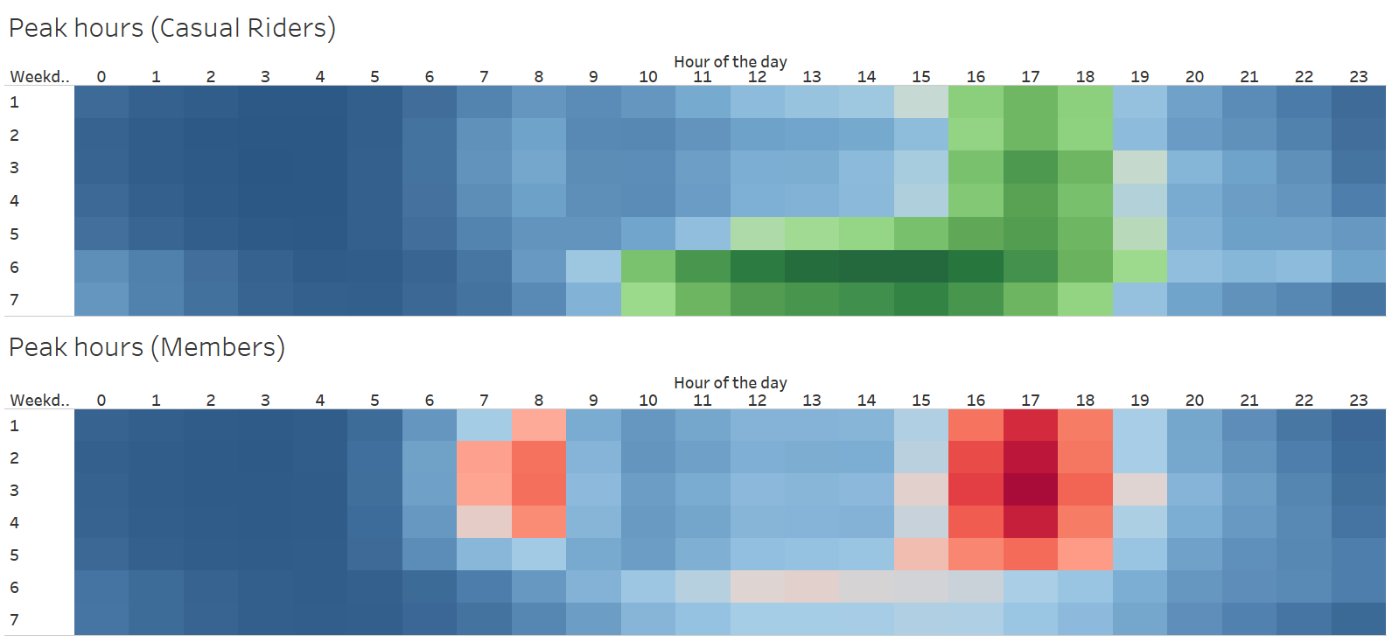
4. Hourly Ride Patterns
Members ride most from 7-9 AM & 5-7 PM (work commute).
Casual riders ride mostly from 4 PM to 6 PM(on weekdays) & 11 AM to 6 PM (on weekends, usually a leisure time).
📌 Insight: Promotions for casual riders should focus on afternoon deals.

Slide 14
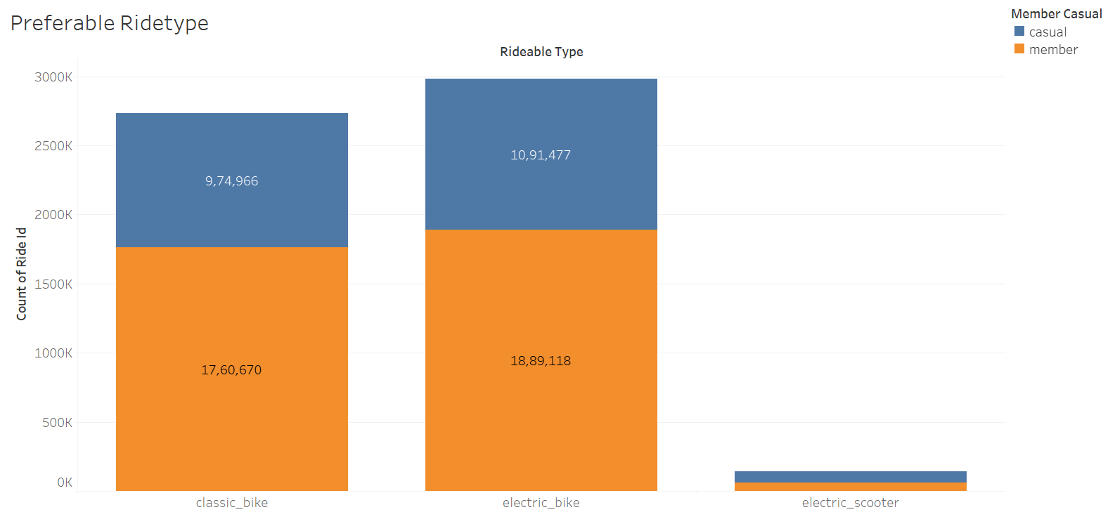
5. Bike Type Usage
Casual riders prefer electric bikes.
Members like to use either of classical and electrical(probably due to cost-saving).
📌 Insight: Electric bikes could be a membership incentive for casual riders.

Slide 15
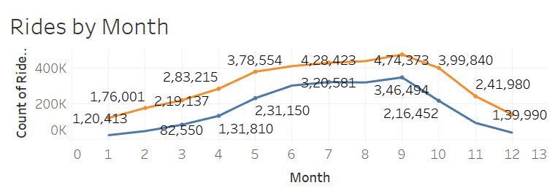
6. Rides by Month
Both casual and member rides increase from January to peak in September.
Casual riders (blue line) show a sharper seasonal trend—rising steeply from spring, peaking in summer, and dropping sharply in fall.
Members (orange line) have a more stable trend, with consistent ridership even in colder months
📌 Insight: Casual Riders Are Highly Seasonal, Members Show More Consistency, Peak for both present in September.

Slide 16
6. Recommendations
🔹 1. Create a "Weekend Pass to Membership" Upgrade
🔹 2. Promote Membership Benefits at Popular Casual Rider Stations
🔹 3. Use Electric Bikes as an Incentive for Membership
🔹 4. Target Casual Riders with Summer Promotions
🔹 3. Launch Special September Campaigns

Slide 17
Final Conclusion
Casual and member riders use Cyclistic bikes very differently:
Members ride shorter distances on weekdays → Commuters.
Casual riders take longer rides on weekends → Leisure users.
Casual riders use electric bikes more → Potential marketing hook.
Casual ridership is strongly influenced by seasonality, peaking in summer.
Members ride consistently year-round, indicating commuting behavior, typically for work.
Targeted marketing during peak casual rider months (May–September) can increase membership conversions.
To convert casual riders into members, Cyclistic should focus on pricing strategies, location-based promotions, and e-bike incentives, and seasonal trends.

Slide 18
Thank you!
Do you have any questions?

