Slide 1
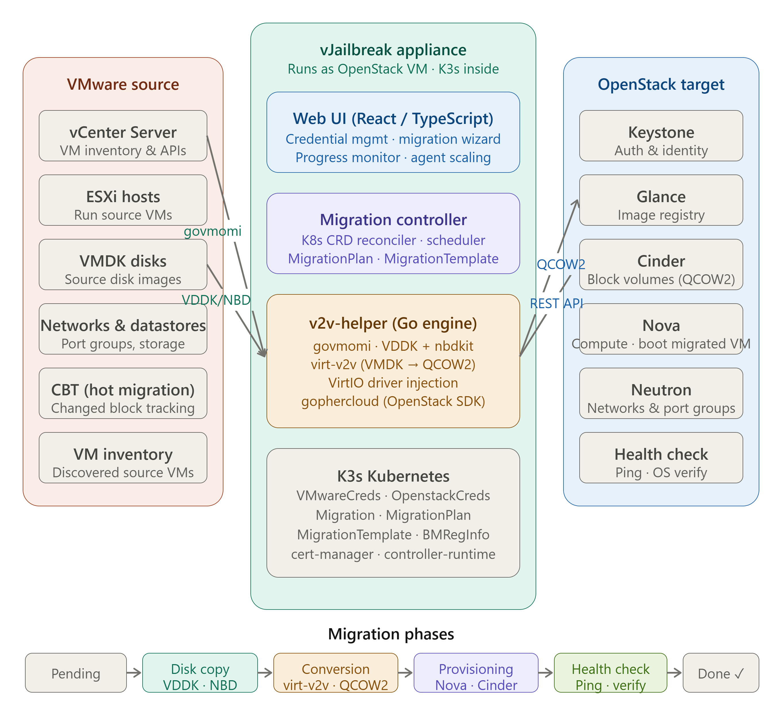
vJailbreak
VMware to OpenStack
Migration Made Easy
Notes:
Welcome to the vJailbreak deep dive. This presentation covers the full GitHub repository — architecture, migration flow, and how to migrate a VM from VMware to OpenStack.

Slide 2
What is vJailbreak?
vJailbreak is a free, open-source tool that simplifies the migration of virtual machines from VMware environments to any OpenStack-compliant cloud platform.
"Helping VMware users migrate to alternative Hypervisors"
VMware Integration
Auto VM Conversion
OpenStack Integration
Connect directly to vCenter to discover and access source VMs
Convert VMDK → QCOW2 and prepare for OpenStack environment
Direct deployment with network and storage mapping
Hot & Cold Migration
Health Verification
Scalable Architecture
Flexible options with customizable scheduling and rolling conversion
Post-migration checks to ensure successful migration
Scale migration agents up/down based on workload
Notes:
vJailbreak is built by Platform9 and is open source. It handles the whole migration lifecycle from vCenter discovery to OpenStack provisioning.

Slide 3
Repository Structure Tour
v2v-helper/
ui/
k8s/
Core Go migration engine — orchestrates disk copy, format conversion, OpenStack provisioning
TypeScript/React frontend — migration wizard, progress monitoring, credential management
Kubernetes CRDs & controllers — MigrationPlan, MigrationTemplate, VMwareCreds, OpenstackCreds
appliance/
image_builder/
deploy/
VM appliance config — K3s, cloud-init, firstboot scripts, pf9-install service
Packer templates to build the vJailbreak qcow2 appliance image
Deployment manifests, Helm charts, and operator configurations
pkg/
scripts/
templates/
Shared Go packages — virt-v2v wrappers, OpenStack SDK, VMware govmomi helpers
Utility scripts — setup, VDDK config, migration helpers, Windows VirtIO injection
Go/K8s templates for CRD manifests and resource generation
Notes:
The repo is organized into clear functional directories. v2v-helper is the heart of the system; ui provides the web interface; k8s houses all the CRDs and operators.

Slide 4
Architecture Overview
VMware Side
vJailbreak Appliance
OpenStack Target
vCenter Server
K3s Kubernetes
Keystone Auth
ESXi Hosts
Migration Controller
Glance Images
VMDK Disks
v2v-helper Agent
Cinder Volumes
VDDK
NBD
REST
API
VM Inventory
Web UI (React)
Nova VMs
VDDK Library
Neutron Networks
virt-v2v + nbdkit
Deployment Model
Core Tech Stack
Kubernetes CRDs
vJailbreak runs AS a VM inside OpenStack; connects outward to VMware
Go (backend), TypeScript/React (UI), K3s (orchestration), virt-v2v, nbdkit
MigrationPlan · MigrationTemplate · VMwareCreds · OpenstackCreds · BMRegInfo
Notes:
vJailbreak itself is deployed inside OpenStack as a VM. It then reaches out to vCenter via VDDK/NBD, copies disks, converts them, and provisions the new VM on OpenStack via REST APIs.

Slide 5
Kubernetes CRDs & Controllers (k8s/ directory)
vJailbreak uses Kubernetes Custom Resource Definitions to model and track every aspect of the migration lifecycle.
🔑 VMwareCreds
🔑 OpenstackCreds
📋 MigrationTemplate
Stores vCenter URL, username, password. Validated against vCenter API at creation time.
Keystone auth: auth URL, project, domain, username, password, region. Tested on save.
Reusable config: source VMs, network/storage mappings, migration type, scheduling options.
🚀 Migration
📅 MigrationPlan
🖥️ BMRegInfo
A single VM migration run. Tracks phases: Pending → Copying → Converting → Provisioning → Done.
Batches multiple Migrations. Supports rolling upgrades and scheduled cutover windows.
Bare-metal registration info for cluster conversion to MAAS-managed physical hosts.
Notes:
The k8s/ folder contains all CRD definitions and their controllers. Each migration is modeled as a Kubernetes resource, giving you full observability and GitOps compatibility.

Slide 6
Prerequisites Before You Begin
VMware Environment
OpenStack Environment
Network Connectivity
✓ VMware vCenter with admin permissions
✓ OpenStack-compliant cloud target
✓ Access to vCenter, ESXi, OpenStack APIs
✓ vSphere environment accessible to vJailbreak
✓ Network and storage access configured
✓ ICMP (ping) access for verification
✓ VDDK 8.0.x library (Broadcom download)
✓ Keystone auth endpoint reachable
✓ DNS for vCenter, ESXi hosts, OS endpoints
✓ ESXi hosts reachable by DNS
✓ m1.xlarge flavor (or larger) available
✓ VPN/tunnel setup if cross-network
Supported OS: All operating systems supported by virt-v2v — Windows, RHEL, CentOS, Ubuntu, Debian, Fedora, SUSE and more. See libguestfs.org/virt-v2v-support.1.html for full list.
⚠️ Critical: DNS for all ESXi hosts must resolve during the VM copy phase. Migration WILL FAIL without DNS for ESXi hosts. Use /etc/hosts or a DNS server — and restart migration-controller-manager after any DNS changes.
Notes:
Pay close attention to DNS — it's the most common migration failure cause. ESXi host DNS must be configured in /etc/hosts or via resolv.conf inside the vJailbreak VM.

Slide 7
Installation: Step-by-Step Guide
oras pull quay.io/platform9/vjailbreak:v0.4.6
# OR
wget https://vjailbreak.s3.us-west-2.amazonaws.com/releases/latest/vjailbreak.qcow2
1
Download vJailbreak Image
Downloads vjailbreak-image.qcow2 (ORAS) or vjailbreak.qcow2 (wget)
openstack image create --os-interface admin --insecure \
--container-format bare --disk-format qcow2 \
--file vjailbreak-image.qcow2 vjailbreak-image
2
Upload to OpenStack
Creates the image in your OpenStack Glance image library
# Via OpenStack CLI or Dashboard:
# Flavor: m1.xlarge (4 vCPU, 8GB+ RAM)
# Network: reachable to vCenter
# Security Group: allow HTTP/SSH inbound
3
Create vJailbreak VM
Use larger flavor for large VM migrations (many/large disks)
Notes:
Two download options: ORAS (recommended, versioned) or direct wget. Then upload to OpenStack Glance and boot a VM from it.

Slide 8
Installation Continued: VDDK, DNS & First Login
scp VMware-vix-disklib-8.0.3-*.x86_64.tar.gz ubuntu@<vm-ip>:/home/ubuntu/
ssh ubuntu@<vm-ip>
cd /home/ubuntu && tar -xvf VMware-vix-disklib-8.0.3-*.x86_64.tar.gz
# Creates: /home/ubuntu/vmware-vix-disklib-distrib/
4
Copy VDDK Libraries
Download VDDK 8.0.x from developer.broadcom.com — Linux version
# Add to /etc/hosts inside vJailbreak VM:
sudo sh -c 'echo "192.168.1.100 vcenter.example.com" >> /etc/hosts'
sudo sh -c 'echo "192.168.1.101 esxi01.example.com esxi01" >> /etc/hosts'
# Then restart controller:
kubectl -n migration-system rollout restart deployment migration-controller-manager
5
Configure DNS Resolution
Critical: ESXi DNS required during disk copy phase
# SSH access:
ssh ubuntu@<vjailbreak-vm-ip> # default password: password
# UI access:
http://<vjailbreak-vm-ip>/
# Username: admin | Password: password
6
Launch & First Login
Change password at first SSH login; UI is available on port 80
Notes:
VDDK is a proprietary Broadcom library that must be manually downloaded and placed in /home/ubuntu. virt-v2v cannot convert VMware disks without it.

Slide 9
VM Migration Walkthrough
Add Credentials
Configure Mapping
Select VMs
Start Migration
Monitor Progress
Verify & Done
Step 1: Add VMware & OpenStack Credentials
Step 2: Configure Network & Storage Mappings
In the vJailbreak UI, go to Credentials. Add VMwareCreds (vCenter URL, username, password) and OpenstackCreds (auth URL, project, domain, username, password). vJailbreak validates both sets immediately.
Map VMware port groups → OpenStack networks. Map VMware datastores → OpenStack volume types. Create a MigrationTemplate with your mapping config — this is reusable across multiple migrations.
Step 3: Select VMs & Set Migration Options
Step 4: Monitor Migration Phases
Select the source VMs from the discovered vCenter inventory. Choose migration type: Hot Migration (minimal downtime, uses CBT) or Cold Migration (VM powered off during copy). Set scheduling if needed.
Migration goes through: Pending → Disk Copy (VDDK/NBD) → VMDK→QCOW2 Conversion (virt-v2v) → OpenStack Provisioning → Post-migration Health Check → Completed. Track in real-time via UI.
Notes:
The migration wizard walks you through credential setup, mapping configuration, VM selection, and monitoring. The process is fully tracked as Kubernetes CRDs.

Slide 10
Under the Hood: How Migration Works (v2v-helper/)
1. Discovery
2. Disk Copy
3. Conversion
4. Provisioning
5. Health Check
govmomi queries vCenter
for VM inventory,
disk layout, network config
NBDKit + VDDK streams
VMDK blocks from ESXi
(CBT for hot migration)
virt-v2v converts VMDK
to QCOW2, injects VirtIO
drivers (Windows)
OpenStack SDK creates
Cinder volume, uploads
image, boots Nova VM
Ping + OS checks verify
new VM is alive and
communicating correctly
→
→
→
→
Key Go Packages & Libraries
govmomi
virt-v2v
nbdkit
VMware vCenter Go SDK for VM discovery and management
Red Hat tool for converting VMs to KVM/OpenStack format
Network Block Device server for streaming VMDK data from ESXi
gophercloud
controller-runtime
virtio-win
OpenStack Go SDK for Nova, Cinder, Glance API interactions
Kubernetes controller framework for CRD reconciliation loops
Windows VirtIO drivers injected for Windows VM compatibility
Notes:
The v2v-helper binary does the heavy lifting. It uses govmomi for vCenter, VDDK+NBD for disk streaming, virt-v2v for format conversion, and gophercloud for OpenStack provisioning.

Slide 11
Migration Options & Modes
🔥 Hot Migration
❄️ Cold Migration
→ VM remains POWERED ON during copy
→ VM POWERED OFF before copy starts
→ Uses Changed Block Tracking (CBT)
→ Full disk copy in powered-off state
→ Initial disk copy while VM runs
→ No CBT requirement
→ Admin-triggered cutover window
→ No cutover step needed
→ Minimal downtime (minutes)
→ Longer downtime (disk copy time)
→ Requires CBT enabled on VM
→ Simpler — no change tracking
→ Best for production workloads
→ Good for non-production / test VMs
Rolling Conversion
Scheduled Cutover
Storage Accel Copy
Hot-Add Proxy
Stage migrations in batches to minimize resource usage and control blast radius
Pre-define cutover windows for hot migration admin-triggered VM switchover
Hardware-accelerated disk copy using OpenStack Cinder Volume cloning paths
Use a proxy VM for disk copy when direct ESXi access is restricted by firewall
Notes:
Hot migration is preferred for production systems — the VM keeps running while disk data is streamed. Cold migration is simpler and doesn't require CBT. Both converge to the same virt-v2v conversion step.

Slide 12
Scaling vJailbreak & Agent Management
Run multiple parallel migrations by scaling out v2v-helper agents. Each agent handles one VM migration concurrently.
↑ Scale Up
↓ Scale Down
Add migration agents to run more concurrent migrations:
Remove idle agents to free OpenStack resources:
# In the vJailbreak UI:
# Settings → Agent Management → Scale Up
# Select number of agents to add
# OR via kubectl:
kubectl -n vjailbreak scale \
deployment/v2v-helper --replicas=5
# In the vJailbreak UI:
# Settings → Agent Management → Scale Down
# Select agents to remove
# Agents drain in-flight migrations
# before shutting down gracefully
# No migrations are interrupted
💡 1 agent = 1 concurrent migration. Add agents to parallelize large migration batches.
⚡ Each agent is a separate VM on OpenStack — provision with m1.xlarge or larger flavor.
🔄 Agents can be scaled up mid-migration-plan to speed up remaining VMs in the queue.
Notes:
Scaling is built into the UI and kubectl. Each agent is its own OpenStack VM. Draining ensures no migrations are lost when scaling down.

Slide 13
UI Walkthrough (ui/ directory — TypeScript + React)
📸
Credential Management
📸
Migration Form — Step 1
📸
Migration Form — Step 2
Add VMware vCenter credentials (URL, username, password) and OpenStack Keystone credentials. Both are validated on save.
Select source VMs from vCenter inventory, choose migration type (hot/cold), and configure scheduling options for the migration plan.
Configure network mappings (VMware port group → OpenStack network) and storage mappings (datastore → volume type).
📸
Progress View — Stage 1
📸
Progress View — Stage 2
📸
Agent Scaling UI
Real-time progress: disk copy phase. Shows transfer rate, bytes copied, estimated time remaining, and current migration phase.
Conversion and provisioning phase. Shows virt-v2v conversion status and OpenStack resource creation progress.
Scale migration agents up or down from the UI. View active agents, their status, and current workload at a glance.
Notes:
The React/TypeScript UI is a full migration wizard. Screenshots are available in the assets/ directory of the repo. The UI runs on port 80 of the vJailbreak VM.

Slide 14
Advanced Features & How-To Guides
Migration Modes
Windows-Specific
● Cluster Conversion (ESXi → MAAS physical)
● VirtIO driver injection (virtio-win)
● Hot-Add Proxy for restricted networks
● Group Policy Object (GPO) VM migration
● Storage Accelerated Copy (Cinder native)
● Windows Dynamic Disk (LDM) handling
● RDM Disk migration via CLI
● vTPM VM migration support
Operations
CLI & API
● Upgrade vJailbreak (rolling upgrade)
● Migrate using kubectl + CRD YAML
● Profiles for reusable migration configs
● Full Swagger UI API reference
● Firstboot scripts post-migration
● Stream logs from migration pods
● Inject custom environment variables
● Admin cutover via API
Notes:
The docs site has guides for every advanced scenario. The guides/ directory in the repo also contains markdown docs covering cluster conversion, CLI migration, Windows specifics, and troubleshooting.

Slide 15
Troubleshooting & Known Limitations
Common Issues & Fixes
⚠ nbdcopy fails during disk copy
✓ DNS resolution for ESXi hosts missing. Add ESXi FQDNs to /etc/hosts and restart migration-controller-manager.
⚠ Migration stuck at 'Provisioning'
✓ OpenStack quota exceeded or Cinder volume creation timed out. Check Nova/Cinder logs and quota.
⚠ Windows VM won't boot after migration
✓ VirtIO drivers not injected. Use the VirtIO injection guide in docs or enable Windows VM boot option in vJailbreak settings.
⚠ vJailbreak UI not accessible
✓ Check K3s pod health: kubectl get pods -n vjailbreak. Check security group allows port 80 inbound.
⚠ Windows Dynamic Disk (LDM) issues
✓ LDM disks have known limitations. Convert to basic disks in Windows before migration or follow the LDM migration guide.
⚠ CBT not enabled on VM
✓ Hot migration requires CBT. Enable Changed Block Tracking on vSphere VM settings or use Cold migration mode.
Debug Commands: kubectl logs -n vjailbreak <pod> | tail -f /var/log/pf9-install.log | kubectl get migrations -A | kubectl describe migration <name>
Notes:
DNS is the #1 issue. Always configure /etc/hosts with both vCenter and all ESXi host entries before starting any migration. Most other issues are OpenStack quota or networking related.

Slide 16
Contributing, Community & License
How to Contribute
Fork the repo
Create feature branch
(feature/my-feature)
Commit changes
(conventional commits)
Push & open
Pull Request
CI checks pass
+ review
Merged! 🎉
→
→
→
→
→
Community & Resources
🐛 GitHub Issues
📖 Documentation
💬 Slack Community
📣 Reddit
github.com/platform9/vjailbreak/issues
platform9.github.io/vjailbreak/
join.slack.com/t/vjailbreak/...
reddit.com/r/vjailbreak/
73 open issues — bug reports & feature requests
Full docs: architecture, guides, API reference, release notes
Join the vjailbreak Slack workspace for help and discussion
Community on r/vjailbreak for announcements and discussions
License: Business Source License 1.1 (BSL)
Built On Open Source
Licensor: Platform9 Systems, Inc.
Change Date: 4 years from publish date → Change License: MPL 2.0
For alternative licensing: info@platform9.com
virt-v2v · nbdkit · K3s · OpenStack
govmomi · virtio-win · cert-manager
Notes:
vJailbreak is open source under BSL 1.1 — it converts to MPL 2.0 after 4 years. Contributions are welcome via GitHub PRs. Community channels include Slack and Reddit.

Slide 17
Summary & Quick Reference
📦 Install
⚙️ Configure
🚀 Migrate
📊 Operate
› oras pull quay.io/platform9/vjailbreak:v0.4.5
› Add DNS to /etc/hosts
› Map networks & storage
› Scale agents for parallel runs
› Upload qcow2 to OpenStack Glance
› SSH: ubuntu / password
› Select VMs from vCenter
› Check logs: kubectl logs -n vjailbreak
› Deploy VM (m1.xlarge+)
› UI: http://<ip>/ admin/password
› Choose hot or cold migration
› Upgrade via rolling restart
› Copy VDDK 8.0.x to /home/ubuntu
› Add VMware + OpenStack credentials
› Monitor via UI or kubectl
› Troubleshoot via pf9-install.log
Notes:
Four-step journey: Install → Configure → Migrate → Operate. Everything is Kubernetes-native, observable, and scriptable via kubectl. Start with the docs at platform9.github.io/vjailbreak.

