Slide 1


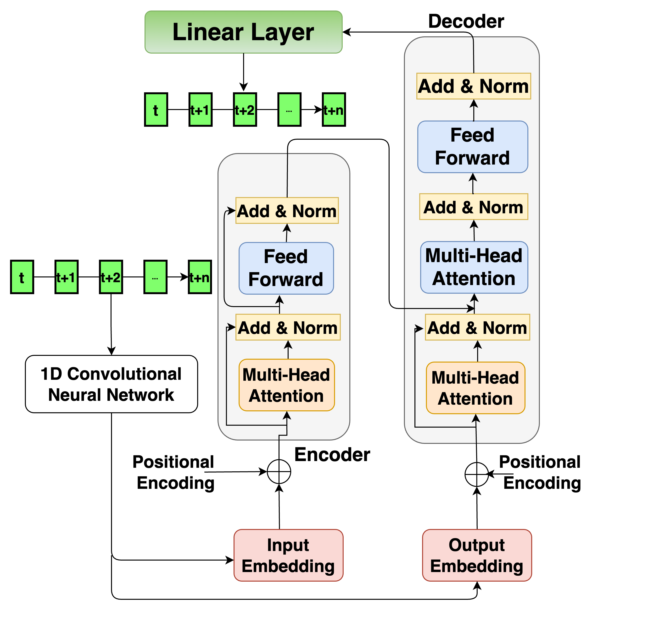
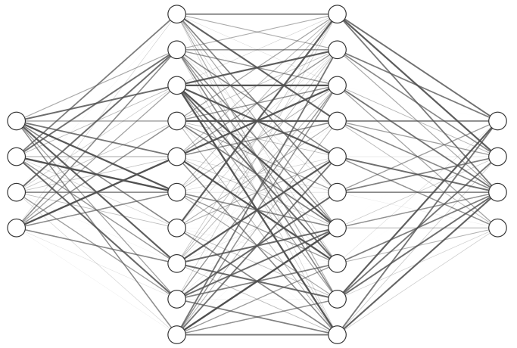
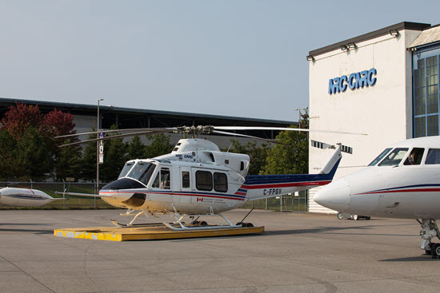
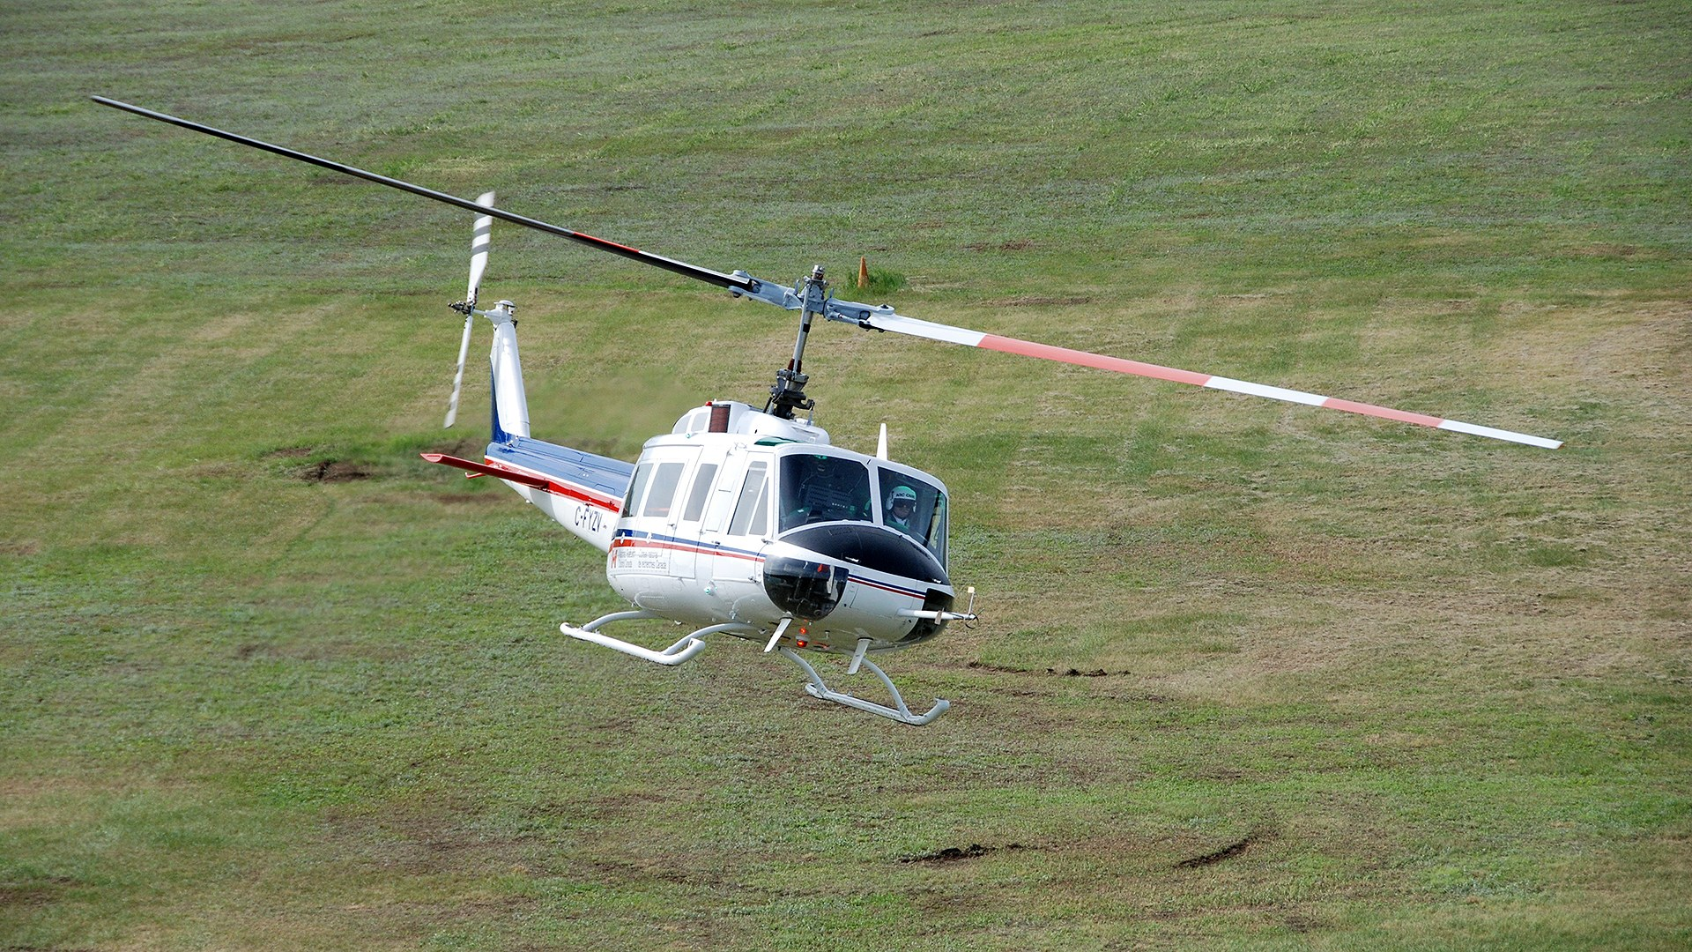
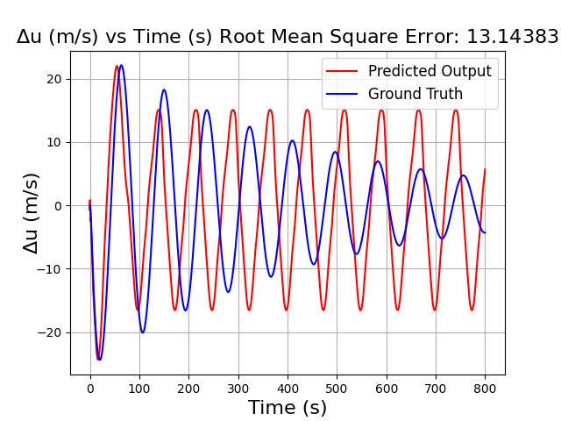
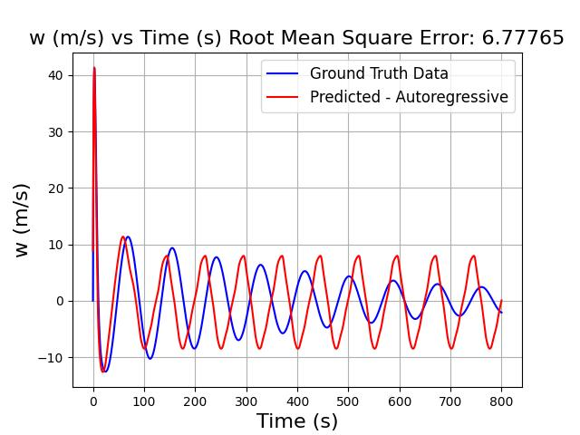
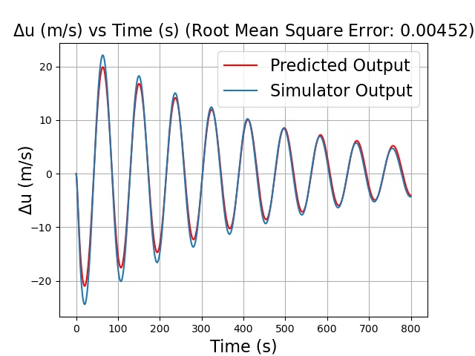
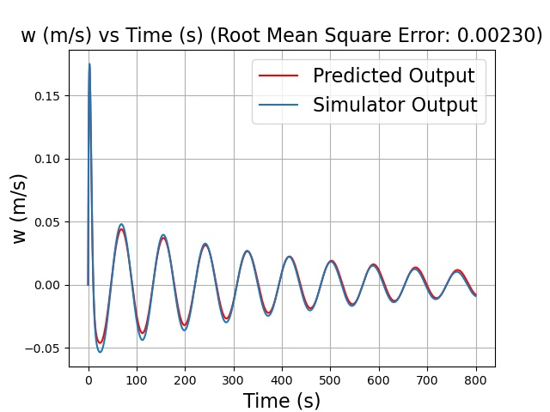
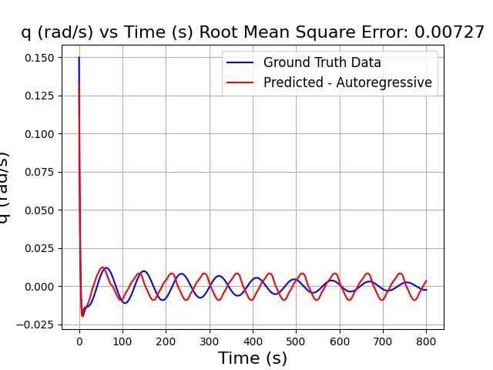
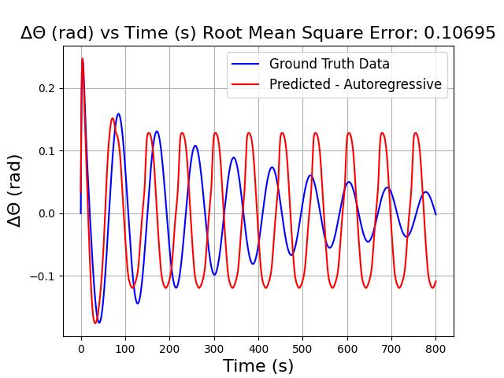
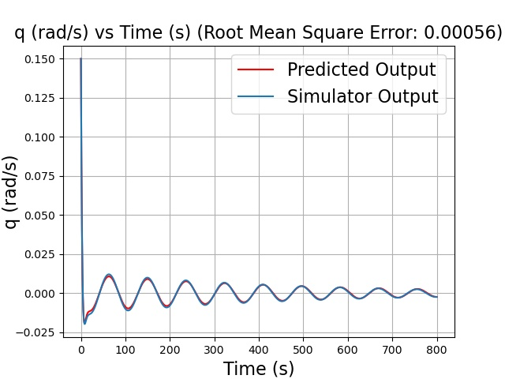
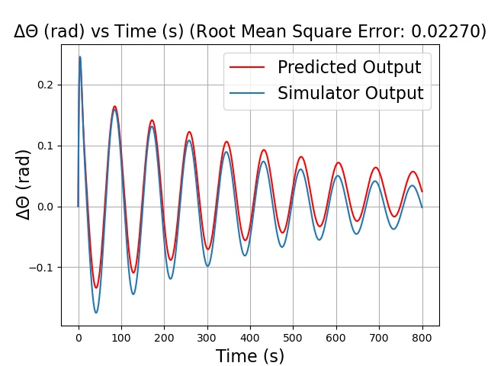
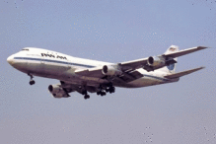
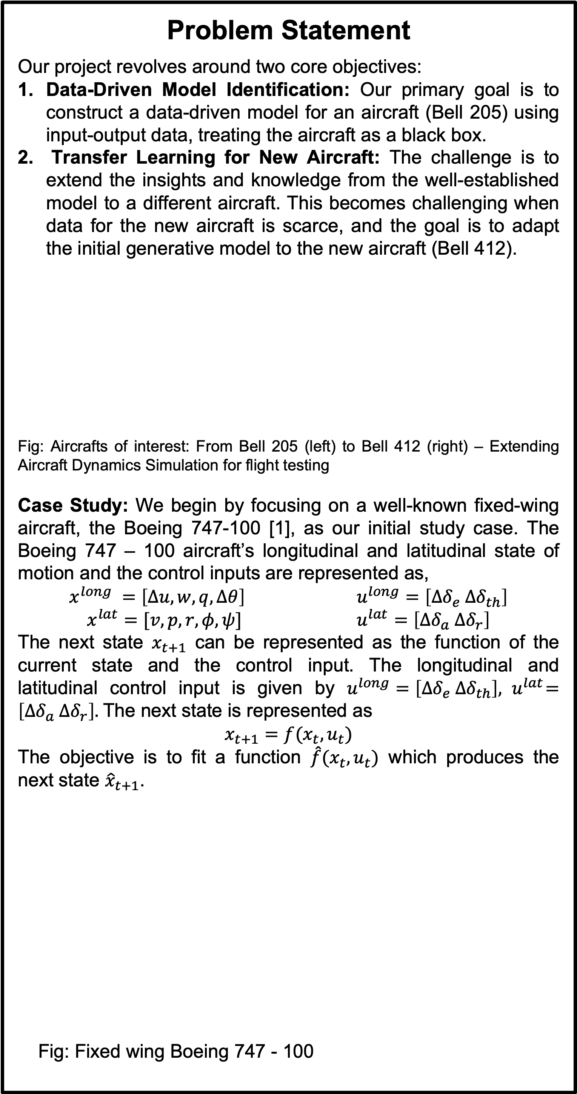

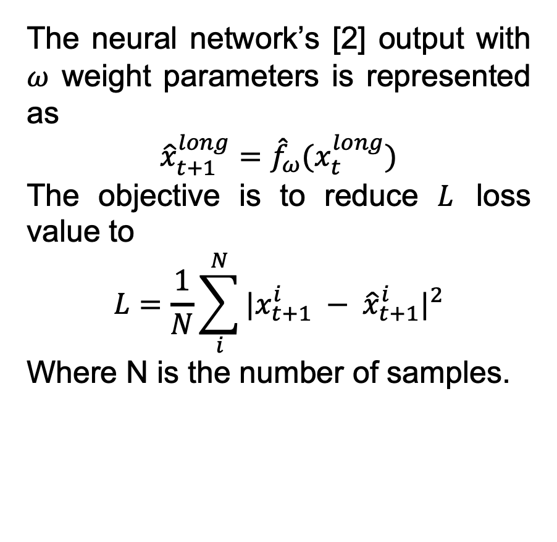





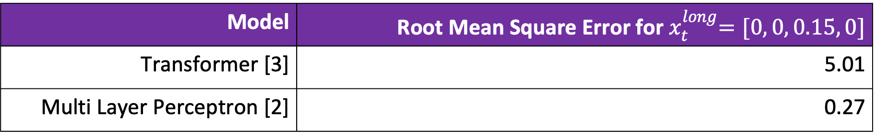
Data-efficient Learning of Aircraft Dynamics for Simulated Flight Testing
Sriram Ranganathan¹ Robert Liu¹ Yash Vardhan Pant¹
¹ Department of Electrical and Computer Engineering, University of Waterloo
Abstract: This research aims to develop a data-efficient machine learning model for flight testing and behavior cloning of the aircraft. The primary goal is to clone physical system behavior through data-driven methods. Current efforts focus on replicating Boeing aircraft's longitudinal motion, which involves experimenting a Deep Residual Recurrent Neural Network (DR-RNN) informed by aircraft physics[1], a Transformer-based model, and an Multi Layer Perceptron (MLP). Future work includes extending emulation to National Research Council’s(NRC) rotary wing Bell 205 data and broadening the model's domain to similar (Bell 412) aircraft, enhancing simulated flight testing in the aerospace industry.
Transformer Based Model
The transformer [3] model’s output with $∅$ weight parameters is represented as
$${\hat{x}}_{t+1}^{long}={\hat{G}}_{∅}(x_{t}^{long})$$
The objective is to reduce $L$ loss value to
$$L=\frac{1}{TN}\sum_{i}^{N}{\sum_{t}^{T}{{|x_{t}^{i} − {\hat{x}}_{t}^{i}|}^{2}}}$$
Where N is the number of samples.
Training data: 800 second with 0.05-time step trajectory with generated by integrating (RK-method) the differential state equations of Boeing 747-100 (linearized around a trim condition) initial disturbance (train size = 30%). The Transformer uses window of 0.25 seconds (lookback of 5 states).
Problem Statement
Our project revolves around two core objectives:
Data-Driven Model Identification: Our primary goal is to construct a data-driven model for an aircraft (Bell 205) using input-output data, treating the aircraft as a black box.
Transfer Learning for New Aircraft: The challenge is to extend the insights and knowledge from the well-established model to a different aircraft. This becomes challenging when data for the new aircraft is scarce, and the goal is to adapt the initial generative model to the new aircraft (Bell 412).
Fig: Aircrafts of interest: From Bell 205 (left) to Bell 412 (right) – Extending Aircraft Dynamics Simulation for flight testing
Case Study: We begin by focusing on a well-known fixed-wing aircraft, the Boeing 747-100 [1], as our initial study case. The Boeing 747 – 100 aircraft’s longitudinal and latitudinal state of motion and the control inputs are represented as,
$$x^{long} =\left[∆u, w, q, ∆θ\right] u^{long}=\left[∆δ_{e} ∆δ_{th}\right]$$
$x^{lat}=[v, p, r, φ, ψ]$ $u^{lat}=\left[∆δ_{a} ∆δ_{r}\right]$
The next state $x_{t+1}$ can be represented as the function of the current state and the control input. The longitudinal and latitudinal control input is given by $u^{long}=\left[∆δ_{e} ∆δ_{th}\right], { u}^{lat}=\left[∆δ_{a} ∆δ_{r}\right].$The next state is represented as
$$x_{t+1}=f(x_{t},u_{t})$$
The objective is to fit a function $\hat{f}(x_{t},u_{t})$ which produces the next state ${\hat{x}}_{t+1}$.
Fig: Fixed wing Boeing 747 - 100
Multi Layer Perceptron (MLP) based model
Training Data: 1000 trajectories of 800 seconds length and 0.1-time step generated by integrating (RK-method) the differential state equations of Boeing 747-100 (linearized around a trim condition) with random initial conditions and the control input set to zero. The weight update is given by the following equation,
$ω_{old}=ω_{old}−λ\frac{∂L}{∂ω_{old}}$ Here $λ$ is the learning rate.
$${\hat{x}}_{t …. t+m}^{long}$$
The neural network’s [2] output with $ω$ weight parameters is represented as
$${\hat{x}}_{t+1}^{long}={\hat{f}}_{ω}(x_{t}^{long})$$
The objective is to reduce $L$ loss value to
$$L=\frac{1}{N}\sum_{i}^{N}{{|x_{t+1}^{i} − {\hat{x}}_{t+1}^{i}|}^{2}}$$
Where N is the number of samples.
$$x_{t …. t+n}^{long}$$
$$x_{t}^{long}$$
$${\hat{x}}_{t+1}^{long}$$
The system of interest Boeing 747-100 is assumed to be in the trim condition; speed of the aircraft is set at Mach 0.8 and altitude is 40,000 feet.
Fig: Preliminary results for longitudinal motion Initial conditions: $x_{t}^{long}=[0, 0, 0.15, 0]$
Model | Root Mean Square Error for${ x}_{t}^{long}=[0, 0, 0.15, 0]$
Transformer [3] | 5.01
Multi Layer Perceptron [2] | 0.27
Fig: Preliminary results for longitudinal motion Initial conditions: $x_{t}^{long}=[0, 0, 0.15, 0]$
Future Work
Extend the transformer-based model to NRC’s Bell 205 data
Transfer learning approach to extend the Bell 205 model’s scope to Bell 412
References
[1] . Yu, H. Yao, and Y. Liu, “Aircraft dynamics simulation using a novel physics-based learning method,” Aerospace Science and Technology, vol. 87, pp. 254–264, 2019.
[2]. B. Fernandez, A. G. Parlos and W. K. Tsai, "Nonlinear dynamic system identification using artificial neural networks (ANNs)," 1990 IJCNN International Joint Conference on Neural Networks, San Diego, CA, USA, 1990, pp. 133-141 vol.2, doi: 10.1109/IJCNN.1990.137706.
[3] M. Janner, “Offline reinforcement learning as one big sequence modeling problem,” arXiv.org, Jun. 03, 2021. https://arxiv.org/abs/2106.02039
Notes:
- Add grid

