Slide 1

Online Examination System
Guided By: Prof.Rajan Dutt
Prepared By:15mca010,15mca034

Slide 2
Table Of Content
Defining Online Examination System.
Types of Online Examination System.
Project Scope.
Hardware/software Requirements.
System Modules.
Roles and Functionalities of Major Entities.
Diagrams:
→ Data Flow Diagram.
→ Entity Relationship Diagram.
Data Dictionary.

Slide 3
Defining Online Examination System
An Online Examination System enables students to appear for different types of exams digitally.
Along with students, teachers are also benefitted as exam assessment gets faster and easier with these types of smart systems.
Such systems also provide ‘space shift’ and ‘resource shift’.

Slide 4
Types of Online Examination System
This system can be developed to conduct following types of exams:
a) Competitive exams: CMAT,GMAT,CAT.
b)Recruitment Oriented Objective Exam.
c)Exam moodle of particular insitute/university.
d) Examination portal of Government Bodies.

Slide 5
Scope
This system is designed by keeping in mind Educational Organizations(like school , institutes and university).
The proposed system handles all basic operations necessary for a online examination to function as well as generates reports on successful completion of the test.
The question bank of the system consist of multiple choice question(MCQ) or True/false.

Slide 6
Hardware/Software Requirements
HARDWARE
ServerSide HardWare
Intel core i3 , 20GB HDD , 4 RAM
ClientSide HardWare
Hardware required by respective clients machine operating system
2 RAM , Communication hardware
SOFTWARE
ServerSide
Web server : GlassFish 1.8
Server Side Scripting : JSP
DataBase Tool : Mysql
Compatible OS : Windows 10
ClientSide
Web browser

Slide 7
System Modules
Login Module.
Student Enrolling Module
Examination Module.
Grade Report Generation Module.

Slide 8
Roles and Functionalities of Major Entities
ADMIN
Central role of maintaining the system.
Admin can create a department whose job would be to create exam
Admin can accept and verify the Exam request from departments
Admin can review all reports/information of exams , department , student , examiner ,etc.

Slide 9
DEPARTMENT:
The main responsibility is to create an exam with details like exam name , exam host(examiner) , schedule ,etc and to review various exam of a particular department and students enrolled for the same with its respective examiner.
EXAMINER:
Is the host of an exam.
Examiner is allocated for a specific exam to post its question bank along with the correct answers .
Can view student appeared for exam and their grades.

Slide 10
STUDENT
Is the actual user for this system.
Students can register in the system by providing a set of personal and academic details.
They can in future login to the system with the help of login credentials provided by the admin.

Slide 11
Data Flow Diagram [ Context-Level ]

Slide 12
Data Flow Diagram [ 1-Level ]

Slide 13
Data Flow Diagram [ 2-Level Exam Creation ]

Slide 14
Data Flow Diagram [ 2-Level Examination]

Slide 15
ENTITY RELATIONAL DIAGRAM

Slide 16
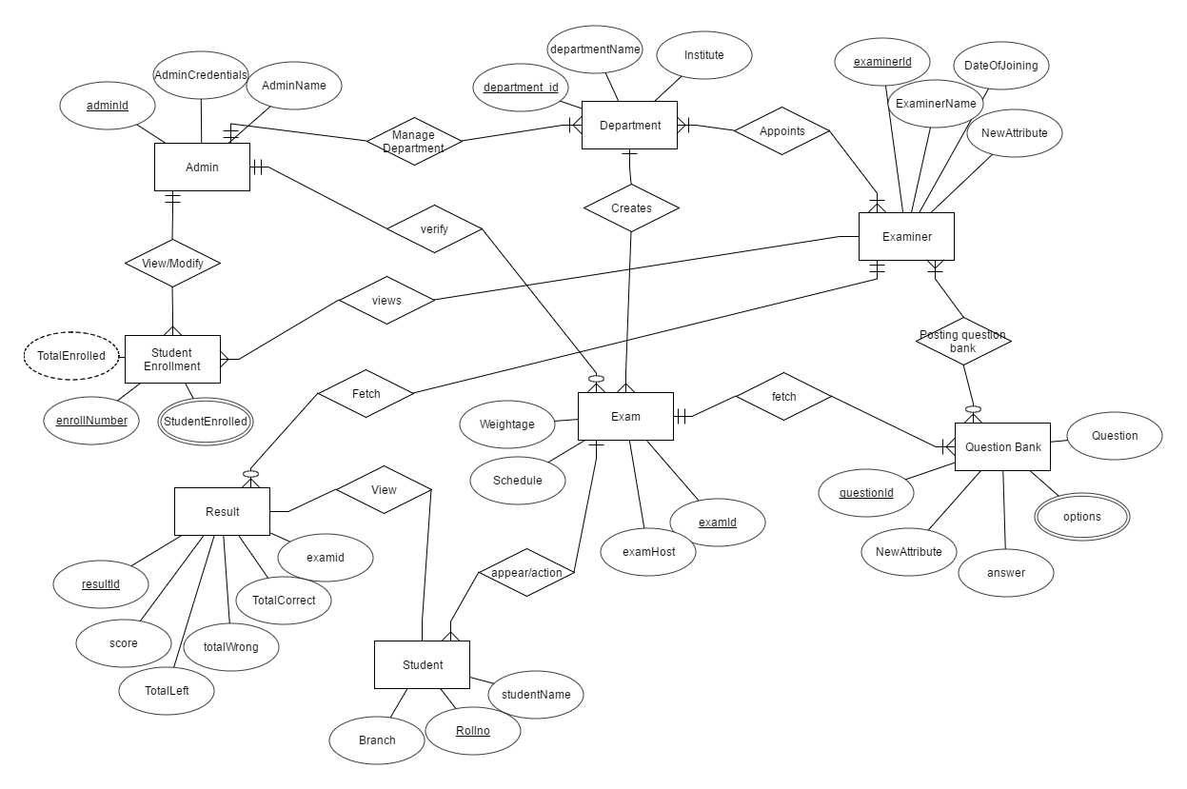

Slide 17
Data Dictionary

Slide 18
Table Name: Admin
Use: To Store Login Details
Field Name | Data Types | Constraint | Relationship
Admin_id | varchar(20) | NOT NULL | Primary Key
Admin_password | varchar(10) | Default NULL
Admin_emailid | varchar(40) | Default NULL

Slide 19
Table Name: Login
Use: To Store login Details
Field Name | Data Types | Constraint | Relationship
Login_id | varchar(20) | NOT NULL | Primary Key
Login_password | varchar(10) | Default NULL
Identify_login | varchar(25) | Default NULL

Slide 20
Table Name: Department
Use: To Store Department Details
Field Name | Data Types | Constraint | Relationship
dept_id | varchar(7) | NOT NULL | Primary Key
dept_name | varchar(20) | Default NULL
Login_id | varchar(7) | Default NULL | Foreign key(login table)
Institute_id | varchar(7) | Default NULL | Foreign key(Institute table)
Dept_email_id | text | Default NULL

Slide 21
Table Name: exam
Use: To Store exam Details
Field Name | Data Types | Constraint | Relationship
Exam_id | varchar(7) | NOT NULL | Primary Key
Exam_name | text | Default NULL
Dept_id | varchar(7) | Default NULL | Foreign key(department table)
Schedule_id | varchar(7) | Default NULL | Foreign key(exam schedule table)
Examinerl_id | varchar(7) | Default NULL | Foreign key(examiner table)
Total_Marks | varchar(5) | Default NULL
Is_it_approved | tinyint(1) | Default NULL
exam_date | date | Default NULL

Slide 22
Table Name: examiner
Use: To Store examiner Details
Field Name | Data Types | Constraint | Relationship
Examiner_id | varchar(7) | NOT NULL | Primary Key
Examiner_name | varchar(20) | Default NULL
Login_id | varchar(7) | Default NULL | Foreign key(Login table)
Examiner email_id | text | Default NULL

Slide 23
Table Name: examiner_appointed
Use: To Store examiner_appointed Details
Field Name | Data Types | Constraint | Relationship
examiner_appointed id | varchar(7) | NOT NULL | primary key
Examiner_id | varchar(7) | Default NULL | Foreign key(examiner table)
dept_id | varchar(20) | Default NULL | Foreign key(dept table)
exam_id | varchar(7) | Default NULL | Foreign key(exam table)
appointed_date | text | Default NULL

Slide 24
Table Name: exam_schedule
Use: To Store exam_schedule Details
Field Name | Data Types | Constraint | Relationship
ScheduleId | varchar(7) | NOT NULL | primary key
StartTime | time | Default NULL
EndTime | time | Default NULL
Duration | varchar(10) | Default NULL

Slide 25
Table Name: institute
Use: To Store institute Details
Field Name | Data Types | Constraint | Relationship
Institute_id | varchar(7) | NOT NULL | primary key
Institute_name | varchar(60) | Default NULL

Slide 26
Table Name: options
Use: To Store options Details of questions
Field Name | Data Types | Constraint | Relationship
option_id | varchar(10) | NOT NULL | primary key
question_id | varchar(10) | Default NULL | foreign key(question table)
option | text | Default NULL
correct_option | tinyint(1) | Default NULL
isitcorrect | tinyint(1) | Default NULL
option image | text | Default NULL

Slide 27
Table Name: questionbank
Use: To Store question_bank of questions
Field Name | Data Types | Constraint | Relationship
questionBank_ID | varchar(10) | NOT NULL | primary key
ExamId | varchar(7) | Default NULL | foreign key(exam table)
TotalMarks | int(11) | Default NULL
ExaminerId | varchar(7) | Default NULL | foreign key(examiner table)

Slide 28
Table Name: questions
Use: To Store questions details
Field Name | Data Types | Constraint | Relationship
questionId | varchar(10) | NOT NULL | primary key
questionBank_Id | varchar(7) | Default NULL | foreign key(question bank table)
question | int(11) | Default NULL
marks | varchar(7) | Default NULL
questionImage

Slide 29
Table Name: student
Use: To Store student details
Field Name | Data Types | Constraint | Relationship
StudentRollno | varchar(10) | NOT NULL | primary key
StudentName | varchar(40) | Default NULL
DeptId | varchar(7) | Default NULL | foreign key(department table)
LoginId | varchar(7) | Default NULL | foreign key(login table)
StudentEmailId | text | Default NULL
TotalExamEnrolled | int(10) | Default NULL
StudentDOB | date | Default NULL
StudentPicture | text | Default NULL
StudentAddress | text | Default NULL
StudentMobileNo | varchar(10) | Default NULL

Slide 30
Table Name: student_exam_appearance
Use: To Store student_exam_appearance details
Field Name | Data Types | Constraint | Relationship
StudentEnrollId | varchar(10) | NOT NULL | primary key foreign key(student_exam_enrollment_
StudentStartTime | datetime | Default NULL
StudentFinishTime | datetime | Default NULL
StudentAppeared | tinyint(1) | Default NULL
ExamSubmission | tinyint(1) | Default NULL

Slide 31
Table Name: student exam enrollment
Use: To Store student exam enrollmentdetails
Field Name | Data Types | Constraint | Relationship
StudentEnrollId | varchar(10) | NOT NULL | primary key
StudentRollno | varchar(10) | Default NULL | foreign key(student table)
ExamId | varchar(7) | Default NULL | foreign key(exam table)
ExamEnrolledDate | date | Default NULL

