Slide 1
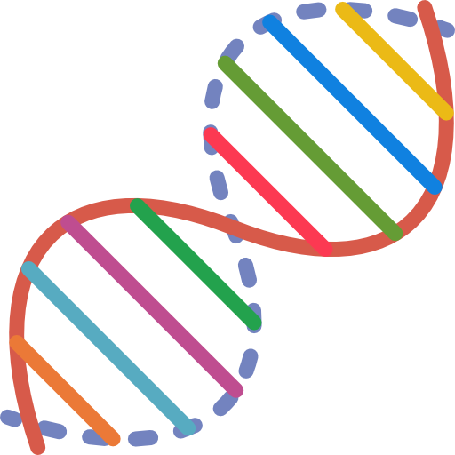
Dna Sequence Matching
Yash Patel
Pranav Sahu

Slide 2



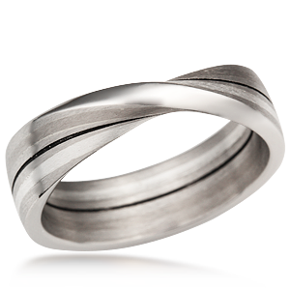
Index
Problem Statement
A Trivial Approach
KMP Algorithm
Dynamic Programming
Graphical Approach
Hybrid Algorithm

Slide 3
Problem statement
Given the sequence of DNA (i.e ATCG characters) we need to find either the perfect match between strings or the best possible alignment (more on that later).
In general how do we find the regions of match and mismatch between given pair strings.

Slide 4
A trivial approach (Brute force)
A simple approach to find the perfect match between two strings
It is like searching for a pattern, P[0...m-1], in text, T[0…n-1].
Algorithm BruteForceStringMatch(T[0...n-1], P[0...m-1])
for i ← 0 to n-m do
j ← 0
while j < m and P[j] = T[i+j] do
j++
if j = m then return i
return -1
Input : -
String 1: “ACTGACTAGAACGATATTAGCATTAGCATG”
String 2 : “AACGATATTAG”
Output : “AACGATATTAG”

Slide 5

So what is the problem ?
This is an expensive operation. O(n*m). Where n and m are the length of strings.
But this is not it. Although it is good for the perfect sequence match (short sequence), it can not solve the basic problem of DNA matching.
Why ?
Think of case when only last character is changed from string 2 then there is no match between strings (i.e brute force does not allow for mutations to happen).
Because DNA have mutation even the DNA from a same person does not match perfectly

Slide 6

Knuth–Morris–Pratt (KMP)
This is the obvious speedup over the brute-force search
KMP algorithm preprocesses pattern[ ] and make an auxiliary lps[ ] of size m (same size as pattern) which is used to hop characters while matching.
The time complexity of the KMP algorithm turns out to be O(m+n). Where m and n are the size of two strings.
But it still not solve the problem, right ?
We will use this as a intermediate algorithm
In the hybrid algorithm, to find the faster perfect lookup

Slide 7

Pseudo code
algorithm KMP(P[1,...,m],T[1,...,n])
pattern P of length m and text T of length n 1 ≤ m ≤ n list of all numbers s, such that P occurs with shift s in T
q ← 0; i ← 0; while (i < n) /* P [1, . . . , q] == T [i − q + 1, . . . , i] {
if (P [q + 1] == T [i + 1]) {
q ← q + 1; i ← i + 1; if (q == m) {
output i − q;
q ← π(q); /*slide the pattern to the right }
}
else /* a mismatch occurred {
if (q == 0) { i ← i + 1 }
else { q ← π(q) } }
}

Slide 8

Dynamic programming
A more sophisticated approach.
So instead of doing the perfect string match we aim for the best alignment of strings.
What is alignment ?
Input :-
String 1 : “ATGCATGACT”
String 2 : “ATGATCAGTA”
Output :
Sequence alignment is a way of arranging the sequences of DNA, RNA, or protein to identify regions of similarity that may be a consequence of functional, structural, or evolutionary relationships between the sequences.
Guess what the output would be ?
“ATGCATG-AC-T-” , “ATG-AT-CA-GTA”

Slide 9


Pseudo Code
Making Matrix
Constructing result
for i = 1 to rows:
for j =1 to cols:
if ith character in seqA == jth character in seqB:
score=match
else
score = mismatch
# Now we have 3 choices
choice1=a[i-1,j-1]+score # If characters are aligned
choice2=a[i-1,j] + gap # Gap in seqB
choice3=a[i,j-1] + gap # Gap in seqA
Let a[i,j] be max(choice1,choice2,choice3)
if a[i,j] is choice1:
let ptr[i,j] be 0 # Chars i and j aligned
else if a[i,j] is choice2:
let ptr[i,j] be 1 # Gap in seqB
else
let ptr[i,j] be -1 # Gap in seqA
AlignmentA ← ""
AlignmentB ← ""
i ← length(A)
j ← length(B)
while (i > 0 or j > 0)
{
if (i > 0 and j > 0 and F(i,j) == F(i-1,j-1) + S(Ai, Bj))
{ AlignmentA ← Ai + AlignmentA
AlignmentB ← Bj + AlignmentB
I ← i-1
j ← j - 1}
else if (i > 0 and F(i,j) == F(i-1,j) + d)
{AlignmentA ← Ai + AlignmentA
AlignmentB ← "-" + AlignmentB
i ← i - 1}
else
{AlignmentA ← "-" + AlignmentA
AlignmentB ← Bj + AlignmentB
j ← j - 1}
}
* This algorithm does the global alignment (length of input strings are same)

Slide 10


PERFORMANCE
The time complexity of dynamic programming approach
using Needleman Wunsch algorithm is O(m*n).
Space complexity is also the order O(m*n).
So how do we make it fast ?
Method 1: Method of four Russians
The Method of Four Russians is a technique for speeding up algorithms involving Boolean matrices, or more generally algorithms involving matrices in which each cell may take on only a bounded number of possible values.
Method 2 : Hybrid algorithm
In this approach we divide the sequence in to number of smaller sequence recursively
now we pull out the perfect match between those strings and then perform the global alignment
and then combine the final result to create an overall local string alignment

Slide 11

The graphical approach
The match between two strings can be represented graphically
by using the dot plot representation.
The idea of a dot plot is very simple, whenever we encounter a
match of characters we just put one in m*n matrix. Then we
can just create a graph from it.
How it is useful ?
Graphs can come really handy when you just need to make a distinction what kind of DNA sequences you are comparing.

Slide 12
THE CONCEPT
Here the diagonal is the perfect match, and the shorter lines off the diagonal represents the longest common perfect string match.

Slide 13
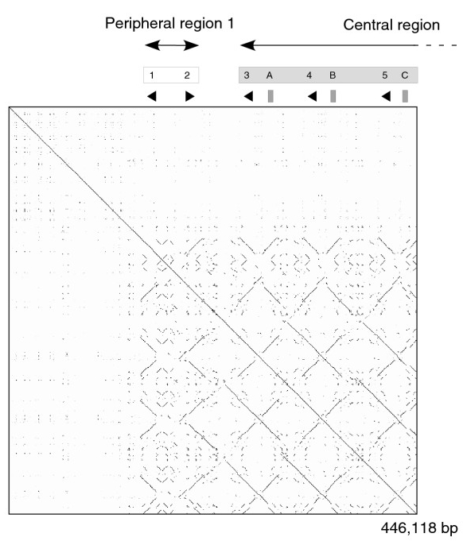
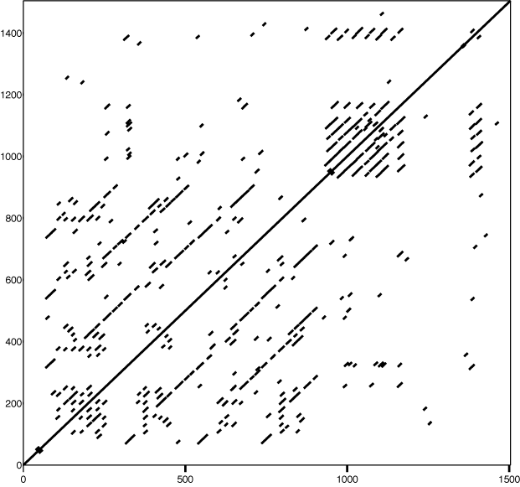
FEW INSIGHTS
Self comparison of a part of a mouse strain genome. The dot-plot shows a patchwork of lines, demonstrating duplicated segments of DNA.
Here the diagonal line shows the perfect match of string while those other dots show small character match

Slide 14

Speeding up Dynamic Programming
The hybrid approach
This method can be used to find the local alignment.
The basic idea is to divide the larger sequence recursively
ATAGCGTAGCATAGTC
ATAG
CGTA
GCAT
AGTC
CTAA
CGGC
GAAT
TGTG
CTAACGGCGAATTGTG

Slide 15

Now we extract the longest strings with the perfect match.
ATAG
CGTA
GCAT
AGTC
CTAA
CGGC
GAAT
TGTG
Now perform the alignment on rest of the data to get the overall local alignment
Where is the speedup ?
Now we don’t have to make a n^2 matrix . But instead we will make a n^2/ k matrix where k depends on the longest match between the divided substrings.

Slide 16

PROGRESS SO FAR
We are done completing the Brute Force Search, KMP, Needleman Wunsch algorithm and the speed up can be realized for the shorter sized protein sequences.
The dot plot can be plotted for the short size sequences in real time. But for longer sequences it takes too long. We are currently working on the clustering method to reduce the data size and plot the information more rapidly.
Why clustering will work ?
Most of the time, we are not concerned about the exact string alignment but a decision what types of sequences those are and whether it is in specific kingdom or phylum.

Slide 17
References
https://en.wikipedia.org/wiki/Needleman–Wunsch_algorithm
https://en.wikipedia.org/wiki/Method_of_Four_Russians
http://www.iiserpune.ac.in/~farhat/courses/idc205/lab12.html
http://rna.informatik.uni-freiburg.de/Teaching/index.jsp?toolName=Needleman-Wunsch
https://www.ncbi.nlm.nih.gov/gene
http://www.bioinformatics.org/sms2/group_protein.html
https://www.cs.ubc.ca/~hoos/cpsc445/Handouts/kmp.pdf

Slide 18

Thank you !
Any Questions ?

