Slide 1

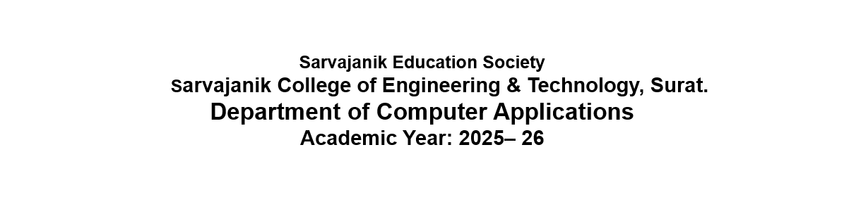


A Project On
“Sip N’ Bite”
Presented By
Deep Chauhan ET25MTCA005
Yash Patel ET25MTCA047
Prathamesh Viras ET25MTCA066
MCA I Sem-3
Under the Guidance of
Prof. Krishna Vaidya

Slide 2
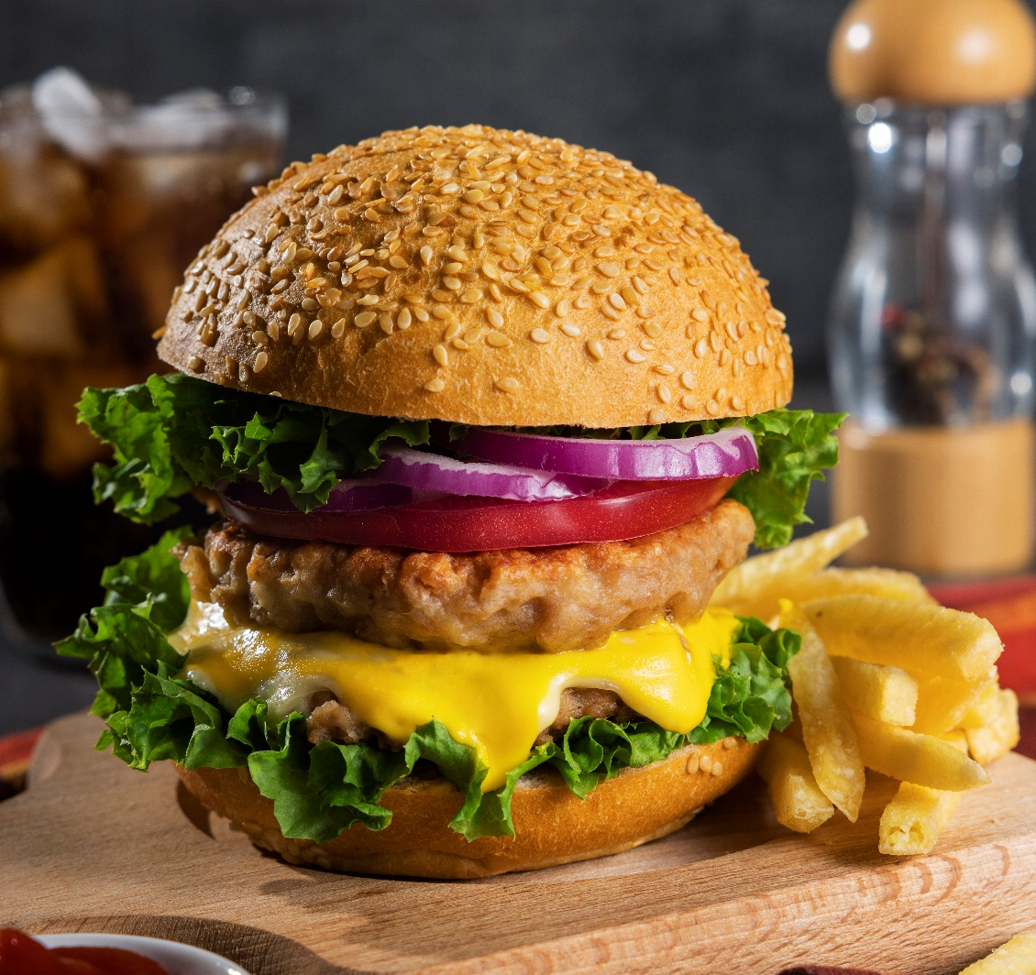
SIP N’ BITE
Online Food ordering System

Slide 3
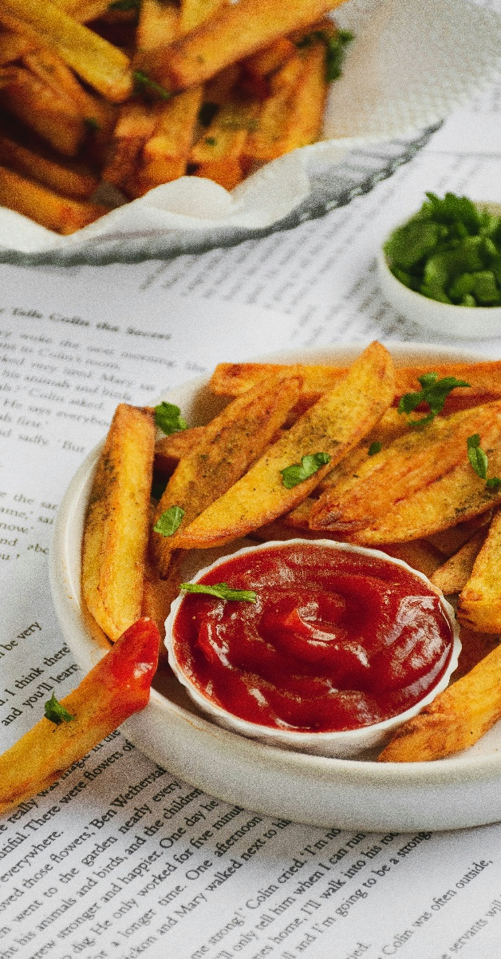
Table of contents
Abstract & Objective
Core Components
System Description
Advantages & Limitations
Database Design/Data dictionary
Diagram
References

Slide 4
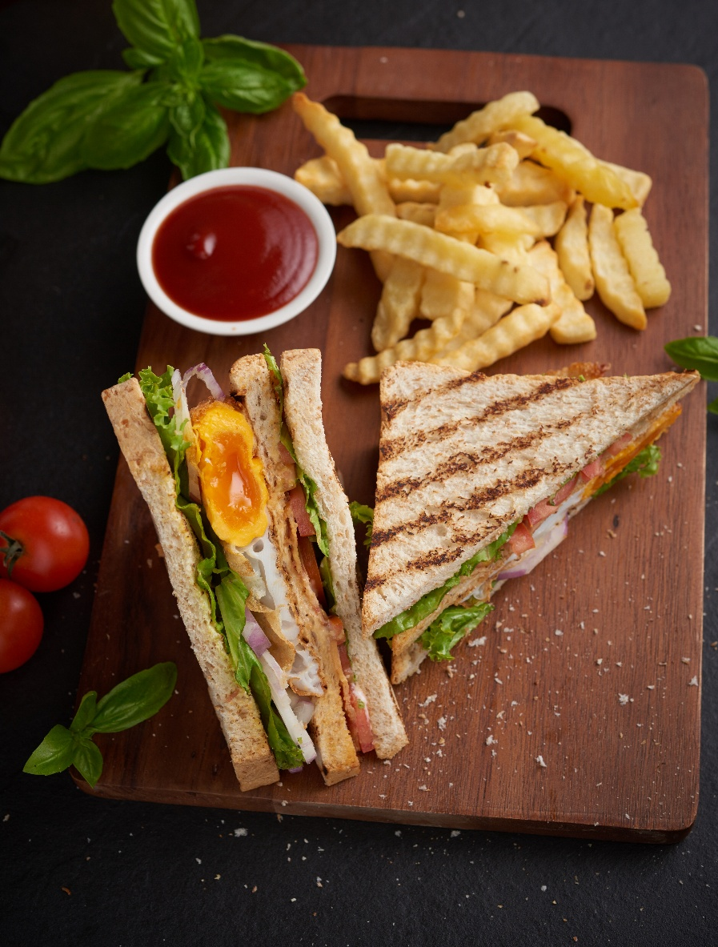
Abstraction
Sip & Bite is a digital food service system designed to make food ordering, table booking, and delivery management easier and faster. The system includes a web application and an Android mobile application for customers, admins, kitchen staff, and delivery staff.
The system reduces manual work such as paper-based orders, phone bookings, and cash records. Customers can easily view the food menu, add items to their cart, place orders, book tables, make online payments, and track their deliveries.
Admins can manage food items, customer orders, table bookings, payments, and delivery details from the system. Kitchen staff can view and manage food orders, while delivery staff can handle and update delivery status. Overall, Sip & Bite provides a simple, organized, and convenient way to manage restaurant services digitally.
$30
$25

Slide 5
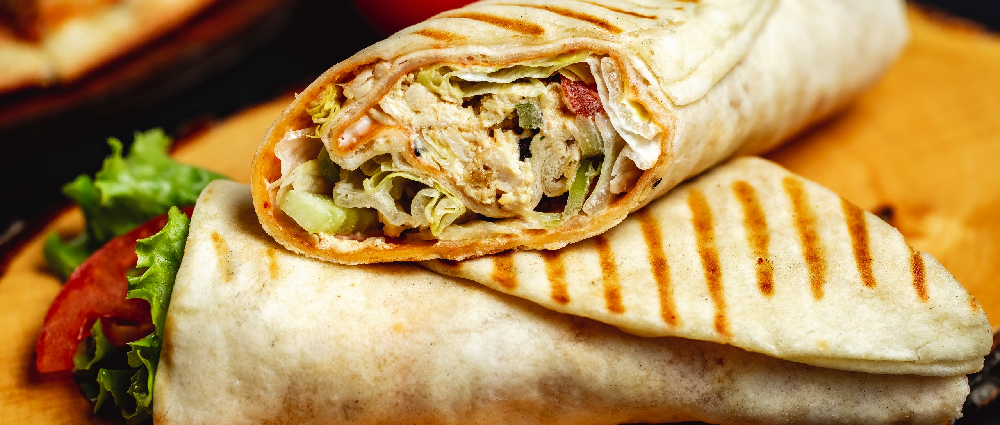
Objectives
Objectives
Digital Menu & Ordering
Real-Time Table Booking
Delivery Tracking
Customers can see food items, choose it ,pick the amount, and order online.
Customers pick a date, time, and number of guests to book a table with no double-booking.
The system works out delivery distance, delivery time, and tracks the rider live.
Feedback & Ratings
Different User Roles
Easy & Safe Payments
Admin, Delivery Partner, and Customer each get their own screen and tools.
Customers can pay online (card, UPI, net banking) or choose Cash on Delivery.
Customers rate their food and give comments to help the restaurant improve.

Slide 6
Core Components
1
2
3
4
5
Web Backend & Admin Panel
Customer Mobile App
Delivery Partner App
Database (MySQL)
Location & Payment Services
Built with the Laravel framework. This is where the restaurant manages everything.
An Android app where customers browse food, order, and book tables.
A simple app for riders to see and update their deliveries.
Stores all the information — users, orders, menu, bookings, and payments.
Connects to map services and Razorpay to handle distance and payments.

Slide 7
Advantages
1
2
3
Fewer Mistakes
Easy for Customers
Live Updates
No more handwritten orders, wrong bills, or double table bookings.
Order food or book a table anytime, from anywhere — no waiting in line.
See every step: order placed, cooking, out for delivery, and delivered.
4
5
Safe Payments
Smart Reports
Online payments follow strict safety rules, so cash is not always needed.
Owners can see sales, popular dishes, and which delivery staff are free.

Slide 8
Limitations
1
Needs Internet
2
Needs a Good Phone
Both the website and the app need an active internet connection to fully work.
Delivery riders need an Android phone with GPS and a working camera.
3
Setup Takes Time
4
Needs Correct Setup
Setting up the server, database, and training staff takes effort at the start.
Payment and map services must be configured correctly, or they will not work.

Slide 9
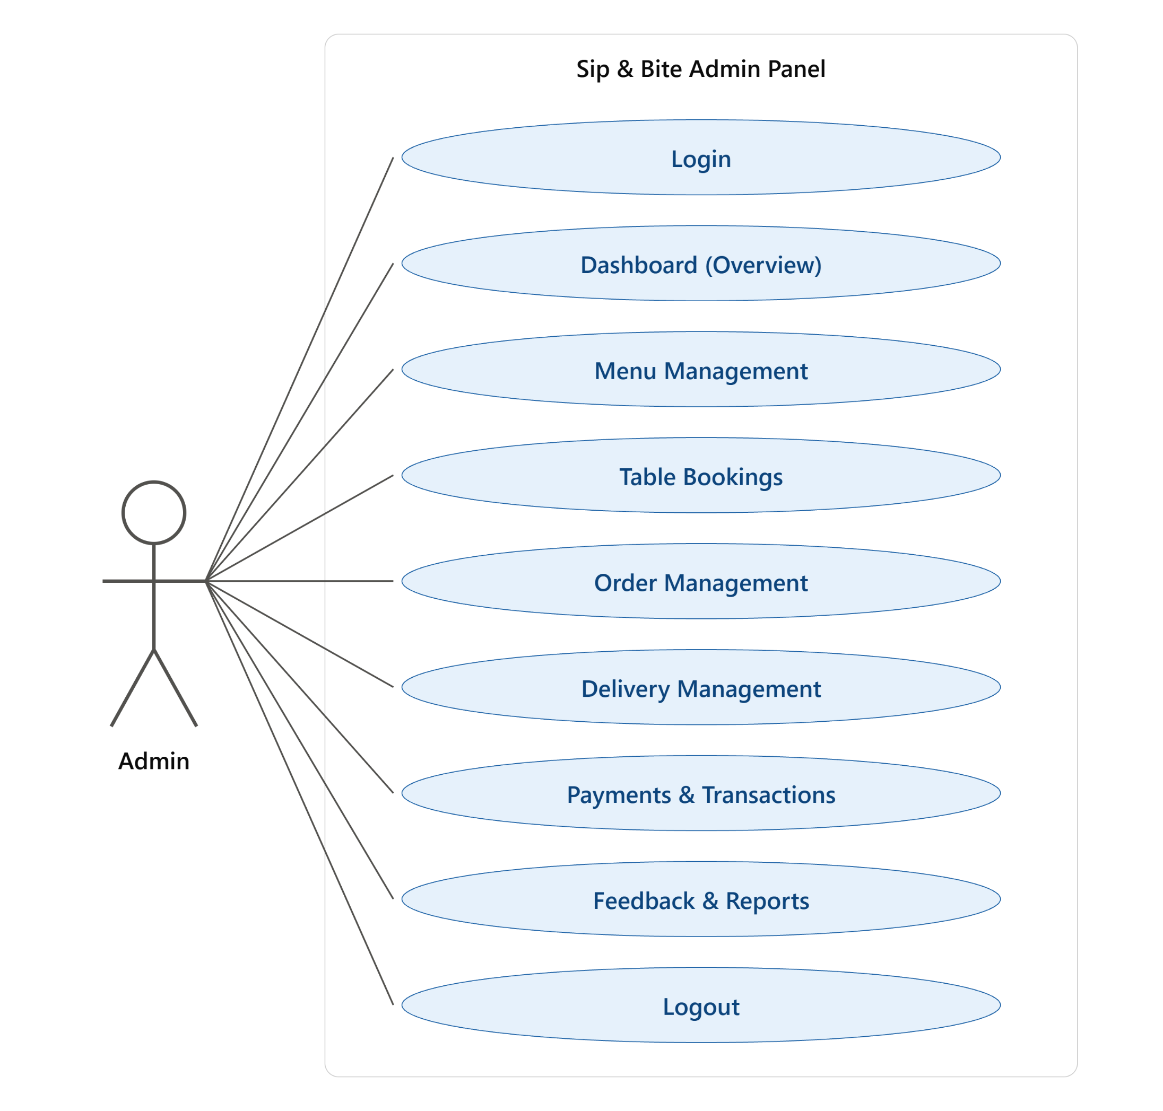
Use Case Diagram

Slide 10
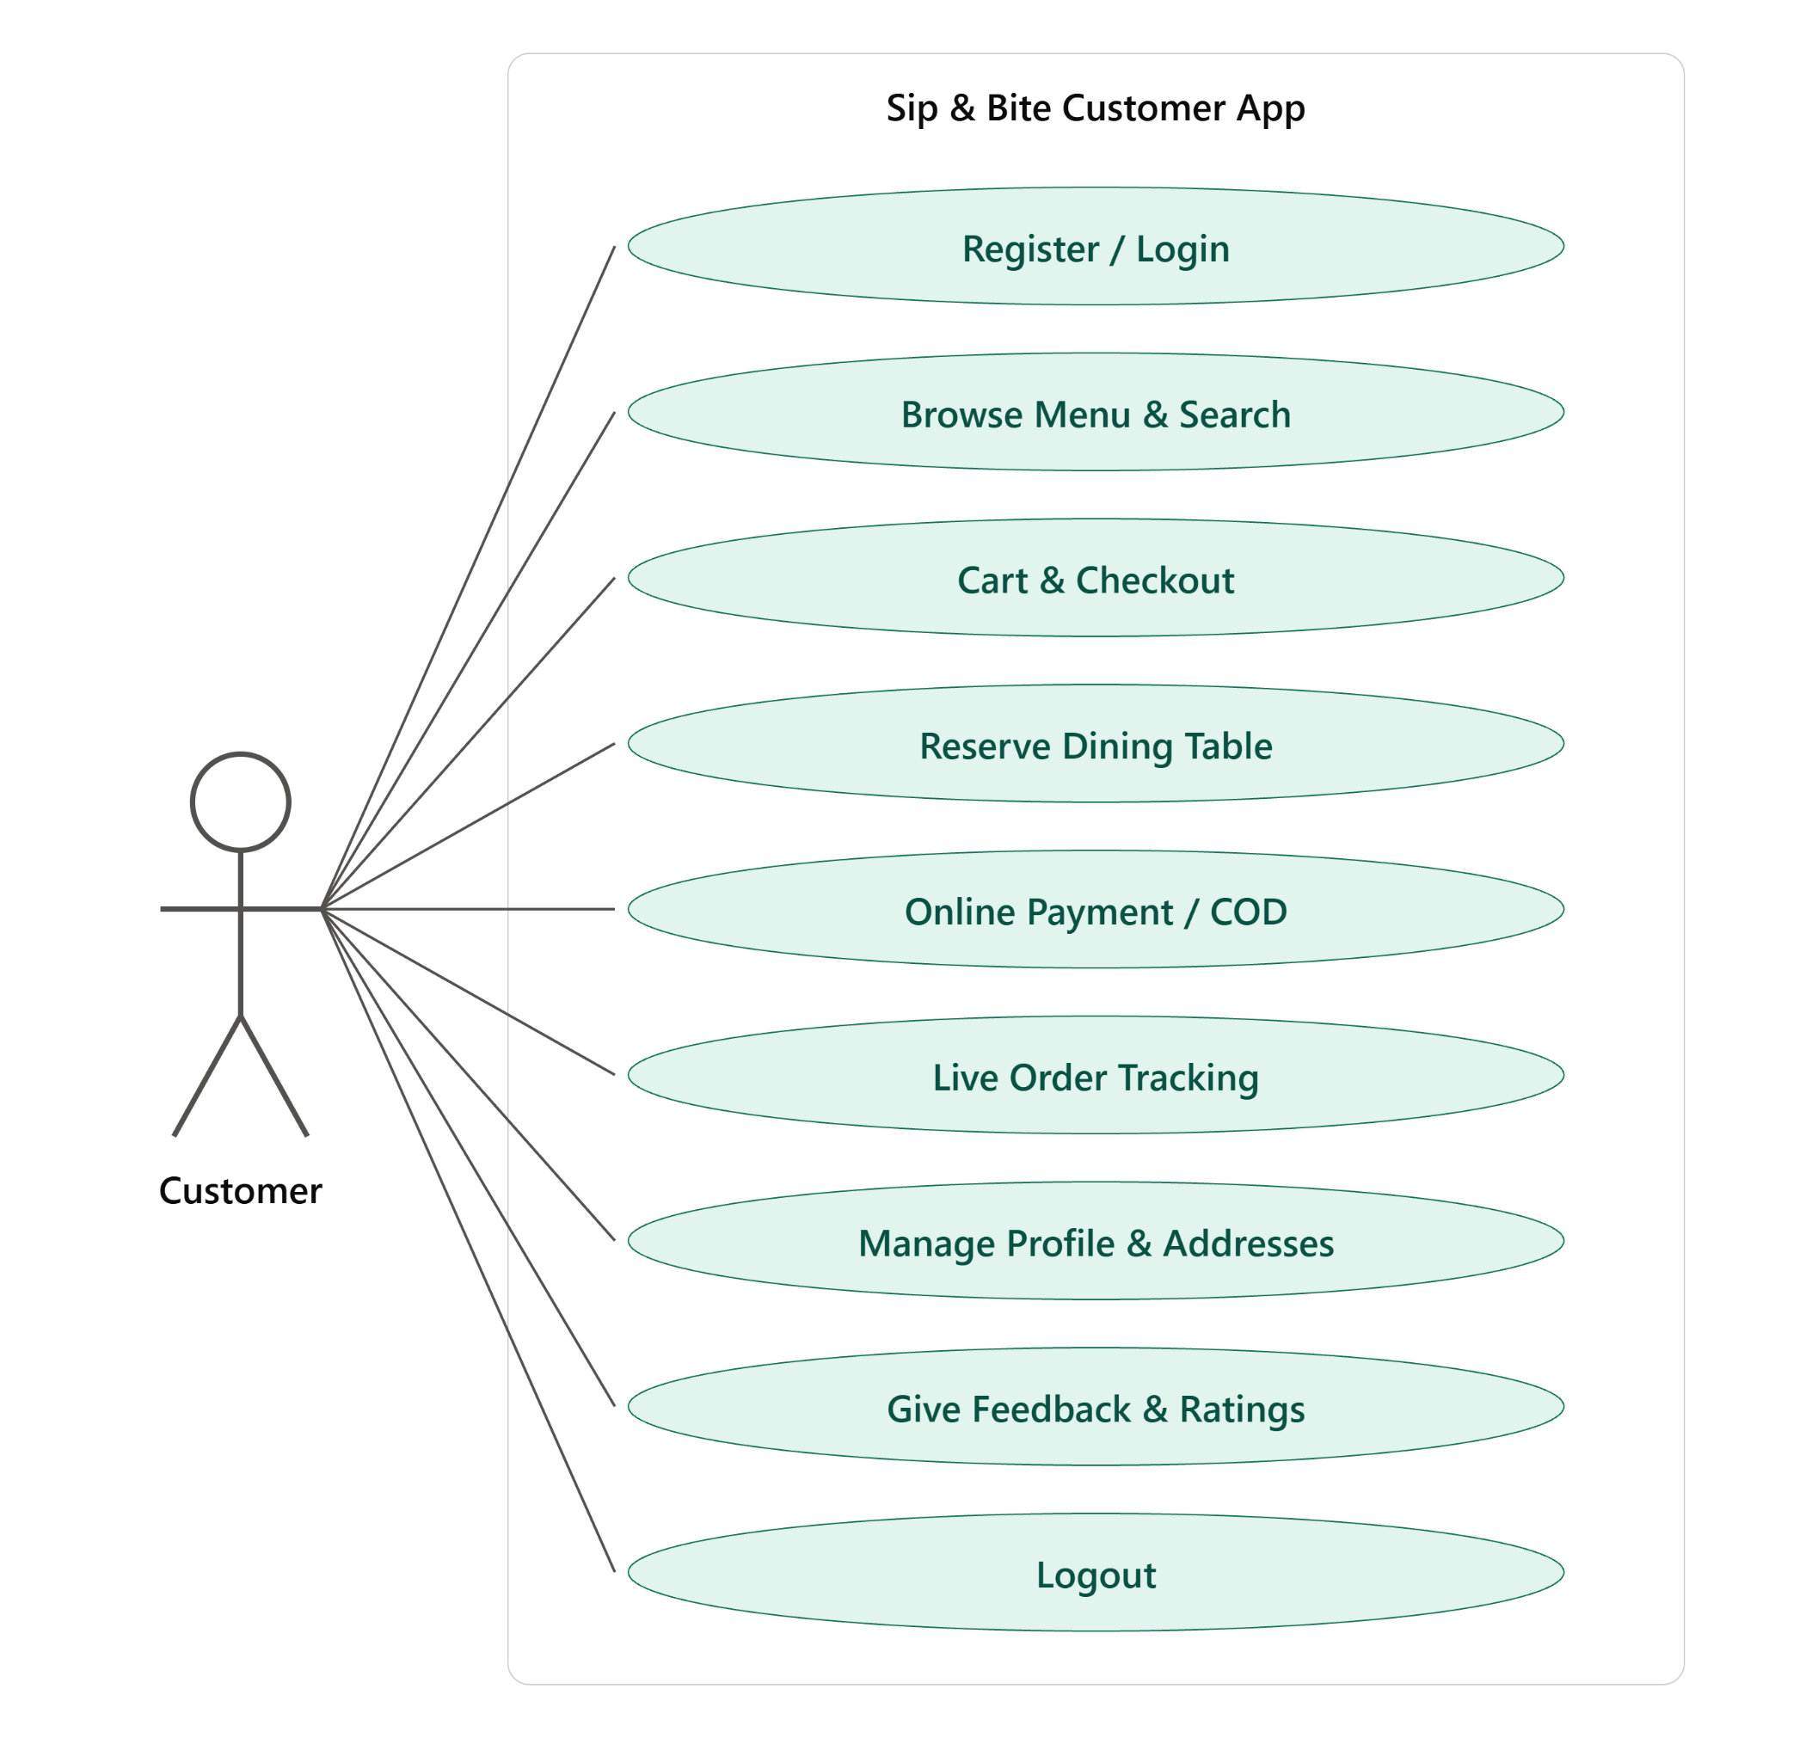
Use Case Diagram

Slide 11
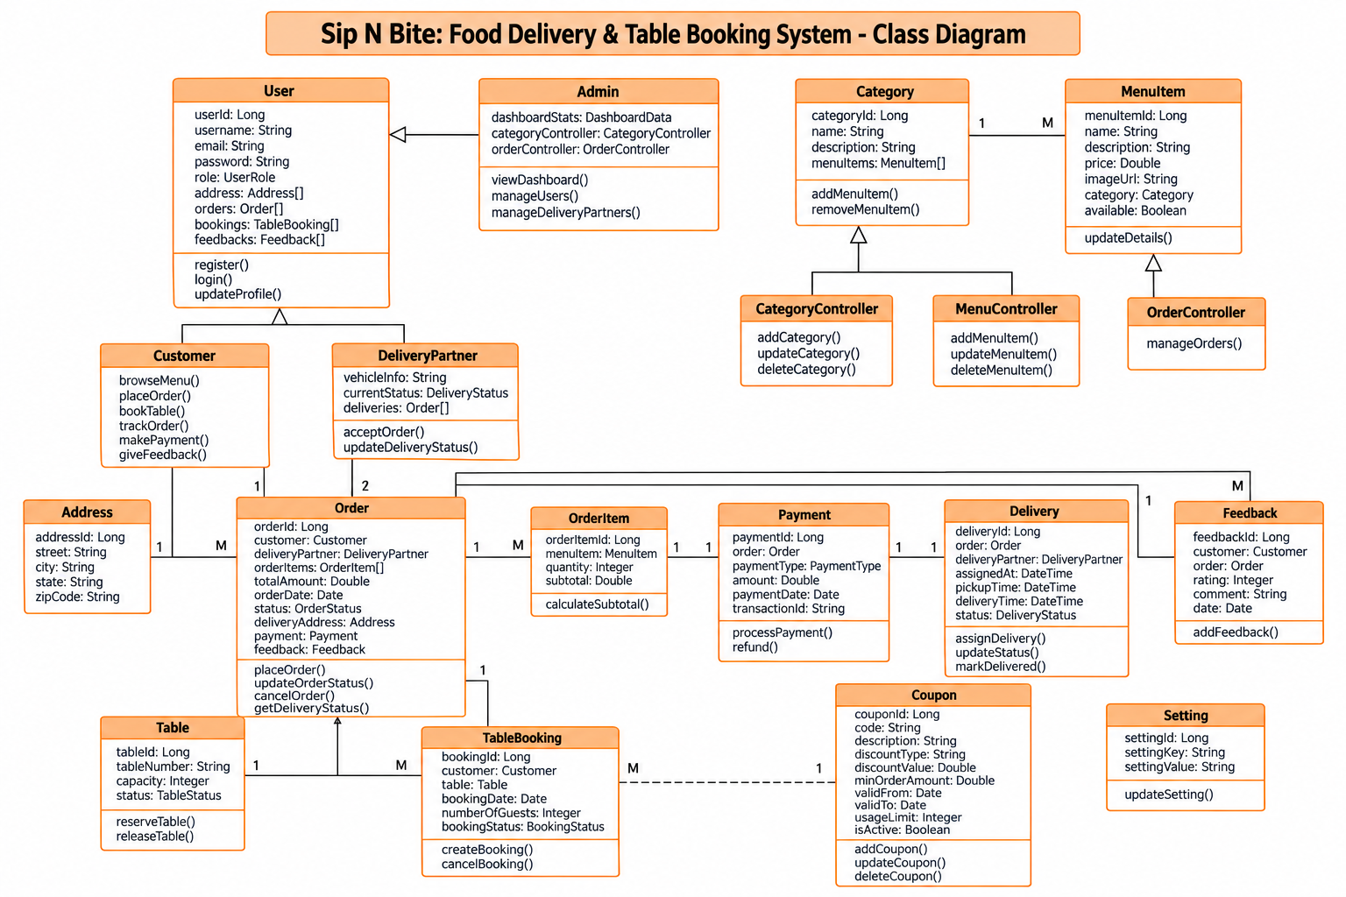
Class Diagram

Slide 12
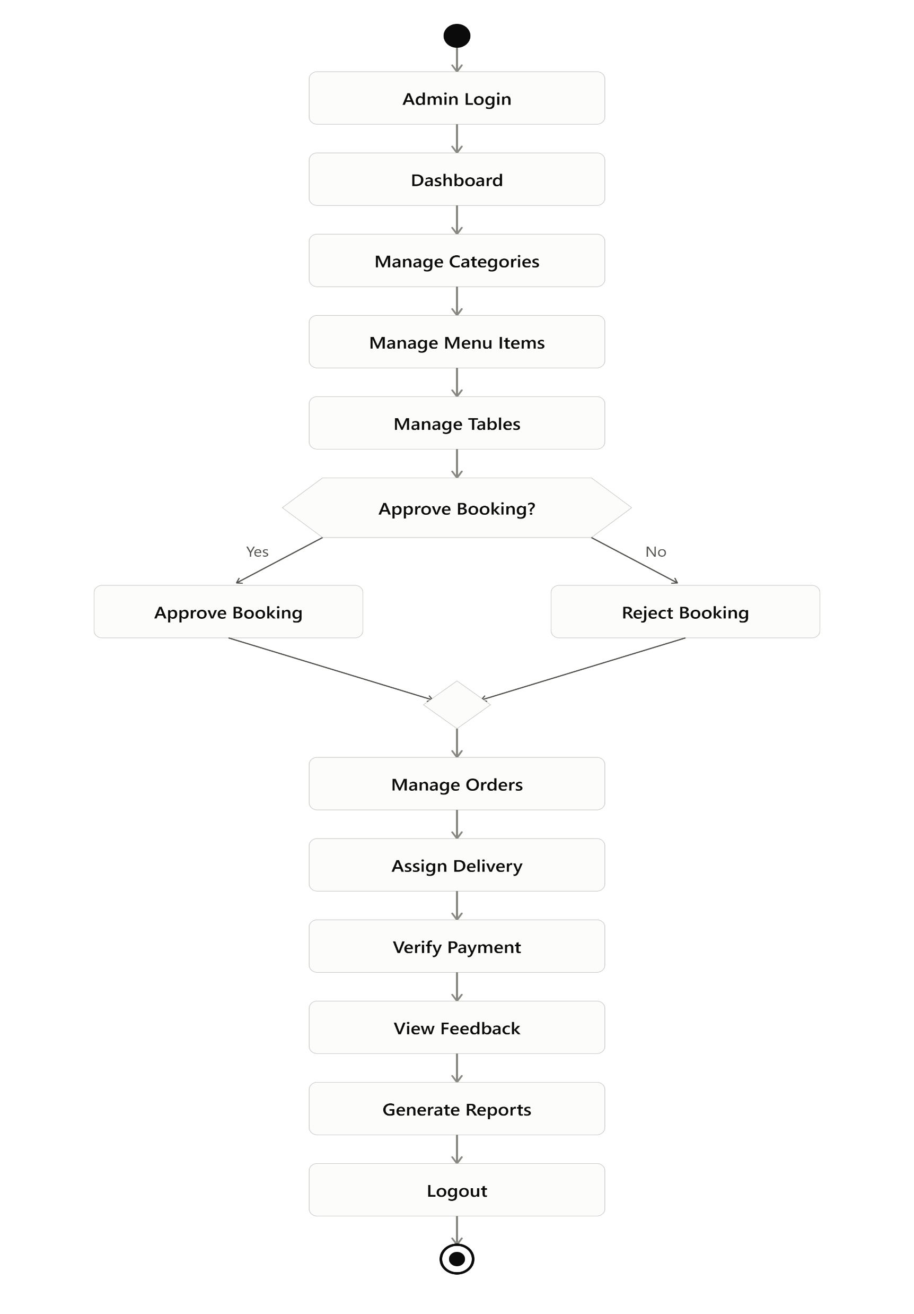
Activity Diagram
Admin Flow

Slide 13
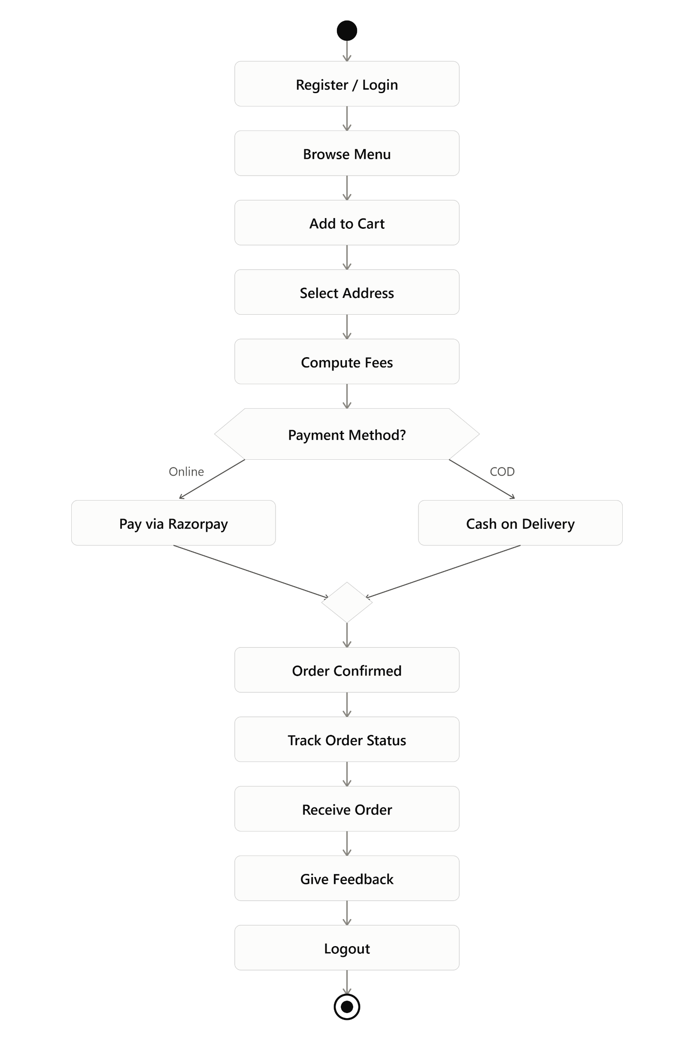
Activity Diagram
Customer Flow

Slide 14
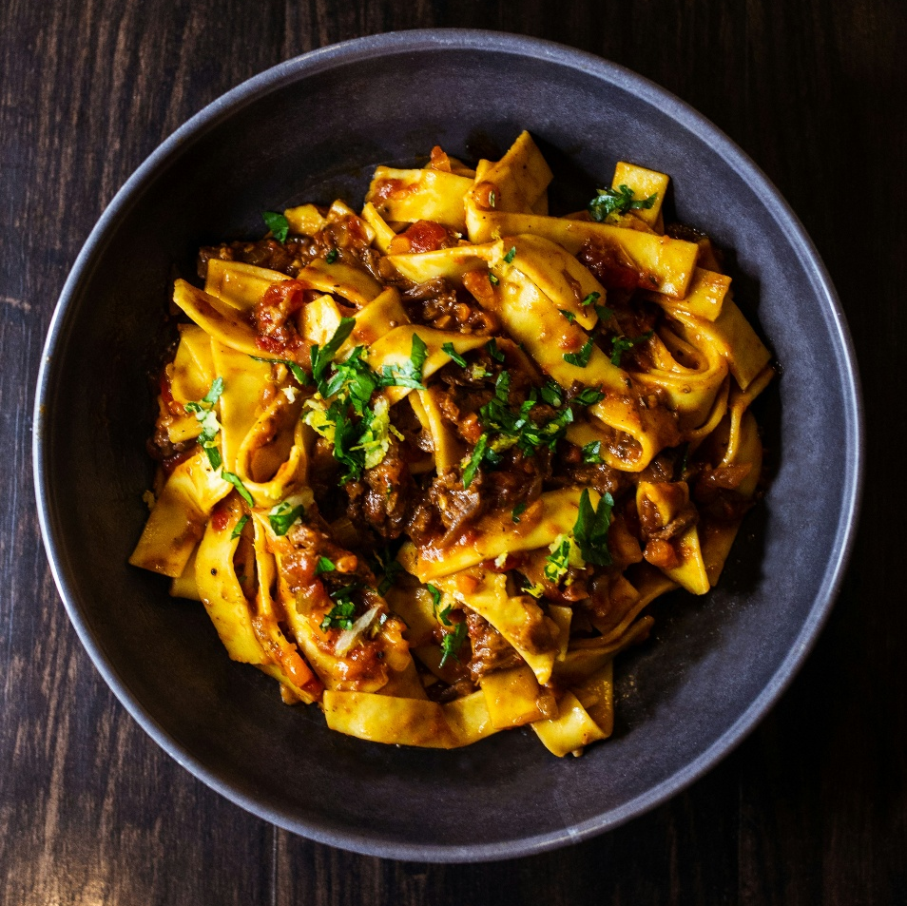
Database Design
&
Data Dictionary

Slide 15
Customer
It Stores Registration And Authentication Details Of The Customers.
No. | Field Name | Data Type | Size | Constrain | Description
1. | Id | BigInt | 20 | Primary Key, AI | Unique user identifier
2. | name | Varchar | 255 | Not Null | User's full name
3. | email | Varchar | 191 | Unique, Not Null | Email address for login
4. | password | Varchar | 255 | Not Null | Bcrypt hashed password
5. | status | Enum | - | 'active','blocked' | Account status
6. | registration_time | Timestamp | - | Nullable | Time of user signup

Slide 16
2. categories
It stores different food categories for menu classification.
No. | Field Name | Data Type | Size | Constrain | Description
1. | id | BigInt | 20 | Primary Key, AI | Unique category ID
2. | name | Varchar | 255 | Not Null | Category name (e.g. Pizza)
3. | image | Varchar | 255 | Nullable | Path to category icon/image

Slide 17
3. tables_layout
It stores the physical layout and status of restaurant tables.
No. | Field Name | Data Type | Size | Constrain | Description
1. | id | BigInt | 20 | Primary Key, AI | Unique table ID
2. | table_number | Varchar | 255 | Unique, Not Null | Display number of the table
3. | capacity | Unsigned Int | - | Not Null | Number of seats available
4. | status | Enum | - | 'available','booked' | Real-time booking status
5. | is_active | Boolean | - | Default true | Active status in layout

Slide 18
4. table_bookings
It stores reservation requests made by users for specific tables.
No. | Field Name | Data Type | Size | Constrain | Description
1. | id | BigInt | 20 | Primary Key, AI | Booking reference ID
2. | user_id | BigInt | 20 | Foreign Key | Reference to users table
3. | table_id | BigInt | 20 | Foreign Key | Reference to layout table
4. | booking_date | Date | - | Not Null | Scheduled date
5. | status | Enum | - | Pending/Accepted... | Current status of request

Slide 19
5. cart
It stores temporary items added by users before checkout.
No. | Field Name | Data Type | Size | Constrain | Description
1. | id | BigInt | 20 | Primary Key, AI | Cart item unique ID
2. | user_id | BigInt | 20 | Foreign Key | The owner of the cart
3. | food_id | BigInt | 20 | Foreign Key | Item added to cart
4. | quantity | Unsigned Int | - | Not Null | Number of items

Slide 20
6. orders
It stores finalized order transactions and delivery details.
No. | Field Name | Data Type | Size | Constrain | Description
1. | id | BigInt | 20 | Primary Key, AI | Order reference number
2. | user_id | BigInt | 20 | Foreign Key | The ordering customer
3. | total_amount | Decimal | 10,2 | Not Null | Base amount
4. | final_amount | Decimal | 10,2 | Not Null | Amount after tax/charges
5. | status | Enum | - | Default prep | Lifecycle of the order

Slide 21
7. bills
It stores generated invoices for completed orders.
No. | Field Name | Data Type | Size | Constrain | Description
1. | id | BigInt | 20 | Primary Key, AI | Invoice entry ID
2. | order_id | BigInt | 20 | Foreign Key | Reference to parent order
3. | bill_number | Varchar | 255 | Unique | Public bill number
4. | final_amount | Decimal | 10,2 | Not Null | Final payable amount
5. | payment_method | Varchar | 255 | Not Null | Mode of transaction

Slide 22
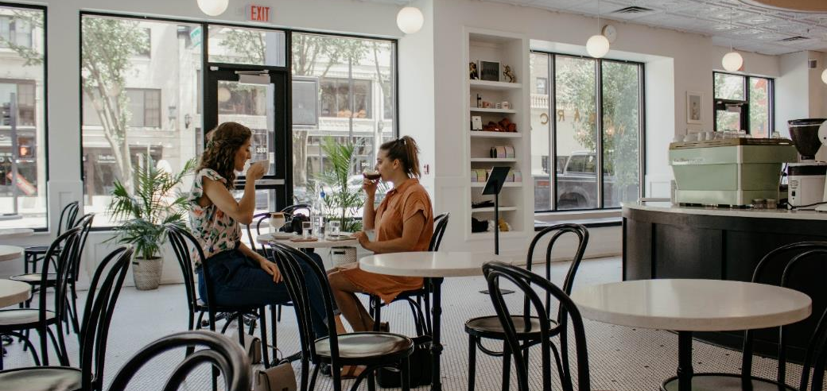
Thank You!

