Slide 1

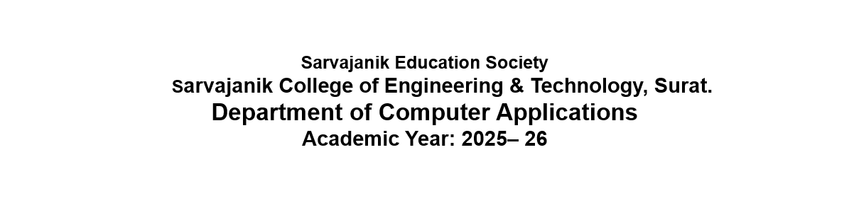

A Project On
“Sip N’ Bite”
Presented By
DEEP CHAUHAN<ET25MTCA005>
YASH PATEL<ET25MTCA047>
PRATHAMESH VIRAS<ET25MTCA066>
MCA I Sem-3
Under the Guidance of
Prof. Krishna Jariwala

Slide 2
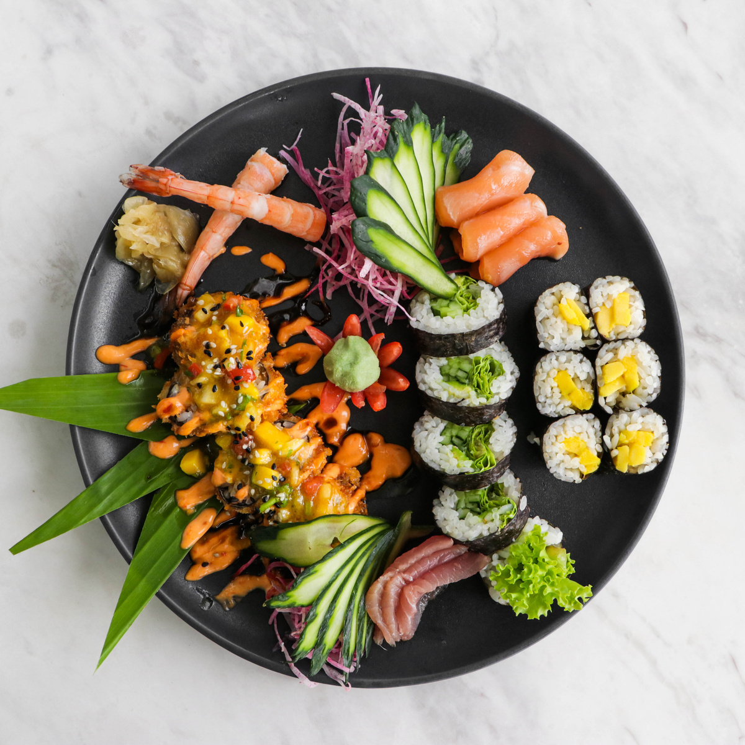
Sip N’
Bite
Online Food ordering System

Slide 3

Agenda
Proposed system and its Objectives
Core Components
Minimum and Maximum Software/Hardware requirements
Advantages and Limitations of the Proposed System
Requirement Determination
Targeted Users
System Design
    Use Case Diagram
    Class Diagram
    Interaction Diagram
    Activity Diagram
    Data Dictionary

Slide 4


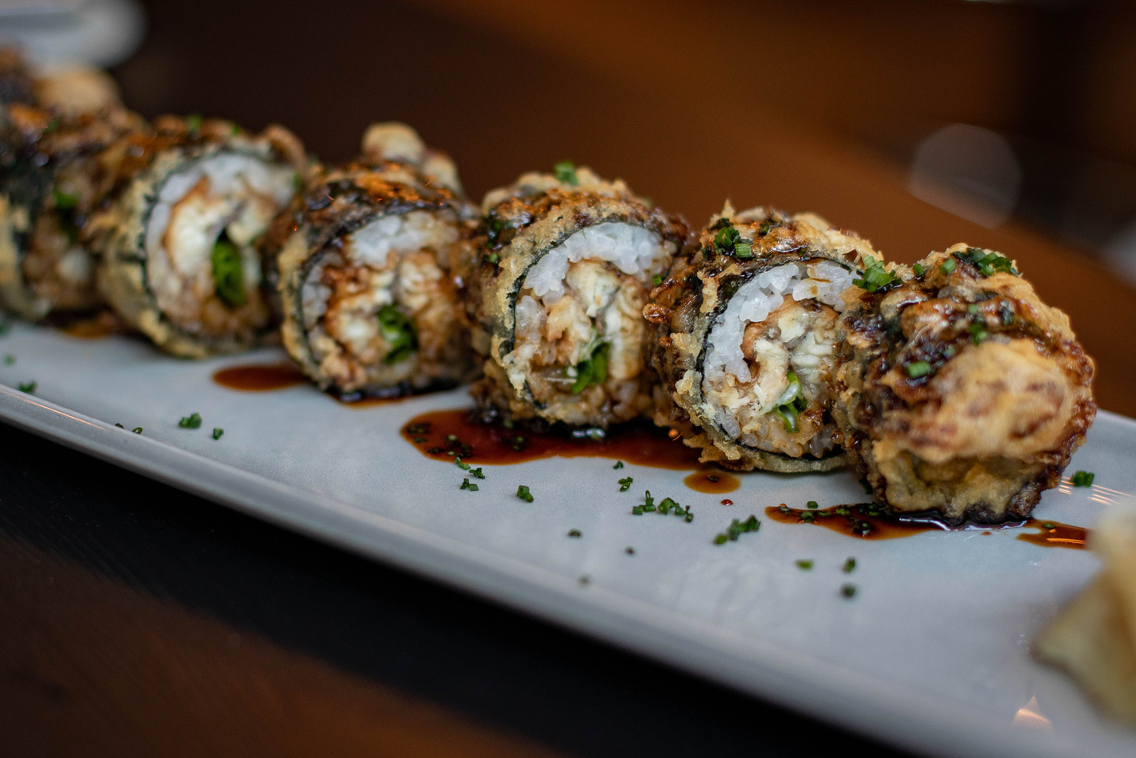
Proposed system and its Objectives
The Sip & Bite platform is an advanced, integrated digital solution designed to transform food ordering, table reservation, and delivery management for contemporary food service businesses. Combining a robust web application powered by Laravel PHP with a high-performance Android mobile application, Sip & Bite streamlines the dining and delivery workflow for customers, administrative management, kitchen staff, and delivery personnel.
Traditional restaurant operations often suffer from fragmented manual systems—such as paper-based menu ordering, telephone table bookings, undocumented cash handling, and lack of real-time delivery visibility. The proposed Sip & Bite system automates the entire restaurant ecosystem, providing a digital menu, automated cart calculations, instantaneous table reservation validation, online payments, and geospatial distance tracking.

Slide 5
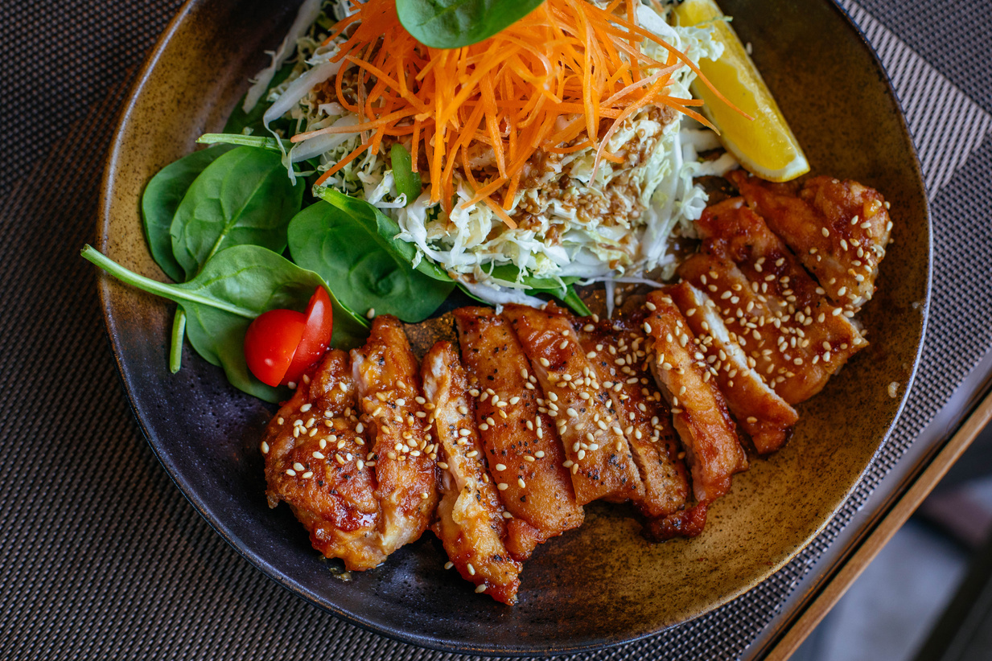
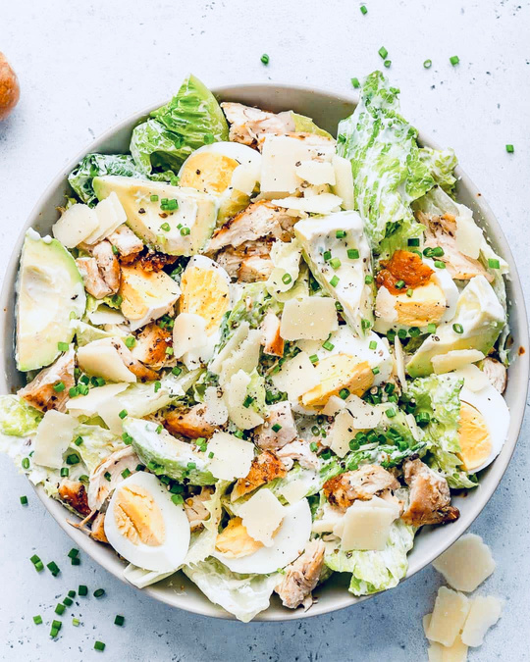


Objective
1. Digitalization of Menu & Ordering: Enable customers to seamlessly explore categorized food & beverage items, filter by dietary preferences (vegetarian vs. non-vegetarian), customize item quantities, and place orders digitally.
2. Real-Time Table Reservation System: Provide customers with an intuitive table booking interface to reserve dining tables in advance, specifying date, time slots, guest capacity, and special dining requests, thereby preventing double bookings and reducing table idle time.
3. Geospatial Distance & Delivery Tracking: Integrate location services and distance APIs to calculate precise delivery charges, estimate delivery lead times, and track delivery personnel dispatch in real time.
4. Multi-Role Operating Environment: Establish role-based access control (RBAC) accommodating Administrators, Kitchen Staff, Delivery Partners, and Customers with tailored dashboards and functional permissions.
5. Seamless Payment Gateway Integration: Support multi-channel payment flows, including Razorpay online transactions (Credit/Debit Card, UPI, Net Banking) and Cash on Delivery (COD), with robust status synchronization.
6. Quality Assurance & Customer Feedback: Incorporate post-order and post-dining feedback mechanisms to collect ratings and qualitative reviews, assisting management in continuous service enhancement.

Slide 6
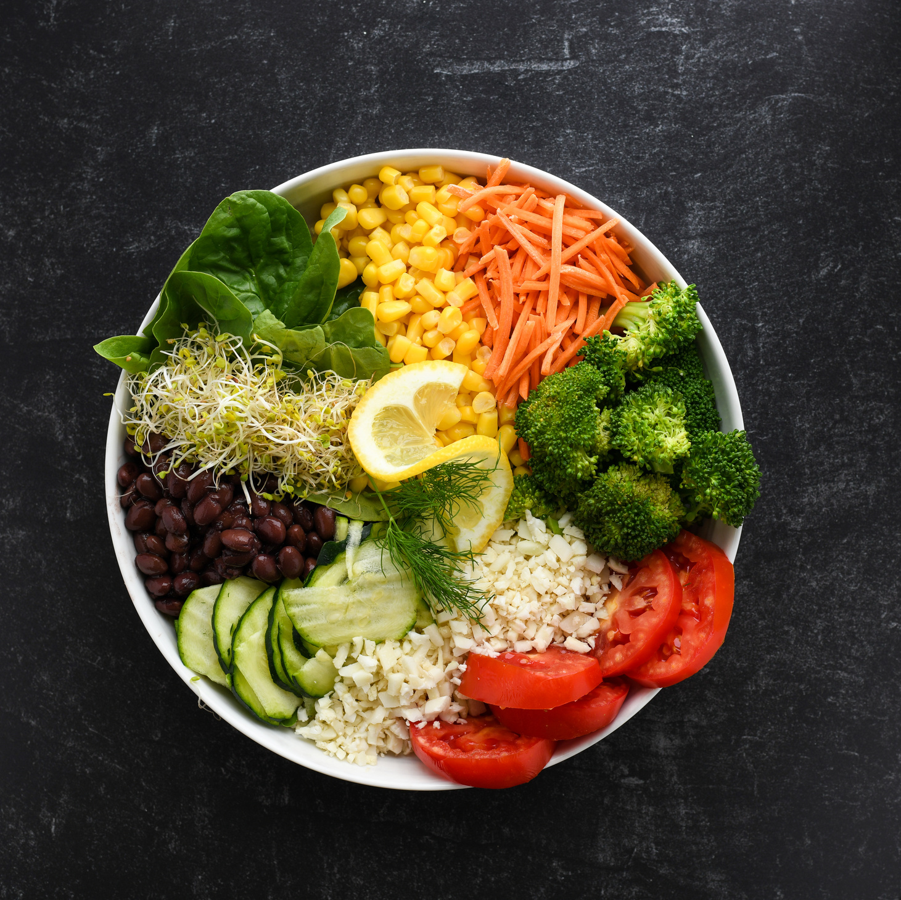
Core Components
1. Web Backend & Admin Subsystem (Laravel Framework)
2. Customer Android Mobile Application
3. Delivery Partner Subsystem
4. Database Subsystem (MySQL)
5. Geolocation & Payment API Integration Subsystems

Slide 7
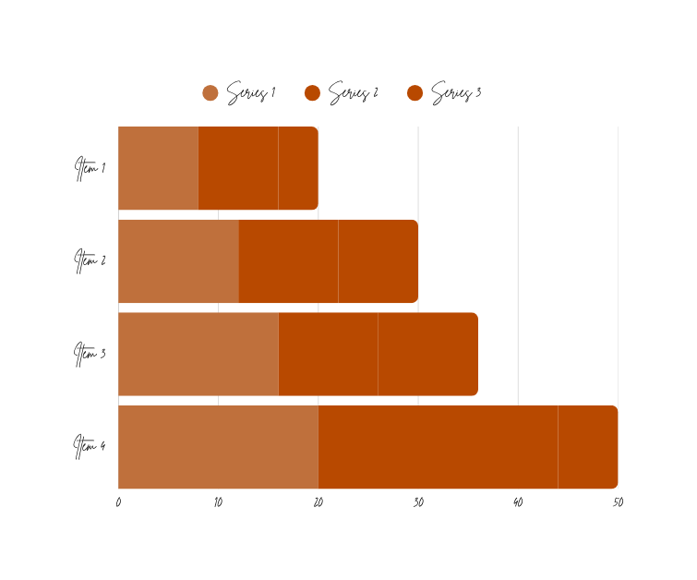
Minimum and Maximum Software/Hardware requirements
Component Layer | Specification Parameter | Minimum Requirement | Maximum / Recommended
Server Side (Web Backend) | Operating System | Ubuntu Linux 20.04 LTS | Ubuntu Linux 24.04 LTS / Cloud Server
Server Side (Web Backend) | CPU Processor | Dual-Core 2.0 GHz | Octa-Core 3.5 GHz+ (Intel Xeon / AMD EPYC)
Server Side (Web Backend) | System Memory (RAM) | 4 GB DDR4 | 16 GB+ DDR5
Server Side (Web Backend) | Storage Capacity | 30 GB SSD | 250 GB+ NVMe SSD
Server Side (Web Backend) | Software Stack | PHP 8.2, MySQL 8.0, Apache/NGINX | PHP 8.3+, MySQL 8.0+, NGINX, Redis Cache
Client Web Interface | Device & Display | Desktop/Laptop (1024x768 display) | Full HD 1080p Desktop/Laptop/Tablet
Client Web Interface | Browser Engine | Google Chrome 90+, Firefox 88+ | Latest Google Chrome / Safari / Edge
Client Web Interface | Network Bandwidth | 2 Mbps Broadband | 100 Mbps+ High-Speed Fiber
Client Mobile App (Android) | Mobile Device OS | Android 8.0 (Oreo / API Level 26) | Android 14 / 15 (Latest API)
Client Mobile App (Android) | Device Memory & Storage | 2 GB RAM, 100 MB free storage | 6 GB+ RAM, 500 MB free storage
Client Mobile App (Android) | Connectivity & GPS | 3G Mobile Data, Basic GPS | 4G LTE / 5G Network, Precision Dual-GPS

Slide 8
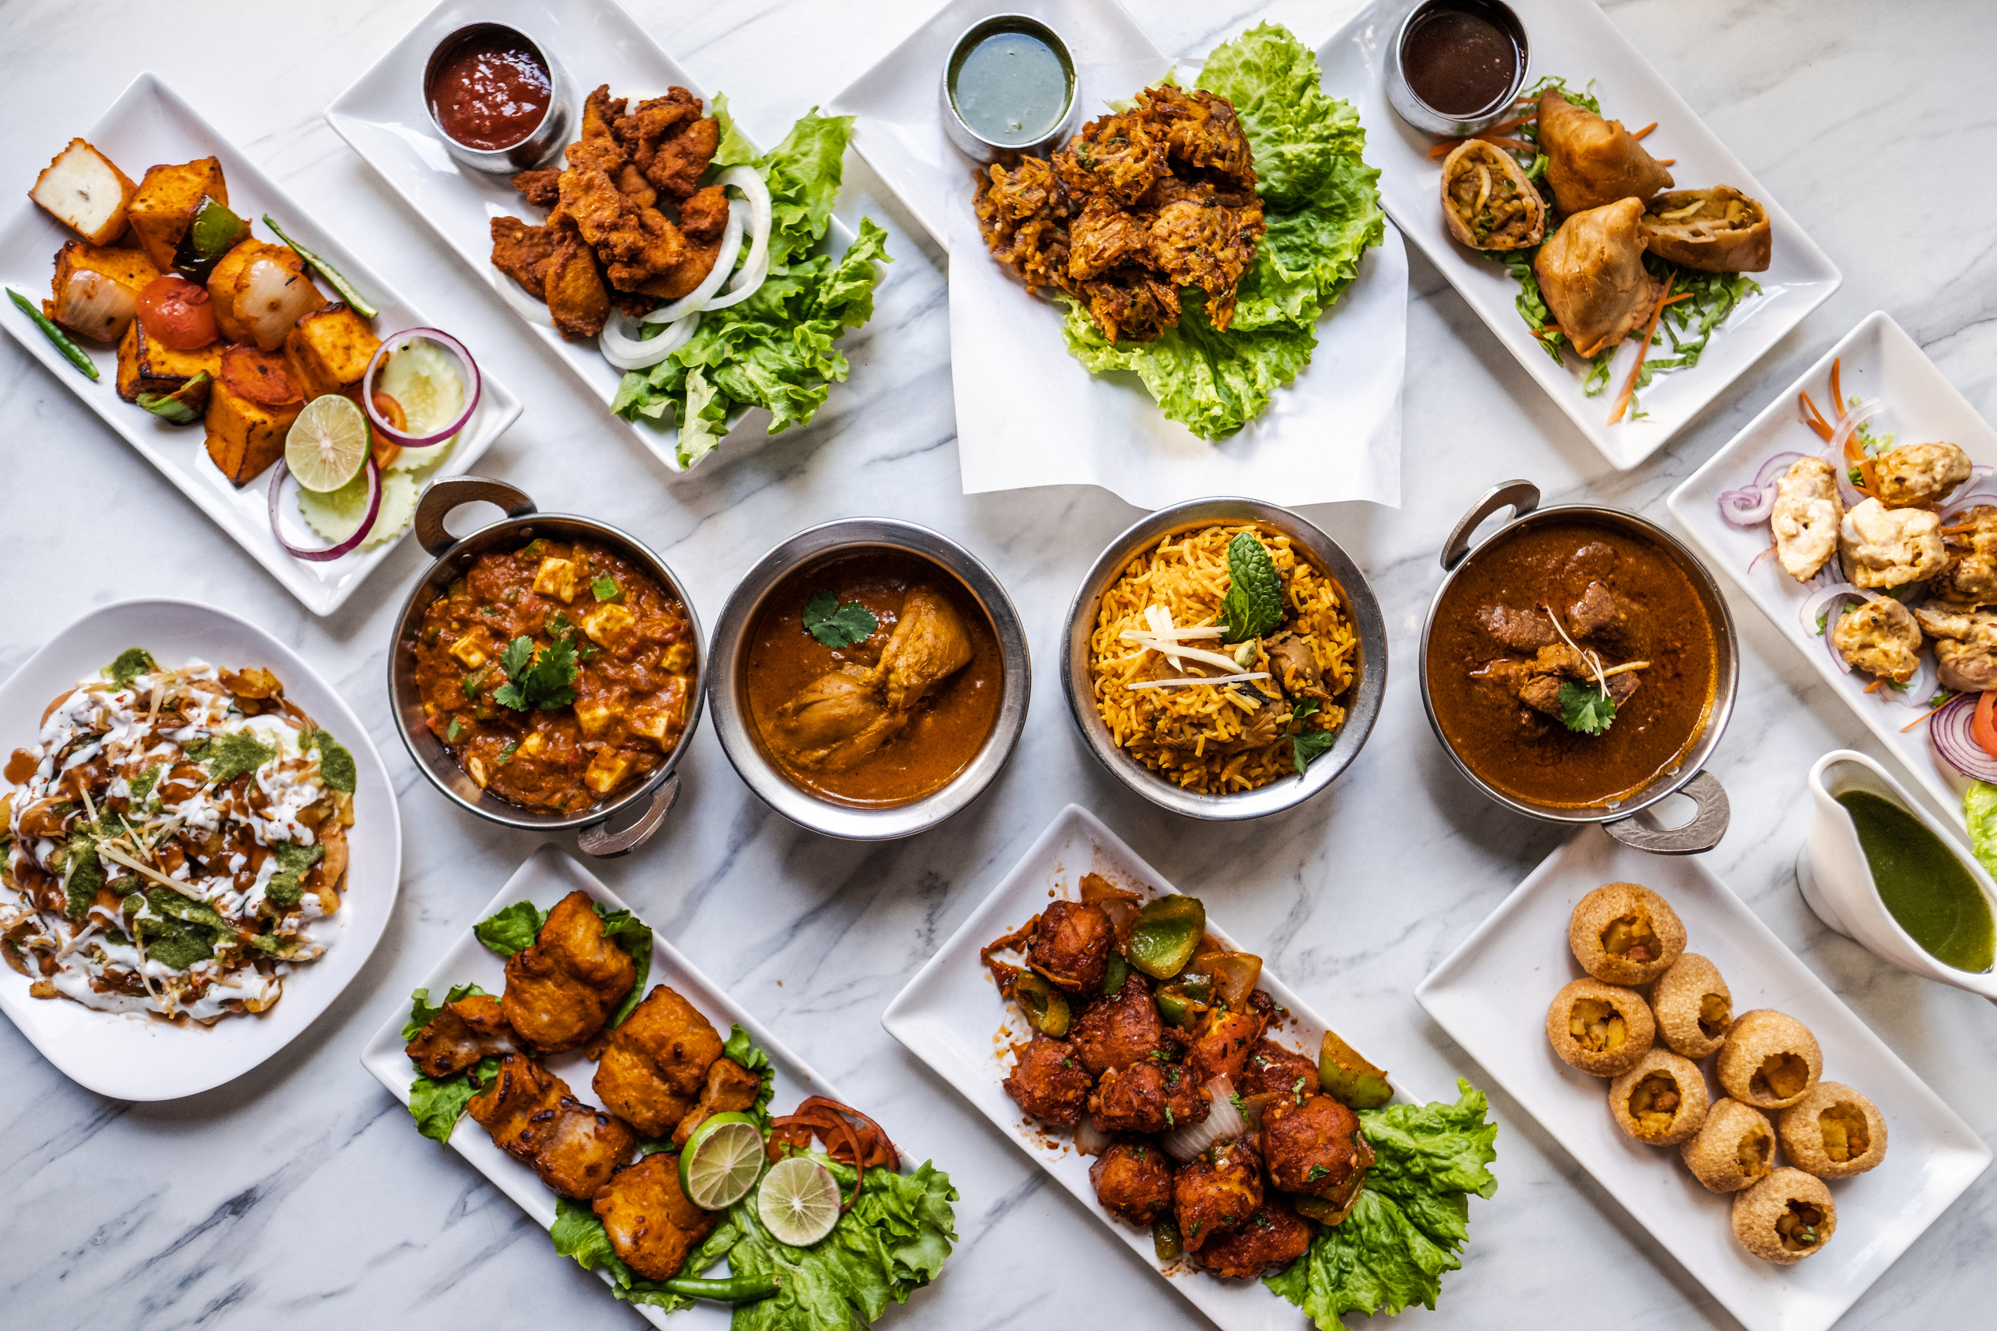

Advantages and Limitations of the Proposed System
• Automated Workflow & Error Reduction: Eliminates manual pen-and-paper order processing, preventing order misinterpretations, incorrect billing, and table booking overlaps.
• Enhanced Customer Convenience: Allows customers to place delivery orders or reserve dining tables anywhere, anytime via mobile app or web portal without waiting in long queues.
• Real-Time Order & Location Visibility: Provides step-by-step transparency from order placement to kitchen preparation, delivery dispatch, and real-time destination arrival.
• Integrated Payment Security: Eliminates cash dependency while guaranteeing PCI-DSS compliant online payment transactions powered by Razorpay signature verification.
• Centralized Business Intelligence: Equips restaurant managers with real-time revenue analytics, popular menu trends, active delivery person availability, and feedback metrics.

Slide 9
Limitations
• Internet Connectivity Reliance: Both web backend and mobile app interfaces require active internet connectivity; offline operation is limited to local cache viewing.
• Device Hardware Dependency: Delivery personnel and mobile app users require GPS-enabled Android smartphones with functional camera sensors for scanning/navigation.
• Initial Deployment & Training Effort: Requires initial configuration of server infrastructure, database migrations, and staff onboarding for kitchen and delivery workflows.

Slide 10
Requirement Determination
User Authentication & Authorization: The system shall allow users to register, log in, and manage profiles with role-based permissions (Customer, Admin, Delivery Person).
Category & Menu Management: Administrators shall be able to create, update, activate/deactivate menu categories and individual menu items with pricing, imagery, vegetarian flags, and availability status.
Cart & Checkout Processing: Customers shall be able to add menu items to a persistent shopping cart, modify item quantities, enter delivery addresses, and calculate taxes and delivery fees dynamically.
Table Reservation Management: Customers shall be able to book dining tables by selecting date, time slot, and guest count. The system shall validate table capacity and prevent conflicting reservations.
Order Processing & Tracking: The system shall process orders through distinct operational statuses ('Pending', 'Preparing', 'Out for Delivery', 'Delivered', 'Cancelled') and reflect changes across customer and admin dashboards.
Delivery Partner Assignment & Distance Computation: Administrators shall assign available delivery personnel to pending orders. The system shall calculate geographical distance to compute delivery fees and estimated transit times.
Payment Processing: The system shall support Cash on Delivery (COD) and online payments via Razorpay API, verifying transaction IDs cryptographically before order completion.
Feedback & Rating Mechanism: Customers shall be able to submit star ratings (1 to 5) and textual reviews for completed orders and dining experiences.

Slide 11
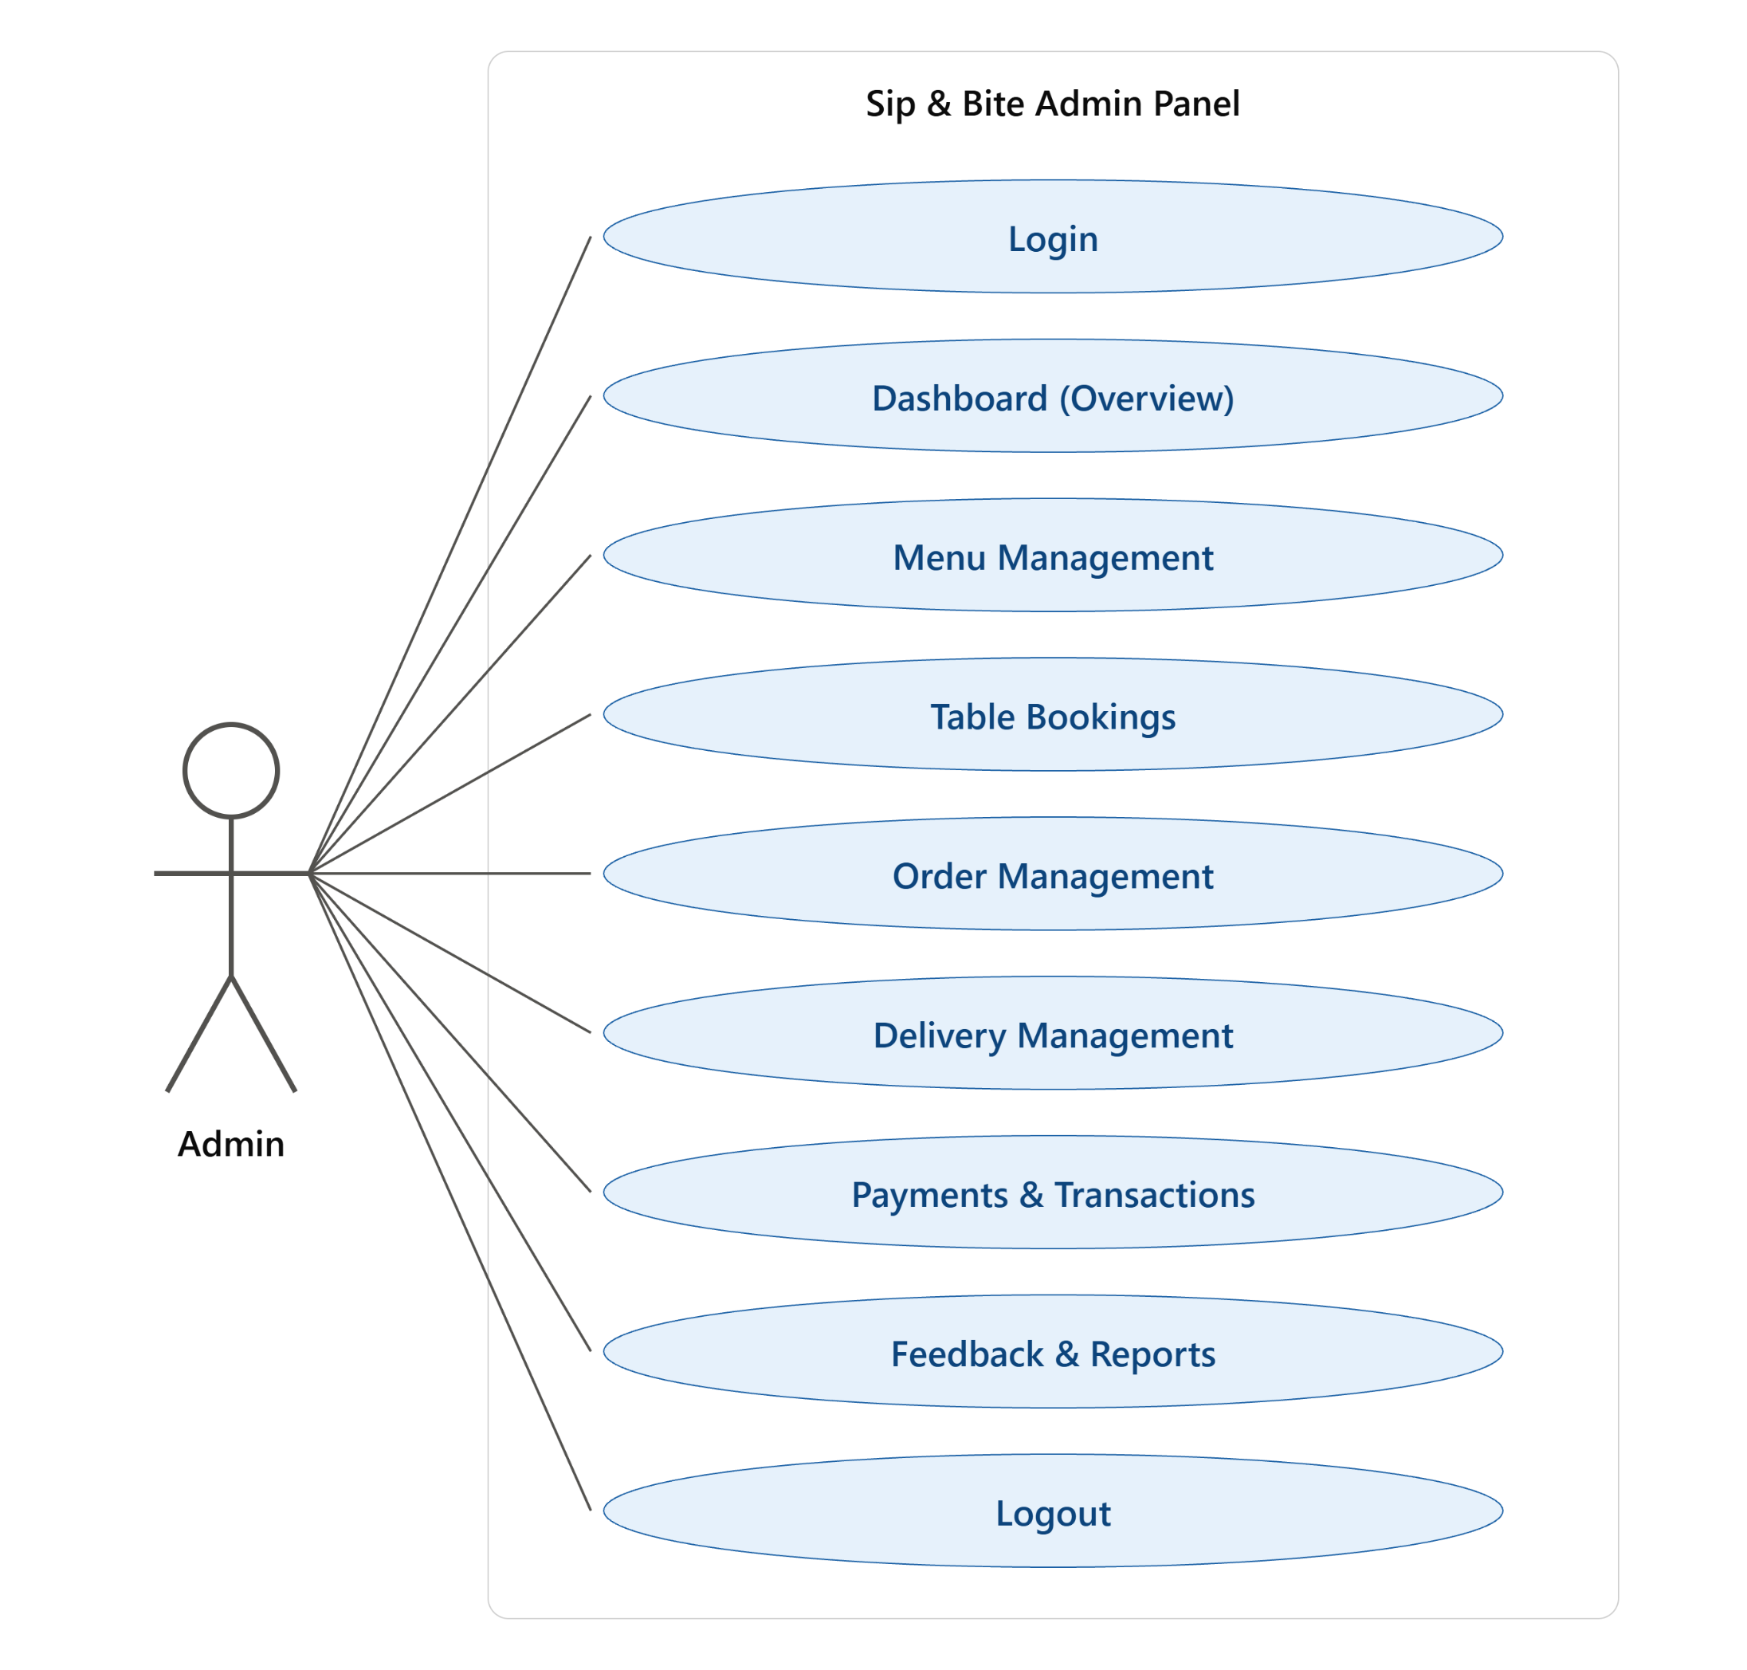

Use Case Diagram

Slide 12
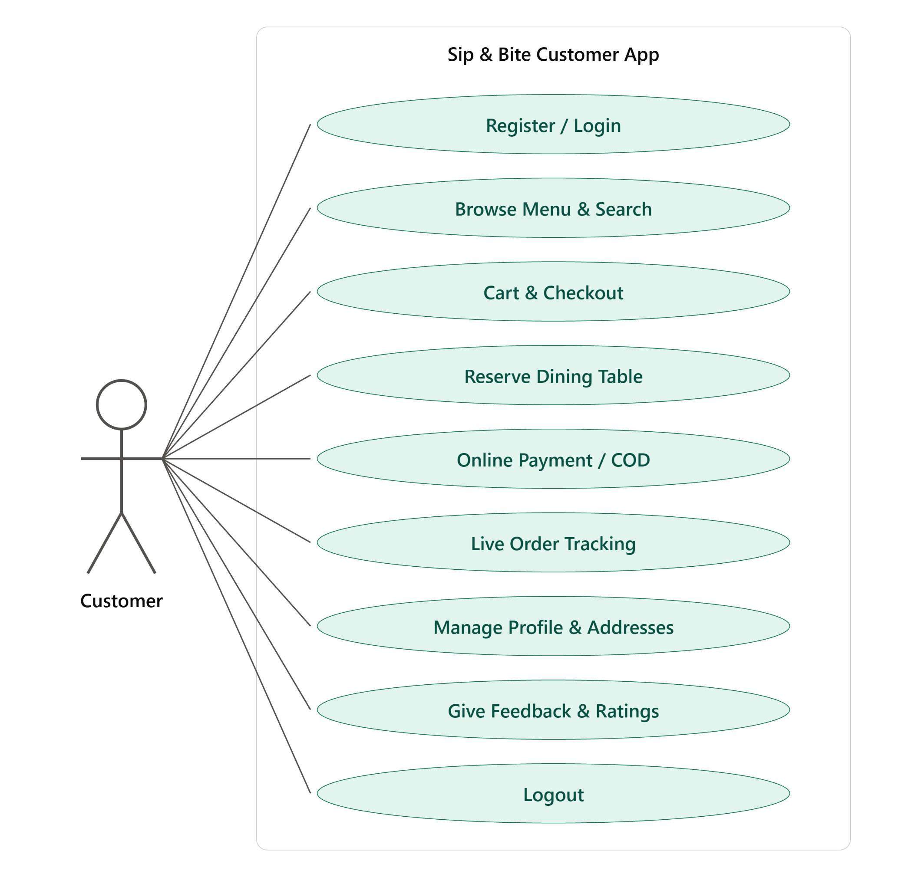
Use Case Diagram

Slide 13
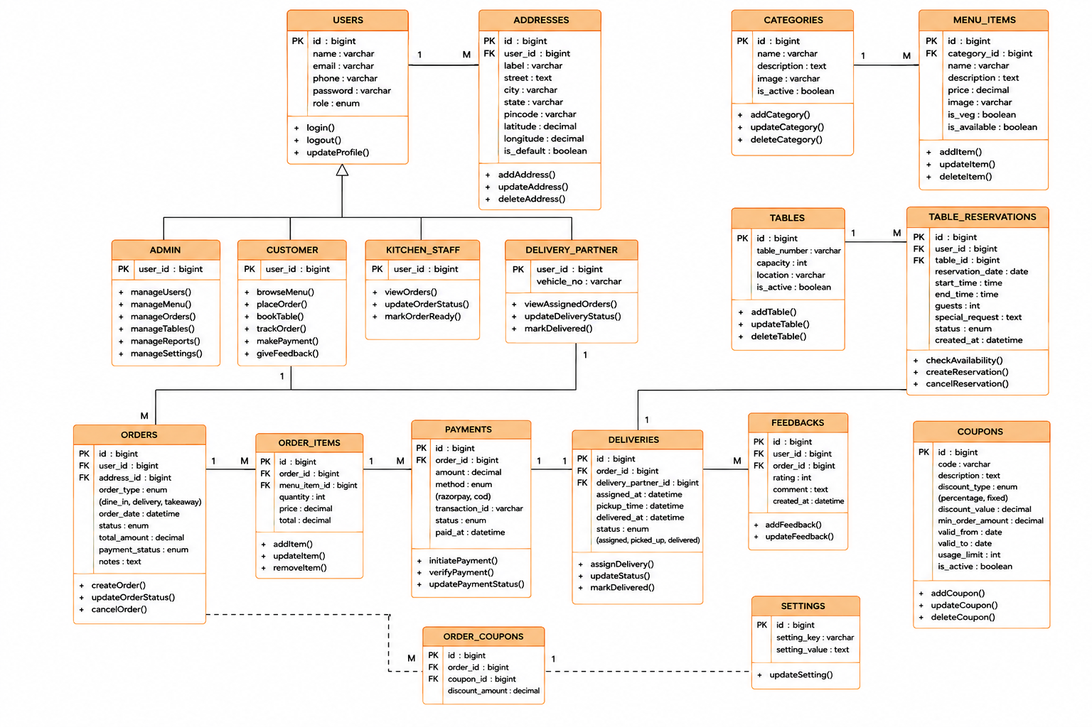
Class Diagram

Slide 14
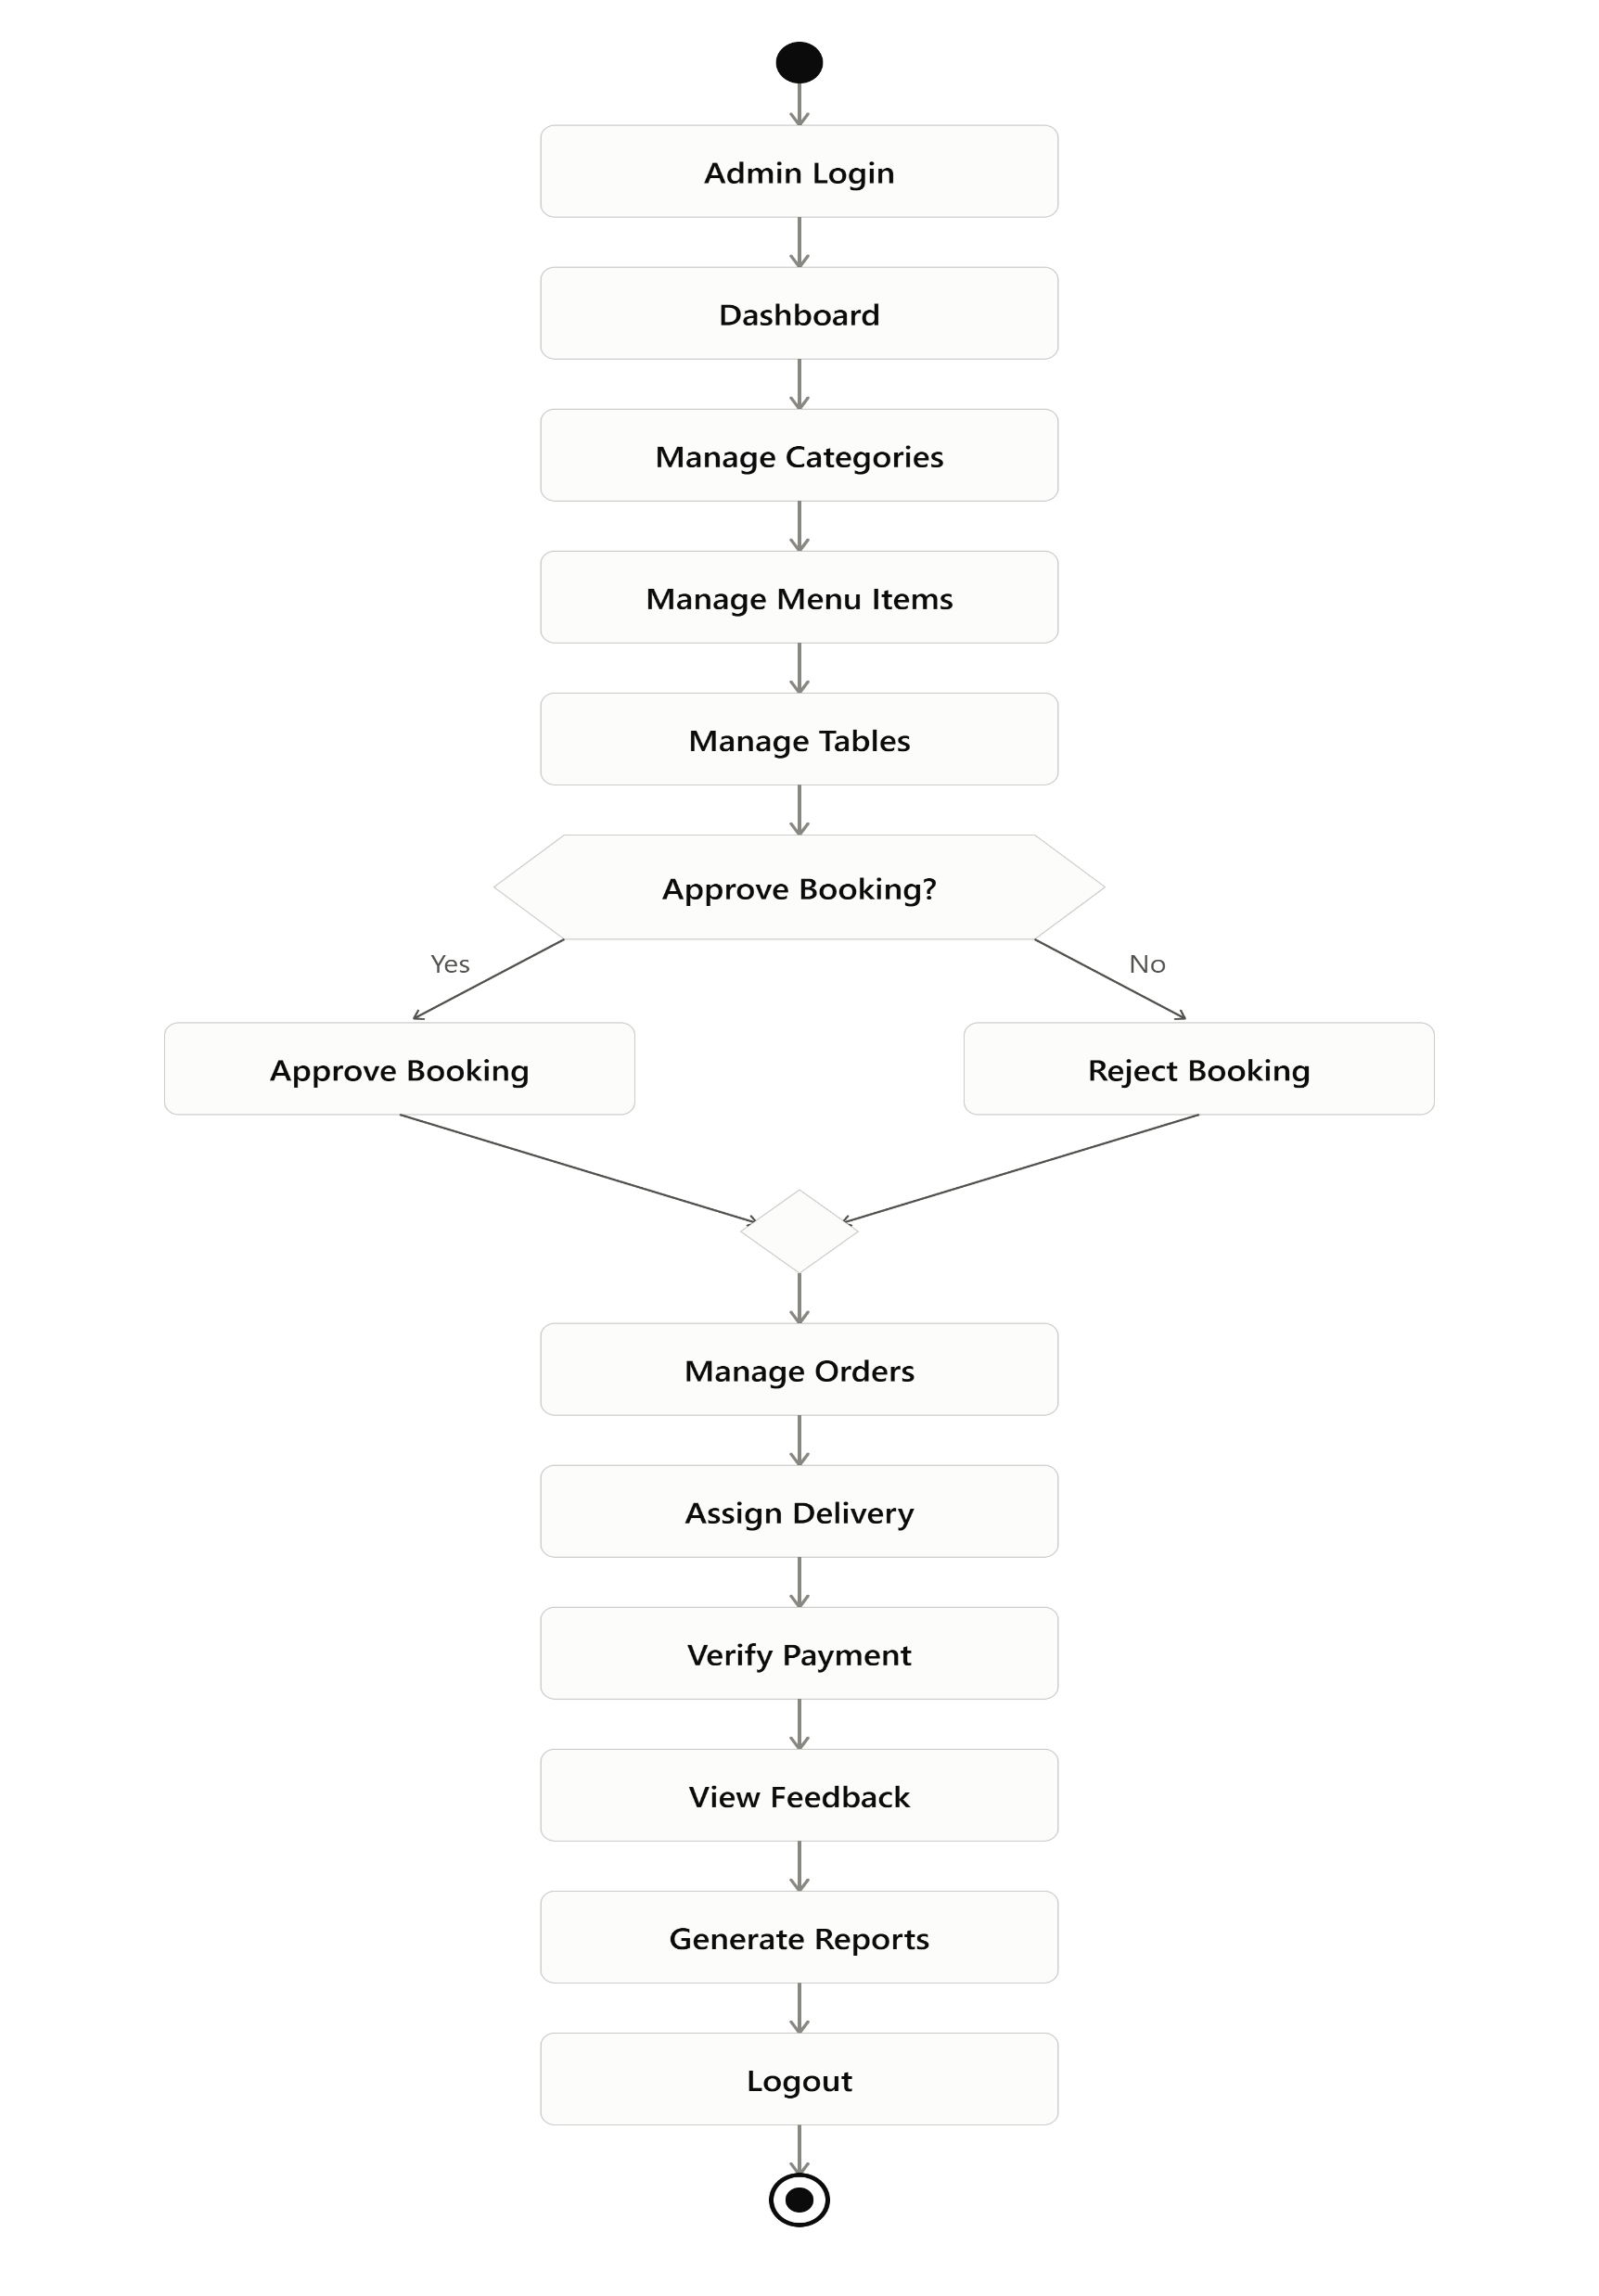
Admin Activity Diagram

Slide 15
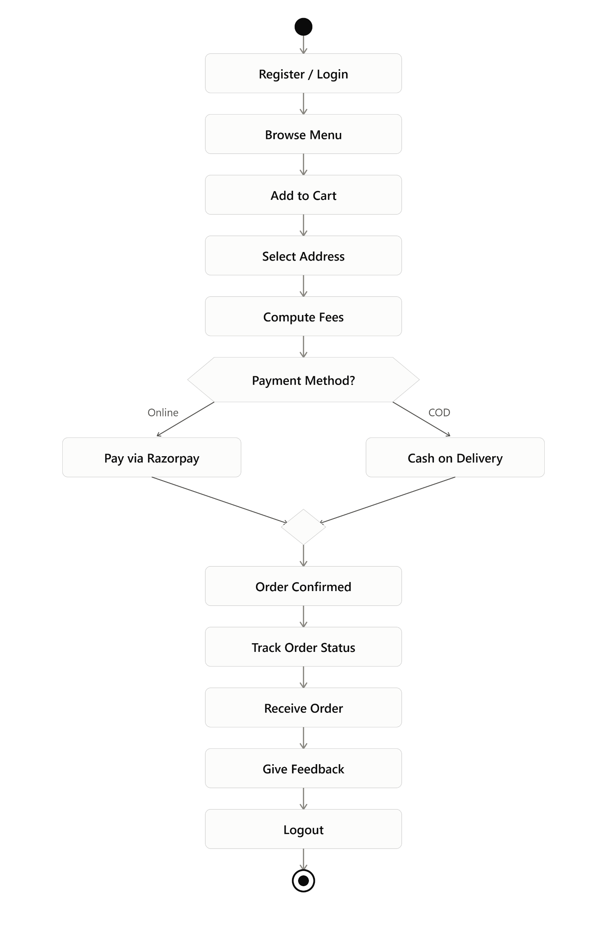
User Activity Diagram

Slide 16
Targeted Users
User Category | Target Roles | Primary System Objectives | Key System Functions Utilized
System Administrator | Restaurant Owner, Managers, Head Chefs | Oversee restaurant business, manage menu offerings, monitor table bookings, assign delivery staff, view financial analytics. | Admin Web Dashboard, Menu CRUD, Table Booking Approval, Delivery Assignment, Revenue Analytics.
End Customer | Dine-in Guests, Takeaway & Delivery Clients | Browse food options, place food delivery orders, reserve dining tables, pay online, track live orders, provide feedback. | Android Mobile App, Web Client, Cart & Checkout, Table Booking, Razorpay Gateway, Order Tracking, Feedback.
Delivery Personnel | In-house Drivers, Courier Partners | Receive delivery assignments, view customer locations, navigate transit routes, deliver orders, update fulfillment status. | Android Mobile App (Delivery Module), Order Accept/Status Toggle, Distance Tracking, COD Payment Collection.

Slide 17
System Design
User Category | Target Roles | Primary System Objectives | Key System Functions Utilized
System Administrator | Restaurant Owner, Managers, Head Chefs | Oversee restaurant business, manage menu offerings, monitor table bookings, assign delivery staff, view financial analytics. | Admin Web Dashboard, Menu CRUD, Table Booking Approval, Delivery Assignment, Revenue Analytics.
End Customer | Dine-in Guests, Takeaway & Delivery Clients | Browse food options, place food delivery orders, reserve dining tables, pay online, track live orders, provide feedback. | Android Mobile App, Web Client, Cart & Checkout, Table Booking, Razorpay Gateway, Order Tracking, Feedback.
Delivery Personnel | In-house Drivers, Courier Partners | Receive delivery assignments, view customer locations, navigate transit routes, deliver orders, update fulfillment status. | Android Mobile App (Delivery Module), Order Accept/Status Toggle, Distance Tracking, COD Payment Collection.

Slide 18
Data Dictionary
Users
Field Name | Data Type | Key / Constraints | Description & Purpose
id | BIGINT UNSIGNED | PRIMARY KEY, AUTO_INC | Unique user account identifier
name | VARCHAR(255) | None | Full name of the user
email | VARCHAR(255) | UNIQUE | User email address for login
email_verified_at | TIMESTAMP | None | Timestamp when email was verified
password | VARCHAR(255) | None | Bcrypt hashed account password
phone | VARCHAR(20) | None | Contact phone number
role | ENUM('admin','customer','delivery') | DEFAULT 'customer' | System access role
remember_token | VARCHAR(100) | None | Session remember token
created_at / updated_at | TIMESTAMP | None | Record creation and modification timestamps

Slide 19
Data Dictionary
categories
Field Name | Data Type | Key / Constraints | Description & Purpose
id | BIGINT UNSIGNED | PRIMARY KEY, AUTO_INC | Unique user account identifier
name | VARCHAR(255) | None | Full name of the user
email | VARCHAR(255) | UNIQUE | User email address for login
email_verified_at | TIMESTAMP | None | Timestamp when email was verified
password | VARCHAR(255) | None | Bcrypt hashed account password
phone | VARCHAR(20) | None | Contact phone number
role | ENUM('admin','customer','delivery') | DEFAULT 'customer' | System access role
remember_token | VARCHAR(100) | None | Session remember token
created_at / updated_at | TIMESTAMP | None | Record creation and modification timestamps

Slide 20
Data Dictionary
menu_items
Field Name | Data Type | Key / Constraints | Description & Purpose
id | BIGINT UNSIGNED | PRIMARY KEY, AUTO_INC | Unique menu item identifier
category_id | BIGINT UNSIGNED | FOREIGN KEY (categories.id) | Parent category reference
name | VARCHAR(255) | None | Name of the dish or drink
description | TEXT | None | Ingredients and dish details
price | DECIMAL(10,2) | None | Item unit price in local currency
image | VARCHAR(255) | None | Path to item photo asset
is_available | BOOLEAN | DEFAULT TRUE | Current kitchen availability flag
is_veg | BOOLEAN | DEFAULT TRUE | Vegetarian (True) vs Non-Veg (False)
rating | DECIMAL(3,2) | DEFAULT 4.50 | Aggregated star rating score
created_at / updated_at | TIMESTAMP | None | Audit timestamps

Slide 21
Data Dictionary
tables
Field Name | Data Type | Key / Constraints | Description & Purpose
id | BIGINT UNSIGNED | PRIMARY KEY, AUTO_INC | Unique table identifier
table_number | VARCHAR(50) | UNIQUE | Table identifier number or code
capacity | INT | None | Maximum seating capacity
location | VARCHAR(100) | None | Table location (Indoor, Terrace, VIP)
status | ENUM('available','booked','maintenance') | DEFAULT 'available' | Current operational table status
created_at / updated_at | TIMESTAMP | None | Audit timestamps

Slide 22
Data Dictionary
table_bookings
Field Name | Data Type | Key / Constraints | Description & Purpose
id | BIGINT UNSIGNED | PRIMARY KEY, AUTO_INC | Unique booking reservation ID
user_id | BIGINT UNSIGNED | FOREIGN KEY (users.id) | Customer who made reservation
table_id | BIGINT UNSIGNED | FOREIGN KEY (tables.id) | Assigned physical table reference
booking_date | DATE | None | Reserved dining date
booking_time | VARCHAR(50) | None | Reserved dining time slot
guests_count | INT | None | Number of guests attending
special_request | TEXT | None | Dietary/seating preferences
status | ENUM('pending','confirmed','completed','cancelled') | DEFAULT 'pending' | Booking fulfillment status
created_at / updated_at | TIMESTAMP | None | Audit timestamps

Slide 23
Data Dictionary
delivery_persons
Field Name | Data Type | Key / Constraints | Description & Purpose
id | BIGINT UNSIGNED | PRIMARY KEY, AUTO_INC | Unique delivery staff profile ID
user_id | BIGINT UNSIGNED | FOREIGN KEY (users.id) | Linked user account ID
vehicle_type | VARCHAR(50) | None | Type of vehicle (Bike, Scooter)
vehicle_number | VARCHAR(50) | None | Vehicle license plate number
current_lat | DECIMAL(10,8) | None | Live GPS latitude coordinate
current_lng | DECIMAL(11,8) | None | Live GPS longitude coordinate
is_available | BOOLEAN | DEFAULT TRUE | Staff active duty status
created_at / updated_at | TIMESTAMP | None | Audit timestamps

Slide 24
Data Dictionary
addresses
Field Name | Data Type | Key / Constraints | Description & Purpose
id | BIGINT UNSIGNED | PRIMARY KEY, AUTO_INC | Unique address identifier
user_id | BIGINT UNSIGNED | FOREIGN KEY (users.id) | Customer owning address
address_line | TEXT | None | Street address and landmark
city | VARCHAR(100) | None | City name
state | VARCHAR(100) | None | State / Province name
pincode | VARCHAR(20) | None | Postal code / Zip code
lat | DECIMAL(10,8) | None | Geocoded latitude coordinate
lng | DECIMAL(11,8) | None | Geocoded longitude coordinate
is_default | BOOLEAN | DEFAULT FALSE | Primary address indicator
created_at / updated_at | TIMESTAMP | None | Audit timestamps

Slide 25
Data Dictionary
orders
Field Name | Data Type | Key / Constraints | Description & Purpose
id | BIGINT UNSIGNED | PRIMARY KEY, AUTO_INC | Unique order record identifier
order_number | VARCHAR(255) | UNIQUE | Human readable order number (e.g., ORD1001)
user_id | BIGINT UNSIGNED | FOREIGN KEY (users.id) | Customer placing order
delivery_person_id | BIGINT UNSIGNED | FOREIGN KEY (delivery_persons.id) | Assigned delivery agent ID
address_id | BIGINT UNSIGNED | FOREIGN KEY (addresses.id) | Target delivery destination
subtotal | DECIMAL(10,2) | None | Sum of menu item prices
tax | DECIMAL(10,2) | DEFAULT 0.00 | Applied tax amount
delivery_fee | DECIMAL(10,2) | DEFAULT 0.00 | Distance computed delivery fee
total_amount | DECIMAL(10,2) | None | Final order grand total
payment_method | ENUM('COD','Razorpay') | DEFAULT 'COD' | Selected payment channel
payment_status | ENUM('pending','paid','failed') | DEFAULT 'pending' | Payment settlement status
razorpay_order_id | VARCHAR(255) | None | External Razorpay order ID
razorpay_payment_id | VARCHAR(255) | None | External Razorpay transaction reference
order_status | ENUM('Pending','Preparing','Out for Delivery','Delivered','Cancelled') | DEFAULT 'Pending' | Current fulfillment stage
notes | TEXT | None | Customer cooking/delivery instructions
created_at / updated_at | TIMESTAMP | None | Audit timestamps

Slide 26
Data Dictionary
order_items
Field Name | Data Type | Key / Constraints | Description & Purpose
id | BIGINT UNSIGNED | PRIMARY KEY, AUTO_INC | Unique order item line ID
order_id | BIGINT UNSIGNED | FOREIGN KEY (orders.id) | Parent order reference
menu_item_id | BIGINT UNSIGNED | FOREIGN KEY (menu_items.id) | Ordered menu item reference
quantity | INT | None | Quantity of dish ordered
unit_price | DECIMAL(10,2) | None | Price per unit at order time
total_price | DECIMAL(10,2) | None | Total line cost (quantity * unit_price)
created_at / updated_at | TIMESTAMP | None | Audit timestamps

Slide 27
Data Dictionary
payments
Field Name | Data Type | Key / Constraints | Description & Purpose
id | BIGINT UNSIGNED | PRIMARY KEY, AUTO_INC | Unique payment record ID
order_id | BIGINT UNSIGNED | FOREIGN KEY (orders.id) | Associated order ID
transaction_id | VARCHAR(255) | UNIQUE | Gateway payment transaction code
payment_method | VARCHAR(50) | None | Payment channel (COD / UPI / Card)
amount | DECIMAL(10,2) | None | Total monetary amount processed
status | ENUM('pending','success','failed') | DEFAULT 'pending' | Final payment gateway verification state
created_at / updated_at | TIMESTAMP | None | Audit timestamps

Slide 28
Data Dictionary
feedback
Field Name | Data Type | Key / Constraints | Description & Purpose
id | BIGINT UNSIGNED | PRIMARY KEY, AUTO_INC | Unique feedback record ID
user_id | BIGINT UNSIGNED | FOREIGN KEY (users.id) | Customer submitting review
order_id | BIGINT UNSIGNED | FOREIGN KEY (orders.id) | Associated order ID
rating | INT | Check (1 to 5) | Star rating given (1 to 5)
comments | TEXT | None | Qualitative review comment text
created_at / updated_at | TIMESTAMP | None | Audit timestamps

Slide 29


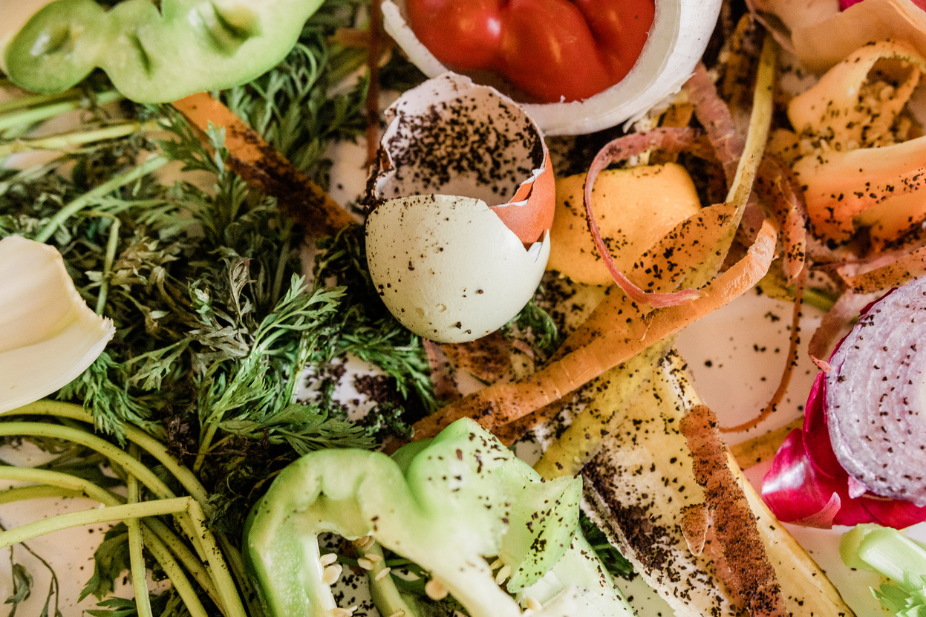
Limitations
• Internet connectivity is required for most operations.
• Delivery tracking depends on GPS-enabled devices.
• Initial server setup, database migration and staff training are required.
• Razorpay and distance APIs require correct configuration.

Slide 30
THANK YOU
for listening to our presentation

