Slide 1
Citadel (Book search website)
Yash Patel - 200403570 - ynp062@uregina.ca
Jaydeep Lakhani - 200418547 - jli530@uregina.ca

Slide 2
The idea was to create a system that would enable users to share their material with others by uploading the book's cover image and a brief summary so that other users could learn more about the book before they read it.
NOTE: This is a book explorer and doesn't have a viewable book feature to the system. This system is only for authors/users who want to see who has written what type of book and not the content inside the book. Please use 1920x1080 or more for better experience.
Problem Definition

Slide 3
By releasing comprehensive summaries of their books, writers may reach out to more readers. Users who want to do pre-reading about books can glance at the brief description of the book to determine whether the topic interests them enough to read the entire book.
Better user interface than existing solutions.
Motivations

Slide 4
Use Case Diagram
(Citadel System)

Slide 5
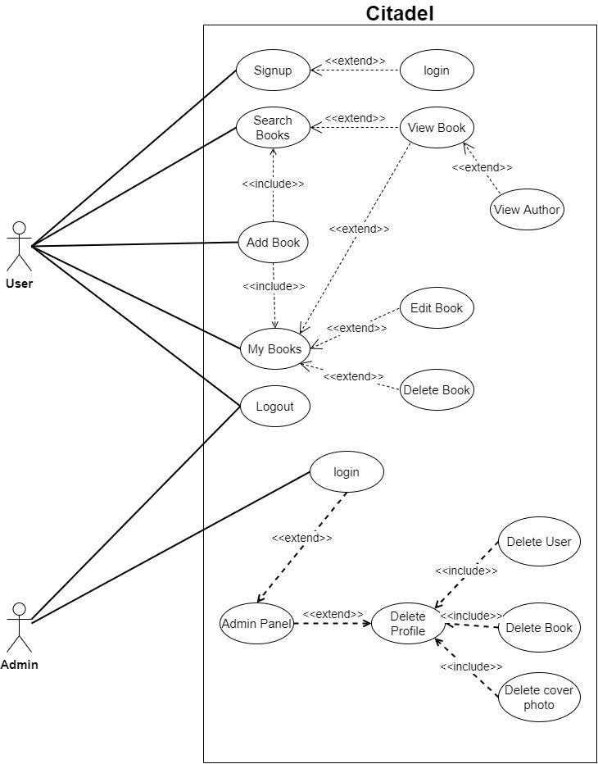

Slide 6
MVC Architecture
(Citadel System)

Slide 7
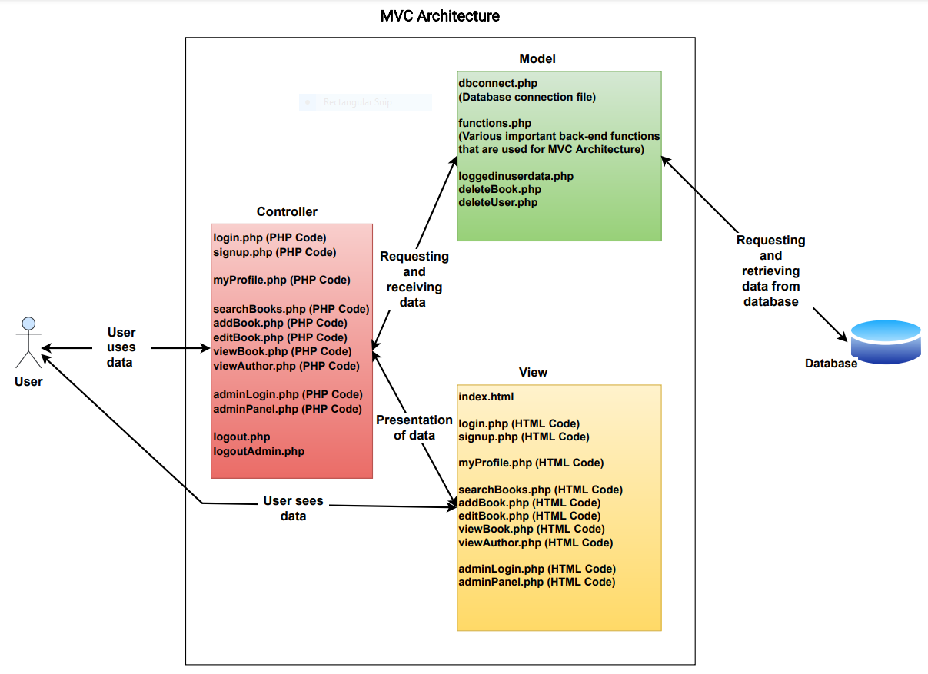

Slide 8
Design Patterns
(Citadel System)

Slide 9
Examples of such files that have an Observer Pattern are listed below:
login.php, signup.php, addBook.php, deleteBook.php, viewBook.php
the core functions are implemented in functions.php
Examples of such files that have a Simple Factory Pattern are listed below:
deleteBook.php, signup.php, addBook.php, viewAuthor.php
the core functions are implemented in functions.php
Observer Pattern
Factory Pattern

Slide 10
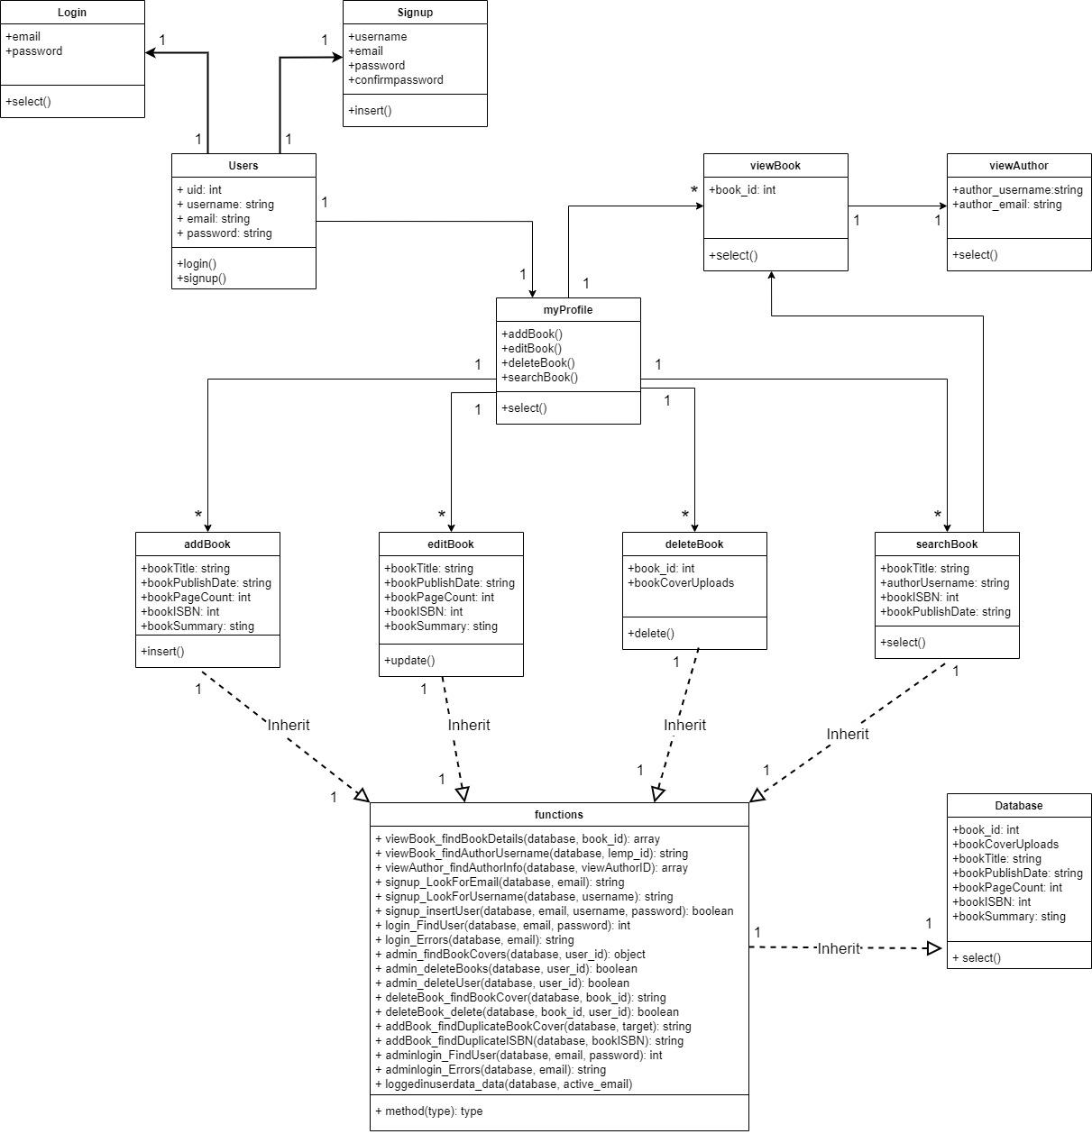

Slide 11
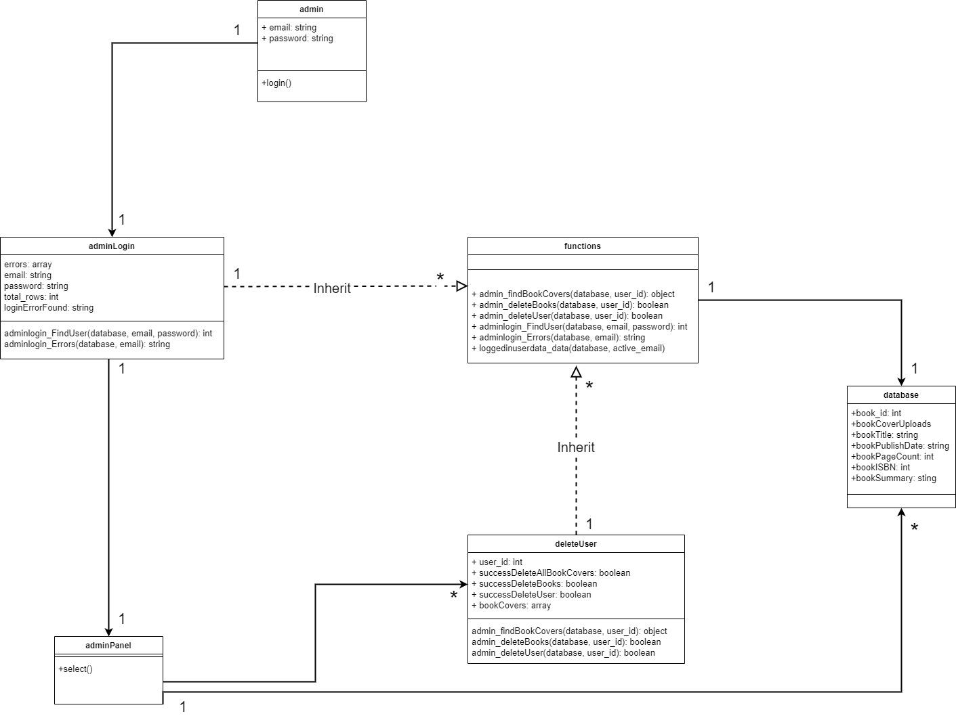

Slide 12
List of software development tools
HTML5 CSS Javascript PHP MySQL | Visual Studio Code Regex Draw.io Coolors.co Google Pagespeed Google Chrome

Slide 13
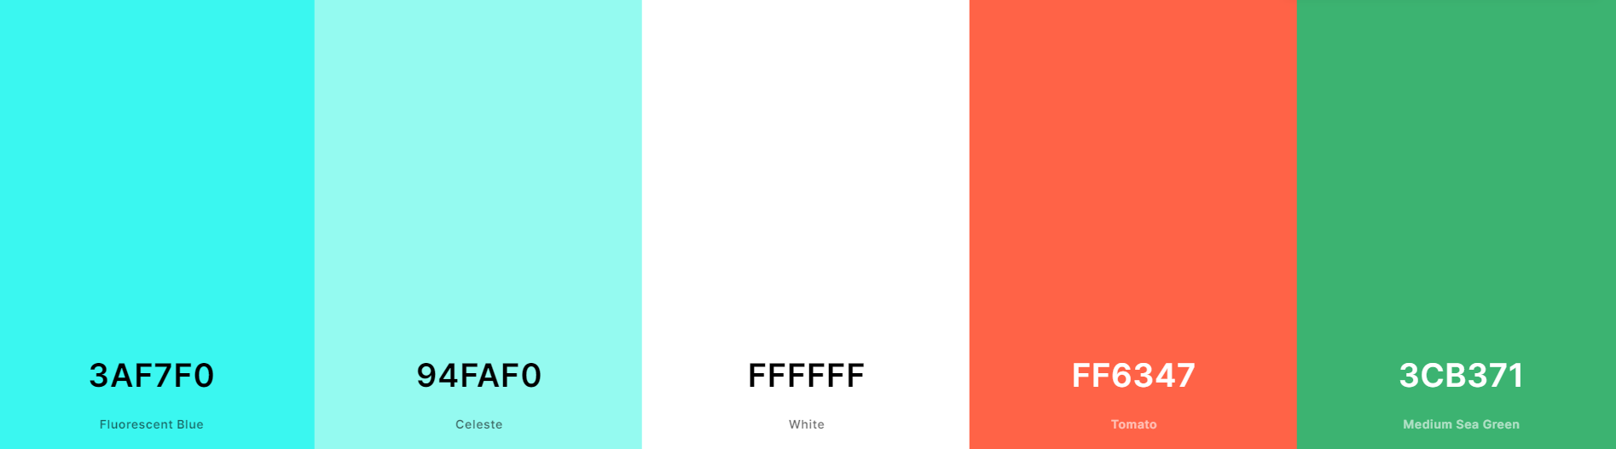

Slide 14
Thank You !

