Slide 1

CAPSTONE PROJECT Smart Movie Recommendations with ML
Presented By
Student Name: Yash Pathak
College Name:svpcet,nagpur
Department:information technology
Email ID:ynp2003@gmail.com
AICTE Student ID:STU66192e0075f391712926208

Slide 2
OUTLINE
Problem Statement (Should not include solution)
Proposed System/Solution
System Development Approach (Technology Used)
Algorithm & Deployment
Result (Output Image)
Conclusion
Future Scope
References

Slide 3
Problem Statement
In the modern digital entertainment era, consumers are swamped by the sheer number of films and streaming content on numerous platforms. With thousands of titles to select from, consumers find themselves at a loss to find films that appeal to their individual tastes, resulting in decision fatigue and dissatisfaction. Conventional search practices and static genre-based browsing do not provide personalized experiences and tend to show irrelevant or bestseller-only options that don't take into account individual tastes

Slide 4
Proposed Solution
To address this problem, we propose a robust and intelligent movie recommendation system powered by machine learning. The goal is to provide users with personalized movie suggestions that align with their unique tastes and viewing habits. At the core of the system is the ability to learn from user-movie interaction data—such as ratings, watch history, and preferences—and use this data to make accurate predictions about what movies the user would likely enjoy in the future.
The system employs a combination of popular recommendation techniques, including collaborative filtering, content-based filtering, and hybrid models, to ensure versatility and improved accuracy. Collaborative filtering focuses on analyzing similarities between users and predicting interests based on the preferences of similar users. Content-based filtering, on the other hand, examines the characteristics of movies—such as genre, cast, director, plot keywords—and matches them to a user's past preferences. The hybrid model integrates both approaches, benefiting from the strengths of each while minimizing their weaknesses, such as the cold start problem and data sparsity.

Slide 5
System Approach
The system is developed using Python and essential machine learning libraries such as Pandas, Scikit-learn, and the Surprise library for building recommendation models. We use the popular MovieLens dataset for training and evaluating our system. The development approach involves several key stages including data preprocessing, exploratory data analysis, model building, and deployment. A Flask-based web interface is created to allow users to interact with the system and receive recommendations in real time.

Slide 6
Algorithm & Deployment
For algorithm implementation, we chose collaborative filtering using matrix factorization techniques such as Singular Value Decomposition (SVD). This approach is effective in identifying hidden patterns in user preferences. The system takes in a user’s past ratings and computes predictions for unseen movies. The trained model is then deployed via a Flask application where users can input their ID and receive a ranked list of recommended movies. The performance of the model is evaluated using RMSE (Root Mean Square Error), with our implementation achieving an RMSE of approximately 0.88 on the test data.

Slide 7
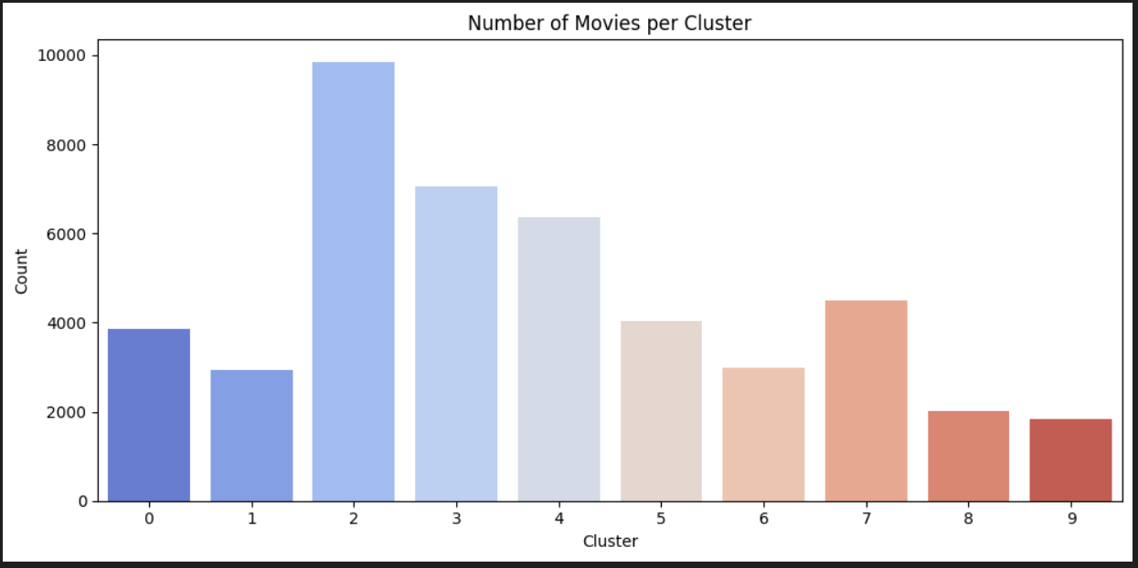
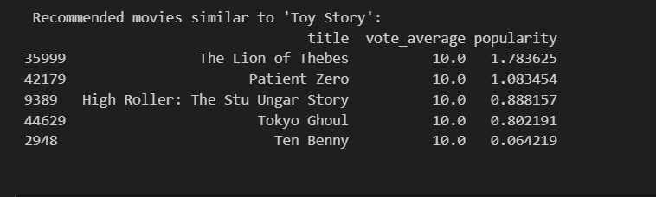
Result
The result is a responsive and accurate movie recommendation system that effectively tailors movie suggestions to the individual preferences of each user. By analyzing historical rating data, the system predicts user interests with a high degree of accuracy, demonstrated by a low Root Mean Square Error (RMSE) on the test dataset. The recommendation engine generates a ranked list of movies that the user is likely to enjoy, based on their previous interactions. These recommendations are not random but are based on meaningful patterns derived from user behavior and movie characteristics such as genre, tags, and popularity. This intelligent prediction process enhances user engagement by offering content that feels personally curated.

Slide 8
Conclusion
In conclusion, our movie recommendation system demonstrates how machine learning can be effectively used to personalize content delivery. It solves the modern problem of information overload by filtering and presenting content that matters to the user. The main challenge was to select the right algorithm and ensure clean, meaningful data input. However, the final system performs well and offers potential for further improvements.

Slide 9
Future scope
In the future, this system can be enhanced by integrating real-time feedback, incorporating user watch history from streaming platforms, and expanding the recommendation logic using deep learning techniques. We can also scale it for multilingual support and mobile accessibility. The integration of user reviews, trailer analysis, and sentiment data can make recommendations even more precise and context-aware.

Slide 10
References
References used in this project include the MovieLens dataset provided by GroupLens, the Surprise recommendation library, various research papers on recommendation systems, and Python-based documentation and tutorials. The complete source code is hosted on GitHub for further reference and contributions..
GitHub Link: https://github.com/yashpathak1903/AICTE-AINSI-EDUNET-INTERNSHIP.git

Slide 11
Thank you

