Slide 1
RTAPS
Procedures that adapt to your operators
Real-Time Adaptive Procedure System · Briefing for the Shell facility team
Notes:
10–15 seconds. Today I want to show you a system we call RTAPS. The simple idea behind it: the manual that an operator follows should adapt to how hard they're concentrating, instead of showing the same instructions to everyone every time.

Slide 2
The challenge today
Every operator is different. Every step is different.
• Some procedure steps are routine; others demand intense focus.
• The same operator can struggle on Step 6 today and breeze through it tomorrow.
• New operators need more detail. Experienced operators don't want clutter.
• Today's displays show the same instructions to everyone, every time.
RTAPS — Real-Time Adaptive Procedure System
2 / 17
Notes:
Picture this — your most experienced operator and a brand-new operator both pick up the same procedure today. The screen shows them the exact same text. The expert finds it patronising; the newcomer is overwhelmed. And even the same person on different days can find the same step easy or hard depending on fatigue and distractions. Today's systems don't respond to it.

Slide 3
The RTAPS idea, in one sentence
The screen quietly senses when the operator is working hard, and shows them more help right at that moment.
• No buttons to press
• No questions to answer
• No interruptions
RTAPS — Real-Time Adaptive Procedure System
3 / 17
Notes:
That's it. That's the pitch. Everything else in this deck is just *how* we do this. The operator never has to ask for help — the screen offers it when they need it, and gets out of the way when they don't.

Slide 4
How does the system know? It watches the eyes.
The eyes give away how hard the mind is working.
Pupil size grows
Blinking slows down
When you concentrate, your pupils dilate slightly — like a camera lens opening in low light.
During deep focus, your blink rate drops measurably.
Fixation length
Gaze steadiness
On hard tasks, your eyes hold still longer on one spot.
When you're searching or confused, your gaze becomes shaky.
Used by pilots, surgeons, and air-traffic controllers for over 40 years.
RTAPS — Real-Time Adaptive Procedure System
4 / 17
Notes:
When you read something difficult, your pupils dilate a tiny amount — about 5 to 15%. You don't notice, but a small camera can. When you're really focused on one thing, you blink less often. These are involuntary responses; you can't fake them and you can't suppress them. We just measure them.

Slide 5
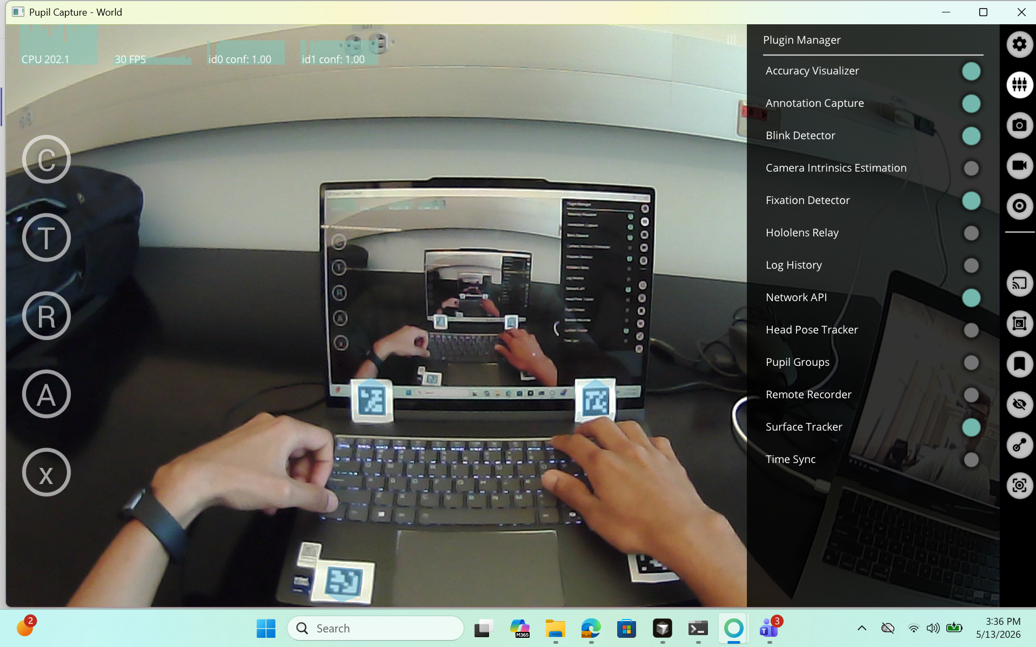
The hardware: a pair of eye-tracking glasses
• Off-the-shelf product from Pupil Labs (research-grade, lightweight)
• Looks like ordinary safety glasses with two tiny cameras
• Plugs into a laptop via USB
• Operator can walk, move, and talk normally
What the glasses see — the operator never has to look at this screen.
RTAPS — Real-Time Adaptive Procedure System
5 / 17
Notes:
These aren't custom-built. They're the same glasses researchers and clinicians have been using for years. From the operator's point of view, they're a slightly bulky pair of glasses. That's all. Everything else happens on a laptop they don't have to touch.

Slide 6
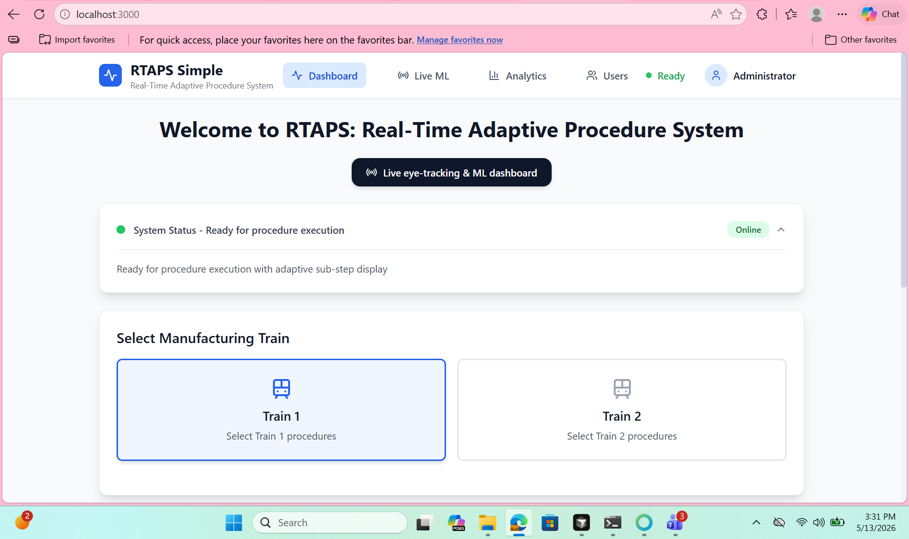
What the operator sees — Step 1: the home screen
• Status light shows the system is Ready (green dot)
• Pick a Train: Train 1 or Train 2
• Three procedures available
• One tap to start
Clean, uncluttered. Everything else is one click away.
RTAPS — Real-Time Adaptive Procedure System
6 / 17
Notes:
The operator's first screen. Notice how little text there is. A status light — green, ready. Two trains. Three procedures. That's everything they need to choose. They tap one and we go.

Slide 7
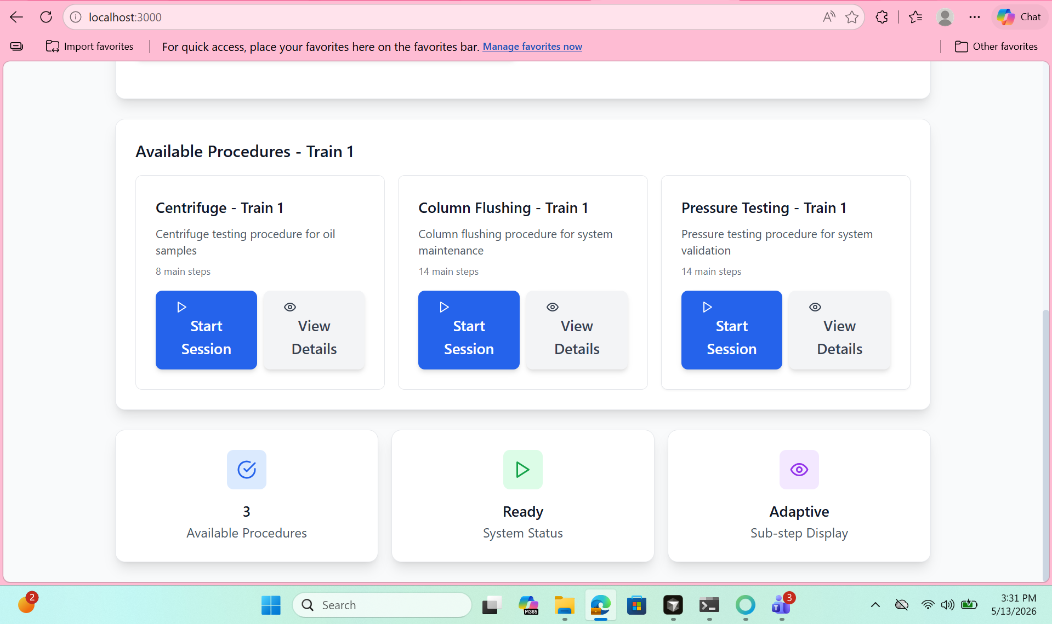
Three procedures supported today, both trains
Procedure
Steps
What it does
Centrifuge testing
8
Oil sample BSW analysis
Column flushing
14
System maintenance
Pressure testing
14
System validation
Adding a new procedure is a configuration change — not new software.
RTAPS — Real-Time Adaptive Procedure System
7 / 17
Notes:
These are real Shell procedures. The system is loaded with the actual step text, the actual tools, the actual instruments your operators know. If tomorrow Shell wants to add a fourth procedure, it's a configuration file, not a software release.

Slide 8
Step 2: a 2-minute calibration before each procedure
The system learns what 'calm you' looks like.
• Operator sees a black screen with a single white '+' symbol
• They sit and look at it for 2 minutes
• Glasses measure their resting pupil size
• This is the 'you on a good day' baseline
• Without this, the system can't tell 'this person is stressed' from 'this person just has bigger pupils than average'
+
01:47
73 / 120 seconds collected
Like tuning a guitar before playing a song.
RTAPS — Real-Time Adaptive Procedure System
8 / 17
Notes:
This is a small but important step. Every person has a different resting pupil size. The 2-minute calibration captures *their* normal — so when the system later sees their pupils grow by 10%, it knows that's 10% relative to *them*, not to some textbook average. The operator does nothing — just looks at the cross. A timer counts down.

Slide 9
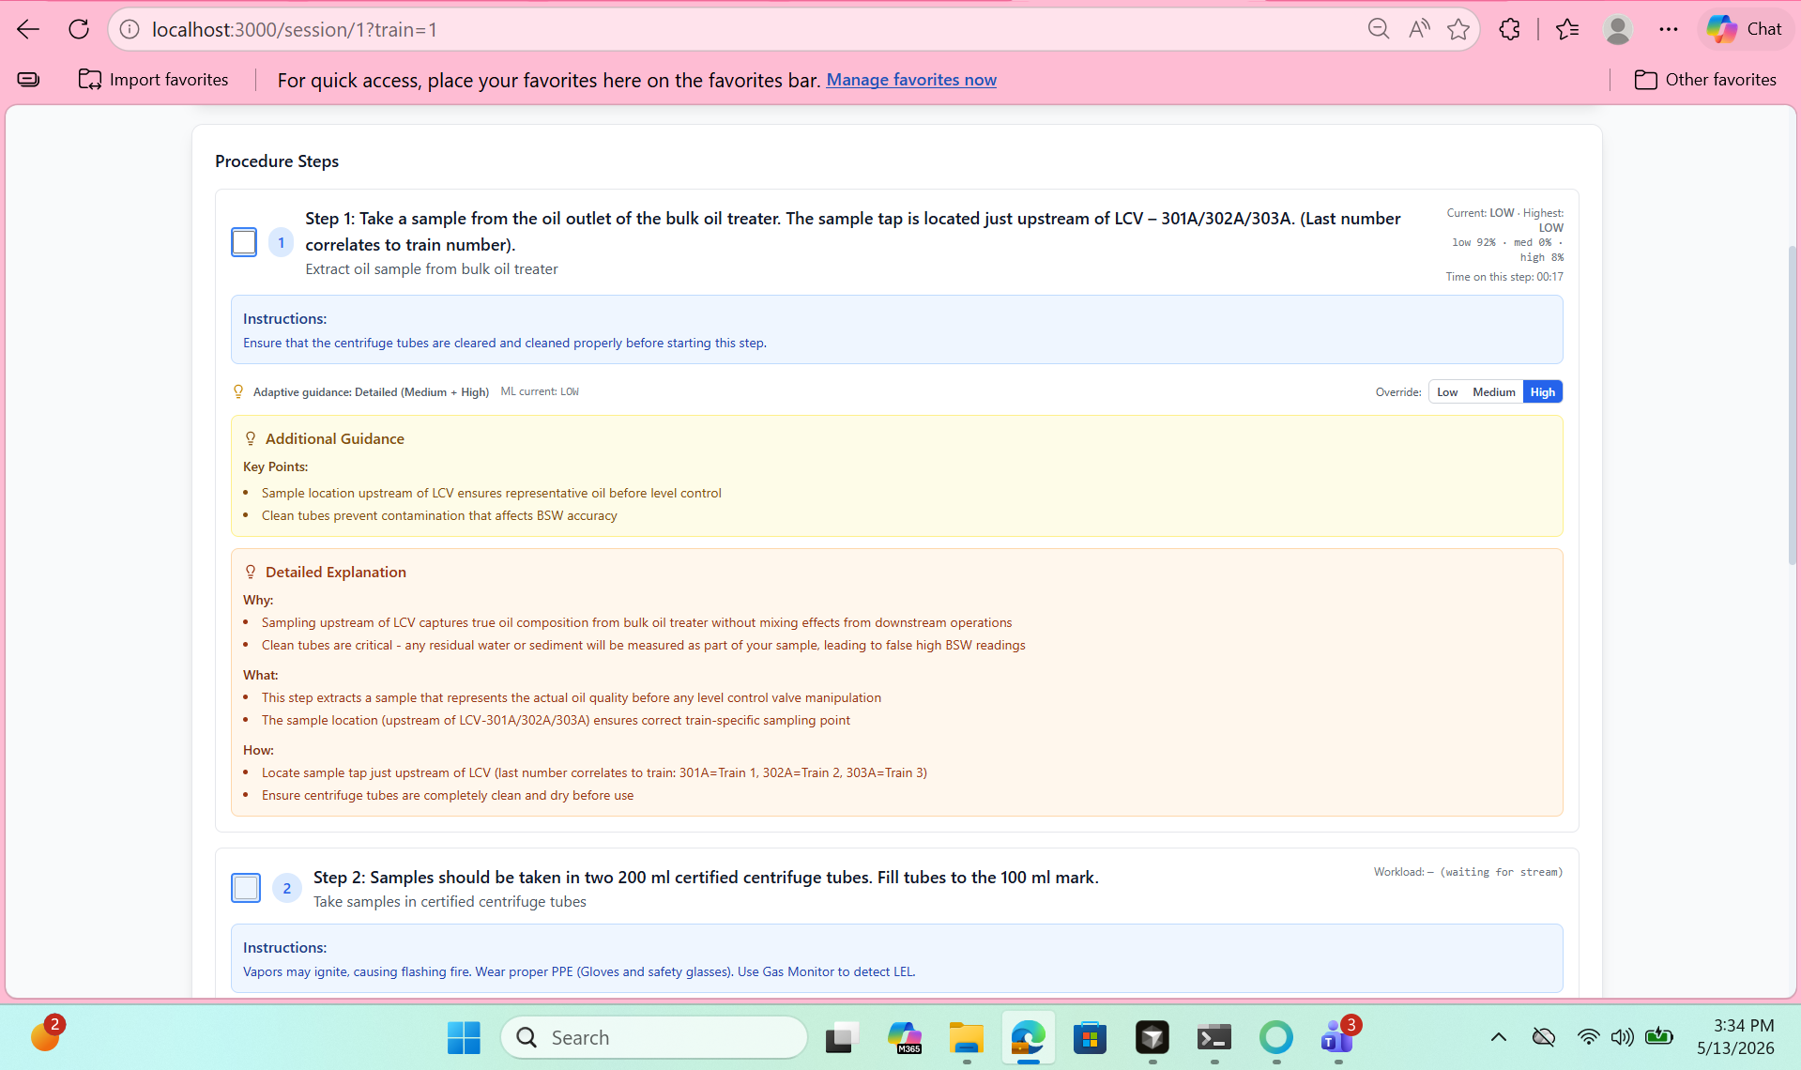
Step 3: doing the procedure — a familiar checklist
• Each step has a number, a clear title, and a short description
• Tap the box to mark a step complete
• Time spent on the step is shown in the corner
• The next step lights up when the previous is done
• And — here's the magic — extra guidance appears when needed
RTAPS — Real-Time Adaptive Procedure System
9 / 17
Notes:
From the operator's point of view, this looks like any other tablet-based procedure guide. They've seen this kind of checklist before. What's different is the box below the step — the 'Additional Guidance' panel. That panel appears and disappears based on how hard the operator is working.

Slide 10
Adaptive guidance — three levels, chosen automatically
The operator does NOTHING to switch levels.
Low workload
Medium workload
High workload
Operator is comfortable
Some effort
Operator is struggling
Just the step name and short description. No extra panel.
A small panel with key reminders. Example: • Sample location upstream of LCV ensures representative oil • Clean tubes prevent BSW contamination
A full explanation appears: Why / What / How. Both the Key Points AND the detailed reasoning are shown.
RTAPS — Real-Time Adaptive Procedure System
10 / 17
Notes:
Here's the heart of it. When the operator is breezing through, the screen stays clean. When the system sees their pupils dilate or their blink rate drop, it quietly adds the Key Points panel. If they keep struggling, the system upgrades to the full Why/What/How. None of this requires the operator to click anything.

Slide 11
Once we've shown it, it stays
A safety feature: previously-shown guidance is never pulled away.
Low — just the step name
Medium — Key Points added
High — Why/What/How added
(no additional guidance)
Key Points panel (yellow)
Key Points panel (still visible)
Detailed Explanation: Why / What / How
→
→
An operator who needed the medium reminder doesn't have it pulled out from under them.
RTAPS — Real-Time Adaptive Procedure System
11 / 17
Notes:
If the system flipped help on and off second by second, the operator would feel like the screen was unstable. So once help appears, it stays for the rest of that step. They see all the help they've earned.

Slide 12
Behind the scenes — just a peek
The system checks four things every second, silently:
1
2
3
4
Pupil size
Blink rate
Fixation length
Fixation steadiness
How dilated are the eyes right now, compared to the calibration baseline?
How often is the operator blinking?
How long are their eyes holding still on one spot?
How much is their gaze wandering?
These four signals are combined into one number: workload level.
No questions. No interruptions. Nothing the operator has to manage.
RTAPS — Real-Time Adaptive Procedure System
12 / 17
Notes:
This slide is the most 'technical' but it's not technical at all — these are biological facts. Emphasise that the operator does NOTHING. The system observes silently.

Slide 13
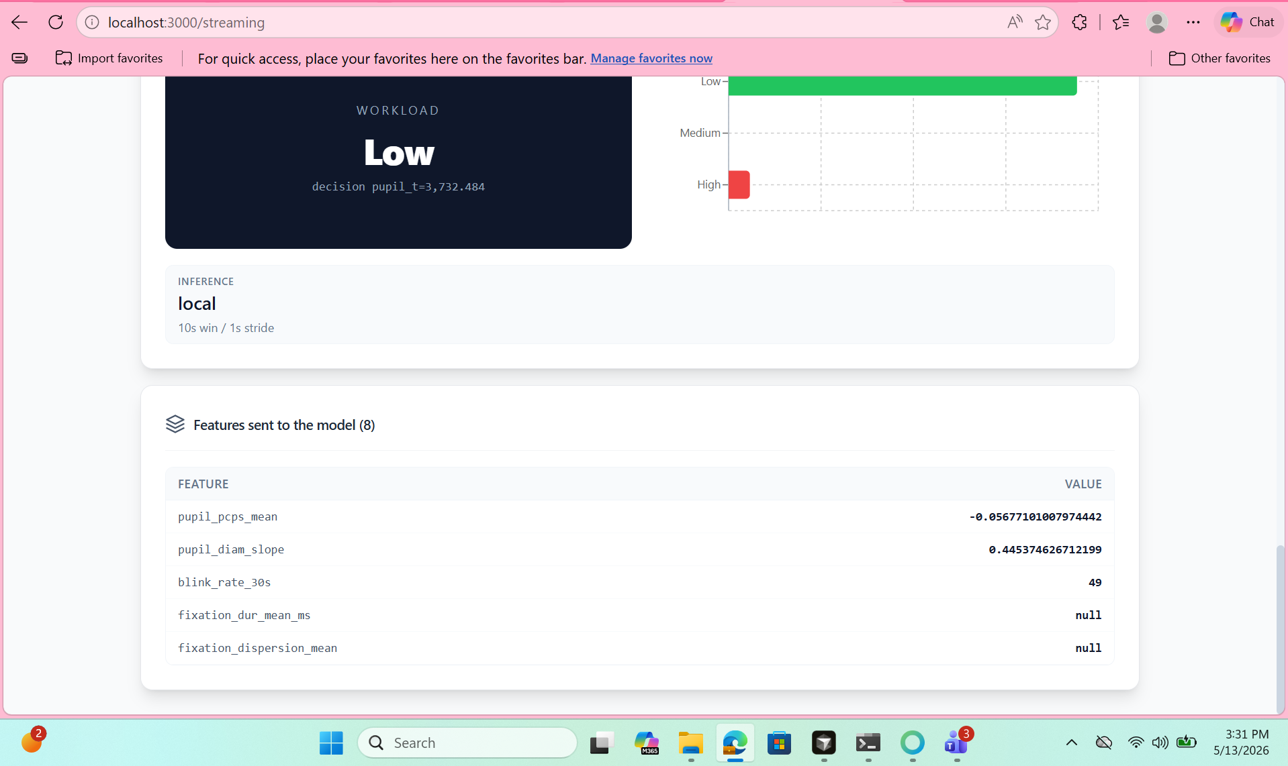
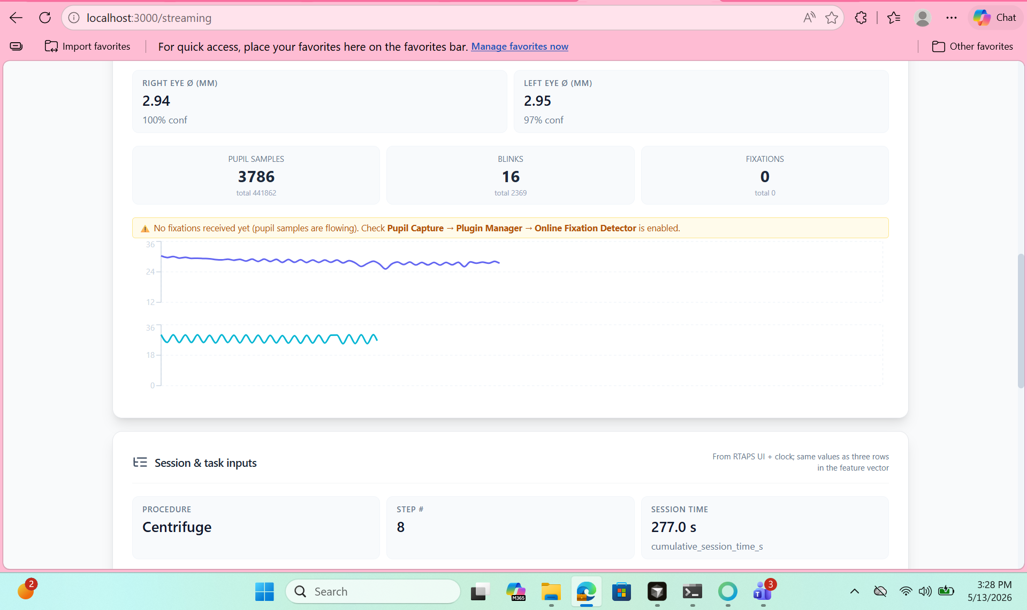
Trainer & admin view — for your back-office team
• Live workload reading for every active session
• Probability bars for Low / Medium / High
• Lifetime counts of pupil samples, blinks, fixations received
• Warnings if any sensor stops responding
• Operators NEVER see this view — it's a back-office screen for trainers and safety auditors
RTAPS — Real-Time Adaptive Procedure System
13 / 17
Notes:
Your training and safety teams can pull up this dashboard for any active session. They can see at a glance whether the system is healthy, how the operator is doing, and whether any sensor needs attention. Operators don't see this.

Slide 14
How it works, end to end
Four pieces, all running on one laptop. No cloud. No internet required.
Operator
Eye signals
RTAPS analyser
Procedure screen
wearing eye-tracker glasses
pupil, blinks, fixations
decides workload level
shows adaptive guidance
→
→
→
End to end, under one second from the eyes opening wider to the panel appearing on screen.
RTAPS — Real-Time Adaptive Procedure System
14 / 17
Notes:
Four pieces. The operator wears the glasses. The glasses send eye signals to the laptop. The laptop figures out the workload level. The screen updates the guidance. End to end, under one second.

Slide 15
Why this matters for Shell
Fewer mistakes
Operators get help right when they need it, before they make an error
Faster onboarding
New operators get more detail automatically; experienced operators get less clutter
Hands-off
Nothing to click, no pop-ups to dismiss, no menus to navigate
Auditable
Every step, every workload reading, recorded for compliance review
Personalised
Adapts to this operator on this day — not a one-size-fits-all manual
Non-disruptive
Screen is calmer when comfortable; busier only when the operator needs it
RTAPS — Real-Time Adaptive Procedure System
15 / 17
Notes:
Here's the value to Shell. Fewer mistakes, faster training, hands-off, auditable, personalised, non-disruptive. If I were going to pick one to emphasise to your safety team: a system that automatically gives more help during high-load moments could catch the exact errors that happen when an operator is overwhelmed.

