Slide 1

E-COMMERCE DATA ANALYZER
Yash Penkar (22106118)
Prarthana Patil (22106035)
Rutuja Pawar (22106043)
Gauri Ramekar (22106068)
Under the Guidance of
Prof. Taruna Sharma

Slide 2
OUTLINE
Introduction
Literature Survey of the existing systems
Limitations of the existing systems
Problem statement
System Design
Technologies and methodologies
Implementation
Conclusion
References

Slide 3
INTRODUCTION
Comparison of prices from different websites
E-Commerce
Multi Billion Dollar Industry
Set competitive prices
Monitor price fluctuations
Gain competitive advantage

Slide 4
LITERATURE SURVEY OF THE EXISTING SYSTEM
Survey of Existing Solutions in the Real World:
Diverse solutions exist in the e-commerce price comparison landscape:
Dedicated websites
Browser extensions
Mobile applications
Prominent platforms include:
PriceGrabber
Google Shopping
Honey
Analysis of the Issues Present in the Surveyed Solutions:
Common challenges:
Limited coverage for smaller or niche websites
Potential inaccuracies in real-time pricing data
Varying user experiences due to complex interfaces

Slide 5
Survey of Users’ Requirements and Expected Improvements:
User surveys reveal demand for:
User-friendly interfaces
High data accuracy
Comprehensive coverage of e-commerce websites
Tools simplifying decision-making and providing reliable information
Survey of Technologies and Methodologies Used:
Technologies:
Web scraping
API integrations
Data mining
Methodologies:
Pattern recognition
Recommendation systems
Data analytics

Slide 6
Limitations:
Limited Website Support
Data Accuracy Challenges
User Interface Complexity
Advantages:
Quick Access to Pricing Information
Transparency
Empowerment of Users
Results Achieved:
Improved Decision-Making
Increased Awareness
Enhanced User Satisfaction

Slide 7
LIMITATIONS OF EXISTING SYSTEMS
Limited Website Support
Data Accuracy Challenges
User Interface Complexity
Incomplete Coverage
Lack of Standardization
Limited Comparative Analysis
Dependency on Web Scraping
Incomplete User Requirements Understanding
Limited Integration of Advanced Technologies
Privacy Concerns

Slide 8
PROBLEM STATEMENT
E-commerce Growth:
Exponential growth in the industry.
Plethora of online platforms.
Price Comparison Challenge:
Challenging for users.
Efficient price comparison.
Informed decisions.

Slide 9
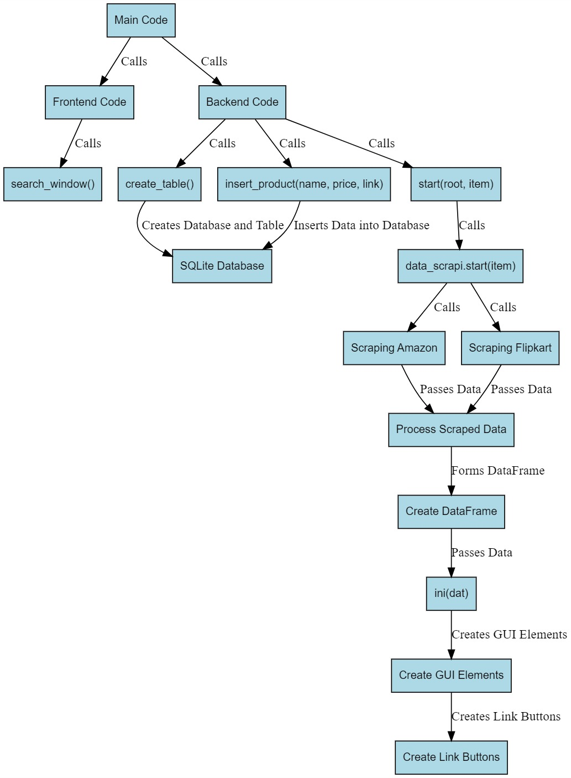
SYSTEM DESIGN

Slide 10
TECHNOLOGIES AND METHODOLOGIES
Web Scraping:
Libraries: BeautifulSoup is used for parsing HTML and extracting information from the web pages.
Requests: The requests library is utilized to make HTTP requests to the Amazon and Flipkart websites and retrieve the HTML content.
Data Storage:
Pandas: The pandas library is employed to structure and store the scraped data in a DataFrame, making it easy to manipulate and analyze.
URL Generation:
String Manipulation: The script generates URLs dynamically based on the user's search query. It uses string manipulation techniques to construct the URLs with the search terms.
URL Shortening:
Pyshorteners: The pyshorteners library is used to shorten the URLs obtained from both Amazon and Flipkart. This can be beneficial for creating concise and shareable links.

Slide 11
User-Agent Spoofing:
Headers: Custom headers are set to mimic the behavior of a web browser, providing user-agent information to the websites. This can help avoid potential blocking or restrictions during web scraping.
Regular Expressions (Regex):
Re Module: The re module is used for pattern matching in the script. It assists in identifying and extracting specific information from the HTML content, such as identifying Amazon and Flipkart product links.
Conditional Statements and Loops:
Control Flow: The script uses conditional statements (if statements) and loops (for loop) to iterate through the HTML content and extract the relevant product information.

Slide 12
Printing and Output Formatting:
Print Statements: The script utilizes print statements to display information, including the logo and a message if the data cannot be fetched.
Function Definition:
Functions: The script is organized into functions. The generate_url function generates URLs based on input parameters, and the start function initiates the web scraping process.
Error Handling:
Status Code Check: The script checks the HTTP status codes of the requests to ensure successful retrieval of HTML content. If the status codes are not 200, an error message is printed.

Slide 13
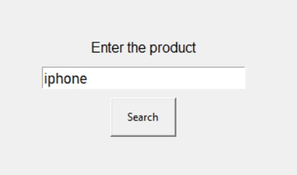
IMPLEMENTATION

Slide 14
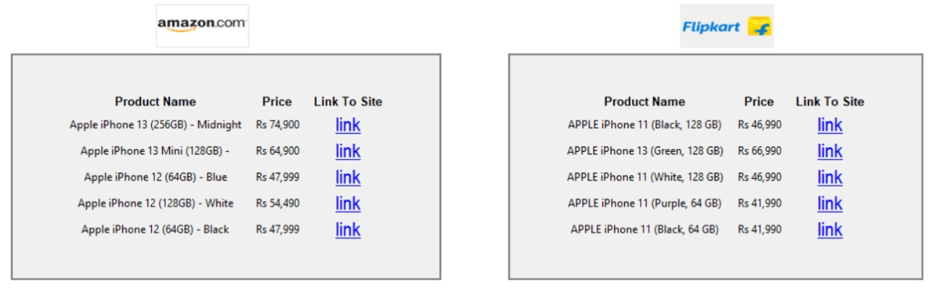
IMPLEMENTATION

Slide 15
CONCLUSION
Saves you the time
Automate tasks
Speed up the process

Slide 16
REFERENCES
[1] “E-commerce Price Comparison Website Using Web Scraping” International Journal of Innovative Research in Engineering & Multidisciplinary Physical Sciences Volume 11(3),June 2023
[2] “E-Commerce Price Comparison With Review Sentimental Analysis”, Sanket Bezalwar, Vikas Bhandekar, Sagar Kumbhare, Rushikesh Rebhankar , Prof. Prajakta Singam , Dept. Of Computer Technology, Rashtrasant Tukadoji Maharaj Nagpur University (RTMNU), KDK College Of Engineering, Nagpur, India,Volume 8, 2023 IJCSMC, Vol. 11, Issue. 3, March 2022
[3]“Price Comparison Website for Online Shopping” ,S. Rajendar, K. Manikanta, M. Mahendar, Assistant Prof. (Mrs.) K. Madhavi Department of Computer Science and Engineering, St. Peter’s Engineering College, Hyderabad. IJCRT | Volume 9, Issue 6 June 2021
[4] “Price Comparison for Products in Various E-Commerce Website” Mrs. M. SOWMIYA, SRINANDHAN CS, MUGESH RAJA M, SUDHEEKSHAN KUMAR Dept. Of Computer Science & Engineering Meenakshi Sundararajan Engineering College, Chennai, India. IJRTI | Volume 8, Issue 5
[5] “E-Commerce Product Price Tracker”, Dr. G Madhusudhan, Nitin Gopalakrishna Bhat, Sahana Venkatraman Patgar, Chandan N A, Bharath S V, Computer Science and Engineering 1,2JSS Science and Technology University, Mysuru, India, JETIR , Volume 8, Issue 6,June 2021
[6] “Comparitive Analytical Study Of Flipkart And Amazon”,Visha Patel,(Mba (Ba) Student) Maazahmed Shaikh,(Mba (Ba) Student) Tushar Pradhan,(Professor) Parul University Tijer || Issn 2349-9249 || Volume 10, Issue 3, March 2023

Slide 17
THANK YOU

