Slide 1
On The Bayesian Characterization of Diffusivity Through Linear Heat Losses
Yash Pincha and Isaac Reid, 03/02/2026

Slide 2
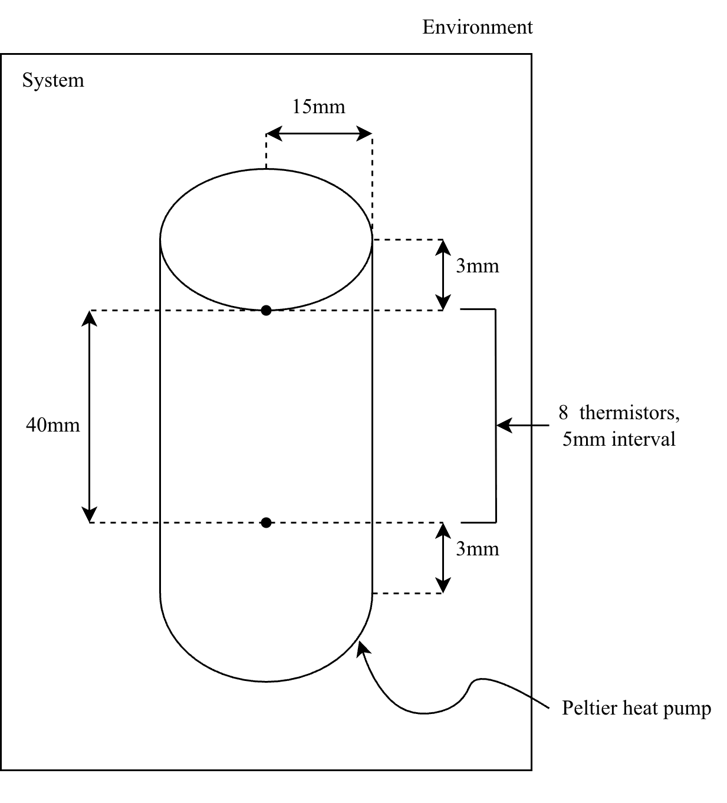
Introduction and Aims
The system is governed by the 1-dimensional heat equation with a periodic source at the origin, to which we append Newton’s cooling term.
We perform Bayesian inference on four candidate models derived from physical motivations of this experiment.
We use Hamiltonian Monte Carlo methods, testing on the leave-one-out predictive power of our models.
Does the inclusion of linear heat loss terms statistically improve the predictive accuracy of diffusivity measurements in Aluminium?

Slide 3
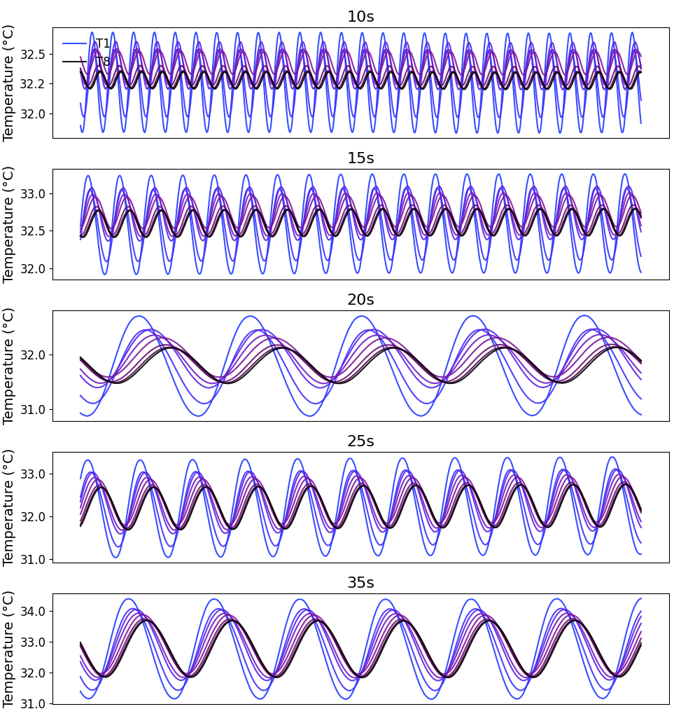
Experimental Methods
Peltier pump outputting sinusoidal voltage of amplitude 7V. We varied the periods, using 5, 10, 15, 20, 25, 35, 40, 50, 60, and 70s.
Linearity check revealed higher-order harmonics; mitigated by filtering data to the fundamental frequency.
Once some sense of equilibrium was observed at each period, we took data over 800s.
Every signal was trimmed to a window with minimal transient power.
We choose to explore aluminium since we expected it would have the least ambiguous existing data.
Figure 1, demonstrating clipping of data to minimal transients across the first five periods collected.

Slide 4
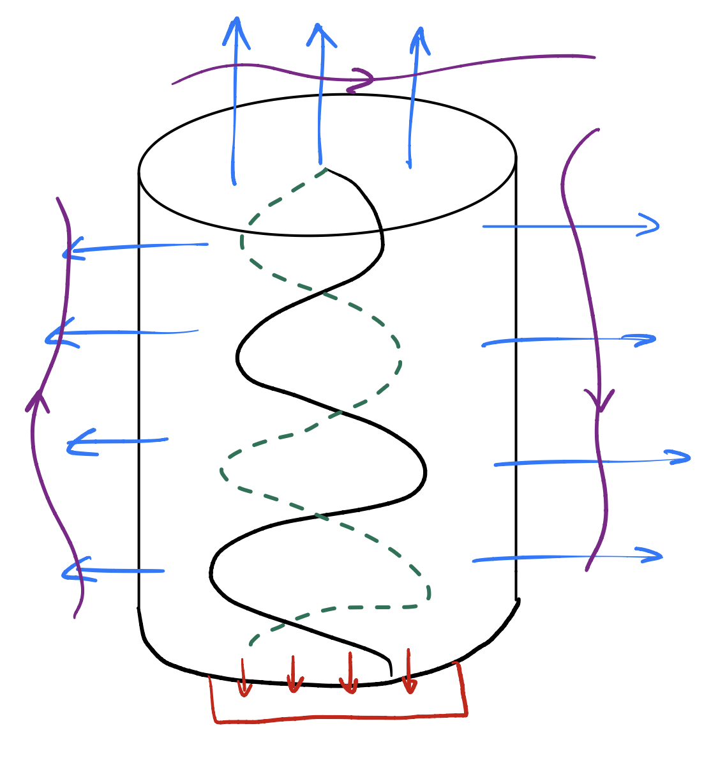


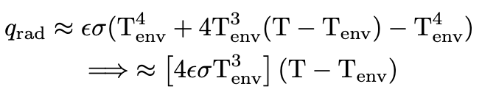
Heat Losses
Convection. Heat is transferred to the air surrounding the cylinder. Even in a stagnant box, natural convection occurs as heated air rises due to buoyancy. For small temperature fluctuations, this is laminar.
Radiation. The rod emits infrared energy to the surrounding walls of the box, following from the Stefan-Boltzmann law. We linearized this by a Taylor expansion about the ambient temperature.
convection
radiation
Conduction. Heat "leaks" through the base or mechanical supports holding the cylinder. Since conduction follows Fourier's Law, it is naturally linear.
conduction

Slide 5
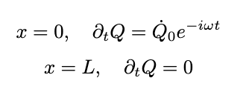



Candidate Models
General boundary conditions
unless specified otherwise, the conditions are:
SimpleForward
basic unbounded 1-dimensional diffusion
FullSolution
Adds the effect of a finite length cylinder with reflection
FullSolutionNewton
includes convective transfer, linearized Stefan-Boltzmann radiation, conduction as a consequence of Fourier’s law
FullSolutionRobin
Diffusion equation with heat losses + convective heat loss at the boundary. Measures leakiness.

Slide 6
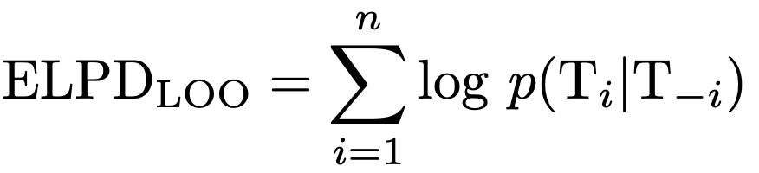
Processing and the Hierarchy
To obtain informed priors, we seeded with least-squares minimized a sinusoid to our data → helped solve identifiability issues between phase and diffusivity
We used the No-U-Turn Sampler [1] to adaptively explore the target distribution space, sampling with 4 chains, 1500 draws and 500 tuning steps per frequency model.
Verified convergence of the posterior via the Gelman-Reuben statistic.
To account for potential variations in heat injection, local parameters (amplitude, phase, mean temperature) were allowed to vary per frequency and sensor; the physical constants D and η and were constrained as global parameters shared across the hierarchy.
Models were then ranked by expected log predictive density using leave-one-out cross validation.
This approach provides a rigorous statistical penalty for model complexity, ensuring that the selected model is the one that best captures the underlying physics without overfitting the thermistor noise. ELPD is defined below.
Notes:
This effectively resolved parameter identifiability issues between phase shift and diffusivity.
This 'partial pooling' prevents individual sensor noise from biasing the material property estimate

Slide 7
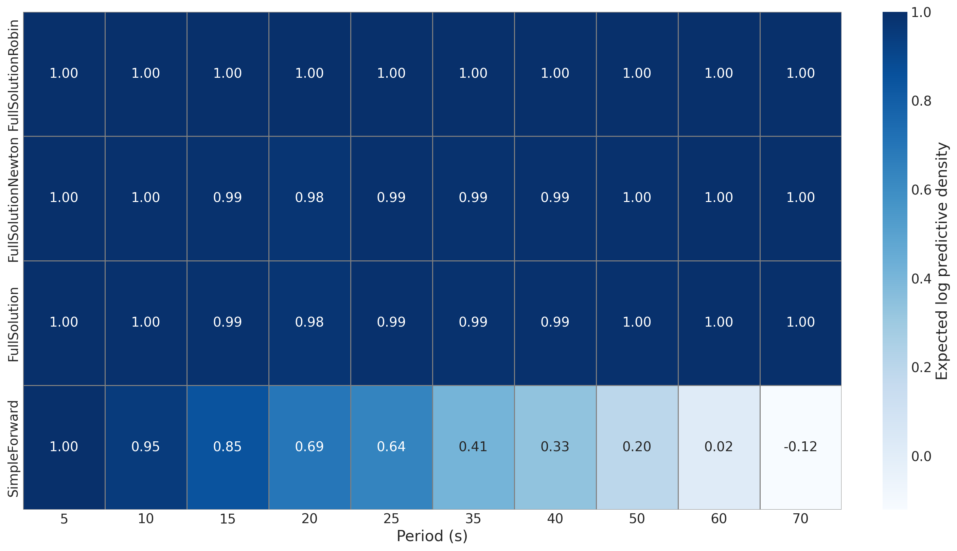
Results and Discussion
Figure 3. Above is a plot with ELPD score normalized by column for each model across every frequency. All FullSolution candidates perform comparingly across all frequencies. SimpleForward sees a consistently decreasing power in predictive capacity as expected.

Slide 8
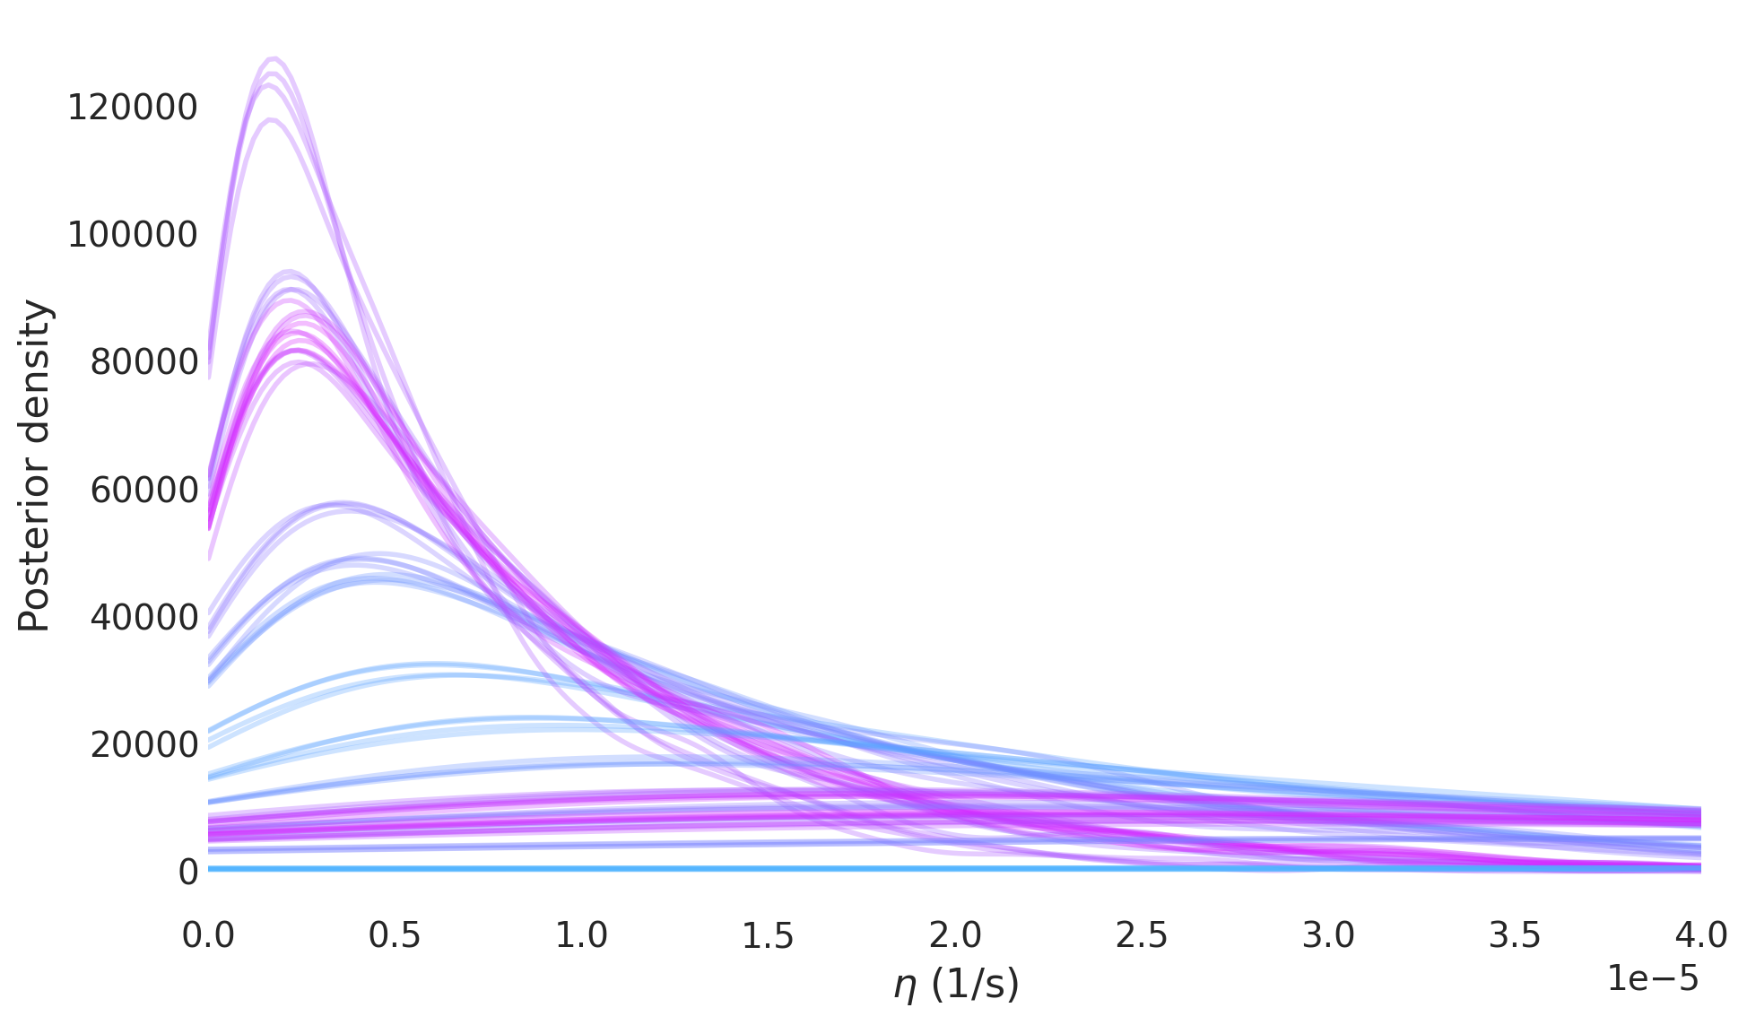
Validating an Isolated System
Figure 3. above is a plot of the posteriors across all chains, all frequencies for the FullSolutionNewton and FullSolutionRobin models. The effective loss coefficient is consistently infinitesimal frequencies → cylinder is thermally isolated during the wave's propagation.
Notes:
The assumption that heat loss can be linearized into a simple Newtonian term is perfectly safe; even if there were non-linearities, their magnitude is too small to affect the diffusivity estimate.

Slide 9
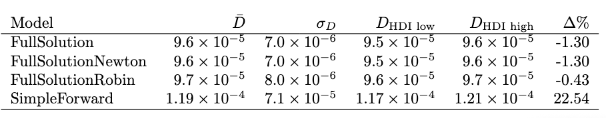
Results and Discussion
Since both models in Figure 4. agree that η is close to zero, the Bayesian evidence will likely favor the simpler FullSolution or SimpleForward models.
The tight grouping of the lines indicates that chains have converged to a single, consistent physical reality across 10 different frequencies.
The null hypothesis is now that the mean diffusivity for each pairwise model is the same.
On performing Welch’s t-tests (since the samples have unequal variances and sizes), we reveal that there is no statistical significantly different results across the models.
Below is a summary of diffusivity statistics for each model, across all frequencies. Percent error is computed relative to the literature value of D = 9.7 m^2/s [3].

Slide 10
References
[1] Hoffman MD, Gelman A. The No-U-Turn Sampler: Adaptively Setting Path Lengths in Hamiltonian Monte Carlo. arXiv:1111.4246 [stat.CO]. 2011 Nov 14 [cited 2026 Feb 3]. Available from: https://arxiv.org/abs/1111.4246
[2] Abril-Pla O, Andreani V, Carroll C, Dong L, Fonnesbeck CJ, Kochurov M, et al. PyMC: a modern, and comprehensive probabilistic programming framework in Python. PeerJ Comput Sci. 2023 Sep 1;9:e1516. doi: 10.7717/peerj-cs.1516.
[3] Wilson J. Thermal Diffusivity. Electronics Cooling [Internet]. 2007 Aug 1 [cited 2026 Feb 3]. Available from: https://www.electronics-cooling.com/2007/08/thermal-diffusivity/
[4] Cramér H. Mathematical methods of statistics. Princeton (NJ): Princeton University Press; 1946.
[5] Freedman D, Pisani R, Purves R. Statistics. 4th ed. New York (NY): W.W. Norton & Company; 2007.
[6] Hogg RV, McKean JW, Craig AT. Introduction to mathematical statistics. 7th ed. Boston (MA): Pearson; 2013.

