Slide 1


ZAP! E-Commerce App/Website
Team Falcon
Date: 24-11-2021

Slide 2
Team Members Details
Krupal Patel (2016212107)
Ujjval Patel (20162121021)
Nitin Prajapati (20162121022)
Yash Prajapati (20162121023)
Jinay Shah (20162121025)
Purav Shah (20162121026)
Anuj Jani (D2D)
Rudra Patel (D2D)

Slide 3
Problem Statement What is the problem that you are trying to solve? What are the business opportunities your solution would fulfil?
Pain Points like Late delivery ,Secure Transaction Issues , Order Misplaced , High Price , Product Availability , Damaged Delivery , Less Range Of Products , Not Deliverable To Some Address etc.
Clearly define your problem statement
Many Times Customer’s Delivery Come In 10-15 Days.
Consumer fear to buy delicate product online because of improper delivery.
Consumer hesitate to pay via online payment methods.
Gains Like We can give goodies or more discounts , faster delivery to the user.

Slide 4
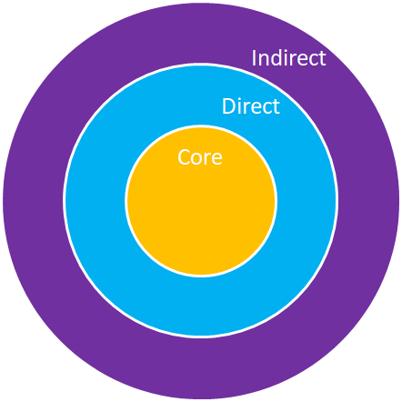
Stakeholder Mapping
- Core SH: Consumer who is interacting with the website
Eg: - Person who wants to buy a phone.
- Direct SH: Influencer of Consumer
Eg: - The one who influences the consumer to buy a phone.
- Indirect SH: Rest are those who do not directly influence the consumer.
Eg: - The One who may or may not influence CORE or DIRECT SH but they are part of the domain

Slide 5
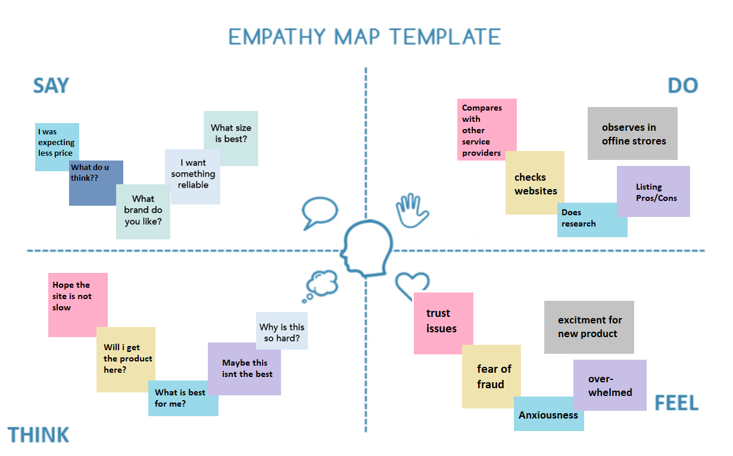
Empathy Map

Slide 6
Competition & Barrier To Entry
How do the current available solutions compare with your solution?
🡪Even well established firms like amazon take 3-5 Business days to return money where our firm will help you out in 1-2 Business Days only.
How easy is it to replicate your solution?
🡪 It’s Easy To Replicate Our Solutions But When It Comes To Implementation It’s Very Hard Because Everyone Can’t Understand The Whole Process Or Might Miss Out Some Imp. Steps.
How difficult for you to enter into the market? What are the barriers and difficulties that you will face?
It’s Too Hard To Enter Market Now a days Because Right Now There Are Well Established Companies Like Amazon , Flipkart , Ajio, Myntra . Because Of That Customers Don’t Trust The New Start-Ups And Hesitate To Buy From This New Start-Ups.

Slide 7
Target Market
Customer Segmentation (Clearly mention your target audience). Who are your customers?
Our Target Customers Are From The All Age Groups,
Children , Adults , Senior Citizen
How big is your market: The size of the market vs the percentage you are targeting.
Our Main Target Customers Are Adults.
From About 100 Million Adult We Are Targeting About 65-75%.
What channels will you use to get to this market?
Electronic Medium

Slide 8
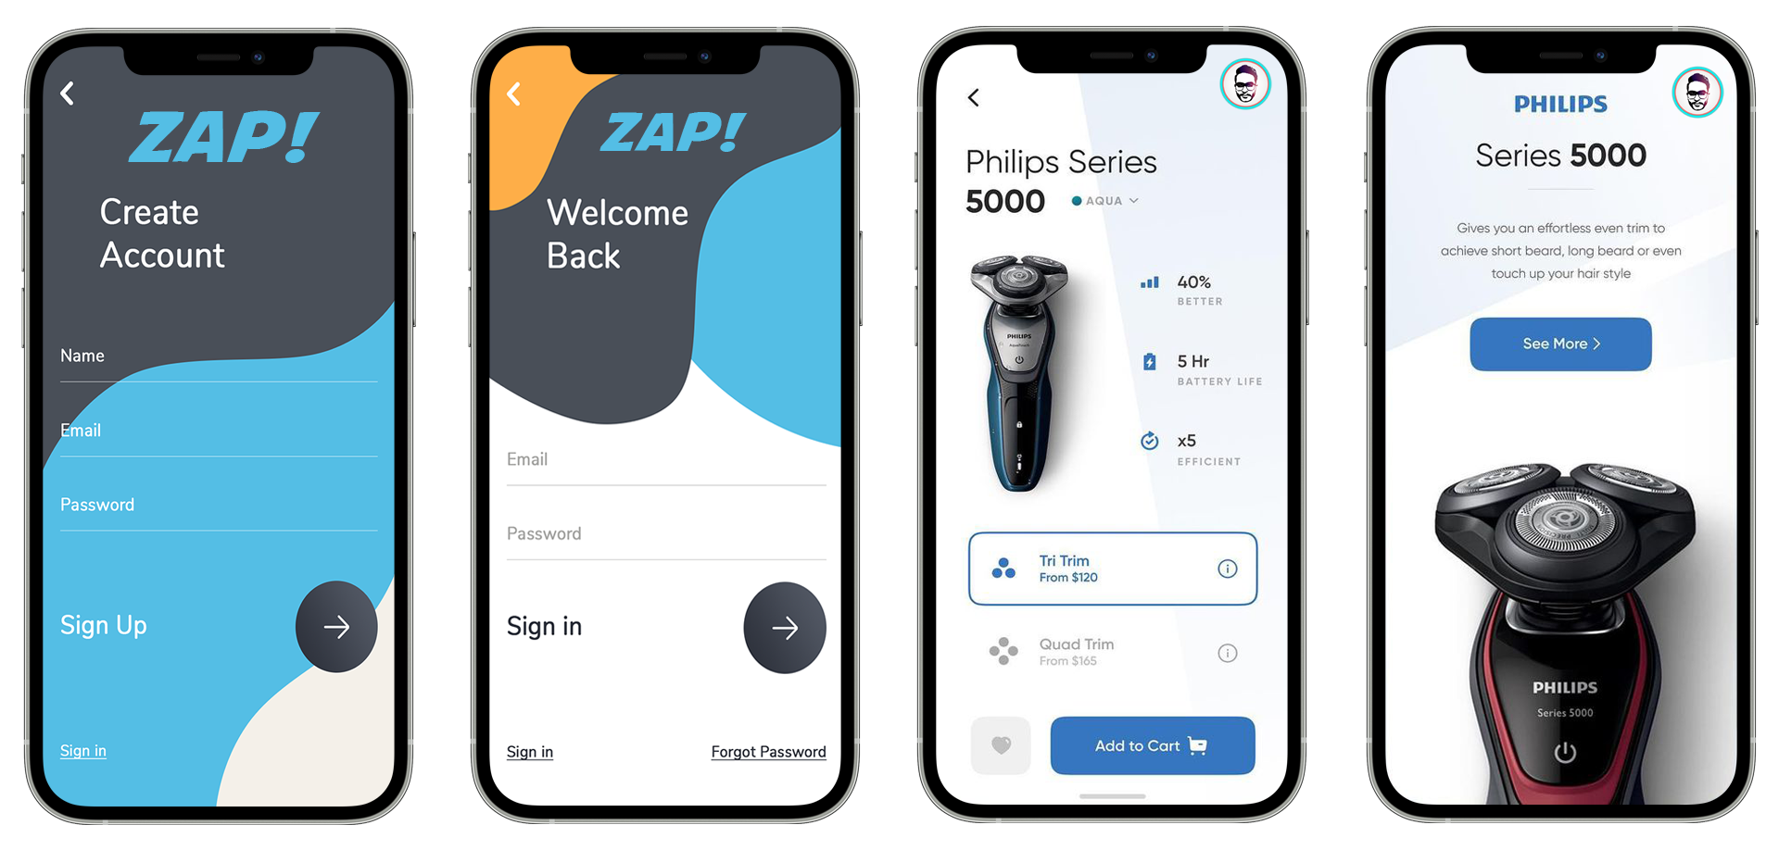
Solution (Prototype 1)

Slide 9
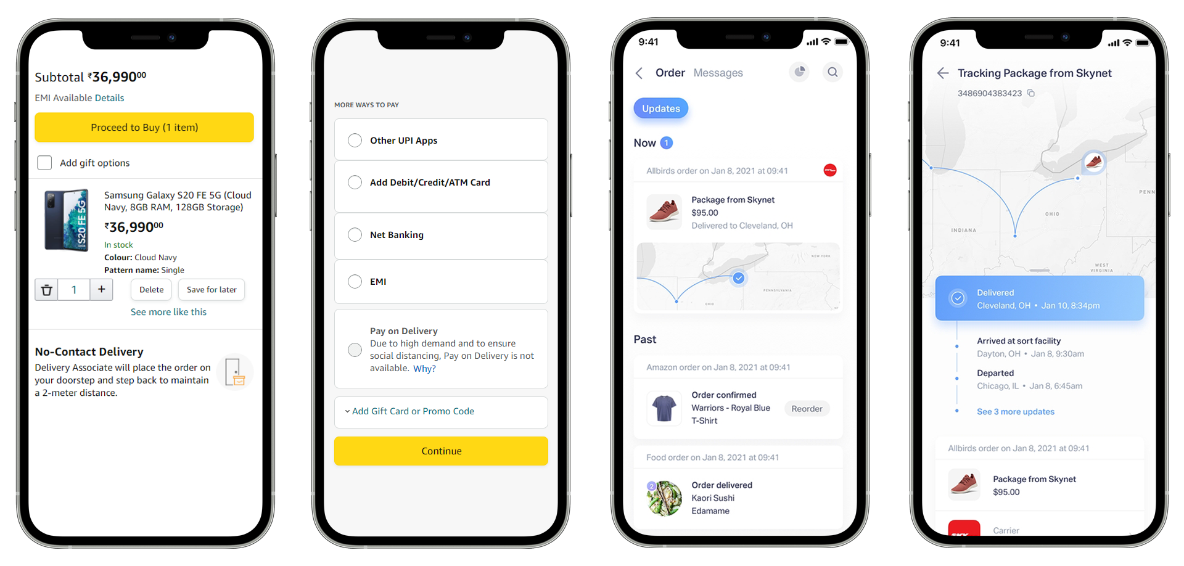
Solution (Prototype 2)

Slide 10
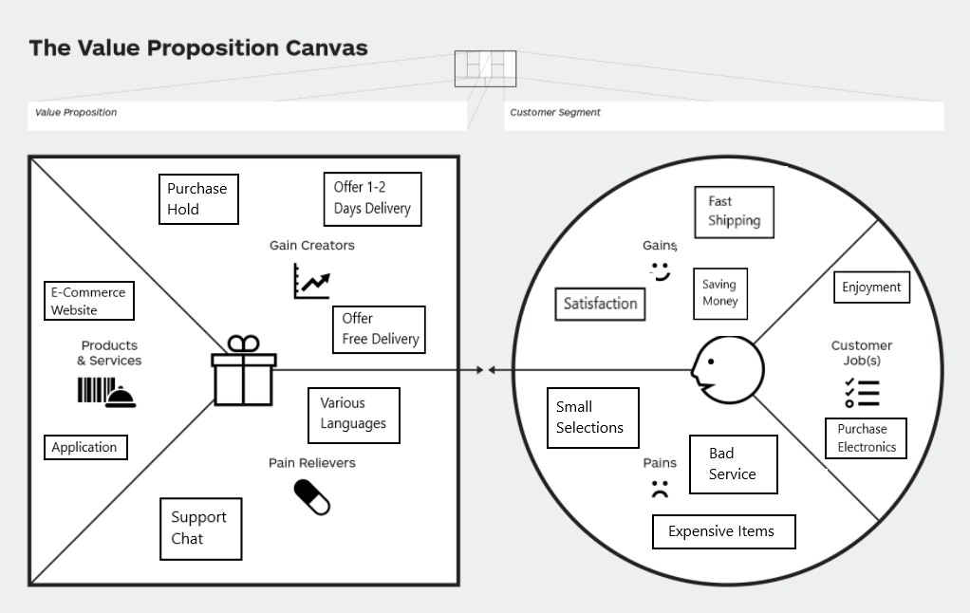
Value Proposition (VPC)

Slide 11
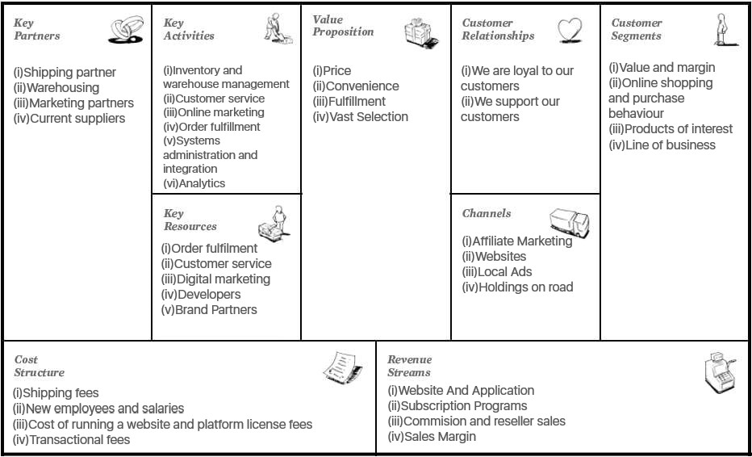
Business Model Canvas (BMC)

Slide 12
Future Planning
We Will Make Website And Mobile Application.
We Will Expand Our Warehouses Locally.
We Will Expand Internationally.
We Will Create Our “ZAP!” Product.
We Will Launch Our Premier Membership.
We Will Use Electric Vehicles For Delivery.

Slide 13
Team
Yash Prajapati (Co-Founder & CEO)
Jinay Shah (Co-Founder & COO)
Krupal Patel (Co-Founder & CTO)
Purav Shah (Co-Founder & MD)
Ujjval Patel (Co-Founder & HRO)
Nitin Prajapati (CMO)
Anuj Jani (GM)
Rudra Patel (AM)

Slide 14
Thank you

