Slide 1
“I want the best for my daughter and the planet. If I can find eco-friendly clothes that are both beautiful and sustainable, and make some extra space by reselling them, it's a win-win.”
Goals
Wants to purchase eco-friendly and sustainable clothing for her child.
Looking for ways to resell outgrown clothes to make extra money and clear space at home.
Prefers an easy, guided reselling process with minimal hassle.
Frustrations
Concerns about the quality and hygiene of second-hand clothes when buying online.
Feels there are limited options for premium eco-friendly clothes in the market.
Meera Sharma
Age:
Tech comfort:
Hometown:
Family:
Occupation:
29
High
Delhi
Mother of a 2-year-old daughter
Marketing Manager
Meera, a marketing manager and mother of a 2-year-old daughter, is passionate about sustainability and wants to ensure that her child wears eco-friendly clothing. She’s already mindful of her family’s environmental footprint and tries to incorporate sustainable practices into her lifestyle.

Slide 2
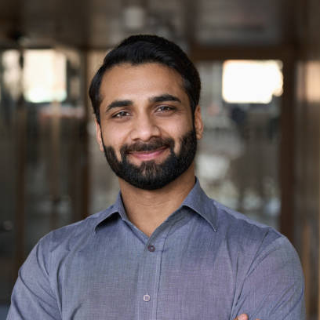
“I believe in getting the best value for my money. Branded clothes for my son should last, and when they don’t fit anymore, I want a simple, safe way to resell them without any hassle.”
Add image that represents this persona
Goals
Primarily interested in branded and durable children's clothing that lasts longer.
Seeks to resell outgrown clothes as children grow quickly and would like to make extra money.
Prefers a guided reselling process with clear instructions and minimal effort.
Frustrations
Worried about the quality and hygiene of second-hand clothes when purchasing for his child.
Finds the reselling process complicated on existing platforms; prefers a simplified approach.
Concerns over the safety and transparency of payment processes
Rajiv Agarwal
Age:
Tech comfort:
Hometown:
Family:
Occupation:
36
High
Bengaluru
Father of a 5-year-old son
IT Professional
Rajiv, a tech-savvy IT professional and father of a 5-year-old son, wants to buy branded clothes for his son but finds that he quickly outgrows them. He’s interested in finding a platform where he can both buy branded items and easily resell them when his son no longer fits into them.

