Slide 1

CODETRACE AI / ML MINI PROJECT
CodeTrace AI
Stylometric and Structural Classification Framework for Detecting LLM-Generated Code Submissions
School of Computer Engineering
Manipal Institute of Technology, Manipal
Academic year 2026–2027
Yash Raj Agarwal — 240905558
Nishaanth S — 240905422
Aman Sharma — 240905500
Faculty guide:
[INSERT FACULTY GUIDE NAME]
Yash Raj Agarwal
01 / 18
Notes:
Good morning. We are Yash Raj Agarwal, Nishaanth S and Aman Sharma. Our project is titled Stylometric and Structural Classification Framework for Detecting LLM-Generated Code Submissions. We built CodeTrace AI as a local machine learning demonstration. It extracts features from Python source without running the program, then uses a saved classifier to estimate which labeled style category the sample resembles. We will explain the implementation, show its measured results, and demonstrate where it is fragile. We want to be clear from the beginning: the included data is synthetic, so this presentation does not claim validated authorship detection.
Sources: actual repository backend/features.py, train.py, predict.py, main.py and models/metrics.json; experiments in evaluation_package/05_Experiments. Literature source URLs: https://ajic.wits.ac.za/article/view/21309 ; https://link.springer.com/article/10.1007/s40979-023-00146-z ; https://onlinelibrary.wiley.com/doi/10.1002/spe.2146 ; https://link.springer.com/article/10.1023/A:1010933404324 . School/logo source: https://www.manipal.edu/academics/departments/school-of-computer-engineering-mit-manipal .

Slide 2
CODETRACE AI / ML MINI PROJECT
Problem statement
01
Shared algorithms can produce similar source code
02
Editing changes surface style without changing logic
03
A prediction cannot establish academic misconduct
Yash Raj Agarwal
02 / 18
Notes:
The question we explore is whether measurable code style and structure can distinguish labeled examples. Code differs from ordinary prose: assignments specify algorithms, libraries introduce standard expressions, and programmers often produce similar valid solutions. A student can also add comments or rename identifiers without changing the program. These facts make the relationship between style and origin uncertain. Academic integrity motivates the question, but a probability alone cannot determine whether someone violated a policy. Our scope is to study a transparent classification pipeline and examine its failure modes, rather than automate academic decisions.
Sources: actual repository backend/features.py, train.py, predict.py, main.py and models/metrics.json; experiments in evaluation_package/05_Experiments. Literature source URLs: https://ajic.wits.ac.za/article/view/21309 ; https://link.springer.com/article/10.1007/s40979-023-00146-z ; https://onlinelibrary.wiley.com/doi/10.1002/spe.2146 ; https://link.springer.com/article/10.1023/A:1010933404324 . School/logo source: https://www.manipal.edu/academics/departments/school-of-computer-engineering-mit-manipal .

Slide 3
CODETRACE AI / ML MINI PROJECT
Motivation and objectives
01
Build an understandable, reproducible baseline
02
Compare three classifiers with real evaluation outputs
03
Connect saved inference to a working website
04
Measure sensitivity to equivalent code edits
Yash Raj Agarwal
03 / 18
Notes:
We selected a compact design that we can explain from source code to prediction. Our first objective is to turn code into numerical features using static analysis. Our second is to compare Logistic Regression, a Decision Tree and a Random Forest under the same data protocol. Our third is to connect the selected saved pipeline to a website and test how its outputs respond to controlled changes. The resulting contribution is an educational system with reproducible experiments. A stronger authorship study would require verified data, independent task families and a more rigorous evaluation protocol, which we discuss later.
Sources: actual repository backend/features.py, train.py, predict.py, main.py and models/metrics.json; experiments in evaluation_package/05_Experiments. Literature source URLs: https://ajic.wits.ac.za/article/view/21309 ; https://link.springer.com/article/10.1007/s40979-023-00146-z ; https://onlinelibrary.wiley.com/doi/10.1002/spe.2146 ; https://link.springer.com/article/10.1023/A:1010933404324 . School/logo source: https://www.manipal.edu/academics/departments/school-of-computer-engineering-mit-manipal .

Slide 4
CODETRACE AI / ML MINI PROJECT
Literature and research gap
01
[1] C# stylometry study: directly related task
02
[2] Text-detector study: cautions about reliability
03
[3] Code authorship comparison: baseline context
04
[4] Random Forests: algorithm foundation
05
Literature gap: 20–25 indexed journal papers not fully verified
Yash Raj Agarwal
04 / 18
Notes:
Our literature record separates direct evidence from background. Reference one is a C# code-stylometry study. Reference two examines text detector reliability and therefore motivates caution rather than supplying code-detection accuracy. Reference three provides source-code authorship comparison context, while reference four is the Random Forest foundation. We did not transfer their numerical findings into our own results. The accessible review did not verify twenty to twenty-five qualifying indexed journal articles, and the report states that gap explicitly. The immediate gap for our project is also empirical: we need a provenance-verified, task-diverse dataset before claiming real authorship performance.
Sources: actual repository backend/features.py, train.py, predict.py, main.py and models/metrics.json; experiments in evaluation_package/05_Experiments. Literature source URLs: https://ajic.wits.ac.za/article/view/21309 ; https://link.springer.com/article/10.1007/s40979-023-00146-z ; https://onlinelibrary.wiley.com/doi/10.1002/spe.2146 ; https://link.springer.com/article/10.1023/A:1010933404324 . School/logo source: https://www.manipal.edu/academics/departments/school-of-computer-engineering-mit-manipal .

Slide 5
CODETRACE AI / ML MINI PROJECT
System architecture
React input
FastAPI
validation
Static
features
Saved ML
pipeline
Result
display
Offline training
CSV → grouped split → TF-IDF + scaling → three classifiers
→ validation selection → saved model + evaluation JSON
Python is selected by the user. Source code never executes.
Yash Raj Agarwal
05 / 18
Notes:
Follow the diagram from left to right. The React client sends source code and the selected Python language as JSON. FastAPI validates the request length, language and syntax. The backend extracts static features and constructs the one-row input expected by the saved preprocessing pipeline. TF-IDF transforms the lexical part and StandardScaler transforms the numerical part. The selected classifier returns class probabilities. The backend finds the AI class by name and returns the estimate plus feature summaries. The source never executes, and no external language-model API is called. Training is a separate offline process, shown below the inference path.
Sources: actual repository backend/features.py, train.py, predict.py, main.py and models/metrics.json; experiments in evaluation_package/05_Experiments. Literature source URLs: https://ajic.wits.ac.za/article/view/21309 ; https://link.springer.com/article/10.1007/s40979-023-00146-z ; https://onlinelibrary.wiley.com/doi/10.1002/spe.2146 ; https://link.springer.com/article/10.1023/A:1010933404324 . School/logo source: https://www.manipal.edu/academics/departments/school-of-computer-engineering-mit-manipal .

Slide 6
CODETRACE AI / ML MINI PROJECT
Dataset and partitions
Partition | Human-style | AI-style | Total
Training | 48 | 48 | 96
Validation | 16 | 16 | 32
Test | 16 | 16 | 32
200 source rows
40 duplicates removed
160 unique examples
20 group IDs reuse a few filtering templates.
Labels are synthetic; no student/LLM provenance is verified.
Yash Raj Agarwal
06 / 18
Notes:
This slide is essential for interpreting every score. The CSV contains two hundred synthetic records generated from a few code templates. Cleanup removes forty duplicate rows, leaving one hundred and sixty unique examples, eighty per label. Group-based splitting produces ninety-six training, thirty-two validation and thirty-two test examples. The groups are disjoint by identifier, but they are not twenty independent algorithmic tasks. Shared template families remain across partitions, and the labels describe designed style categories rather than actual human or LLM provenance. I will now hand over to Nishaanth to explain exactly how those code samples become machine learning inputs.
Sources: actual repository backend/features.py, train.py, predict.py, main.py and models/metrics.json; experiments in evaluation_package/05_Experiments. Literature source URLs: https://ajic.wits.ac.za/article/view/21309 ; https://link.springer.com/article/10.1007/s40979-023-00146-z ; https://onlinelibrary.wiley.com/doi/10.1002/spe.2146 ; https://link.springer.com/article/10.1023/A:1010933404324 . School/logo source: https://www.manipal.edu/academics/departments/school-of-computer-engineering-mit-manipal .

Slide 7
CODETRACE AI / ML MINI PROJECT
Feature engineering
01
18 numeric features + lexical TF-IDF
02
Style: comments, line length, identifiers, naming ratios
03
Structure: functions, loops, conditions, AST, nesting
04
Size: characters, lines, tokens, lexical diversity
05
Entropy and cyclomatic complexity are not implemented
Nishaanth S
07 / 18
Notes:
The numeric extractor combines style, structure and size measurements. It counts identifiers by occurrence and computes their mean length and naming ratios. It measures line length, comments and blank lines. It uses Python AST nodes to count functions, loops, conditionals, classes, exceptions and docstrings, together with a selected-construct nesting measure. Finally, it records source length, token count and unique-token ratio. This is eighteen numerical features in total. Naming entropy and cyclomatic complexity are not in the implementation. We explain them as possible future features, but do not present them as measured outputs. TF-IDF adds separate lexical coordinates.
Sources: actual repository backend/features.py, train.py, predict.py, main.py and models/metrics.json; experiments in evaluation_package/05_Experiments. Literature source URLs: https://ajic.wits.ac.za/article/view/21309 ; https://link.springer.com/article/10.1007/s40979-023-00146-z ; https://onlinelibrary.wiley.com/doi/10.1002/spe.2146 ; https://link.springer.com/article/10.1023/A:1010933404324 . School/logo source: https://www.manipal.edu/academics/departments/school-of-computer-engineering-mit-manipal .

Slide 8
CODETRACE AI / ML MINI PROJECT
Mathematical foundations
TF-IDF: (1 + ln count) × [1 + ln((1+N)/(1+df))]
Scale numeric features: (x − training mean) / training SD
Logistic probability: σ(wᵀx+b)
Gini impurity: 1 − Σ pₖ²
Classify AI when p(AI) ≥ threshold
Nishaanth S
08 / 18
Notes:
The equations here match the code. Sublinear term frequency dampens repeated words, and smoothed inverse-document frequency increases the weight of less common terms. Each lexical vector is then L2-normalized. Numerical features use training means and standard deviations. Logistic Regression maps a weighted score through the sigmoid. For example, a score of zero gives probability one half, while a score of zero point six gives about zero point six four six. The tree uses Gini impurity by default, not an entropy feature. The inference threshold is one half. The confidence displayed by the website is an uncalibrated model output, not an authorship guarantee.
Sources: actual repository backend/features.py, train.py, predict.py, main.py and models/metrics.json; experiments in evaluation_package/05_Experiments. Literature source URLs: https://ajic.wits.ac.za/article/view/21309 ; https://link.springer.com/article/10.1007/s40979-023-00146-z ; https://onlinelibrary.wiley.com/doi/10.1002/spe.2146 ; https://link.springer.com/article/10.1023/A:1010933404324 . School/logo source: https://www.manipal.edu/academics/departments/school-of-computer-engineering-mit-manipal .

Slide 9
CODETRACE AI / ML MINI PROJECT
Three implemented models
01
Logistic Regression: linear weighted baseline, C=1
02
Decision Tree: depth ≤12, minimum leaf 2
03
Random Forest: 160 randomized trees, minimum leaf 2
04
Balanced class weights; fixed seed 42
05
XGBoost and CodeBERT remain future scope
Nishaanth S
09 / 18
Notes:
Logistic Regression gives a compact weighted baseline over the combined transformed feature vector. The standalone Decision Tree forms feature-based branches, constrained to depth twelve and at least two samples per leaf. Random Forest averages one hundred and sixty randomized trees with a minimum leaf size of two. All three use balanced class weights and seed forty-two. Shared numeric scaling simplifies the pipeline, although trees do not require it. We did not implement XGBoost or CodeBERT. Those were proposed in the original synopsis, and should be described as possible future extensions if a faculty member asks about them.
Sources: actual repository backend/features.py, train.py, predict.py, main.py and models/metrics.json; experiments in evaluation_package/05_Experiments. Literature source URLs: https://ajic.wits.ac.za/article/view/21309 ; https://link.springer.com/article/10.1007/s40979-023-00146-z ; https://onlinelibrary.wiley.com/doi/10.1002/spe.2146 ; https://link.springer.com/article/10.1023/A:1010933404324 . School/logo source: https://www.manipal.edu/academics/departments/school-of-computer-engineering-mit-manipal .

Slide 10
CODETRACE AI / ML MINI PROJECT
Training and model selection
01
GroupShuffleSplit seeds: 42 then 43
02
Fit vocabulary, IDF, scaling and models on train only
03
Select highest validation F1, then accuracy
04
All candidates tie: insertion order selects Logistic Regression
05
One selected pipeline saved; no cross-validation or grid search
Nishaanth S
10 / 18
Notes:
The first grouped split reserves test groups, and the second reserves validation groups from the remainder. Each candidate fits its own transformation and classifier on training examples only. Validation F1, with AI as the positive class, is the main selection criterion. Accuracy breaks an F1 tie, and insertion order resolves a remaining tie. On this fixture all three candidates tie, so Logistic Regression is selected because it is listed first. The saved model remains fitted on the training subset. There is no cross-validation, grid search or later train-plus-validation refit in production. The separate experiment runner compares configurations without overwriting the deployed model.
Sources: actual repository backend/features.py, train.py, predict.py, main.py and models/metrics.json; experiments in evaluation_package/05_Experiments. Literature source URLs: https://ajic.wits.ac.za/article/view/21309 ; https://link.springer.com/article/10.1007/s40979-023-00146-z ; https://onlinelibrary.wiley.com/doi/10.1002/spe.2146 ; https://link.springer.com/article/10.1023/A:1010933404324 . School/logo source: https://www.manipal.edu/academics/departments/school-of-computer-engineering-mit-manipal .

Slide 11
CODETRACE AI / ML MINI PROJECT
Actual model comparison
Model | Accuracy | Precision | Recall | F1
Logistic Regression | 1.000 | 1.000 | 1.000 | 1.000
Decision Tree | 1.000 | 1.000 | 1.000 | 1.000
Random Forest | 1.000 | 1.000 | 1.000 | 1.000
Actual / Predicted | Human | AI
Human | 16 | 0
AI | 0 | 16
Synthetic held-out test: n=32
Perfect template separation
Real-world reliability unvalidated
Nishaanth S
11 / 18
Notes:
The table reports the real saved evaluation output. Every candidate scores one point zero on accuracy, precision, recall and F1 on the thirty-two test examples. The selected matrix contains sixteen correctly predicted human-style and sixteen correctly predicted AI-style records. There are no errors on this test fixture. That is a limited observation, not a universal performance claim. The generator deliberately repeats strong style cues such as docstrings, and related templates occur across group partitions. Therefore the apparent perfection reflects an easy artificial task. We cannot infer the error rate on actual student submissions or code from a new model.
Sources: actual repository backend/features.py, train.py, predict.py, main.py and models/metrics.json; experiments in evaluation_package/05_Experiments. Literature source URLs: https://ajic.wits.ac.za/article/view/21309 ; https://link.springer.com/article/10.1007/s40979-023-00146-z ; https://onlinelibrary.wiley.com/doi/10.1002/spe.2146 ; https://link.springer.com/article/10.1023/A:1010933404324 . School/logo source: https://www.manipal.edu/academics/departments/school-of-computer-engineering-mit-manipal .

Slide 12
CODETRACE AI / ML MINI PROJECT
Explainability and its limits
Global ranking
Signs are discarded.
Raw sample signals
are not SHAP values.
Importance is not
proof of authorship.
Nishaanth S
12 / 18
Notes:
The global importance chart sorts absolute coefficients for the selected Logistic Regression model. Code length, docstring count and identifier length rank prominently in this fitted fixture. Absolute values lose direction, and correlated measurements can share predictive weight. The sample feature panel is even more limited: it describes the submitted code but is not a complete local explanation of the prediction. We have not implemented SHAP or permutation importance. Renaming can change several measurements simultaneously, so one probability change does not identify one causal feature. I will now hand over to Aman for the working application, controlled demonstrations and conclusions.
Sources: actual repository backend/features.py, train.py, predict.py, main.py and models/metrics.json; experiments in evaluation_package/05_Experiments. Literature source URLs: https://ajic.wits.ac.za/article/view/21309 ; https://link.springer.com/article/10.1007/s40979-023-00146-z ; https://onlinelibrary.wiley.com/doi/10.1002/spe.2146 ; https://link.springer.com/article/10.1023/A:1010933404324 . School/logo source: https://www.manipal.edu/academics/departments/school-of-computer-engineering-mit-manipal .

Slide 13
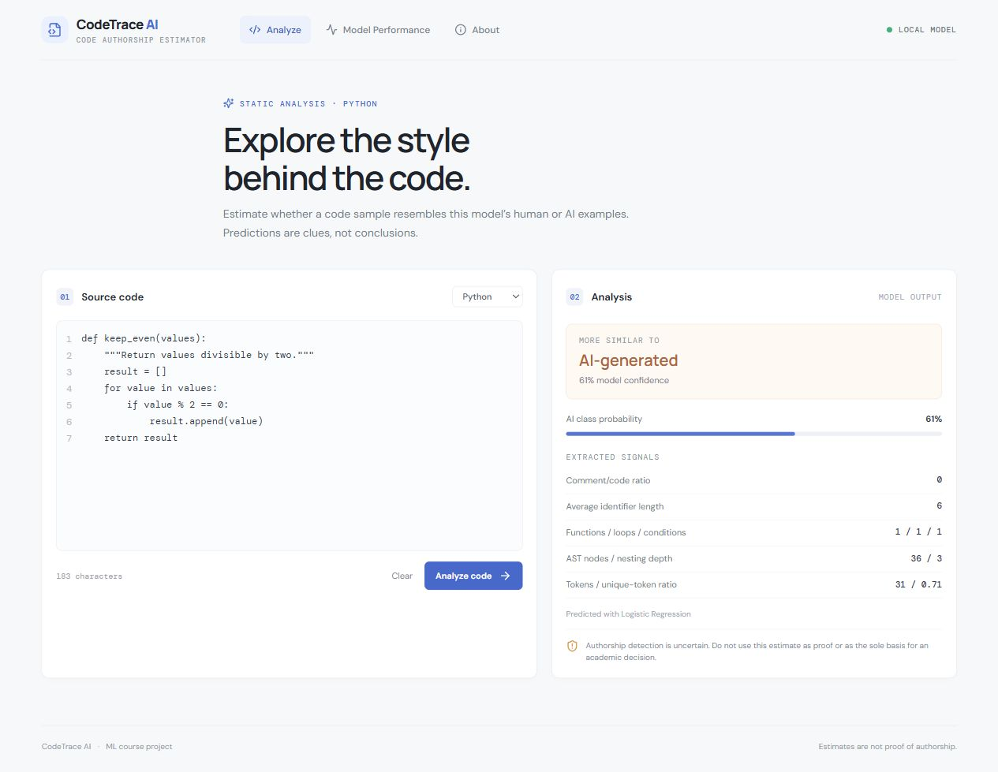
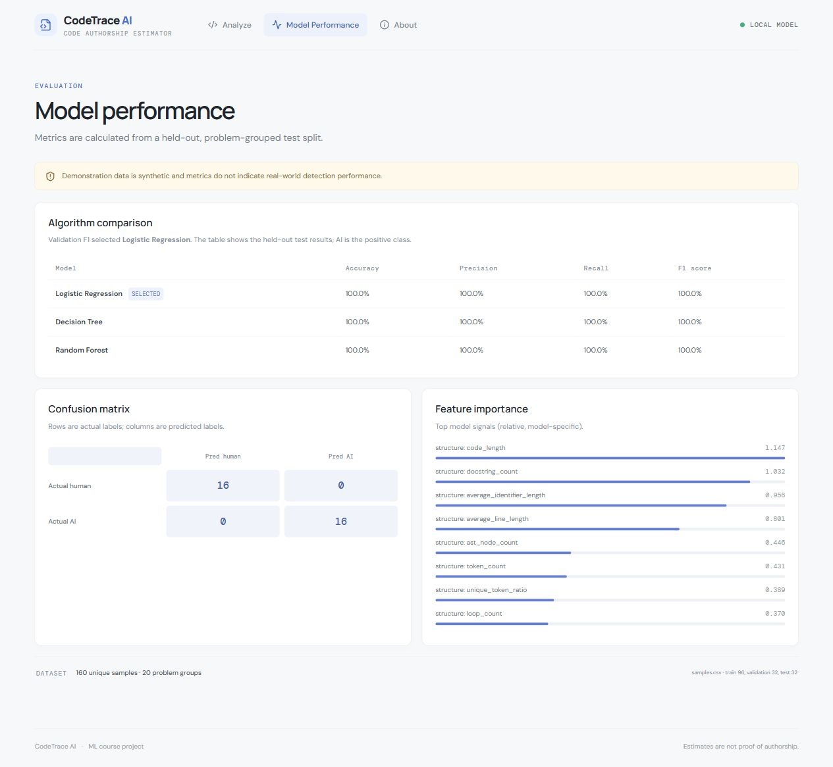
CODETRACE AI / ML MINI PROJECT
Website demonstration
Real prediction view
Real performance view
Aman Sharma
13 / 18
Notes:
The screenshots are from our running application. In the live demonstration I will paste valid Python and press Analyze. The request goes to FastAPI, which loads the saved pipeline and returns the prediction. I will point to the AI-class probability and the extracted structural and style signals. I will then open Model Performance to show the actual saved comparison table and confusion matrix, and About to show the scope and limitations. The interface has three views rather than separate landing and prediction systems. If the server is unavailable, these screenshots and recorded JSON outputs provide an honest demonstration fallback.
Sources: actual repository backend/features.py, train.py, predict.py, main.py and models/metrics.json; experiments in evaluation_package/05_Experiments. Literature source URLs: https://ajic.wits.ac.za/article/view/21309 ; https://link.springer.com/article/10.1007/s40979-023-00146-z ; https://onlinelibrary.wiley.com/doi/10.1002/spe.2146 ; https://link.springer.com/article/10.1023/A:1010933404324 . School/logo source: https://www.manipal.edu/academics/departments/school-of-computer-engineering-mit-manipal .

Slide 14
CODETRACE AI / ML MINI PROJECT
Controlled equivalent-code edits
Input change | Class | AI probability
original | human | 0.0448
variable naming | ai | 0.9983
comment density | human | 0.0863
formatting | human | 0.0176
structure | ai | 0.5442
Logic-preserving edits can change the class estimate.
Multiple lexical and numeric measurements change together.
Aman Sharma
14 / 18
Notes:
The baseline function filters even integers. We apply several changes while preserving that behavior for ordinary finite integer lists. Long camelCase names change identifier statistics, code length and lexical words. Adding comments changes comment ratio and lexical content. Compact spacing changes line and source length while much AST structure remains unchanged. Replacing the loop with a comprehension changes the selected AST counts. The exact before-and-after probabilities are recorded in the experiment CSV and shown here. Some changes alter the predicted class and others only alter probability. We did not force any label switch; unchanged decisions are meaningful observations too.
Sources: actual repository backend/features.py, train.py, predict.py, main.py and models/metrics.json; experiments in evaluation_package/05_Experiments. Literature source URLs: https://ajic.wits.ac.za/article/view/21309 ; https://link.springer.com/article/10.1007/s40979-023-00146-z ; https://onlinelibrary.wiley.com/doi/10.1002/spe.2146 ; https://link.springer.com/article/10.1023/A:1010933404324 . School/logo source: https://www.manipal.edu/academics/departments/school-of-computer-engineering-mit-manipal .

Slide 15
CODETRACE AI / ML MINI PROJECT
Configuration experiments
Validation configuration | Accuracy | F1
All features; C=1 | 1.000 | 1.000
Without lexical features | 1.000 | 1.000
Without stylometric group | 1.000 | 1.000
Without structural group | 1.000 | 1.000
C=0.01, 1, 100 changes baseline probabilities.
Thresholds 0.40–0.70 leave validation class scores unchanged.
One unlabeled factorial prediction cannot establish generalization.
Aman Sharma
15 / 18
Notes:
We also change the learning configuration reproducibly. Stronger and weaker regularization change the baseline probability while all tested validation class metrics remain perfect. Ablation retrains after removing defined feature groups. Those groups overlap conceptually with remaining length and token statistics, so the results are conditional comparisons rather than clean isolation of every notion of style. The tested thresholds leave validation precision and recall unchanged because no validation scores cross the boundaries. Finally, a factorial function probes a different task. We can report its output, but because it has no verified authorship label, we cannot turn that single probe into a generalization accuracy.
Sources: actual repository backend/features.py, train.py, predict.py, main.py and models/metrics.json; experiments in evaluation_package/05_Experiments. Literature source URLs: https://ajic.wits.ac.za/article/view/21309 ; https://link.springer.com/article/10.1007/s40979-023-00146-z ; https://onlinelibrary.wiley.com/doi/10.1002/spe.2146 ; https://link.springer.com/article/10.1023/A:1010933404324 . School/logo source: https://www.manipal.edu/academics/departments/school-of-computer-engineering-mit-manipal .

Slide 16
CODETRACE AI / ML MINI PROJECT
Limitations and future scope
01
Synthetic provenance and shared template families
02
Sensitive to renaming and refactoring
03
No calibration or unseen-generator validation
04
First priority: consented, matched and diverse data
05
Then grouped repeated evaluation, richer features and languages
Aman Sharma
16 / 18
Notes:
The strongest limitation is the dataset, not the choice of classifier. Synthetic labels and repeated templates make the measured problem much easier than real authorship detection. Probability outputs are uncalibrated. Equivalent refactoring can change estimates, and there is no evidence of performance on unseen generators, languages or real assignments. Our first improvement should be consented human submissions and matched generated outputs with known provenance. We should split by meaningful task families and authors where appropriate, repeat grouped evaluation and keep an independent final test set. Only then should we compare advanced models, richer AST features, entropy or extra languages.
Sources: actual repository backend/features.py, train.py, predict.py, main.py and models/metrics.json; experiments in evaluation_package/05_Experiments. Literature source URLs: https://ajic.wits.ac.za/article/view/21309 ; https://link.springer.com/article/10.1007/s40979-023-00146-z ; https://onlinelibrary.wiley.com/doi/10.1002/spe.2146 ; https://link.springer.com/article/10.1023/A:1010933404324 . School/logo source: https://www.manipal.edu/academics/departments/school-of-computer-engineering-mit-manipal .

Slide 17
CODETRACE AI / ML MINI PROJECT
Conclusion
01
Completed: static ML pipeline + saved inference + web app
02
Verified: actual evaluation and reproducible experiments
03
Observed: equivalent code can receive different estimates
04
Research claim: educational prototype, reliability unvalidated
Aman Sharma
17 / 18
Notes:
We have completed the computational workflow from source input through static features and fitted transformations to saved-model inference and a working website. We have also made the results and sensitivity experiments reproducible. The experiments show both stable and changing predictions under controlled modifications, which helps explain the relationship between features and learned behavior. The actual claim we can defend is an educational prototype with transparent limitations. We cannot defend operational authorship reliability from this dataset. That distinction is central to the project, because a clear explanation of what the experiment establishes is more valuable than an impressive-looking accuracy number.
Sources: actual repository backend/features.py, train.py, predict.py, main.py and models/metrics.json; experiments in evaluation_package/05_Experiments. Literature source URLs: https://ajic.wits.ac.za/article/view/21309 ; https://link.springer.com/article/10.1007/s40979-023-00146-z ; https://onlinelibrary.wiley.com/doi/10.1002/spe.2146 ; https://link.springer.com/article/10.1023/A:1010933404324 . School/logo source: https://www.manipal.edu/academics/departments/school-of-computer-engineering-mit-manipal .

Slide 18
CODETRACE AI / ML MINI PROJECT
References and questions
01
[1] Adegbite & Kotzé, AJIC, 2025
02
[2] Weber-Wulff et al., IJEI, 2023
03
[3] Burrows et al., Software: Practice and Experience, 2014
04
[4] Breiman, Machine Learning, 2001
05
Full DOI and verification record in the package
Aman Sharma
18 / 18
Notes:
Thank you. We are ready to discuss the mathematics, source code, data protocol and reliability concerns. Yash can explain the motivation, literature and dataset. Nishaanth can walk through tokenization, AST measurements, TF-IDF, scaling and the classifiers. I can demonstrate the API, saved inference, evaluation and experiments. If a question asks why we chose XGBoost, the accurate answer is that it is not implemented. If asked why the scores are perfect, we will explain the repeated synthetic templates. The references and reproduction scripts are available in the evaluation package for inspection.
Sources: actual repository backend/features.py, train.py, predict.py, main.py and models/metrics.json; experiments in evaluation_package/05_Experiments. Literature source URLs: https://ajic.wits.ac.za/article/view/21309 ; https://link.springer.com/article/10.1007/s40979-023-00146-z ; https://onlinelibrary.wiley.com/doi/10.1002/spe.2146 ; https://link.springer.com/article/10.1023/A:1010933404324 . School/logo source: https://www.manipal.edu/academics/departments/school-of-computer-engineering-mit-manipal .

