Slide 1
Billy – Buddy Against Cyber Bullying
PIP2001 Capstone Project
Review-0
Batch Number: CSD-G10
Under the Supervision of,
Dr. Manjula H M,
Professor,
School of Computer Science and Engineering
Presidency University
20211CSD0156 | Yashraj
20211CSD0170 | Nayeem Laheji
20211CSD0175 | Shivakumar Ramu Kamate
20211CSD0181 | Bharath G
Roll Number | Student Name
Name of the Program: CSE (Data Science)
Name of the HoD: Dr. Saira Banu Atham
Name of the Program Project Coordinator: Dr. Manjula H M
Name of the School Project Coordinators: Dr. Sampath A K / Dr. Abdul Khadar A / Mr. Md Ziaur Rahman

Slide 2
Content
Problem Statement
Github Link
Analysis of Problem Statement
Timeline of the Project
References

Slide 3
Problem Statement Number: PSCS200
Organization: AICTE
Category (Hardware / Software / Both) : Software
Problem Description:
Cyberbullying is a form of harassment on a social/online platform. It has become very common, especially among teenagers.
Harmful bullying behavior can include posting rumors, threats, sexual remarks, a victims’ personal information , or pejorative
labels (i.e., hate speech), Bullying or harassment can be identified by repeated behavior and an intent to harm. victims may
have lower self-esteem, increased suicidal ideation, and a variety of emotional responses, including being scared, frustrated,
angry, and depressed. Our Website: Provides instant help through a user-friendly chatbot (“Billy”) which not only comforts the
victim but also reports the person behind, to the cyber-crime department keeping the user’s identity anonymous. It will provoke
the victim to provide important information and evidences. It will also calculate the statistics of cyber-crimes in an area visible
to the cyber crime department to keep a track of crimes on a regular basis. The areas with red alert will be given more focus in
any part of the country. Tips and defense tactics would be mentioned on the website to guide the youth and others. Connects
the people across the country who have already faced cyber-bullying by forming a community which would help the victims to
learn from the experiences of the formers. We would incorporate Q&A sessions and let them share experiences online. All the
data will be kept anonymous so that it cannot be used in a negative way.
Difficulty Level: Medium

Slide 4
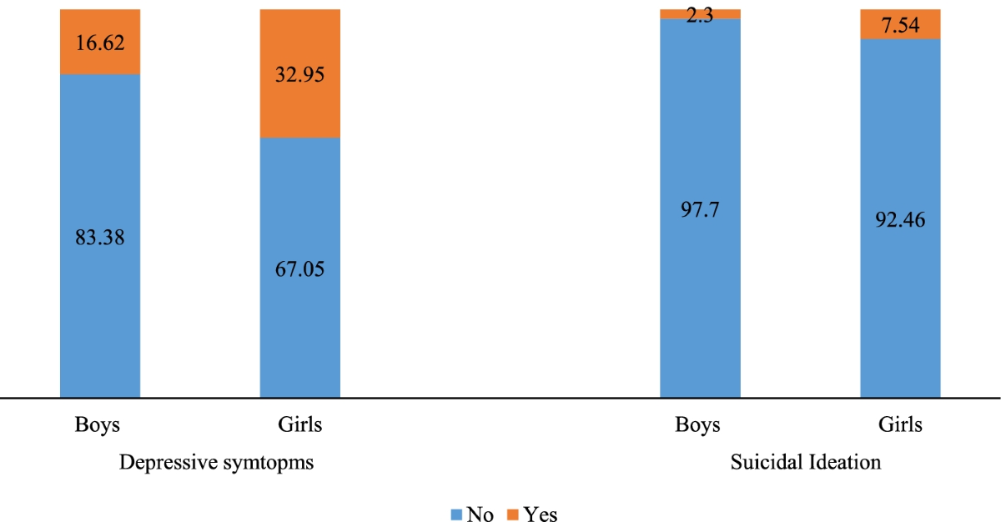
surveys conducted in two most-populated Indian states of Uttar Pradesh and Bihar., 2015-16, 2018-19

Slide 5
Github Link
The Github link provided should have public access permission.
Github Link
https://github.com/yashraj2003e/CSD-G10_billy_buddy_against_cyber_bullying

Slide 6
Analysis of Problem Statement
Technology Stack Components:
Frontend – React.js
Backend – Express.js
Database – PostgreSQL
4. Chatbot – Tensorflow (Python) /LLMs API/DialogFlow
5. Data Visualization – D3.js/Chart.js
6. Hosting – Netlify, AWS/Azure/DigitalOcean

Slide 7
Analysis of Problem Statement (contd...)
Software and Hardware Requirements:
VSCode – Visual Studio Code software for developing frontend and backend of the application.
Postman – To Test Application APIs.
Git – For Version Control System
PyCharm – For training the Machine Learning Model if Python libraries are used.

Slide 8
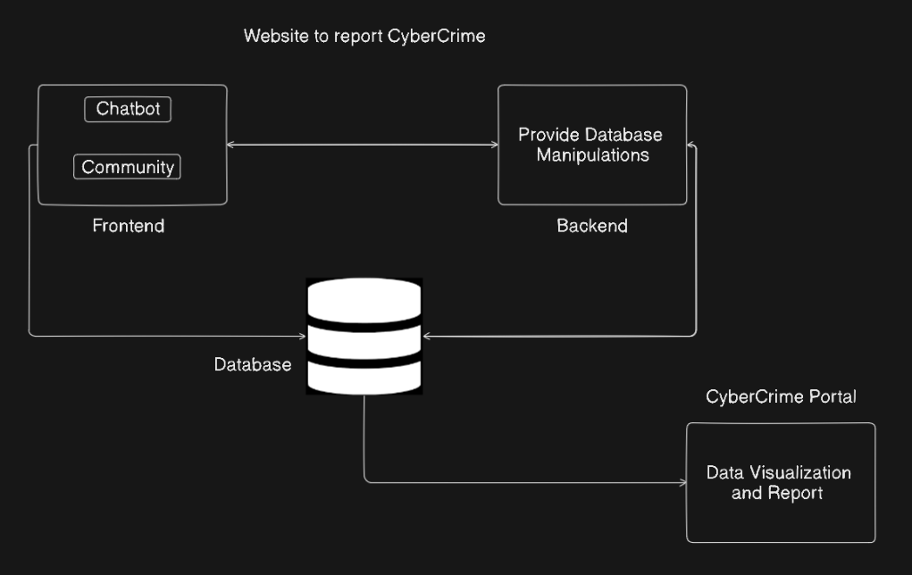
Analysis of Problem Statement (contd...)

Slide 9


Slide 10
Timeline of the Project (Gantt Chart)
Review 0 • 18-09-2024
Discuss the Approach of the
Problem Statement
Review 1
Front-End Area Completion for Billy-Chatbot Website and Cybercrime Portal
(30% Completion of Project)
Review 2
Fully-Functional Billy Chatbot that provides support to the victim and registers cyber-bullying to portal
(70% Completion of Project)
0
1
2
3
Final Viva
Voce
Review
Review 3
100% completion of project, Billy-Buddy Website with Community and Live Analytics of Cyber-Bullying all hosted on the web
Final Viva-Voce
Live Demonstration of the project and submission of the Publication Paper

Slide 11
References (IEEE Paper format)
Kumar, Y. J. N., Vanapatla, R. R., Pinamoni, V. K., Kandukuri, J., Almusawi, M., K., A., Kansal, L., & Kalra, R. (2024). Detecting cyberbullying in social media using text analysis and ensemble techniques. E3S Web of Conferences, 507, 01069. https://doi.org/10.1051/e3sconf/202450701069
V, Vijayakumar.,Prasad, Hari (2021). Intelligent Chatbot Development for Text based Cyberbullying Prevention.
Maurya, C., Muhammad, T., Dhillon, P., & Maurya, P. (2022). The effects of cyberbullying victimization on depression and suicidal ideation among adolescents and young adults: A three-year cohort study from India. BMC Psychiatry, 22(1), 599. https://doi.org/10.1186/s12888-022-04238-x

Slide 12


