Slide 1
Billy – Buddy Against Cyber Bullying
PIP2001 Capstone Project
Review-1
Batch Number: CSD-G10
Under the Supervision of,
Dr. Manjula H M,
Professor,
School of Computer Science and Engineering
Presidency University
Roll Number | Student Name
20211CSD0156 | Yashraj
20211CSD0170 | Nayeem Laheji
20211CSD0175 | Shivakumar Ramu Kamate
20211CSD0181 | Bharath G
Name of the Program: CSE (Data Science)
Name of the HoD: Dr. Saira Banu Atham
Name of the Program Project Coordinator: Dr. Manjula H M
Name of the School Project Coordinators: Dr. Sampath A K / Dr. Abdul Khadar A / Mr. Md Ziaur Rahman

Slide 2
Introduction
Cyberbullying is a form of harassment on a social/online platform. It has become very common, especially among teenagers.
Harmful bullying behavior can include posting rumors, threats, sexual remarks, a victims’ personal information , or pejorative
labels (i.e., hate speech), Bullying or harassment can be identified by repeated behavior and an intent to harm. victims may
have lower self-esteem, increased suicidal ideation, and a variety of emotional responses, including being scared, frustrated,
angry, and depressed. Our Website: Provides instant help through a user-friendly chatbot (“Billy”) which not only comforts the
victim but also reports the person behind, to the cyber-crime department keeping the user’s identity anonymous. It will provoke the victim to provide important information and evidences. It will also calculate the statistics of cyber-crimes in an area visible to the cyber crime department to keep a track of crimes on a regular basis. The areas with red alert will be given more focus in any part of the country. Tips and defense tactics would be mentioned on the website to guide the youth and others. Connects the people across the country who have already faced cyber-bullying by forming a community which would help the victims to learn from the experiences of the formers. We would incorporate Q&A sessions and let them share experiences online. All the data will be kept anonymous so that it cannot be used in a negative way.

Slide 3
Literature Review
Authors | Publication Year | Method/ Technology | Outcome | Limitations
Jeevan, N. K., Vanapatla, R. R., Pinamoni, V. K., Kandukuri | 2024 | Ensemble Techniques | Cyberbullying Detection | Not multi-lingual and only classifies the text
Vijayakumar, V., & Prasad, H. D | 2021 | LSTM | Chabot to predict and store cyberbullying | Less data (16k rows)
P. Tata, S. P. Devaneyan, and J. I. Sheeba | 2018 | Linear SVM | Cyberbullying Detection | Need of new Algorithms
C. Ziems, Y. Vigfusson, and F. Morstatter | 2020 | Logistic Regression Classifier | Aggressive Speech Detection | Use of Unlabelled Dataset

Slide 4
Literature Review
Author | Publication Year | Method/ Technology | Outcome | Limitations
Dr. Vijayakumar P | 2021 | CNN and LSTM | Model to detect cyberbullying on text, video and image | Hardware Support is required
N. Lu, G. Wu, Z. Zhang, Y. Zheng, Y. Ren, and K. K. R. Choo | 2019 | CNN | Cyberbullying Detection | Low Precision
Pradheep. T, J L Sheeba | 2017 | Naïve Bayes | Multi-Model Cyberbullying Detection | Need of new algorithms
Tanmayee Patange, Jigyasa Singh, Aishwarya Thorve | 2019 | CNN | Multi-input Cyberbullying Detection | Dataset only consists of Instagram comments

Slide 5
Objectives
Creation of a Friendly Chatbot to report Cyberbullying to authorities.
Helping a victim during distressed moments through chatbot support.
Securely storing Victim’s credentials.
User-Friendly Interface.
A community to educate against Cyberbullying.

Slide 6
Proposed Method
Real-time Assistance with Chatbot "Billy" The chatbot, powered by machine learning using TensorFlow or DialogFlow, provides instant emotional support and practical advice to victims.
Anonymous Reporting System The system will securely forward the collected evidence to the cybercrime department while maintaining the victim’s anonymity. This ensures that victims feel safe reporting incidents without fear of further retaliation. Authentication is managed using JWT.
Community Support and Education The platform fosters a supportive community where victims of cyberbullying can connect and share their experiences.
Data Collection and Visualization Using PostgreSQL as the database, the platform stores incident reports and geographical data.

Slide 7
Methodology
Technology Stack Components:
Frontend – React.js
Backend – Express.js
Database – PostgreSQL
4. Chatbot – Tensorflow (Python) /LLMs API/DialogFlow
5. Data Visualization – D3.js/Chart.js
Hosting – Netlify, AWS/Azure/DigitalOcean
Authentication - JWT

Slide 8
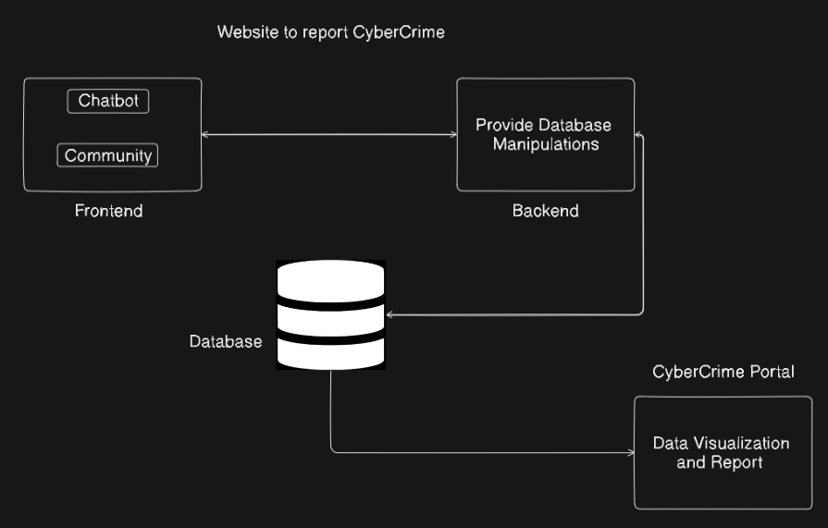
Architecture Diagram

Slide 9
Expected Outcomes
Enhanced Support for Victims: Victims of cyberbullying will have immediate access to emotional support and resources, which can help them cope with their experiences and reduce feelings of isolation.
Increased Reporting of Cyberbullying: By providing an anonymous and secure reporting mechanism, the platform aims to increase the number of reported incidents, facilitating better tracking and response from authorities.
Long-Term Impact: Over time, the platform aims to contribute to a significant reduction in cyberbullying incidents by equipping individuals with the tools they need to combat bullying behaviors and by fostering a culture of support and accountability.

Slide 10
Github Link
https://github.com/yashraj2003e/CSD-G10_billy_buddy_against_cyber_bullying

Slide 11
Timeline of the Project (Gantt Chart)
Review 0 • 18-09-2024
Discuss the Approach of the
Problem Statement
Review 1 • 18-10-2024
Presentation of Proposed Solution
Review 2
Fully-Functional Billy Chatbot that provides support to the victim and registers cyber-bullying to portal
(70% Completion of Project)
0
1
2
3
Final Viva
Voce
Review
Review 3
100% completion of project, Billy-Buddy Website with Community and Live Analytics of Cyber-Bullying all hosted on the web
Final Viva-Voce
Live Demonstration of the project and submission of the Publication Paper

Slide 12


Slide 13
References
Kumar, Y. J. N., Vanapatla, R. R., Pinamoni, V. K., Kandukuri, J., Almusawi, M., Aravinda, K., Kansal, L., & Kalra, R. (Year). Detecting cyberbullying in social media using text analysis and ensemble techniques.
Vijayakumar, V., & Prasad, H. D. (Year). Intelligent chatbot development for text-based cyberbullying prevention.
Sheeba, J. I., Devaneyan, S. P., & Tata, P. (Year). Improved cyberbully detection techniques using multiple correlation coefficient from forum corpus.
Ziems, C., Vigfusson, Y., & Morstatter, F. (Year). Aggressive, repetitive, intentional, visible, and imbalanced: Refining representations for cyberbullying classification.

Slide 14
References
Vijayakumar, V., Prasad, H. D., & Adolf, P. (Year). Multi-input deep learning algorithm for cyberbullying detection.
Lu, N., Wu, G., Zhang, Z., Zheng, Y., Ren, Y., & Choo, K.-K. R. (Year). Cyberbullying detection in social media text based on character-level convolutional neural network with shortcuts.
Pradheep, T., Yogeshwaran, T., Sheeba, J. I., & Devaneyan, S. P. (Year). Automatic multimodel cyberbullying detection from social networks.

Slide 15
Thank You

