Slide 1
Elevator dispatch strategies
How we approached the requirements, and what the strategies show
kkr-simulator-py

Slide 2
Our approach
Four steps, each checked before the next one started
1
2
3
4
Requirements
Entities and Design
Build and test
Compare
Read the rules that decide behaviour: direction, capacity, no look-ahead.
Refer: Requirements.md
Decide on Entities for the system
Layers with one class per strategy, so a new strategy needs no simulator change.
Car and tick first, then each strategy with its own tests.
Same inputs for every strategy: waits, total times, and fairness across cars.

Slide 3
Four rules the design is built around
Direction
Capacity
A passenger boards only when the car is going their way. Riders share one direction.
Riders never exceed a car's capacity. A full car can be given a trip, and the passenger waits for a seat.
No look-ahead
Express cars
A decision at a tick uses only requests made by that tick.
An express car never stops outside its served set. Floor 1 is always served.

Slide 4
Two kinds of requirement: what it does and how well
Both are listed in docs/requirements.md, and the tests check them
Functional (36)
Non-functional (34)
What the simulator does
How well it must do it
• Floors and cars, with their settings
• Requests: source, destination, time
• Assigning each request to a car
• Movement, boarding and alighting
• Traffic modes: NORMAL and rush modes
• Input checks and output files
• Correctness and safety: capacity, direction
• Determinism: same input, same output
• Configurable settings, run with no arguments
• Strategy design and bounded decision time
• Clear error messages, no stack traces
• Testability: each rule can be tested
Functional requirements say what the simulator must do. Non-functional requirements set the standards it must meet.

Slide 5
Traffic modes: NORMAL and four rush modes
One mode is set for each run in elevator.properties (mode=). It decides where an empty car waits.
Mode | Who is travelling | Where an empty car waits
NORMAL | No rush. Everyone is served as they call | The car stays where it last stopped
MORNING_RUSH | People arriving and going up | Floor 1 (the lobby)
LUNCH_BACK_RUSH | People returning and going up | Floor 1 (the lobby)
LUNCH_OUT_RUSH | People leaving and going down | A parking floor set for each car
EVENING_RUSH | People leaving and going down | A parking floor set for each car
The rush modes change only where empty cars wait. The strategies, the eligibility rules and the car movement are the same in every mode.

Slide 6
Technical design: six layers
Each layer depends only on the layers below it
config
settings, checks, building the cars
model
Car, Trip, PassengerRequest, Direction
dispatch
the strategies and the eligibility tiers
simulator
tick loop, request queue, movement and boarding rules
files
request reader and output writer
metrics
waits, total times, summary statistics

Slide 7
Technical design: one tick
The same order in the real run and in every forward-run copy
Record car floors
Riders alight
Assign new requests
Board waiting passengers
Move one floor
Riders alight first, then new requests are assigned. Each car then boards and moves one floor, in car-number order.
A car boards only passengers going its own direction, and only when there is a free seat.

Slide 8
Predicting a pickup time: the forward run
Time-based strategies simulate each car instead of guessing
1. Copy the car
3. Read the result
Riders and pending passengers are copied with it.
The tick at which the new passenger boards gives the pickup time.
2. Add the new request
4. Throw the copy away
Run the copy forward, one tick at a time, with the same steps.
The real car and its trips are never changed.

Slide 9
Round Robin: take turns, and group same-direction riders
Cars are tried in rotation. The pointer moves past the car that was picked.
Requests made at the same time, going the same way, share a car if it has room for all of them and can reach both floors.
A request that cannot be grouped goes alone, to the next car in rotation.
Pass 1: ready now
Has room, and is idle or going the passenger's way with the passenger ahead.
Pass 2: has room
Has room, whatever its direction, since it will turn around.
Pass 3: any car
Any car that serves both floors.

Slide 10
Nearest Car Simple: distance in floors (comparison only)
Distance is the number of floors between the car and the passenger.
A car that can take the passenger now always beats a car that cannot.
If no car can take them now, the nearest car that serves both floors still gets them.
A tie goes to the lower car number.
Distance
|car floor − passenger floor|

Slide 11
Nearest Car: the nearest car in floors
Only cars with room for the passenger now are measured, unless no car has room.
Distance is the floors to the passenger. A car heading away also pays the floors to its turn point and back.
The car with the smallest distance gets the request. Ties go to the lower car number.
Distance
floors to the passenger, plus the detour
an estimate: stops, seats and time at each floor are not counted

Slide 12
Nearest Car Forward Run: the fastest pickup
Each eligible car is tested with a forward run: a copy of the car, with the new request added, runs one tick at a time.
The copy includes the car's riders and pending passengers, so stops, seats and turns are counted.
The car with the smallest wait gets the request. Ties go to the lower car number.
Score
pickup time − request time
measured in ticks

Slide 13
Balanced: pickup time against load (FR-ASN-4d)
Each eligible car gets a score from its wait and its load.
The car with the lowest score gets the request. Ties go to the lower car number.
Both weights default to 1.0 and are set in the code. With the load weight at 0, it matches Nearest Car Forward Run.
Score
wait_time_weight × wait + car_load_weight × passengers
passengers = riders plus pending passengers

Slide 14
Cost Based: keep every passenger's wait fair (FR-ASN-4c)
Each eligible car is tested with a forward run that predicts its trips, including the new passenger.
A car's largest wait is the longest wait of anyone on it, the new passenger included.
The car with the smallest largest wait gets the request, so no one is left far behind.
A tie goes to the lower car number.
Largest wait of a car
max wait over its predicted trips
Chosen car
smallest largest wait

Slide 15
Six strategies, two ways of measuring
Distance-based strategies use floors. Time-based strategies use the forward run.
Strategy | Measures | Forward run | Filters first
ROUND_ROBIN | Rotation, direction, room | No | Ready cars first
NEAREST_CAR_SIMPLE | Floors only | No | Ready cars first
NEAREST_CAR | Floors, plus the turn detour | No | Cars with room first
NEAREST_CAR_FORWARD_RUN | Ticks to pickup | Yes | No
BALANCED_STRATEGY | Wait + load | Yes | No
COST_BASED | Longest predicted wait | Yes | No

Slide 16
How the time-based strategies score a car
1
2
3
Forward run
Cost Based
Balanced
Wait in ticks until the car picks the passenger up.
The longest wait of anyone on the car after the new passenger is added. The smallest wins.
wait_time_weight x wait + car_load_weight x passengers. Both weights are 1.0.

Slide 17
The sample
One input of 100 passengers, the same for every strategy
100
50
6
10
passengers
floors
cars
capacity per car
All cars start on floor 1.
Requests arrive between tick 0 and tick 291, from data/requests_big.csv.

Slide 18
Results on the 100-passenger sample
Green marks the best strategy for each measure
Measure | ROUND_ROBIN | NEAREST_CAR | NEAREST_CAR_FORWARD_RUN | NEAREST_CAR_SIMPLE | COST_BASED | BALANCED_STRATEGY
Average total time | 44.62 | 33.23 | 29.16 | 35.80 | 38.93 | 28.82
Max total time | 132 | 91 | 91 | 132 | 90 | 91
Median total time | 34.0 | 31.0 | 25.0 | 30.0 | 38.5 | 26.0
Max wait | 91 | 87 | 74 | 97 | 49 | 74
95th percentile wait | 75 | 50 | 39 | 74 | 39 | 31
Total floors travelled | 1990 | 1429 | 1524 | 1703 | 1833 | 1554
Passenger balance across cars | 0.986 | 0.942 | 0.939 | 0.972 | 0.925 | 0.967
Total ticks | 364 | 324 | 345 | 369 | 332 | 323
Sample: data/requests_big.csv, one run of 100 passengers. 50 floors, 6 cars, capacity 10, all cars start on floor 1 (config/elevator.properties).

Slide 19
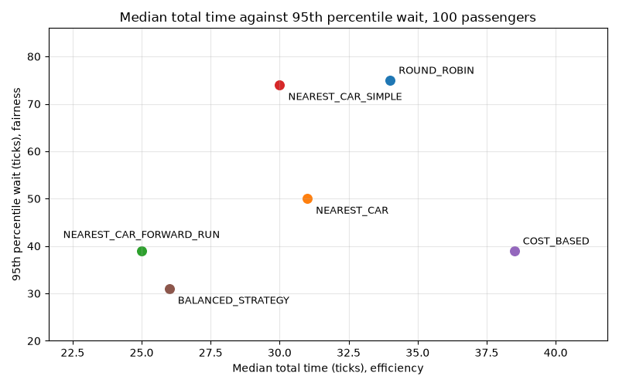
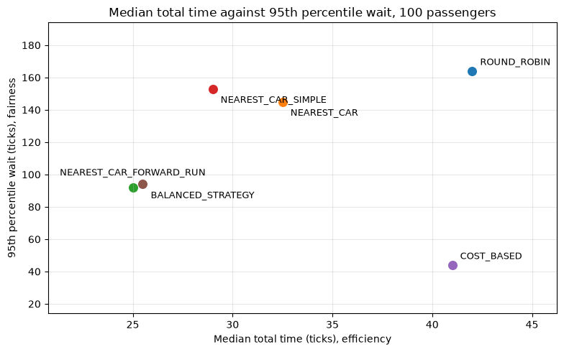
Fairness against efficiency
100 passengers. Lower and further left is better on both measures
Nearest Car Forward Run has the lowest median total time (25.0 ticks), with Balanced close (26.0).
Balanced has the lowest 95th percentile wait (31 ticks), against 39 for Nearest Car Forward Run and Cost Based.
No strategy is best on both, so the choice is a trade-off.
Sample: data/requests_big.csv, one run of 100 passengers. 50 floors, 6 cars, capacity 10 (config/elevator.properties).

Slide 20
What the 100-passenger sample shows
Efficiency
Fairness
Even spread
Nearest Car Forward Run has the lowest median total time, 25.0 ticks.
Balanced has the lowest 95th percentile wait, 31 ticks.
Round Robin spreads passengers most evenly across cars (passenger balance 0.99).

Slide 21
Scenarios: which strategy wins where
Averages over generated traffic (rush hour: 100 files per direction; others: 20 files)
Scenario | Best average wait | Best longest wait | Fewest floors | Most balanced | Fewest total ticks
Rush hour | Nearest Car Forward Run (7.13), just ahead of Balanced (7.33) | Cost Based (16) | Nearest Car Forward Run | Round Robin | Balanced (47.8)
Uniform traffic | Nearest Car Forward Run (4.5) | Cost Based (12) | Nearest Car Forward Run | Round Robin | Cost Based (44.10), just ahead of Nearest Car Forward Run (44.25)
Sparse traffic | Balanced (3.25), just ahead of Nearest Car Forward Run (3.37) | Cost Based (9) | Nearest Car Forward Run | Round Robin | Nearest Car and Balanced (38.80), just ahead of Nearest Car Forward Run (38.95)
Large building | Cost Based (26.7) | Cost Based (51) | Cost Based | Round Robin | Cost Based (166.6)
Samples: generated traffic, averaged over files. Morning and evening rush: 100 files, 30 passengers, 10 floors, 3 cars, capacity 4. Uniform: 20 files, 30 passengers, same building. Sparse: 20 files, 10 passengers. Large building: 20 files, 100 passengers, 50 floors, 6 cars, capacity 8.

Slide 22
Efficiency and fairness across scenarios
Efficiency is the median total time. Fairness is the 95th percentile wait. Averages over generated traffic.
Scenario | Efficiency: lowest median total time | Fairness: lowest 95th percentile wait | Trade-off? | Note
Rush hour (100 files per direction, 30 passengers) | Nearest Car Forward Run (10.9) | Cost Based (15.3) | Yes | Average of morning and evening rush
Uniform traffic (20 files, 30 passengers) | Nearest Car Forward Run (7.7) | Cost Based (11.3) | Yes | Second on the median: Balanced (8.15)
Sparse traffic (20 files, 10 passengers) | Balanced (6.30), just ahead of Nearest Car Forward Run (6.47) | Cost Based (8.7) | Yes | 10 passengers, so the 95th percentile is the maximum
Large building (20 files, 100 passengers) | Nearest Car Forward Run (38.9) | Cost Based (45.6) | Yes | Cost Based 46 against 73 for Nearest Car Forward Run (95th percentile)
Same generated scenarios as slide 21, averaged over files. Rush hour is the average of morning and evening rush.

Slide 23
Longest wait: Cost Based is lowest in every scenario
Mean of the longest wait in each run, in ticks

Slide 24
Conclusion: best and worst, by term
Term | Best | Worst
Average wait | Nearest Car Forward Run in rush hour and uniform traffic; Cost Based in the large building; Balanced in sparse traffic | Round Robin in most scenarios; Nearest Car Simple in rush hour
Longest wait | Cost Based in every scenario | Round Robin in sparse traffic; Nearest Car Simple in most scenarios
Energy (floors) | Nearest Car Forward Run in most scenarios; Cost Based in the large building | Round Robin in most scenarios; Nearest Car Simple in rush hour
Passenger balance | Round Robin in every scenario | Nearest Car Forward Run in sparse traffic; Nearest Car Simple in rush hour; Cost Based in uniform traffic and the large building
Efficiency (median total time) | Nearest Car Forward Run in most scenarios; Balanced in sparse traffic | Round Robin in every scenario
Fairness (95th percentile wait) | Cost Based in every scenario | Round Robin in sparse traffic; Nearest Car Simple in most scenarios
Total ticks (run length) | Nearest Car in sparse traffic; Cost Based in uniform traffic and the large building; Balanced in rush hour and sparse traffic | Round Robin in uniform traffic and sparse traffic; Nearest Car Simple in rush hour and the large building
Simplicity | Nearest Car Simple (the baseline) | Its longest wait is the highest in rush hour, uniform traffic and the large building

Slide 25
What we would improve next
1
Test the trade-off on more request files, and on cars of different capacities.
2
Use peak-mode parking across a group of floors, not one floor.
3
Make the Balanced weights settings, and add an energy-saving strategy.
4
Group passengers by destination, and give each group to one car with a single forward run (destination dispatch). This needs a new strategy and a requirement change first.

Slide 26
Appendix: Morning rush: 100 files of 30 passengers
Means over the files. Green marks the best strategy for each measure.
Measure | ROUND_ROBIN | NEAREST_CAR | NEAREST_CAR_FORWARD_RUN | NEAREST_CAR_SIMPLE | COST_BASED | BALANCED_STRATEGY
Average wait | 9.00 | 7.53 | 6.66 | 9.06 | 7.30 | 7.20
Max wait | 23.1 | 21.0 | 18.7 | 29.2 | 16.1 | 20.4
Median total time | 13.19 | 11.68 | 10.90 | 11.25 | 11.82 | 11.48
95th percentile wait | 20.0 | 18.1 | 14.7 | 25.8 | 15.2 | 15.7
Average total time | 13.51 | 12.05 | 11.17 | 13.58 | 11.82 | 11.72
Total floors travelled | 149.4 | 144.0 | 135.2 | 153.3 | 139.9 | 139.1
Passenger balance across cars | 0.987 | 0.972 | 0.966 | 0.933 | 0.975 | 0.977
Total ticks | 53.0 | 52.4 | 49.1 | 59.0 | 49.7 | 49.0
Sample: generated morning rush, 100 files, 30 passengers each. 10 floors, 3 cars, capacity 4. Empty cars wait on floor 1.

Slide 27
Appendix: Evening rush: 100 files of 30 passengers
Means over the files. Green marks the best strategy for each measure.
Measure | ROUND_ROBIN | NEAREST_CAR | NEAREST_CAR_FORWARD_RUN | NEAREST_CAR_SIMPLE | COST_BASED | BALANCED_STRATEGY
Average wait | 9.55 | 9.28 | 7.61 | 10.06 | 7.71 | 7.45
Max wait | 25.8 | 25.8 | 28.4 | 32.9 | 16.8 | 25.8
Median total time | 13.92 | 13.99 | 10.96 | 12.77 | 12.16 | 11.05
95th percentile wait | 20.8 | 22.2 | 22.9 | 28.0 | 15.4 | 20.7
Average total time | 14.09 | 13.81 | 12.14 | 14.60 | 12.24 | 11.98
Total floors travelled | 143.0 | 136.1 | 133.3 | 143.8 | 138.2 | 133.2
Passenger balance across cars | 0.985 | 0.975 | 0.970 | 0.926 | 0.964 | 0.979
Total ticks | 49.8 | 49.3 | 48.4 | 54.1 | 48.2 | 46.6
Sample: generated evening rush, 100 files, 30 passengers each. 10 floors, 3 cars, capacity 4. Empty cars wait on parking floors 10, 6 and 3.

Slide 28
Appendix: Uniform traffic: 20 files of 30 passengers
Means over the files. Green marks the best strategy for each measure.
Measure | ROUND_ROBIN | NEAREST_CAR | NEAREST_CAR_FORWARD_RUN | NEAREST_CAR_SIMPLE | COST_BASED | BALANCED_STRATEGY
Average wait | 8.17 | 5.80 | 4.52 | 6.44 | 5.98 | 5.11
Max wait | 19.1 | 17.1 | 15.5 | 21.1 | 12.2 | 16.1
Median total time | 11.32 | 8.90 | 7.67 | 8.97 | 9.82 | 8.15
95th percentile wait | 17.1 | 14.1 | 12.8 | 17.7 | 11.3 | 12.7
Average total time | 11.90 | 9.54 | 8.25 | 10.17 | 9.71 | 8.85
Total floors travelled | 128.7 | 109.7 | 105.9 | 121.8 | 115.2 | 112.0
Passenger balance across cars | 0.986 | 0.956 | 0.940 | 0.941 | 0.939 | 0.964
Total ticks | 49.2 | 44.5 | 44.2 | 48.9 | 44.1 | 45.0
Sample: generated uniform traffic, 20 files, 30 passengers each. 10 floors, 3 cars, capacity 4.

Slide 29
Appendix: Sparse traffic: 20 files of 10 passengers
Means over the files. Green marks the best strategy for each measure.
Measure | ROUND_ROBIN | NEAREST_CAR | NEAREST_CAR_FORWARD_RUN | NEAREST_CAR_SIMPLE | COST_BASED | BALANCED_STRATEGY
Average wait | 5.20 | 3.69 | 3.37 | 4.06 | 3.85 | 3.25
Max wait | 10.4 | 10.1 | 9.4 | 10.3 | 8.7 | 9.4
Median total time | 8.35 | 7.00 | 6.47 | 6.83 | 7.05 | 6.30
95th percentile wait | 10.4 | 10.1 | 9.4 | 10.3 | 8.7 | 9.4
Average total time | 8.86 | 7.34 | 7.03 | 7.72 | 7.51 | 6.92
Total floors travelled | 77.3 | 52.5 | 52.4 | 65.0 | 62.5 | 54.4
Passenger balance across cars | 0.976 | 0.832 | 0.807 | 0.899 | 0.896 | 0.836
Total ticks | 42.0 | 38.8 | 39.0 | 40.1 | 39.4 | 38.8
Sample: generated sparse traffic, 20 files, 10 passengers each. 10 floors, 3 cars, capacity 4. With 10 passengers the 95th percentile equals the maximum.

Slide 30
Appendix: Large building: 20 files of 100 passengers
Means over the files. Green marks the best strategy for each measure.
Measure | ROUND_ROBIN | NEAREST_CAR | NEAREST_CAR_FORWARD_RUN | NEAREST_CAR_SIMPLE | COST_BASED | BALANCED_STRATEGY
Average wait | 41.76 | 31.79 | 26.98 | 35.54 | 26.73 | 28.45
Max wait | 93.1 | 95.7 | 111.3 | 141.6 | 50.8 | 96.3
Median total time | 56.70 | 45.85 | 38.88 | 42.08 | 43.00 | 41.70
95th percentile wait | 82.8 | 74.0 | 73.0 | 100.7 | 45.6 | 68.2
Average total time | 58.08 | 48.10 | 43.30 | 51.86 | 43.05 | 44.76
Total floors travelled | 1052.4 | 880.0 | 849.4 | 999.7 | 844.5 | 901.6
Passenger balance across cars | 0.989 | 0.970 | 0.875 | 0.874 | 0.822 | 0.929
Total ticks | 196.2 | 189.2 | 192.1 | 226.2 | 166.6 | 184.3
Sample: generated large building, 20 files, 100 passengers each. 50 floors, 6 cars, capacity 8.

