Slide 1
Hackout (Let’s Meet)
Team Name : ¯\_ (̿▀̿‿ ̿▀̿ ̿)_/¯

Slide 2
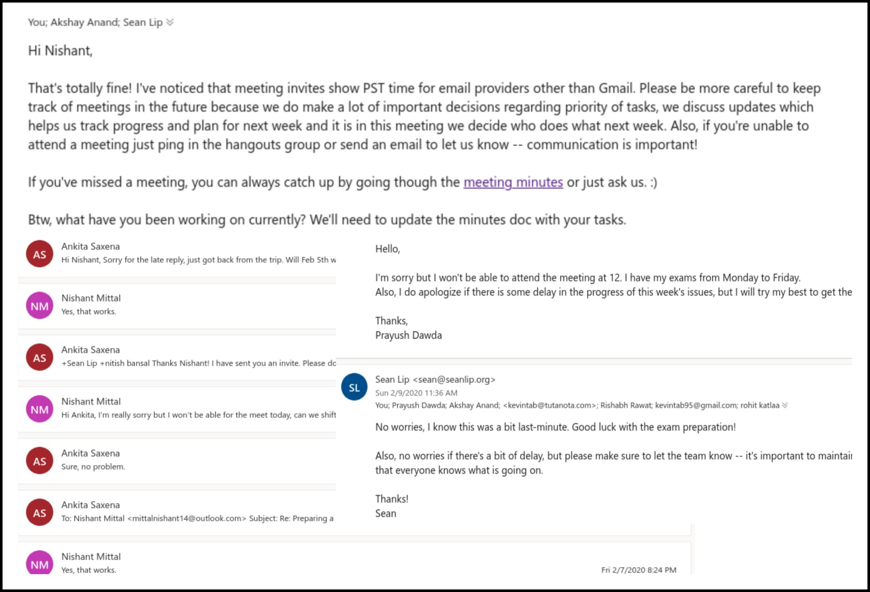
The Problem

Slide 3

Our Solution
Slack application + Web App
Takes care of all your hassle.

Slide 4
Features
Slack Bot - Simple to use with commands.
Web Portal - all meetings / tasks at one place.
Tasks assignment after meeting.
Automatic Video Conference Room - Zoom
Easy to integrate with any platform (Django REST API)

Slide 5



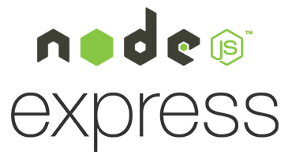

The Tech Stack
Database - PostgreSQL.
Django Rest Framework (REST APIs)
Swagger Tools (API Testing)
NodeJS (Slack Bot)
Express (Slack Bot)
Django (Frontend Web App)
Deployments - Heroku

Slide 6
Future Scope
Scalability:
Through APIs, various other apps will be able to use our services.
Integration with services like:
Github / Gitlab
Trello etc...

Slide 7
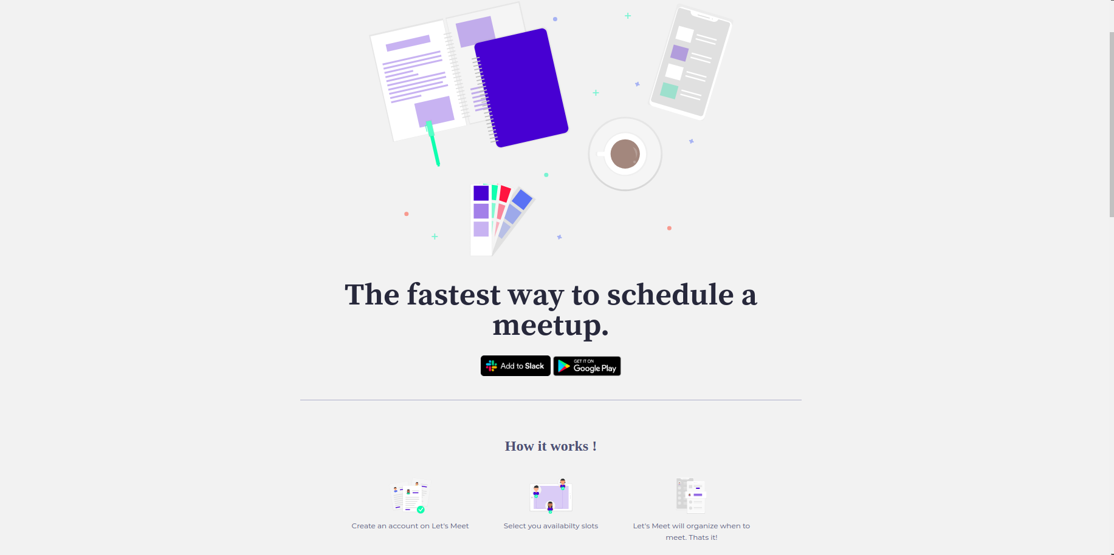
Screenshots (Frontend Web App)

Slide 8
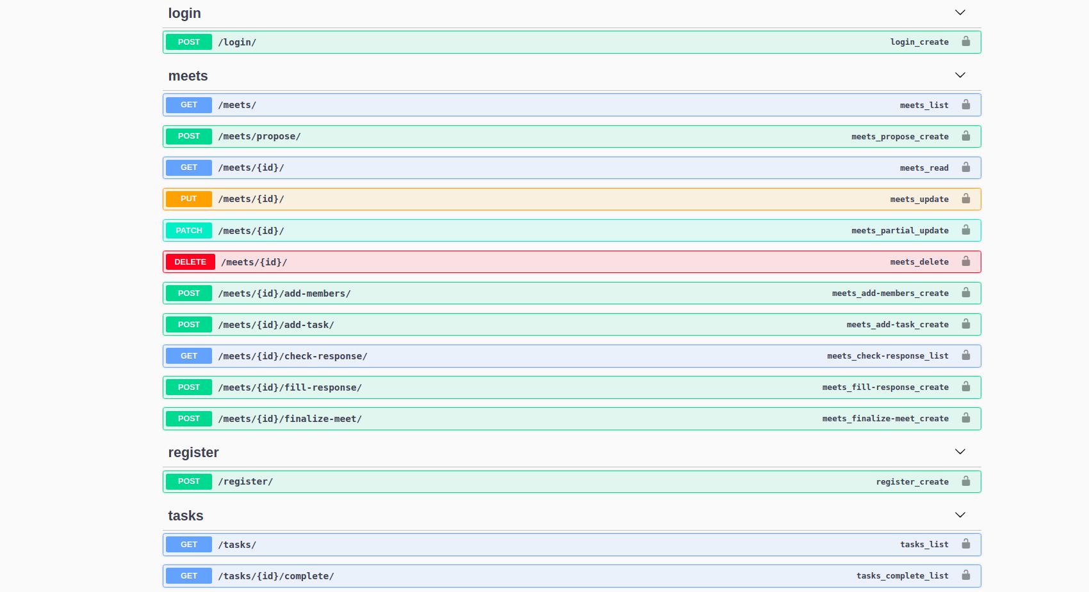
Screenshots (Django REST API)

Slide 9
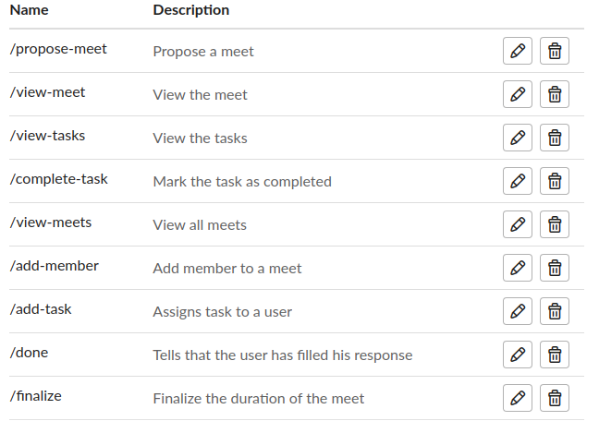
Screenshots (Slash Commands)

Slide 10
Live Demo
https://lets-meet-backend.herokuapp.com/ (Django REST API)
https://lets-meet-slack-bot.herokuapp.com/ (Slack Bot Deployment)
https://lets-meet-web-app.herokuapp.com/ (Frontend Web App)

Slide 11
Team Members:
Nishant Mittal
Ashish Kumar
Nishant Kumar
Yash Raj Bharti

