Slide 1


Customer Shopping Behaviour Analysis - Retail Analytics Report 2026
Insights from 3,900 Customers Across Multiple Dimensions
Prepared by
Yashraj Somnath Kakade
2026

Slide 2



Customer Shopping Behaviour Analysis Report
2026
Project Overview
This page summarizes the purpose and scope of the Customer Shopping Behaviour Analysis project, covering 3,900 transactions across 18 features in the retail domain.
3,900
18
Power BI
Transactions
Features
Dashboard
Retail dataset covering demographics, payment methods, purchase patterns, discounts, and seasonality.
Dataset attributes including age, gender, category, season, review rating, and more.
Interactive Power BI dashboard built for data-driven retail decision-making and insights visualization.

Slide 3

Customer Shopping Behaviour Analysis
2026
Dataset Summary
3,900
The dataset contains 3,900 customer transactions across 18 features, spanning demographics, purchase behaviour, payment methods, and seasonal patterns in the retail domain.
Total Records | 18 Features
Key Metric
Avg Purchase
Avg Rating
Subscribers
Dataset Values
$59.8
3.75 ★
27%

Slide 4

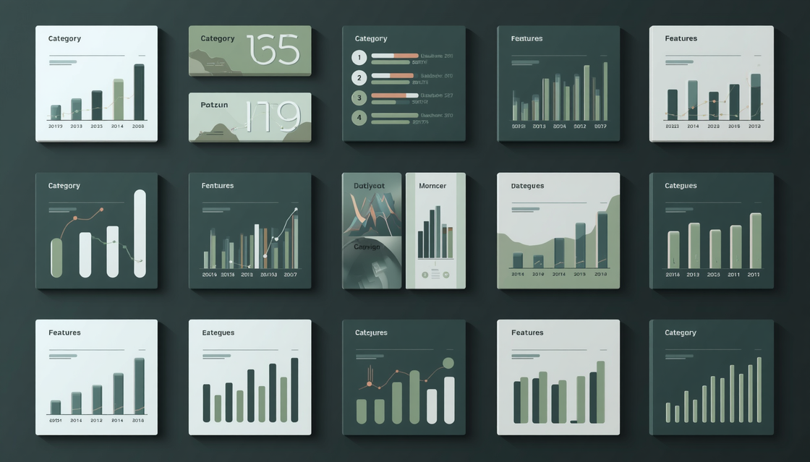
Yashraj S. Kakade
Customer Shopping Behaviour Analysis
2026
Features Breakdown
Overview of the 18 dataset features grouped into four logical categories covering customer attributes, purchase details, behaviour patterns, and transaction specifics.
01
Customer & Demographics
03
Purchase Details
Customer ID, Age, Gender, Location
Item Purchased, Category, Purchase Amount, Season, Review Rating
02
Customer Status & Behaviour
04
Transaction Details
Subscription Status, Previous Purchases, Frequency of Purchases
Payment Method, Shipping Type, Discount Applied, Promo Code Used

Slide 5
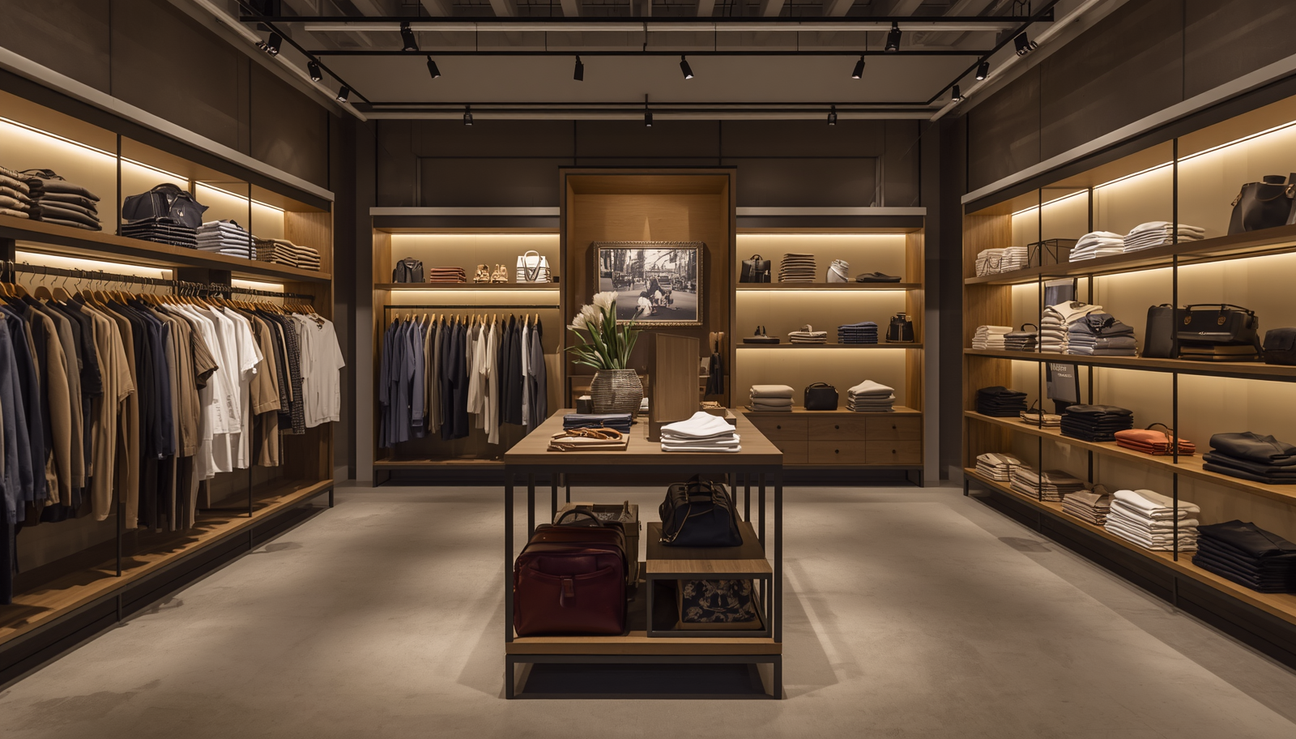
Retail Analytics
Customer Shopping Behaviour Analysis Report
2026
Category & Revenue Insights
1,737
Transaction and revenue distribution across 4 product categories. Clothing dominates with nearly half of all transactions, while purchase amounts remain remarkably consistent across all categories.
Clothing — 44.5%, avg $60.0
1,240
Accessories — 31.8%, avg $59.8
599
Footwear — 15.4%, avg $60.3
Outerwear — 8.3% (324), avg $57.2

Slide 6

Customer Shopping Behaviour Analysis Report
2026
Customer Demographics
68%
Male customers
Analysis of 3,900 customers reveals a male-dominant base at 68%, with an average age of 44.1 years. The 36–45 age group represents the most active buyers, informing targeted retail strategies.
2,652
Male customers
1,248
Female customers

Slide 7
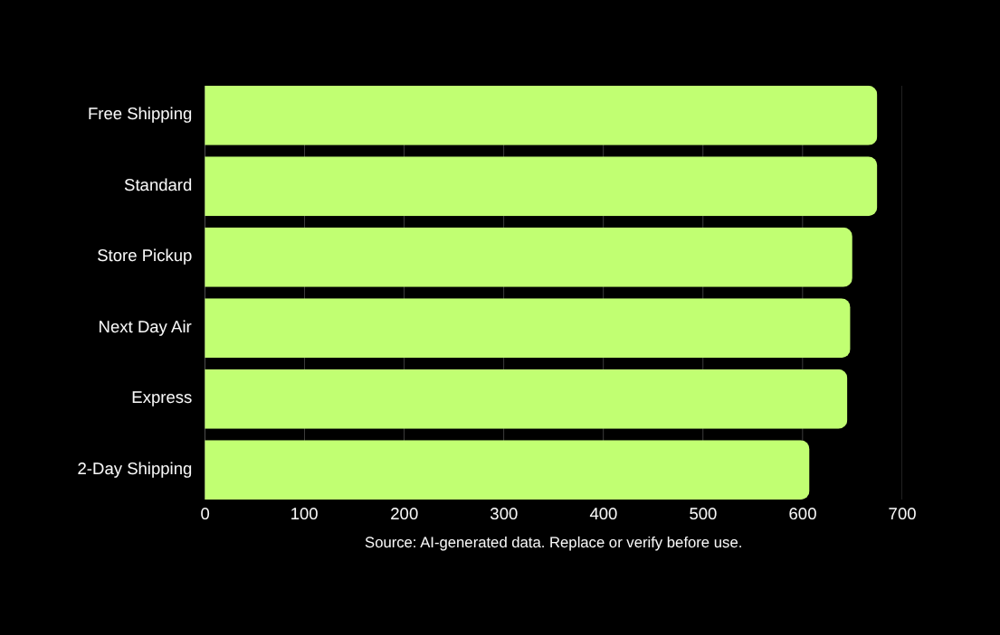
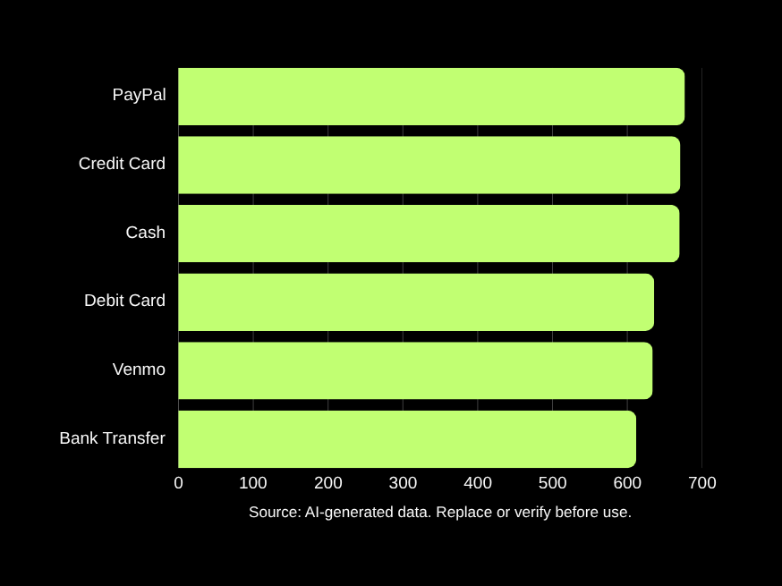
Customer Shopping Behaviour Analysis
2026
Payment Methods & Shipping
Payment methods are fairly balanced: PayPal (677), Credit Card (671), Cash (670), Debit Card (636), Venmo (634), Bank Transfer (612). Shipping types are nearly evenly distributed across Free Shipping, Standard, Store Pickup, Next Day Air, Express, and 2-Day Shipping — indicating customers value choice with no single dominant preference.

Slide 8
Customer Shopping Behaviour Analysis
2026
Purchase Frequency & Seasonality
2026 Data
Purchase frequency is evenly spread from weekly to annual buyers. Seasonal transactions are stable year-round with consistent average purchase amounts of $59.4–$60.2.
Spring
Summer
Fall / Winter
01
Purchase Frequency
02
Seasonality
Every 3 Months: 584 customers (most common), Weekly: 539 (smallest segment)
Spring: 999 | Fall: 975 | Winter: 971 | Summer: 955 transactions
03
Avg. Purchase
Stable across all seasons: $59.4 – $60.2 per transaction

Slide 9
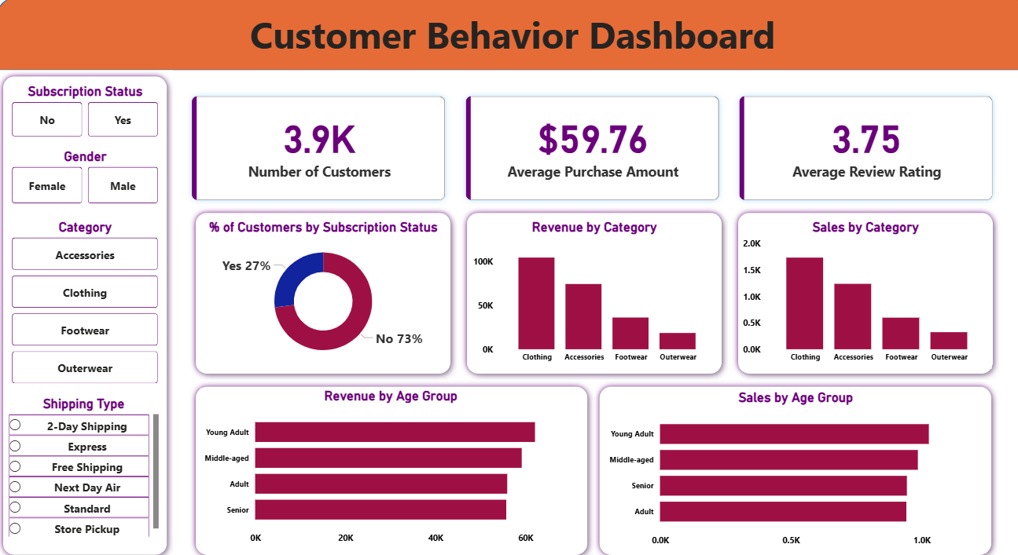
Customer Shopping Behaviour Analysis Report
2026
Power BI Dashboard Insights
An interactive Power BI dashboard was developed to enable drill-down and filtering for actionable retail insights across 3,900 customer transactions.
01
Overview Panel: Transactions & Revenue
Displays total transactions, revenue, category breakdown, and payment methods.
02
Demographics Panel: Age & Gender
Covers age groups, gender distribution, shipping types, and review ratings.
03
Drill-Down & Filtering Capabilities
Enables dynamic filtering for actionable, data-driven retail decisions.

Slide 10
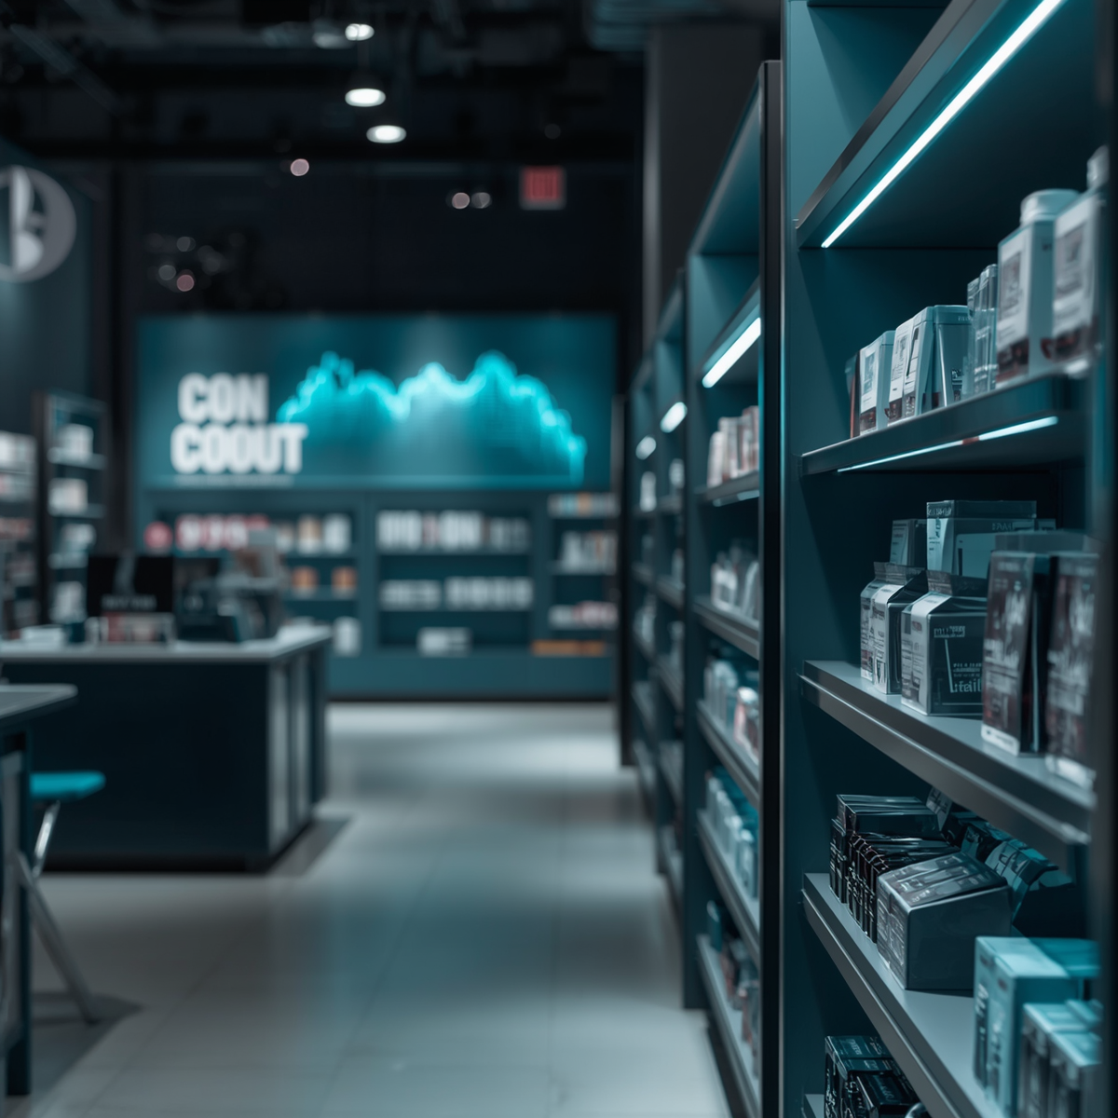




Customer Shopping Behaviour Analysis - Retail Analytics Report 2026
2026
Conclusions
Clothing leads at 44.5% of transactions with consistent avg. purchase amounts across all categories and seasons. Balanced payment and shipping preferences confirm customer choice is essential. Year-round demand supports steady inventory planning.
Key Recommendations:
Grow loyalty programs (only 27% subscribers)
Maintain diverse payment & shipping options
Refine promotional strategies (43% use discounts)
Plan steady inventory for year-round demand

