Slide 1
Face Rotation Classification
Centre for development of Advanced Computing
By
-Gagan Khandelwal
-Mayuresh Patil
-Vivek Singh
-Yashraj Modani

Slide 2
Problem Statement
The task of rotation classification involves determining the angle by which an image has been rotated and assigning it to one of four discrete classes:
0° (rotation between 315° and 45°),
90° (rotation between 45° and 135°),
180° (rotation between 135° and 225°),
270° (rotation between 225° and 315°).

Slide 3
Objective
.
The primary objectives of this project are:
Rotation Classification: Develop a deep learning model to classify facial images into four rotation categories.
Robustness: Ensure the model generalizes well to unseen data through dynamic data augmentation techniques.
Model Comparison: Evaluate and compare the performance of multiple architectures, including VGG-16, ResNet-18, ResNet-34, ResNet-50, Vision Transformer (ViT), and a custom CNN.
Usability: Created an intuitive web interface with Streamlit for end-user interaction.

Slide 4
Proposed System
Face Detection & Preprocessing: MTCNN is used to detect faces from images, followed by resizing, normalization, and rotation augmentation (0°, 90°, 180°, 270°).
Deep Learning-Based Classification: Various models (VGG16, ResNet18, ResNet34, ResNet50) are trained to classify face orientation accurately.
Performance Benchmarking: The CelebA dataset is used for training, while the Human Faces dataset from Kaggle (7,219 images) is used for benchmarking to select the best model.
Evaluation & Optimization: Accuracy, confusion matrix, and loss metrics are analyzed, and hyperparameters are fine-tuned for improved performance.

Slide 5
System Architecture & Workflow
System Architecture
Input Image: Face images from the CelebA and Human Faces datasets.
Face Detection: MTCNN is used to detect and extract faces from images.
Preprocessing: Images are resized, normalized, and rotated into four classes (0°, 90°, 180°, 270°).
Feature Extraction & Classification: Deep learning models (VGG16, ResNet18, ResNet34, ResNet50) classify face rotation.
Model Evaluation: Accuracy, loss, and confusion matrix are analyzed to select the best model.

Slide 6
Workflow
Dataset Loading & Preprocessing: Face detection, resizing, normalization, and augmentation.
Model Training: Training multiple deep learning models with rotation-labeled images.
Evaluation & Benchmarking: Testing on the Kaggle Human Faces dataset for model selection.
Final Model Deployment: Best-performing model is used for real-world classification tasks.

Slide 7
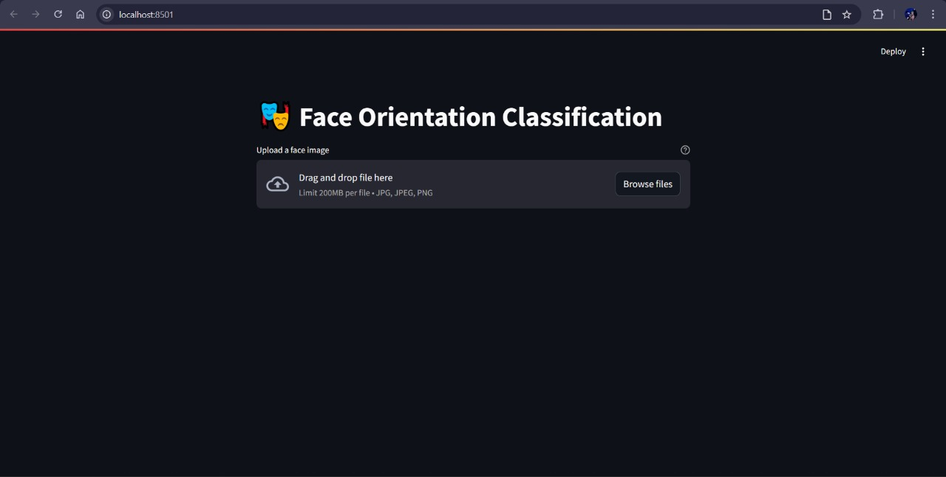
User Interface-

Slide 8
Conclusion & Future Scope
The proposed system effectively classifies face orientations (0°, 90°, 180°, 270°) using deep learning models, with MTCNN for face detection and preprocessing. Benchmarking on the Human Faces dataset ensures optimal model selection. The system demonstrates high accuracy, making it useful for biometric authentication, surveillance, and image alignment.
Future Scope -
Improve accuracy with advanced models like Swin Transformer.
Optimize for real-time applications in surveillance and AR/VR.
Extend classification to arbitrary face rotations.
Train on larger datasets for better generalization.

Slide 9
Thank You !!

