Slide 1
Slide 1 — MakeMyTrip Clone
Frontend Web Development Project
A frontend clone inspired by the MakeMyTrip travel website
Designed to provide a simple and attractive travel-booking experience
Focused on user-friendly interface and responsive design
Presented by: Yash Rajput

Slide 2
Slide 2 — Project Overview
About the Project
MakeMyTrip Clone is a frontend web development project.
It replicates the basic design and layout of a travel-booking website.
Users can explore different travel services through an easy-to-use interface.
The project focuses mainly on UI/UX and frontend functionality.
Objective:
Create a modern and responsive travel website.
Make navigation simple and user-friendly.
2

Slide 3
Slide 3 — Technologies Used
1. HTML
2. CSS
3. JavaScript
Used to create the structure of the website.
Creates sections, buttons, forms, navigation bars, etc.
Used for styling and designing the website.
Handles colors, fonts, spacing, layouts and responsiveness.
Adds interactivity and dynamic functionality.
Used for buttons, search interactions, form validation and user actions.
3

Slide 4
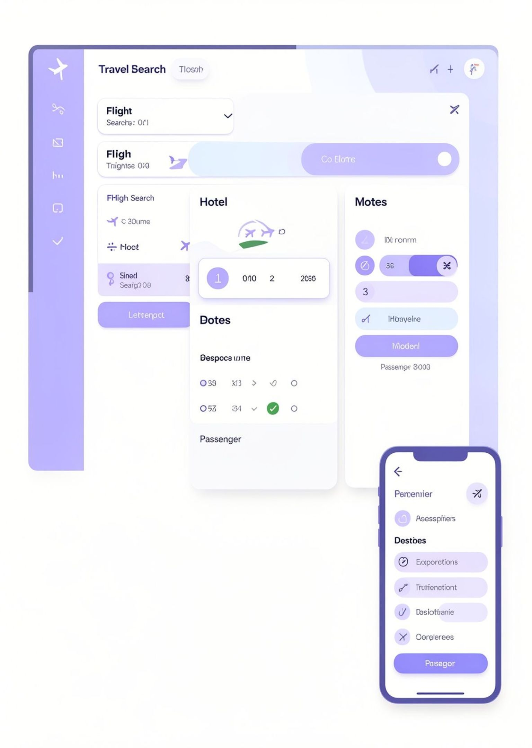








Slide 4 — Key Features
Responsive Homepage
Flight Search Section
Hotel Search Section
Search and Input Forms
Date Selection
Passenger/Guest Selection
Modern and Attractive UI
4
Responsive Design for Different Screen Sizes

Slide 5
Slide 5 — User Flow
How the Website Works
User opens the MakeMyTrip Clone website.
User selects a travel service such as Flights or Hotels.
User enters required details.
JavaScript processes the user's input.
Available/search results are displayed.
User selects the required option and continues.
Main Focus:
Simple navigation + attractive UI + smooth user interaction.
5

Slide 6
Slide 6 — Conclusion & Future Scope
Conclusion
Future Scope
Successfully designed a travel-booking website frontend.
Learned practical implementation of HTML, CSS and JavaScript.
Improved understanding of responsive web design and user interface development.
Add real-time flight and hotel APIs.
Add user login and registration.
Integrate online payment.
Connect the website with a database.
Add complete booking and cancellation functionality.
Thank You
Any Questions?

