Slide 1
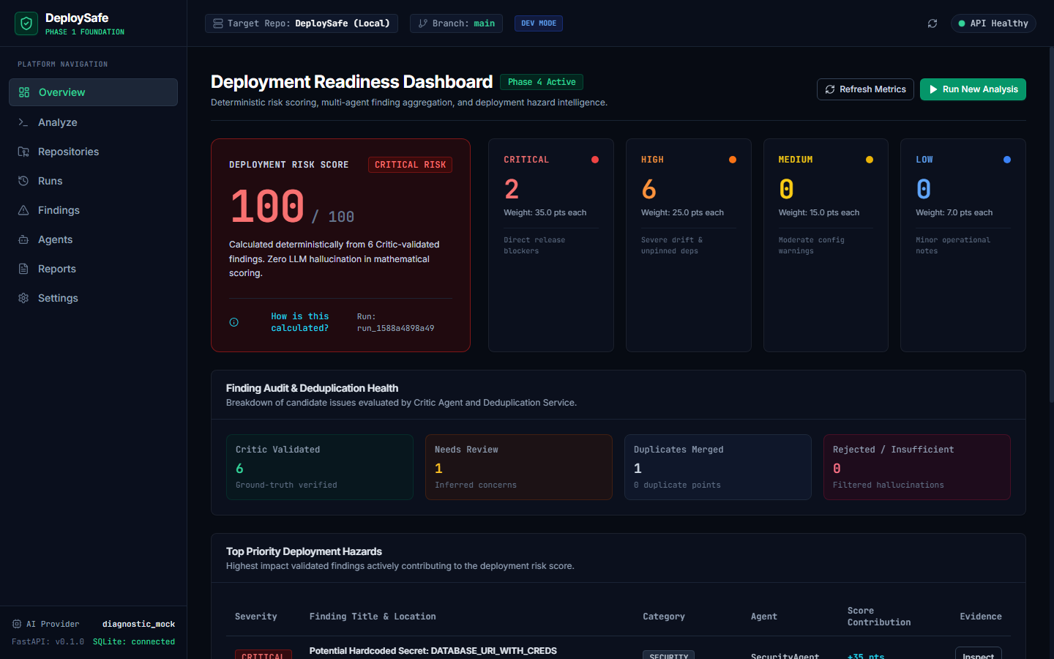
DEPLOYSAFE
Deployment Readiness Analysis Before Release
An intelligent analysis layer that identifies cross-domain deployment risks across code, configurations, dependencies, and documentation.
Agentic AI · CSE3101 · Midterm Presentation
Team DeploySafe · Evaluation Repository Demo
Actual DeploySafe Console · Deterministic Risk Overview
DeploySafe · Agentic AI · CSE3101 01 / 10
Notes:
TALKING POINTS:
• Good morning Professor. Today we present DeploySafe, an AI-powered deployment readiness platform.
• DeploySafe analyzes software repositories before release to detect deployment-blocking risks that traditional CI tests miss.
• It evaluates code changes, deployment configurations, dependencies, and documentation in unison.
• All findings are validated by an adversarial Critic agent and scored with a deterministic risk engine.
LIKELY PROFESSOR QUESTION:
Why is this problem best solved by Agentic AI rather than standard static analysis?
CONCISE ANSWER:
Static analysis checks individual files for syntax and stylistic rules in isolation. DeploySafe uses specialized agents to correlate human intent in documentation with deployment manifests, catching cross-file misconfigurations.

Slide 2
A Passing Pipeline Doesn't Tell the Whole Story
Standard CI/CD checks whether code compiles and passes unit tests—not whether it is safe to deploy.
TRADITIONAL RELEASE PIPELINE
Code Change → Unit Tests (Passed) → Container Build → Production Deployment (Outage)
Blind spot: Unit tests pass completely while environment configurations and service dependencies are broken.
01
Configuration Mismatch
Documentation specifies Redis for session storage, but Redis is completely missing from docker-compose.yml.
Impact: Deployment fails on container boot.
02
Dependency Drift
Unpinned package versions or missing native build dependencies in requirements.txt.
Impact: Build succeeds locally but crashes in production.
03
Missing Environment Variables
Source code expects runtime secrets or port configurations that were never declared in deployment manifests.
Impact: Application throws unhandled 500 crashes.
DeploySafe · Agentic AI · CSE3101 02 / 10
Notes:
TALKING POINTS:
• Every engineering team experiences green CI builds that immediately fail when deployed to production.
• Traditional pipelines execute tests and builds, but they do not reason about cross-file configuration mismatches.
• For example, code can pass 100% of unit tests while docker-compose is missing a required database service.
• DeploySafe bridges this gap by analyzing the systemic deployment context across code, config, and docs.
LIKELY PROFESSOR QUESTION:
Why don't staging environments catch these problems?
CONCISE ANSWER:
Staging catches only scenarios exercised by scripted integration tests. It misses unpinned dependencies, silent config drift, and missing documentation requirements before release.

Slide 3
DeploySafe Adds an Analysis Layer
DeploySafe does not replace CI/CD—it analyzes the change before production release.
CI / CD PIPELINES
Executes Predefined Checks
• Runs pre-programmed test suites and builds
• Checks binary exit codes (0 = Success, 1 = Failure)
• Operates on single files without architectural context
• Cannot read documentation or correlate requirements
DEPLOYSAFE INTELLIGENCE
Analyzes Deployment Readiness
• Correlates code changes against deployment manifests
• Retrieves architectural intent from docs via vector RAG
• Critic verifies physical evidence on repository disk
• Computes a deterministic 0–100 risk score with fixes
THE COMBINED WORKFLOW
Repository Change → [ CI / CD Pipeline + DeploySafe Analysis ] → Deterministic Risk Score + Fixes
DeploySafe · Agentic AI · CSE3101 03 / 10
Notes:
TALKING POINTS:
• We want to emphasize clearly: DeploySafe does not attempt to replace GitHub Actions, GitLab CI, or Jenkins.
• CI/CD is an execution engine. It asks 'Did the tests pass?'
• DeploySafe is an analytical intelligence layer. It asks 'Is this change safe to deploy?'
• By analyzing context and cross-file relationships, DeploySafe complements standard pipelines.
LIKELY PROFESSOR QUESTION:
Does DeploySafe slow down the development workflow?
CONCISE ANSWER:
No. In our tested runs, full multi-agent analysis, Critic validation, and scoring complete in under 2.5 seconds on typical repository sizes.

Slide 4
How DeploySafe Works
An end-to-end pipeline from repository ingestion to deterministic risk scoring.
01
Repository
Code, config, tests,
and documentation
02
Context & RAG
Discovers files and indexes
architectural intent
03
Agents
Specialized agents analyze
technical domains
04
Critic
Checks findings against
actual disk evidence
05
Risk Engine
Calculates deterministic
0–100 risk score
06
Result
Actionable findings with
line numbers and fixes
→
→
→
→
→
Key Architectural Principle: LLMs propose candidate findings; the Critic and Risk Engine enforce strict evidence and deterministic scoring.
DeploySafe · Agentic AI · CSE3101 04 / 10
Notes:
TALKING POINTS:
• Here is the high-level data flow through the DeploySafe pipeline.
• First, the repository is ingested and indexed into ChromaDB for semantic retrieval.
• Specialized domain agents analyze code, configuration, dependencies, tests, and documentation in parallel.
• Candidate findings are submitted to the Critic agent for physical verification before the Risk Engine calculates the score.
LIKELY PROFESSOR QUESTION:
What happens if an agent suggests a finding that does not exist in the code?
CONCISE ANSWER:
The Critic reads the actual target file on disk. If the cited line does not exist or the evidence is invalid, the Critic rejects the finding with a detailed reason, preventing hallucinated alerts.

Slide 5
Why Multiple Agents?
Each agent focuses on one type of repository evidence, allowing focused analysis.
Orchestrator Agent
Inspects tech stack · Plans domain tasks · Runs agents in parallel
Code Agent
Analyzes source code changes, error handling, and runtime safety.
Config Agent
Inspects Dockerfiles, compose specs, and environment variables.
Dependency Agent
Audits package manifests, unpinned versions, and supply chain risks.
Test Agent
Reviews test suite coverage, skipped tests, and deployment relevance.
Documentation RAG
Queries architectural requirements and deployment instructions.
Security Agent
Scans for committed secrets, permissive keys, and security flags.
Critic Agent & Validation Gate
All 6 domain agents submit findings to the Critic. The Critic verifies line existence, checks false positive heuristics, and deduplicates findings before passing them to the Risk Engine.
DeploySafe · Agentic AI · CSE3101 05 / 10
Notes:
TALKING POINTS:
• Why use multiple agents instead of one large prompt? Because deployment readiness spans heterogeneous domains.
• A prompt loaded with Docker syntax, Python ASTs, and package manifests suffers from attention loss.
• DeploySafe divides work into 6 specialized domain agents that execute in parallel.
• All findings must be approved by the Critic agent, ensuring every finding is backed by physical evidence.
LIKELY PROFESSOR QUESTION:
How are the agents orchestrated?
CONCISE ANSWER:
The Orchestrator inspects the repository's technology stack (e.g. Python, Docker, Node) and dispatches independent domain agents concurrently using a thread pool before aggregating findings.

Slide 6
The AI Uses Repository Context
RAG bridges the gap between written developer documentation and deployment code.
SEMANTIC RETRIEVAL PIPELINE
1. Ingestion
Parses README, docs, guides, and configs.
2. Chunking
Splits markdown into header-aware sections.
3. Embeddings
Generates dense semantic vector embeddings.
4. ChromaDB
Stores vectors locally with line metadata.
5. Agent Query
Agents query context via similarity search.
REAL REPOSITORY EXAMPLE
Documentation Context vs. Deployment Manifest
1. Retrieved Architectural Intent (README.md, lines 18–22):
"DeploySafe demo requires an active Redis cache service for distributed session storage (REDIS_URL=redis://redis:6379/0)."
2. Inspected Deployment Manifest (docker-compose.yml, lines 1–15):
services:
web:
build: .
ports: ['8000:8000']
# Redis service completely omitted from compose specification
3. Critic-Validated Finding & Risk Impact:
High Severity: Missing Redis container definition. Web service will crash on initial boot when resolving session cache endpoint.
DeploySafe · Agentic AI · CSE3101 06 / 10
Notes:
TALKING POINTS:
• This slide demonstrates the real power of RAG in DeploySafe.
• Traditional linters only see syntax. They don't know what external services the developer intended to run.
• Here, our RAG agent retrieved documentation from README.md specifying that Redis is required for sessions.
• The Config Agent cross-referenced docker-compose.yml, discovered Redis was missing, and flagged a High-severity crash risk.
LIKELY PROFESSOR QUESTION:
What happens if a repository has no documentation?
CONCISE ANSWER:
DeploySafe continues operating cleanly. Agents fall back to static code inspection and configuration manifests, while the Documentation RAG agent gracefully reports no indexed guidelines.

Slide 7
From Finding to Risk
Findings are backed by exact source lines, and risk is calculated deterministically.
STAGE 1
Candidate Finding
LLM Proposal
The specialized agent identifies a potential problem.
• Category: Configuration Drift
• Title: Missing Redis Service
• Agent: Config Analysis Agent
• Confidence: 0.90 (High certainty)
STAGE 2
Physical Verification
Critic Verification
The Critic checks the actual repository disk.
• Target File: docker-compose.yml
• Line Reference: Lines 1–15 checked
• Heuristic Check: No false-positive flags
• Validation Status: VALIDATED (Approved)
STAGE 3
Risk Calculation
Deterministic Engine
The Risk Engine computes the score with zero AI.
• Severity Base: HIGH: 25.0 points
• Confidence Factor: 0.90 weight applied
• Impact Factor: 1.0 (Runtime critical)
• Final Contribution: +22.5 Risk Points
Mathematical Safety Guarantee:
LLMs propose findings. The Critic verifies physical evidence. The Risk Engine calculates the 0–100 score mathematically. An LLM never generates the risk score directly.
DeploySafe · Agentic AI · CSE3101 07 / 10
Notes:
TALKING POINTS:
• A critical design choice in DeploySafe is the strict separation between AI reasoning and risk scoring.
• The LLM is responsible for identifying potential issues based on repository evidence.
• The Critic verifies that the cited file and lines physically exist on disk.
• Finally, deterministic Python code calculates the risk score using fixed severity weights and confidence factors.
LIKELY PROFESSOR QUESTION:
Can the LLM hallucinate a risk score of 95?
CONCISE ANSWER:
No. The LLM never outputs numbers or risk scores. Risk scores are calculated deterministically by pure Python arithmetic based on verified findings.

Slide 8
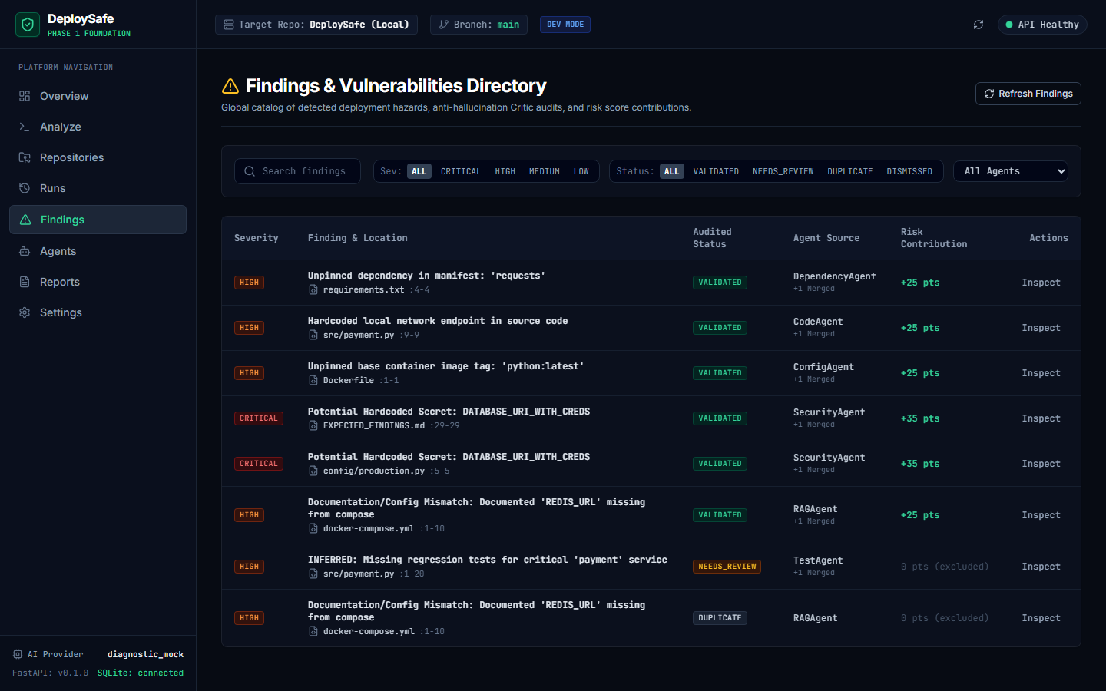
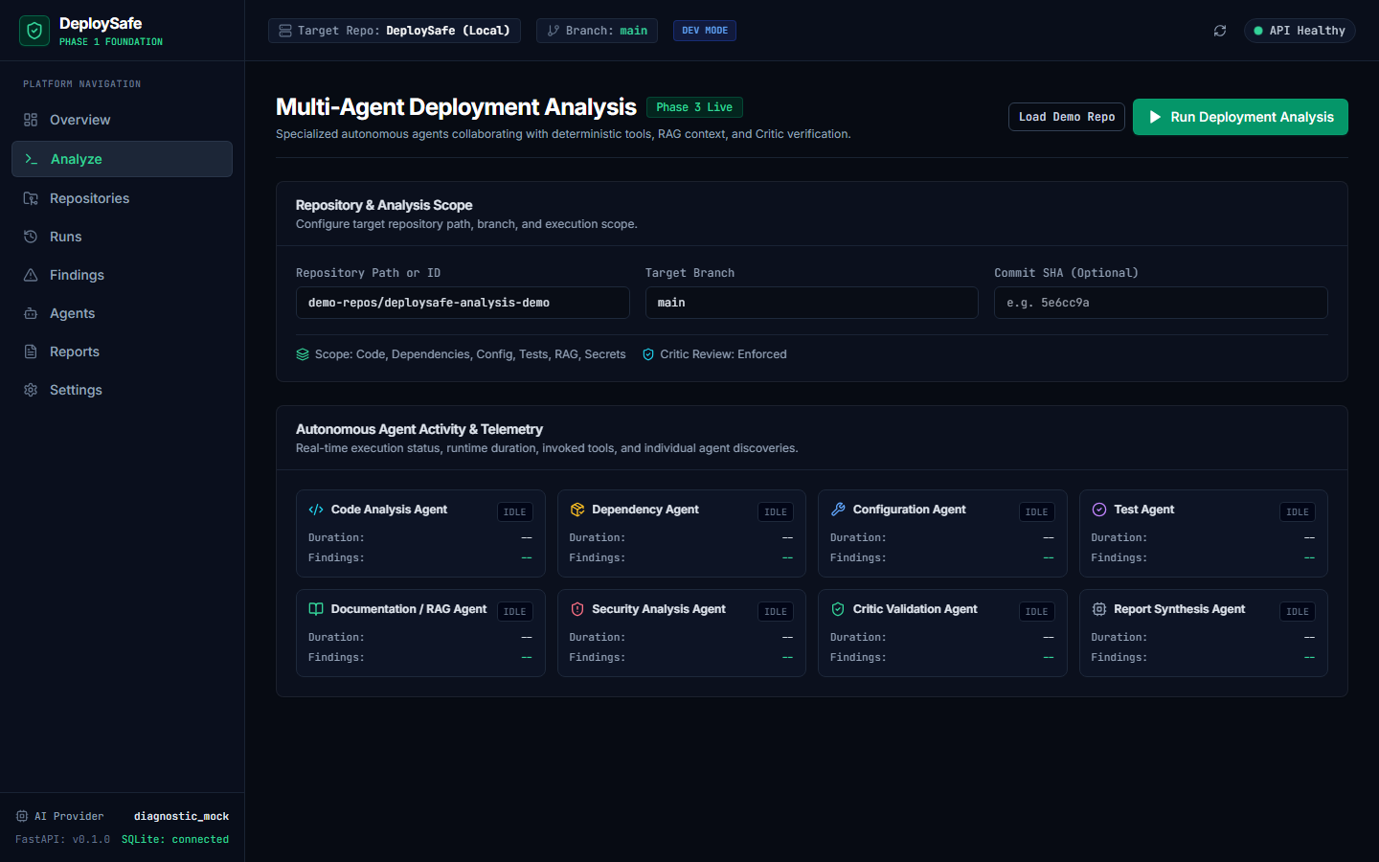
The Working Product
A clean web console for reviewing deployment risks, evidence, and history.
Risk Overview Dashboard
100/100 risk score hero, severity cards, and Critic audit health.
Findings Directory
Line-accurate evidence, confidence metrics, and score contributions.
Real-Time Execution
Multi-agent parallel execution timeline and runtime telemetry.
DeploySafe · Agentic AI · CSE3101 08 / 10
Notes:
TALKING POINTS:
• This slide showcases the actual running DeploySafe web console built in React, TypeScript, and Tailwind CSS.
• Engineers can review the overall risk score hero, inspect severity breakdowns, and see real-time pipeline status.
• Each finding links directly to the source file, line numbers, and actionable remediation instructions.
• Our run telemetry tracks per-agent duration, finding counts, and Critic validation rates.
LIKELY PROFESSOR QUESTION:
How does the frontend communicate with the backend?
CONCISE ANSWER:
The React frontend communicates with our FastAPI REST gateway via typed API endpoints, supporting real-time status polling during analysis runs.

Slide 9
What Is Working Today
Core capabilities implemented and verified across Phases 1 through 4.
01 · Core Foundation
• FastAPI REST service with typed Pydantic models
• React 19 + TypeScript + Tailwind CSS web console
• Multi-provider LLM abstraction (OpenAI, Groq, Mock)
• 62 automated unit and integration tests passing
02 · Repository Understanding
• Recursive AST and safe repository file-tree parsing
• Markdown chunking with line number preservation
• ChromaDB persistent vector store with cosine search
• Semantic context retrieval for specialized agents
03 · Multi-Agent Engine
• CrewAI orchestration with parallel domain tasks
• 6 specialized domain agents + Orchestrator
• Typed inspection tools (file reader, diff, grep)
• Critic validation agent & semantic deduplication
04 · Risk & Reporting
• Deterministic 0–100 mathematical risk scoring
• Findings catalog with line-accurate citations
• Multi-format deployment reports (HTML, MD, JSON)
• Verified on realistic evaluation repositories
DeploySafe · Agentic AI · CSE3101 09 / 10
Notes:
TALKING POINTS:
• Rather than showing abstract phase names, this slide details our completed capabilities by functional area.
• Everything on this slide is implemented, tested, and operational today.
• We have 62 passing automated tests covering our API, RAG store, agents, Critic, and Risk Engine.
• The system supports multiple LLM providers, including Groq for fast inference and a local mock for offline testing.
LIKELY PROFESSOR QUESTION:
What is the test coverage of the backend?
CONCISE ANSWER:
Our test suite includes 62 unit and integration tests covering the ingestion pipeline, Chroma storage, agent orchestration, Critic validation, and the mathematical risk formula.

Slide 10
Next: See It Run
Live demonstration on our evaluation repository, followed by future roadmap.
LIVE DEMO ARCHITECTURAL FLOW
Repository → Run Analysis → Parallel Agents → Critic Evidence → Risk Score → Fix Recommendations
DEMONSTRATION SEQUENCE
1. Select Evaluation Repository — Target local demo-repos/deploysafe-analysis-demo
2. Trigger Multi-Agent Pipeline — Watch real-time execution status across all 6 domain agents
3. Review Chroma Vector RAG Context — Observe semantic retrieval from project documentation
4. Inspect Critic-Validated Findings — Review verified findings with line-accurate file citations
5. Examine Deterministic Risk Score — Understand the 100 / 100 CRITICAL score calculation
6. Export Multi-Format Deployment Report — Inspect generated HTML, Markdown, and JSON reports
Next development (Phases 5 & 6): GitHub Actions CI workflow integration, automated PR commenting bot, and benchmark evaluations.
DeploySafe · Agentic AI · CSE3101 10 / 10
Notes:
TALKING POINTS:
• We will now transition to the live demonstration of DeploySafe running on our evaluation repository.
• We will trigger an analysis run, watch the agents execute, inspect findings, and review the risk score.
• Following the demo, we are excited to expand DeploySafe into GitHub Actions and PR commenting bots in Phase 5.
• Thank you Professor, and we are ready for your questions.
LIKELY PROFESSOR QUESTION:
How will GitHub Actions integration work in Phase 5?
CONCISE ANSWER:
DeploySafe will run as a containerized action triggered on pull_request events, analyzing the git diff against the target branch and posting a risk summary comment.

