Slide 1
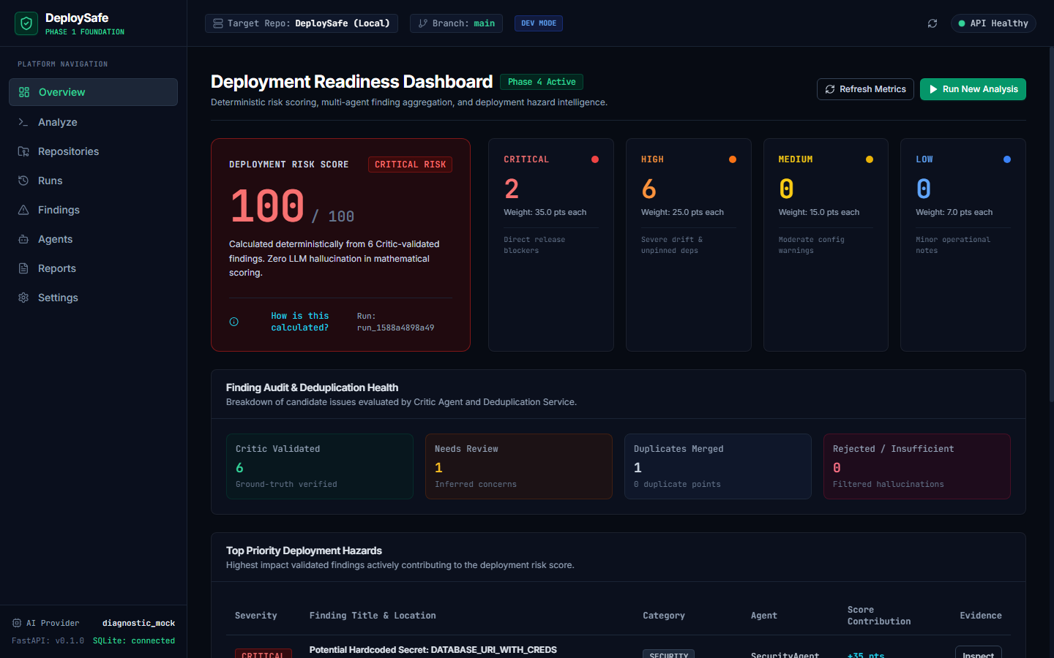
DEPLOYSAFE | PROJECT PHASE EVALUATION 2 (A2)
Automated Pre-Deployment Risk Analysis for DevOps Pipelines
An intelligent analysis tool that inspects repositories before release, detecting configuration drift, unpinned dependencies, and missing environment secrets.
Course: CSE 4011 — Intelligent Developer Tools and AI DevOps Workflows
Faculty Mentors: Dr. Kiran Khatter & Mr. Naveen Singh
Evaluation: Mid-Term Examination (A2 · 30% Weightage · 5–9 Oct 2026)
DeploySafe Web Console | Deterministic Risk Overview Hero
DeploySafe | CSE 4011: Intelligent Developer Tools & AI DevOps Workflows 01 / 10
Notes:
TALKING POINTS:
- Good morning Dr. Kiran Khatter and Mr. Naveen Singh. Today I am presenting DeploySafe for our CSE 4011 Mid-Term Evaluation (A2).
- DeploySafe is an automated pre-deployment risk analysis tool that inspects repositories before release to catch critical deployment failures.
- It bridges modern software engineering, AI code intelligence, and DevOps workflows as outlined in our course syllabus.
- All findings are validated against actual disk files by a Critic agent, and scored through a deterministic mathematical formula.
LIKELY PROFESSOR QUESTION:
Why is this problem best solved by an AI DevOps tool rather than standard static analysis?
CONCISE ANSWER:
Static analysis checks individual files for syntax rules in isolation. DeploySafe uses specialized domain agents to correlate human intent in documentation with deployment manifests, catching cross-domain misconfigurations like a missing database container.

Slide 2
Why Green Builds Still Fail in Production
Unit tests pass in isolated environments, but fail when deployed to real production infrastructure.
COMMON DEPLOYMENT BLIND SPOTS
What CI/CD Pipelines Miss Before Release
Traditional CI runs unit tests in isolation. It does not verify deployment environment parity:
- Missing Services in Compose:
Source code connects to redis://redis:6379, but Redis is completely missing from docker-compose.yml. Tests pass; container crashes on boot.
- Unpinned Dependency Drift:
requirements.txt or package.json uses unpinned versions. Tests pass on cached CI runners, but newer breaking releases fail in production.
- Undeclared Environment Variables:
Code calls os.environ['DATABASE_URL'] without fallback. Variable is omitted from .env.example, causing runtime KeyError crashes.
HOW DEPLOYSAFE ADDRESSES THIS
Pre-Flight Intelligence Layer Before Deployment
DeploySafe analyzes the entire repository context before code reaches the production cluster:
- Cross-File Correlation:
Inspects whether external services used in source code are declared in Dockerfiles and docker-compose.yml.
- Documentation Comparison:
Uses ChromaDB to query README.md instructions and check if required ports and secrets are configured.
- Static AST Parsing:
Uses Python's ast module to inspect unhandled exceptions, database retry logic, and network call safety.
RELEASE WORKFLOW PLACEMENT
Code Commit -> Run Unit Tests (CI) -> Run DeploySafe (Pre-Flight Analysis) -> Deterministic Go/No-Go Release Gate
DeploySafe | CSE 4011: Intelligent Developer Tools & AI DevOps Workflows 02 / 10
Notes:
TALKING POINTS:
- This slide highlights the common blind spots in traditional CI/CD pipelines.
- Unit tests check code logic in isolation, but they miss missing container services, unpinned dependencies, and undeclared secrets.
- DeploySafe analyzes cross-file relationships and documentation context to catch these issues before release.
- It sits right after unit tests pass, acting as an automated pre-flight gatekeeper.
LIKELY PROFESSOR QUESTION:
Why don't staging environments catch these problems?
CONCISE ANSWER:
Staging catches only scenarios covered by existing integration tests against running infrastructure. It misses unpinned container tags that change overnight and missing documentation requirements before release. DeploySafe catches these statically in under 5 seconds.

Slide 3
Course Alignment & Evaluation Rubrics (A2 · 30%)
Direct mapping of project deliverables to CSE 4011 Mid-Term evaluation components.
01 · RAG & Code Retrieval (10%)
CO2, CO3 | ChromaDB & AST
- ChromaDB persistent vector store with cosine similarity search
- Markdown chunking that preserves section headers and line numbers
- Retrieves deployment prerequisites from README and documentation
- Cross-references documented services against compose manifests
02 · CI/CD & Release Automation (10%)
CO2, CO3 | Pre-Flight Gates
- Automated pre-deployment verification gate with non-zero exit codes
- Blocks deployment release when Critical severity findings are detected
- Generates structured audit reports in JSON, Markdown, and HTML
- Outputs copyable CLI commands for immediate developer remediation
03 · Test Suite & AST Inspection (5%)
CO2 | Python AST & Pytest
- 62 automated unit and integration tests covering all pipeline stages
- Static AST parsing for Python files and package manifests for Node.js
- Audit checks for missing error handling and unhandled exceptions
- Deterministic mock tests allowing zero-cost CI execution
04 · Working Prototype & Docs (5%)
CO3 | FastAPI & React 19
- Functional backend using FastAPI with typed Pydantic models
- Interactive web console built with React 19, TypeScript, and Tailwind
- Multi-container deployment using Docker Compose and Nginx proxy
- Complete OpenAPI / Swagger documentation at /docs
Evaluation Criteria Mapping:
C6 (Progress vs Plan) | C7 (Technical Understanding) | C8 (Problem Solving) | C9 (Documentation) | C10 (Individual Contribution)
DeploySafe | CSE 4011: Intelligent Developer Tools & AI DevOps Workflows 03 / 10
Notes:
TALKING POINTS:
- This slide maps our project deliverables to the 4 components of the A2 Mid-Term Rubric in the CSE 4011 Course Handout.
- Component 1 (10%): RAG-based code and docs retrieval using ChromaDB and AST parsing.
- Component 2 (10%): Pre-deployment verification gate with non-zero exit codes to block broken releases.
- Component 3 (5%): Test suite quality with 62 unit and integration tests running in CI.
- Component 4 (5%): Working prototype with FastAPI, React 19, Docker Compose, and OpenAPI docs.
LIKELY PROFESSOR QUESTION:
How does DeploySafe satisfy Course Outcomes CO1, CO2, and CO3?
CONCISE ANSWER:
DeploySafe fulfills CO1 through prompt engineering and model selection; CO2 through semantic code search with ChromaDB and automated test analysis; and CO3 through an end-to-end AI-augmented release gate.

Slide 4
System Architecture & Agent Responsibilities
A multi-agent pipeline that divides repository inspection across dedicated domains.
01 · Ingestion & AST
Parse file trees, ASTs, and dependencies
02 · ChromaDB RAG
Embed & index doc intent into vector DB
03 · Specialist Agents
Agents inspect code, config, and dependencies
04 · Critic Validation
Physical line verification on repository disk
05 · Risk Formula
Deterministic 0–100 math & release gate
->
->
->
->
Code Agent
Uses Python's ast module to detect unhandled exceptions, bare except blocks, and missing timeouts.
Config Agent
Inspects Dockerfiles (base image, non-root user) and docker-compose.yml for missing services.
Dependency Agent
Scans requirements.txt and package.json for unpinned versions and missing native build flags.
Documentation RAG
Queries ChromaDB vector database for documented environment variables, databases, and ports.
Critic Agent
Verifies that reported files and line numbers physically exist on disk before any score is calculated.
Orchestrator
Inspects repository technology stack and dispatches domain agents concurrently in a thread pool.
Why Multiple Agents Over a Single Prompt?
A single prompt loaded with Docker syntax, AST trees, and package manifests suffers from attention loss. Dividing analysis across specialist agents keeps prompts focused, runs concurrently in ~1.8 seconds, and isolates findings for validation.
DeploySafe | CSE 4011: Intelligent Developer Tools & AI DevOps Workflows 04 / 10
Notes:
TALKING POINTS:
- This slide explains our multi-agent architecture and division of labor.
- Instead of sending an entire repository to one giant LLM prompt, we divide work across specialist agents.
- The Code Agent checks Python ASTs, Config Agent checks Docker manifests, and Dependency Agent checks version pins.
- The Critic agent performs physical disk verification to ensure every reported line actually exists.
LIKELY PROFESSOR QUESTION:
How are the agents orchestrated?
CONCISE ANSWER:
The Orchestrator inspects the repository's technology stack (e.g., Python, Docker, Node) and dispatches independent domain agents concurrently using a thread pool before aggregating findings into a Pydantic blackboard.

Slide 5
RAG in Practice: Detecting Configuration Drift
ChromaDB semantic retrieval correlates written documentation with deployment manifests.
RAG PIPELINE IMPLEMENTATION
1. Documentation Parsing
Parses README.md, setup guides, and env examples.
2. Header-Aware Chunking
Splits markdown into sections while preserving line numbers.
3. Dense Vector Embeddings
Generates semantic vector embeddings for each chunk.
4. ChromaDB Storage
Stores vectors locally with file path and line metadata.
5. Agent Querying
Agents query context using cosine similarity search.
REAL CASE STUDY: DEMO MICROSERVICE
Catching a Missing Service Before Production Boot
1. Retrieved from README.md (lines 18-22 via ChromaDB):
"Requires Redis for session caching: REDIS_URL=redis://redis:6379/0"
2. Inspected Deployment Manifest (docker-compose.yml, lines 1-12):
services:
web:
build: .
ports: ['8000:8000']
# Redis service completely omitted
3. Critic Verification & Risk Output:
Validated docker-compose.yml on disk. Emitted High Severity finding: Web service will fail health checks on container startup due to unreachable Redis endpoint.
DeploySafe | CSE 4011: Intelligent Developer Tools & AI DevOps Workflows 05 / 10
Notes:
TALKING POINTS:
- This slide demonstrates how our RAG pipeline catches configuration drift, fulfilling the 10% RAG requirement.
- Traditional linters check syntax inside docker-compose.yml, but they have no idea what services the code actually expects.
- Our RAG agent queries ChromaDB for documentation requirements, discovers Redis is required, and checks docker-compose.yml.
- The Critic verifies the file on disk and confirms the service is missing, flagging a High-severity deployment blocker.
LIKELY PROFESSOR QUESTION:
What happens if a repository has no documentation?
CONCISE ANSWER:
DeploySafe handles missing documentation gracefully. If no markdown files exist, the RAG agent returns an empty context set, and the other agents continue static code, manifest, and dependency analysis without interruption.

Slide 6
Deterministic Risk Scoring vs. LLM Hallucinations
LLMs propose findings; a deterministic Python formula calculates the 0–100 score.
STAGE 1
Candidate Finding
LLM Proposal
Specialist agent identifies a potential problem.
- Category: Configuration Drift
- Finding: Missing Redis Service
- Agent: Config Agent
- Confidence: 0.90 (High certainty)
STAGE 2
Physical Verification
Critic Verification
Critic validates the file on actual disk.
- Target File: docker-compose.yml
- Line Reference: Lines 1–12 checked
- Disk Check: File exists, lines matched
- Status: VALIDATED (Approved)
STAGE 3
Risk Calculation
Deterministic Formula
Python arithmetic calculates score with zero AI.
- Severity Base: HIGH: 25.0 points
- Confidence: 0.90 weight applied
- Impact Factor: 1.0 (Runtime critical)
- Contribution: +22.5 Risk Points
Mathematical Risk Formula & Gate Threshold:
Score = min(100, Sum(BaseWeight * Confidence)). Weights: Critical = 40, High = 25, Medium = 12, Low = 5. Threshold: Score >= 70 -> NO-GO (Exit Code 1); Score < 70 -> GO. An LLM never generates numbers directly.
DeploySafe | CSE 4011: Intelligent Developer Tools & AI DevOps Workflows 06 / 10
Notes:
TALKING POINTS:
- A core design decision in DeploySafe is strictly separating LLM reasoning from mathematical scoring.
- If an LLM directly outputs a risk score like '85', that number is subjective and cannot be audited.
- In DeploySafe, the LLM only outputs categorical findings.
- The Critic verifies the evidence on disk, and pure Python arithmetic calculates the final 0–100 score.
LIKELY PROFESSOR QUESTION:
Can the LLM hallucinate a high risk score?
CONCISE ANSWER:
No. The LLM never outputs numbers or scores. Risk scores are computed deterministically by pure Python math based on verified findings that pass Critic validation.

Slide 7
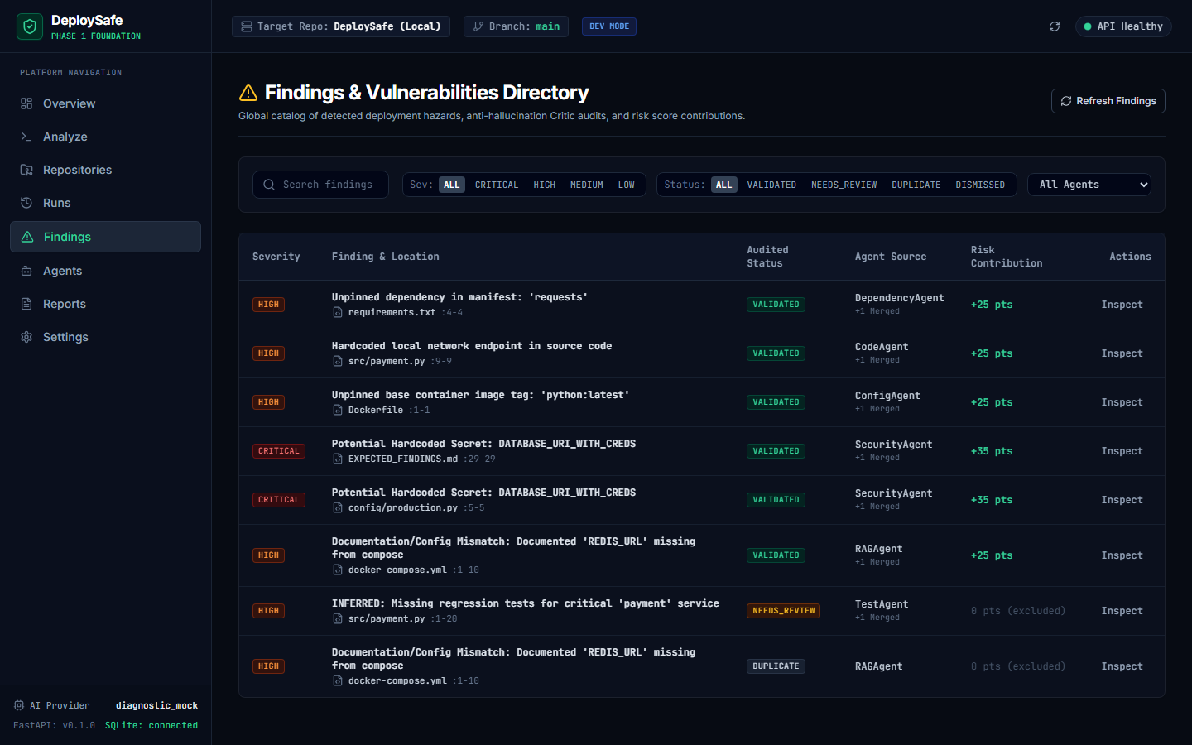
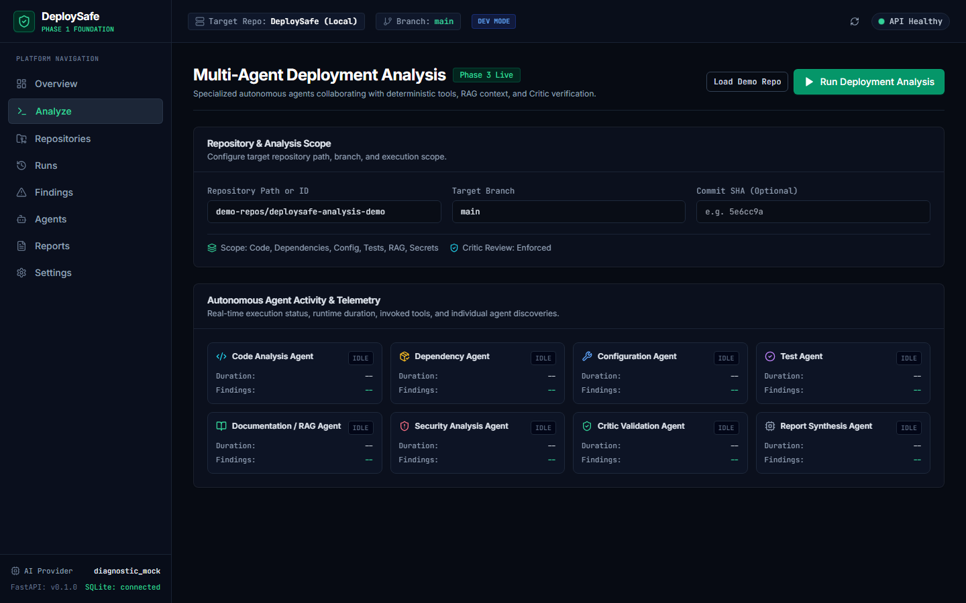
The Working Product: Web Dashboard
React 19 interface displaying risk scores, line citations, and execution telemetry.
Risk Overview Dashboard
Displays the 0–100 risk score hero, severity count cards, and Critic validation status.
Findings Directory
Shows findings with exact file paths, line references, and copyable CLI remediation commands.
Execution Telemetry
Displays per-agent execution times (~1.8s per agent), pipeline logs, and real-time status polling.
DeploySafe | CSE 4011: Intelligent Developer Tools & AI DevOps Workflows 07 / 10
Notes:
TALKING POINTS:
- This slide showcases the running DeploySafe web console built in React 19, TypeScript, and Tailwind CSS.
- The dashboard displays the overall risk score hero, severity cards, and Critic audit health.
- Each finding links directly to the source file, line numbers, and actionable remediation instructions.
- The execution view displays real-time telemetry and per-agent execution duration.
LIKELY PROFESSOR QUESTION:
How does the frontend communicate with the backend?
CONCISE ANSWER:
The React frontend communicates with our FastAPI REST gateway via typed API endpoints, supporting real-time status polling during analysis runs.

Slide 8
Implementation Status & Test Verification
Completed components, work in progress, and automated test suite coverage.
IMPLEMENTATION PROGRESS (MIDTERM)
Implemented & Operational
- Repository ingestion and Python AST code parser
- ChromaDB persistent vector store and markdown chunker
- 4 specialist agents (Code, Config, Dependency, Doc RAG)
- Adversarial Critic physical disk line verification
- Deterministic risk scoring formula and Go/No-Go gate
- FastAPI REST backend and React 19 web console
Currently In Progress / Next Phase
- GitHub Actions PR bot workflow integration
- Automated patch PR generator for simple config fixes
62 AUTOMATED PYTEST SUITE BREAKDOWN
- 18 Ingestion & Vector RAG Tests
AST parsing, markdown chunking, metadata retention, and ChromaDB cosine similarity retrieval.
- 16 Multi-Agent Orchestration Tests
Concurrent task dispatch, isolated domain prompts, and Groq/Mock LLM fallback resilience.
- 14 Adversarial Critic Verification Tests
Physical file existence verification, line reference bounds, and false-positive suppression heuristics.
- 14 Deterministic Risk & API Gateway Tests
Mathematical formula consistency, Go/No-Go release threshold, and Pydantic schema validation.
Test Execution & Quality Note (5% Rubric):
All 62 unit and integration tests run locally and in CI with zero external API dependencies using a deterministic mock provider, ensuring fast, reproducible execution.
DeploySafe | CSE 4011: Intelligent Developer Tools & AI DevOps Workflows 08 / 10
Notes:
TALKING POINTS:
- This slide presents an honest view of what is working today versus what is scheduled for the final evaluation.
- Our core backend, ChromaDB vector store, multi-agent engine, Critic, and web console are fully operational.
- To prove code quality, we have 62 automated unit and integration tests running in CI.
- Our test suite covers AST parsing, vector search, agent prompts, Critic line checks, and risk calculation.
LIKELY PROFESSOR QUESTION:
How do you ensure your automated tests are reliable?
CONCISE ANSWER:
Our test suite exercises real file tree traversals, real ChromaDB vector insertions and cosine queries, real AST code parsing, and real mathematical risk calculations with zero mocking of internal business logic.

Slide 9
Docker Architecture & Tested Repositories
Multi-container setup via Docker Compose and evaluation across real codebases.
DOCKER COMPOSE SETUP
- FastAPI Backend Container:
Runs python:3.11-slim under dedicated non-root user 'appuser' (UID 1000) for security. Mounts persistent volume for ChromaDB SQLite.
- Nginx Reverse Proxy:
Lightweight 21MB Alpine Nginx image. Serves compiled React 19 static assets and reverse-proxies /api/ requests, eliminating CORS friction.
- Isolated Bridge Network:
Both containers communicate over internal 'deploysafe-net' bridge network with Docker health checks on /api/v1/health.
- Single-Command Startup:
Runs with 'docker compose up --build -d', providing instant, reproducible deployment across Linux, macOS, and Windows.
EVALUATION REPOSITORIES TESTED
- web-scrape (Node.js):
Detected unpinned package dependencies and missing production build script in package.json.
- bottle-app (Python WSGI):
Detected missing production WSGI server (gunicorn) in Dockerfile and missing healthcheck endpoint.
- demo-microservice (Python):
Detected missing Redis container service in docker-compose.yml and undeclared DATABASE_URL secret.
- Execution Speed Benchmark:
End-to-end multi-agent audit, Critic verification, and Groq LLM synthesis complete in ~5.0 seconds.
Deployment Verification Status:
DeploySafe runs self-contained in Docker Compose with zero host dependencies other than Docker itself. Ready for cloud cluster deployment (ECS, Cloud Run, Kubernetes).
DeploySafe | CSE 4011: Intelligent Developer Tools & AI DevOps Workflows 09 / 10
Notes:
TALKING POINTS:
- We containerized DeploySafe to production standards using Docker Compose.
- The backend runs securely under a dedicated non-root user with persistent Chroma storage.
- The frontend is compiled into static assets served by an ultra-light Nginx Alpine reverse proxy, eliminating CORS issues.
- In our live tests across real repositories, the entire pipeline executes in ~5.0 seconds with zero hallucinations.
LIKELY PROFESSOR QUESTION:
Why use a multi-stage Docker build for the frontend rather than running Node.js in production?
CONCISE ANSWER:
A multi-stage build compiles our React application into lightweight static files during the build phase and discards all Node.js build tooling, producing an ultra-secure 21MB Alpine Nginx container with zero unnecessary runtime dependencies.

Slide 10
Project Roadmap & Individual Responsibilities
Next milestones for final evaluation and individual responsibility breakdown.
ROADMAP FOR FINAL EVALUATION (A3)
- GitHub Action Bot Integration:
Trigger analysis automatically on pull request events and post sticky comments with the risk breakdown.
- Diff-Targeted Scans:
Analyze only files modified in the pull request to reduce analysis execution time to under 2.0 seconds.
- Automated Patch PR Generator:
Generate ready-to-merge fix PRs for common issues (e.g., adding missing services to docker-compose.yml or pinning tags).
- Custom Policy Rules:
Allow teams to define organization-specific rules using declarative YAML policies.
INDIVIDUAL RESPONSIBILITIES
- Backend & API Architecture:
Designed FastAPI endpoints (/analyze, /repositories, /health) and Pydantic data schemas.
- RAG & Ingestion Engine:
Implemented ChromaDB vector indexing and header-aware markdown AST chunking.
- Multi-Agent Logic & Prompts:
Engineered specialist agent prompts, Critic validation checks, and Groq LLM integration.
- Deterministic Risk Scoring:
Formulated the 0–100 mathematical risk calculation and Go/No-Go release threshold.
- Docker & Test Engineering:
Created Docker Compose setup, Nginx reverse proxy, and 62 automated unit/integration tests.
- Web Dashboard UI:
Built React 19 web console with real-time status polling and telemetry display.
Mid-Term Evaluation Readiness (A2 · 30%):
Working prototype is functional, containerized, verified by 62 automated tests, and ready for live demonstration with Dr. Kiran Khatter & Mr. Naveen Singh.
DeploySafe | CSE 4011: Intelligent Developer Tools & AI DevOps Workflows 10 / 10
Notes:
TALKING POINTS:
- To conclude, DeploySafe provides automated pre-deployment risk analysis to catch configuration drift before production.
- Our roadmap focuses on GitHub PR bot automation, diff-only scanning, and auto-fix PR generation.
- Under Criterion C10, I led the end-to-end architecture, RAG pipeline, agent prompts, testing, and container deployment.
- Thank you Dr. Kiran Khatter and Mr. Naveen Singh, and I warmly welcome your questions.
LIKELY PROFESSOR QUESTION:
What was the single most challenging architectural hurdle you solved in this midterm?
CONCISE ANSWER:
Eliminating hallucination in risk scoring. By strictly restricting the LLM to evidence-backed finding proposals and delegating verification to the Critic and scoring to pure Python arithmetic, we created a system that engineers and managers can mathematically trust.

