Slide 1
Black Hole Mass Prediction using Data Science
A Machine Learning Approach to Astrophysical Analysis
Prepared by: Yashra Tailor

Slide 2
Objective & Problem Statement
Objective: Use data science to predict black hole mass from measurable properties.
Problem: Direct mass measurements are resource-intensive; predictive models speed up classification.

Slide 3
Project Scope & Role
Duration: 12 days (solo project)
Tools: Python, Pandas, Scikit-learn, Streamlit, Matplotlib, Seaborn
Tasks: Data cleaning, EDA, feature engineering, model training, dashboard deployment.

Slide 4
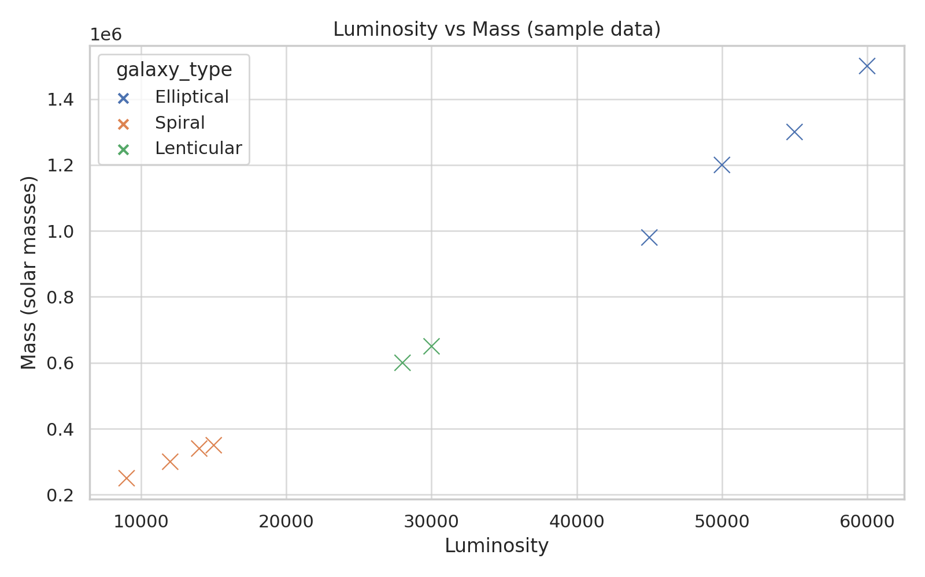
Dataset & Key Variables
Dataset: ~10,000 observations (sample provided)
Key Variables:
- Luminosity
- Redshift
- Spin
- Host Galaxy Type
- Eddington Ratio

Slide 5
KPIs & Insights
KPIs:
- Mean/median mass per galaxy type
- Correlation metrics (Pearson r)
- Model RMSE and prediction intervals
Top Insights:
1. Luminosity strongly predicts mass (r ≈ 0.87)
2. Elliptical galaxies host larger BHs on average
3. High-spin objects tend to be more massive
4. Eddington Ratio separates stellar vs supermassive BHs

Slide 6
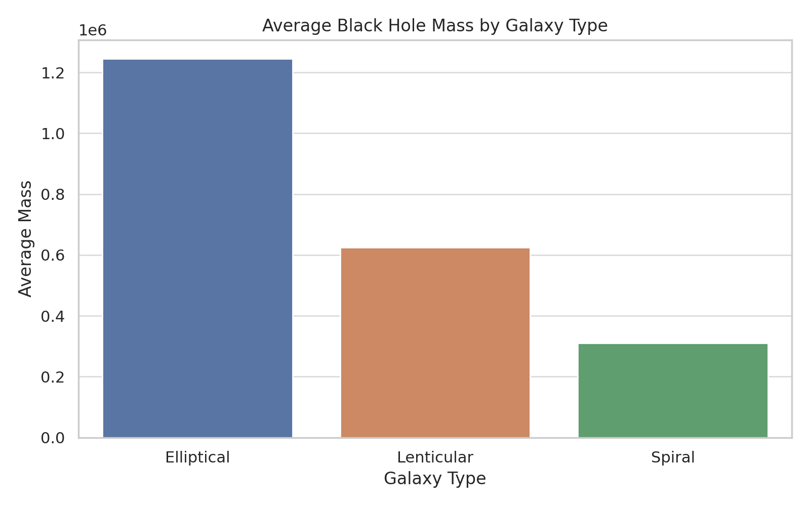
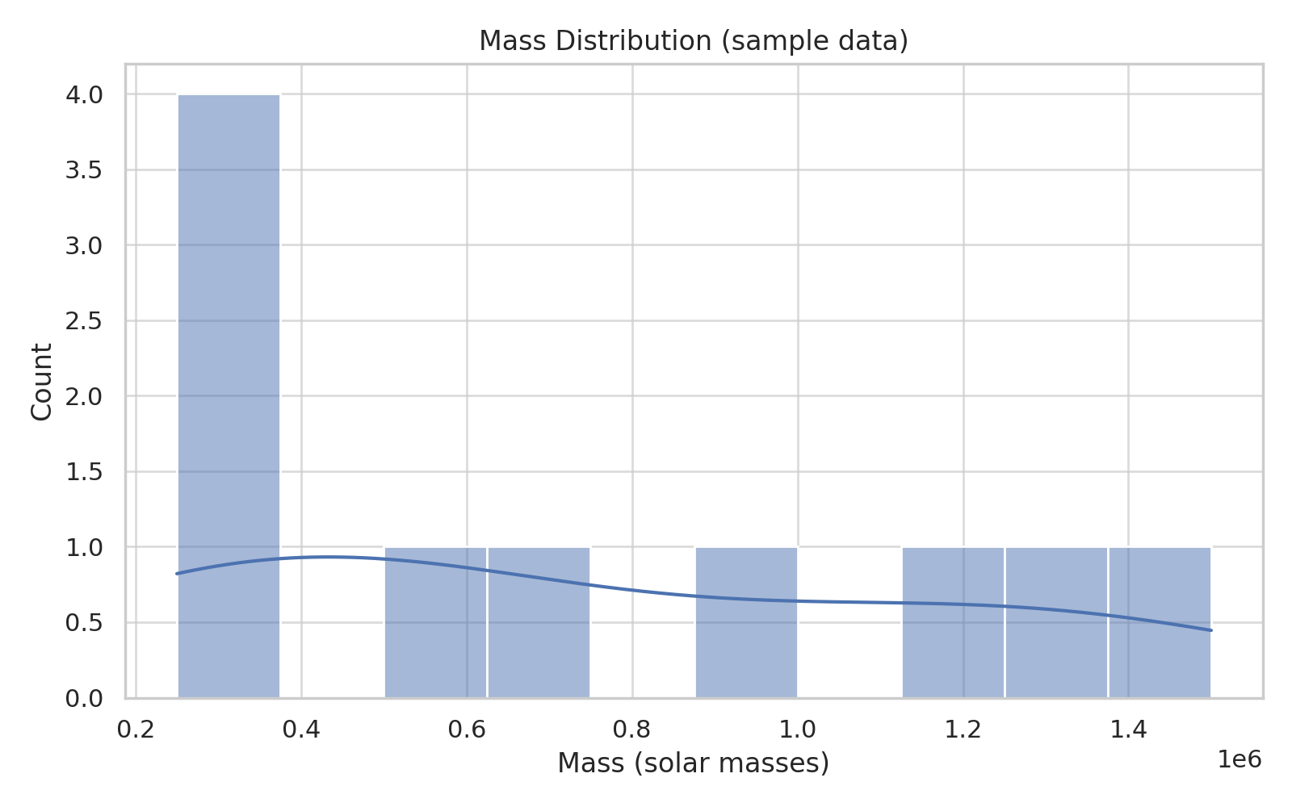
Dashboard Demo - Visuals

Slide 7
Conclusion & Recommendations
Conclusion: Luminosity and galaxy type are the most influential predictors for black hole mass.
Recommendation: Prioritize measuring high-correlation features (luminosity, spin) in surveys for faster classification.

