Slide 1
Formal Verification for Rust Ported Codebases
Group No: G5 Siddhant Kulkarni 2021A7PS2606G
Aditya Bhat 2021A7PS2071G
Yash Bhisikar 2021A7PS0483G
Nirmal Govindaraj 2021A7PS0441G

Slide 2
Project Overview
Objective: Memory Safety Verification
Methods: Model Checking and Symbolic Execution
Target: Verification of a Hybrid C/C++ Codebase Ported to Rust

Slide 3
Project Goals
Utilize Formal Verifiers for Rust and C/C++
Formulate Assertions for Code Properties
Compare Memory Safety in C/C++ and Rust

Slide 4
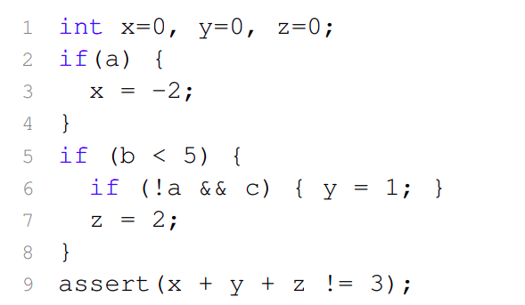
How symbolic execution works

Slide 5
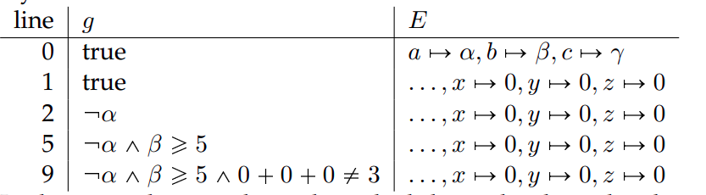
Different paths checked by symbolic execution - I

Slide 6
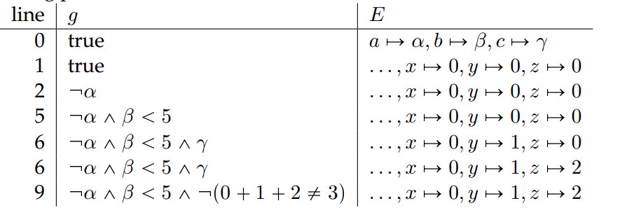
Different paths checked by symbolic execution - II

Slide 7
Verifiers Used
Rust
Tool: Kani Rust Verifier, a specialized model checker for Rust
Purpose: Memory safety verification for unsafe blocks in Rust code.
C/C++
Tool: KLEE Symbolic Execution Engine
Purpose: Find Memory-Related Bugs. Comparison with Rust Verification
Since KLEE is LLVM based, we can use it for Rust as well and hence a hybrid codebase

Slide 8
Model Checking vs. Symbolic Execution
Model Checking
Purpose: Verifies system properties.
Abstraction: Higher-level finite-state models.
State Space: Explores entire state space.
Expressiveness: Focuses on temporal and system-level properties.
Automation: Highly automated but may face state explosion.
Symbolic Execution
Purpose: Analyzes program behavior.
Abstraction: Source or binary code.
State Space: Explores program execution paths.
Expressiveness: Code-level analysis.
Automation: Semi-automated, user-guided analysis.

Slide 9
Milestone 1: Linked List Code
Implemented Linked List in Rust and C++
Used Verifiers to Detect Null Pointer Exceptions
Results and Lessons Learned

Slide 10
Rust Code and Verification Result

Slide 11
C/C++ Code and Verification Result

Slide 12
Next Milestone
Verification for hybrid C/C++ and Rust codebases
Work with the other team to verify a large hybrid codebase
Comparatively assess memory safety of C/C++ and Rust code

Slide 13
Limitations
Large time complexity/ state explosion leads to prolonged execution on large codebases, impeding scalability.
Incompleteness of the solution: no formal verification method can guarantee the absence of all bugs.
Current verifiers lack the ability to detect critical issues like data races, mutating immutable data and usage of uninitialized memory.
Access to the source code is essential for successful verification; opaque code is not compatible with the process of symbolic execution.

Slide 14
Thank You

