Slide 1

deep learning challenge 深い学習課題 Fukai gakushū kadai
Yash mittal
ヤッシュミタル
Yasshumitaru

Slide 2
Classify food images into 43 categories.
The Problem
Rakuten Institute of Technology a dedicated R&D wing of Rakuten Inc.
Enable better taxonomy and improved indexing for search operations.
What is the problem?
Who wants the problem to be solved?
Why should this problem be solved?

Slide 3
Framework used
Fastai 1.0
Pytorch 1.0
Python 3.6

Slide 4
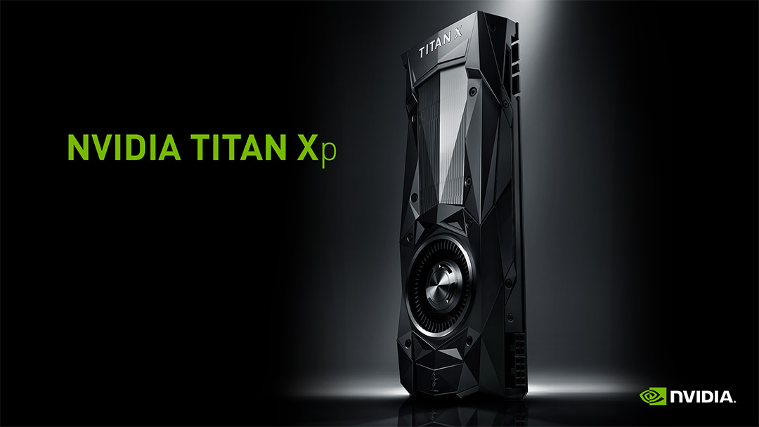

GPU used
Nvidia Titan XP
GCP Nvidia Tesla K80

Slide 5
Data analysis
Training data – 554656 images.
Test data – 118864 images in phase1 and 118875 in phase 2.
Data was imbalanced but who cares??
Systematic study of the class imbalance problem in convolutional neural networks

Slide 6
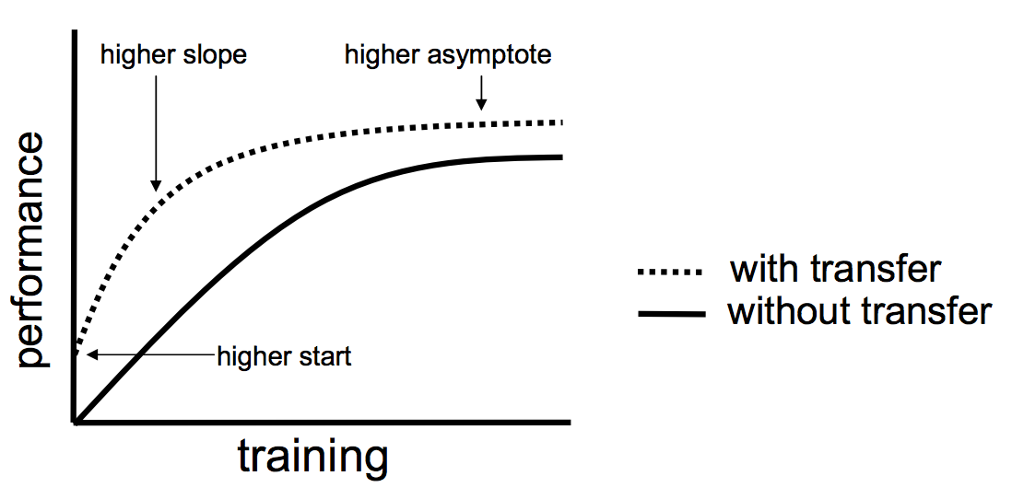
The Prototype
Used transfer learning.
Trained by just removing the last layer of pre-trained model and adding layers according to the output.
Found suitable learning rate, unfreeze the model and trained all layers in the model.

Slide 7
Workable Solutions
Resnet101
Resnet50
Resnet34
Winner
Heavy structure, require more memory and power
Takes a lot more time on each epoch as compared to resnet50, but its accuracy was unbeatable
First runner up
Slightly heavy structure, require moderate memory and power
Vanilla resnet50 didn’t give me enough good result to reach top 2. It need some techniques to be embedded with it
Second runner up
Light structure, require less memory and power
Resnet34 results were poor amongst all. It may be due to complex data.

Slide 8
Techniques used
1 cycle policy to beat old optimizers like SGD with restart(SGDR).
Deeper structure of resnet101 gave best results.
Test time augmentation.
Right learning rate through fastai utilities.
Resizing the images to bigger size didn’t helped.

Slide 9
Final model
Trained frozen resnet101 model for 8 epochs
Unfreeze the model
Trained for 8 epochs
Score: 0.8166
Trained for 2 more epochs
Score: 0.818

Slide 10
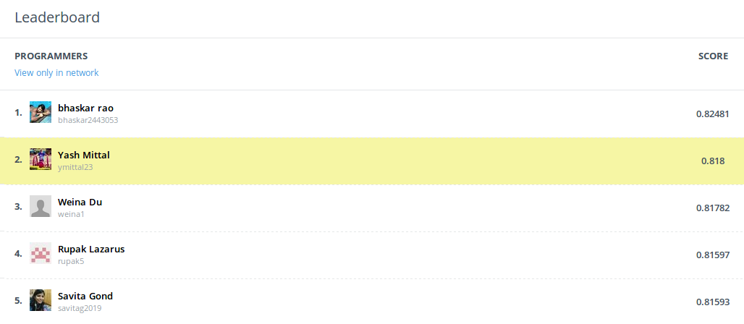
Result

