Slide 1
PREDICTION OF AUTOMOTIVE COMPONENT FAILURE CAUSES
VIVA-VOCE
Batch Number:COM-18
Under the Supervision of,
Mr. MUTHURAJU V,
Assistant Professor,
School of Computer Science & Engineering
Presidency University
20211COM0028 | SRUSHTI N
20211COM0045 | SAMSKRUTH DIXIT
20211COM0021 | T BHAVITHA REDDY

Slide 2
Introduction
Predicting the failure causes of automotive components is vital for enhancing vehicle safety, reliability, and performance. Metallurgical analysis of automotive parts provides critical insights into material properties and structural integrity. The Automotive Research Association of India (ARAI) holds extensive data on various automobile components, including metallurgical properties and corresponding micrographs. Leveraging this data, the proposed software aims to analyze micrographs to predict potential failure causes in automotive components.
The software will incorporate advanced image processing and machine learning algorithms to identify patterns, correlate material characteristics, and detect early signs of failure. This predictive analysis will assist manufacturers in implementing preventive measures, improving component design, and optimizing production processes. By developing a web-based application, the solution will offer a user-friendly interface for real-time assessment and reporting. This project not only addresses current challenges in failure prediction but also sets the foundation for future advancements in automotive component analysis.

Slide 3
Literature Review
SL.NO | TITLE | AUTHOR(s) | YEAR | REMARKS
01 | "Microstructural Analysis for Predicting Failure in Automotive Components." | Wang, X., & Li, Y | 2022 | Detailed focus on microstructure
02 | "Machine Learning Approaches for Predicting Material Failures." | Zhang, J., & Chen, H | 2023 | Recent research highlights the need for evolving models, multi-event evaluations, and intelligent strategies like renewable integration and storage optimization to enhance power system resilience, while comparing economic benefits of these actions.
03 | "Predictive Maintenance Using Metallurgical Data." | Kumar, R., & Patel, S | 2021 | Practical insights into maintenance strategies.
04 | "Material Science and Automotive Component Design." | Ahmed, N., & Khan, O. | 2023 | Design considerations based on materials science.

Slide 4
Continued…
SL.NO | TITLE | AUTHOR(s) | YEAR | REMARKS
05 | "Environmental Factors in Material Degradation.” | Taylor, B., & Evans, R | 2022 | Impact of environment on automotive materials.
06 | "Innovative Approaches to Predictive Automotive Maintenance." | Roy, A., & Dasgupta, T. | 2023 | Cutting-edge methodologies in maintenance.
07 |  |  |  | .

Slide 5
Research Gaps Identified
Predictive Analytics
Machine Learning (ML) and Deep Learning (DL)
IoT and Wireless Sensor Networks
Satellite and Social Media Data

Slide 6
Proposed Methodology
Proactive disaster detection has evolved with advancements in AI, machine learning, and IoT technologies. Key methods include :
Predictive Analytics: AI models analyze historical and real-time data to predict disasters like earthquakes and floods. Techniques such as logistic regression and generative adversarial networks (GANs) have achieved high accuracy.
Machine Learning (ML) and Deep Learning (DL): Techniques like logistic regression, support vector machines (SVMs), and convolutional neural networks (CNNs) help predict natural disasters based on historical data. GANs are also used for tsunami prediction and meteorological analysis.
IoT and Wireless Sensor Networks: Networks collect real-time environmental data to monitor flood risks, wildfires, and earthquakes, providing early alerts to minimize damage.
Satellite and Social Media Data: Remote sensing and AI-powered social media analytics track events and identify early disaster signals from remote areas.

Slide 7
Objectives
Develop a Predictive Software Solution: To design and implement a software application that accurately analyzes metallurgical data and micrographs to predict the probable causes of automotive component failures.
Enhance Failure Detection and Prevention: To identify patterns and correlations in material properties that contribute to failures, enabling proactive maintenance and reducing unexpected breakdowns.
Improve Component Design and Reliability: To provide actionable insights that assist manufacturers in improving material selection and component design, ultimately enhancing the durability and performance of automotive parts.

Slide 8
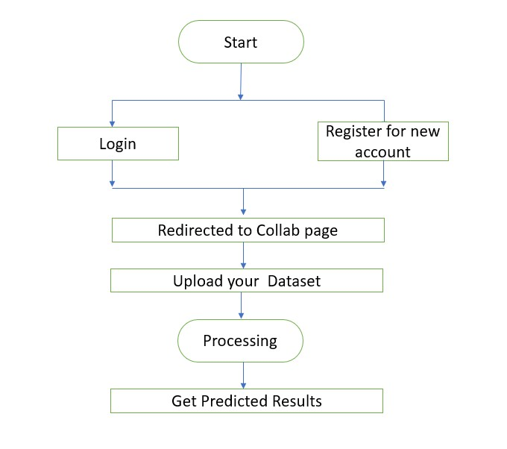
System Design and Implementation

Slide 9
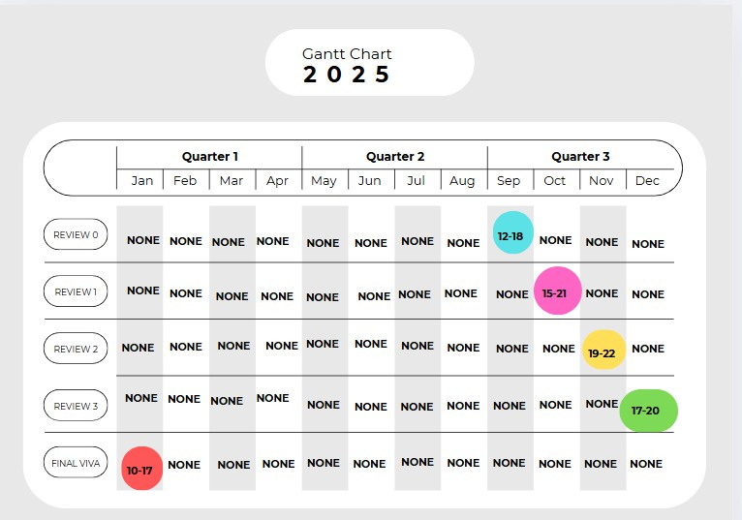
Timeline of Project

Slide 10
Outcomes/Results Obtained
Accurate Failure Prediction: The developed software successfully predicts the probable causes of automotive component failures by analyzing metallurgical data and micrographs with high accuracy.
Pattern Recognition and Correlation: The system identifies patterns and correlations between material properties and failure types, enabling better understanding of component behavior under various conditions.
Real-time Analysis: The web-based application provides real-time assessment of component integrity, allowing manufacturers to take timely preventive measures.
Enhanced Maintenance Planning: Predictive insights help optimize maintenance schedules, reducing unexpected failures and minimizing downtime.
Cost Reduction: Early detection of potential failures leads to significant cost savings in repairs, replacements, and warranty claims.
Improved Component Design: Insights gained from failure analysis contribute to the improvement of component design and material selection, enhancing overall product durability and performance.

Slide 11
Conclusion
The prediction of automotive component failure through metallurgical analysis and micrograph assessment is crucial for enhancing vehicle safety, reliability, and performance. By leveraging advanced software algorithms that incorporate image processing and machine learning techniques, manufacturers can effectively identify potential failure causes and implement proactive measures. This approach not only aids in understanding material behavior under various conditions but also enables the discovery of patterns and correlations within metallurgical data.
The integration of these predictive tools into a user-friendly web application offers real-time analysis and decision-making support for engineers and designers. This innovation will significantly reduce maintenance costs, prevent unexpected breakdowns, and improve the overall lifespan of automotive components. Furthermore, continuous improvements in data analysis techniques and AI-driven solutions will open new avenues for future research and development, contributing to the advancement of automotive technology and fostering safer, more efficient transportation systems.

Slide 12
References
[1] F. Campean, A. J. Day and S. Wright, "Camshaft timing belt reliability modelling,"Annual Reliability
Maintainability Symposium. 2001
[2] Guo and W. Guo, "Process Monitoring and Fault Prediction in Multivariate Time Series Using Bag-
of-Words," in IEEE, Jan. 2022
[3] Voronov, E. Frisk and M. Krysander, "Data-Driven Battery Lifetime Prediction and
Confidence Estimation for Heavy-Duty Trucks," in IEEE, June 2018
[4] Gupta, A. Singh, N. Saxena, G. Ravivarman, P. Gajendran and P. Deshpande, "Increasing Automotive
Electrical Equipment Effectiveness with Enhanced Iron Loss Estimation Techniques," 2023
[5] Kim, C. Chun, S. J. Park, S. Yun and Y. H. Sung, "Fault Diagnoses Method Using
Convolutional Recurrent Neural Network for Rotating Machine," 2023

Slide 13
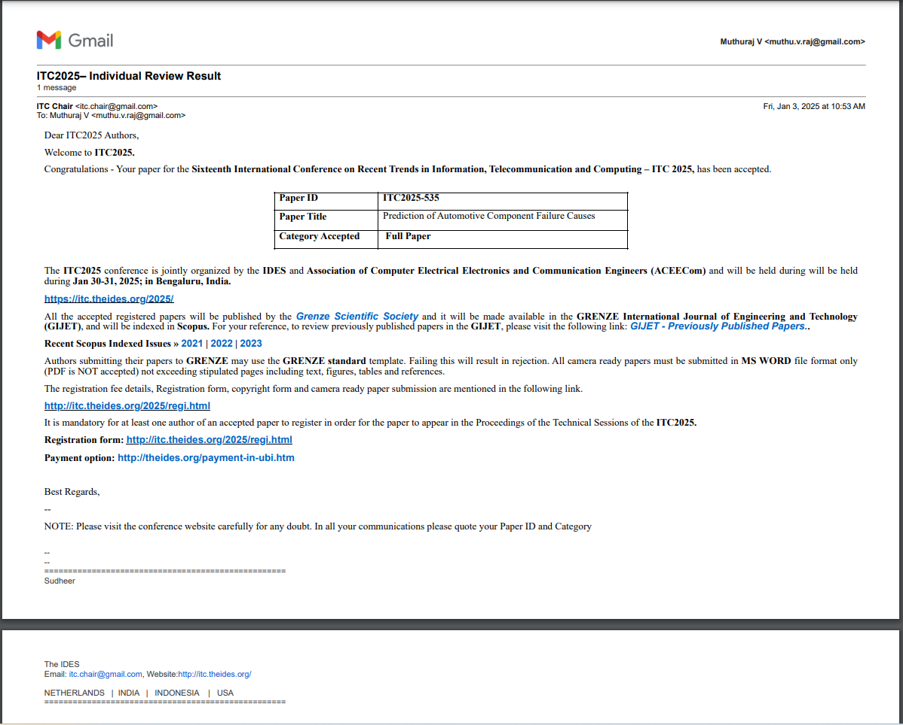
Publication Details

Slide 14
Thank You

