Slide 1

Shadow Governance
Member Name:
GARGI RANI PATHAK – 46095047

Slide 2
Admin should accept the user id and password for the Admin login and once validated, the Admin should have an option to create other users who can be Analytics Users
Analytical user Should give provision for filters and based on the filters chosen a report should be generated and should be available for download as an excel sheet.
End user should allow the user to enter the data in the appropriate fields and save the data.
ABOUT

Slide 3
FUNCTIONALITIES required :
Signup, Login or Logout
User can enter data.
Admin can add or remove user/Analytical user on Shadow Governance Application.
Analytical user can generate the report for user.

Slide 4
Modules
User Module
Admin Module
Analytical User Module

Slide 5
Technical Requirements
JSON-SERVER
ANGULAR 9

Slide 6
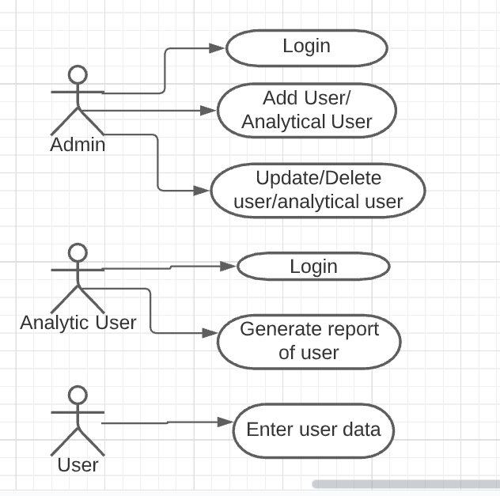
Use case diagram

Slide 7
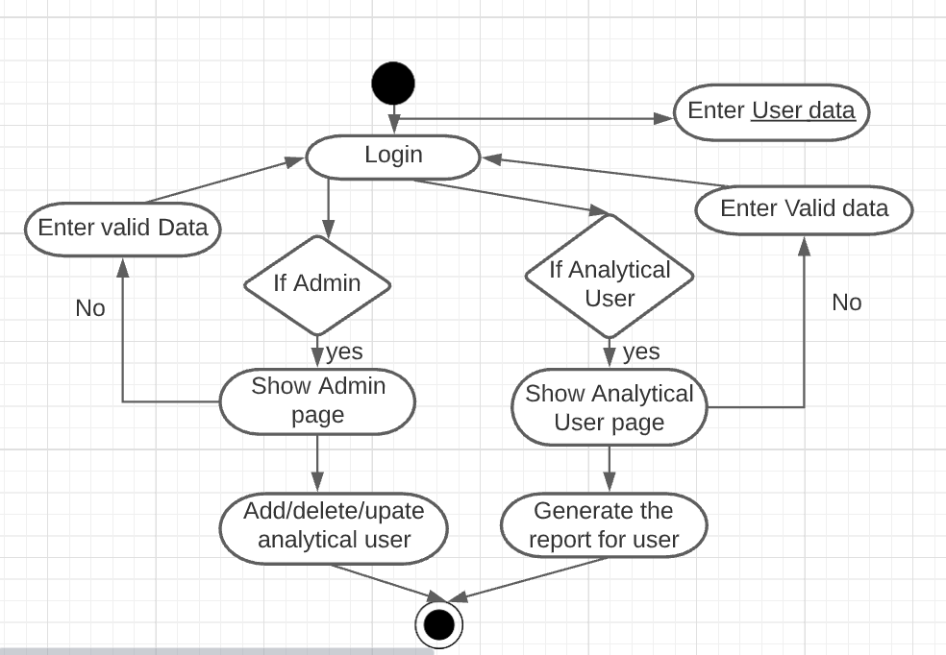
Activity diagram

Slide 8
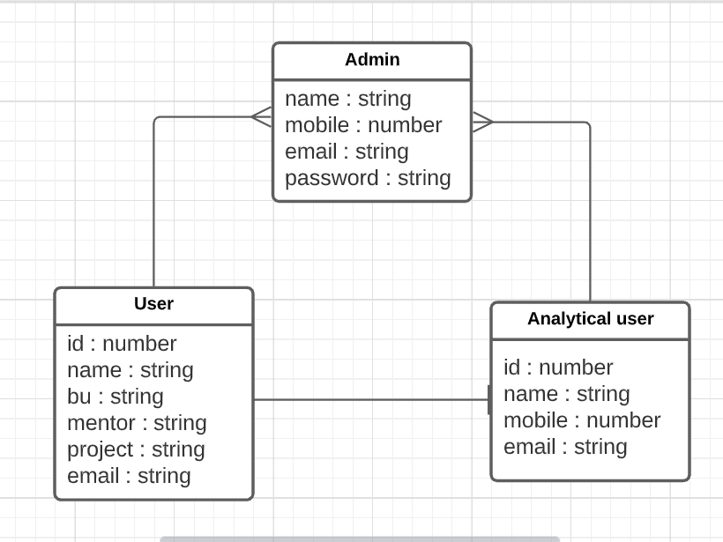
Database diagram

Slide 9

Thank you

