Slide 1
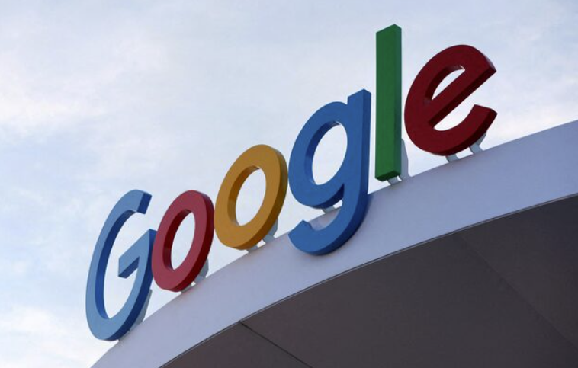
MARKETING WEB ANALYTICS AND INSIGHTS (GROUP 7)
For our group project we have chosen
Google Electronics
We are using data from the Google Merchandise Store account, assuming it is representative of GOOGLE ELECTRONICS online operations for the purposes of our analysis
GROUP MEMBERS:
K S, NAVEENKUMAR CATAJAN, D'ANDRE ANTHONY SALVI, YASH JITENDRA BALADHANDAYUTHAM, AMITABHA NALAWADE, ATHARVA NARENDRA NIKHADE, DEVYANI BANDOPANT

Slide 2
About Us
FOUNDED
Google was founded by founders Larry Page and Sergey Brin. They were operating from garage in Menlo Park, California and the company was officially incorporated on September 4, 1998.
GOOGLE ELECTRONICS PRODUCT CATEGORIES: - Smartphones - Smart Home Devices - Wearables - Laptops & Tablets
GLOBAL REACH CEO: Sundar Pichai Headquarter: Mountain View, California Established: October 4, 2016 Global Revenue 2022: $19.6 billion Brand Value: $263.4 billion
CORE MISSION
To organize the world’s information and make it universally accessible and useful.

Slide 3
Business Objective
Increase Market Share in Consumer Electronics Expand the reach of Google Electronics products (such as Pixel devices, smart home products, and accessories) through targeted marketing campaigns, strategic partnerships, and global distribution channels.
Enhance Customer Engagement and Loyalty Focus on building strong customer relationships by providing exceptional product experiences, excellent after-sales service, and personalized marketing to boost customer retention and lifetime value.
Optimize Product Innovation and Development Continuously innovate and improve existing product offerings by integrating new technologies (e.g., AI, IoT, and sustainability features) that align with consumer needs and market trends, keeping Google Electronics at the forefront of tech advancements.
Increase Profits and Efficiency Boost profits by cutting costs, making the supply chain run more smoothly, and figuring out which products sell the best to focus on what works.

Slide 4
Key Performance Indicators
REVENUE Revenue is the total amount of money generated from a company's primary activities.
AVERAGE ORDER VALUE Average Order Value (AOV) is an e-commerce metric that determines the average amount of money a customer spends on each order placed online.
CONVERSION RATE Conversion rate is the percentage of users or visitors who perform a desired action on a website or digital platform.
BOUNCE RATE Bounce rate is a metric that measures the percentage of single-page sessions that do not include any conversion event.
ENGAGEMENT METRIC Engagement metric is a measure of how users interact with a website or digital platform, including actions like clicks, comments, shares, or time spent on the site.

Slide 5
REVENUE
The total revenue for December 2024 was $3,44,619.61 a decrease of $2,18,755.9 when compared to January 2025.
Revenue saw a massive decrease of 63.48% when compared to December of the previous year.

Slide 6
AVERAGE ORDER VALUE
OVERALL AVERAGE ORDER VALUE
The AOV for Google Electronics decreased from $161.64 to $135.19 in January 2025, showing a decrease in 26.45%
This means customers spent slightly less per order in January 2025 compared to the previous year
AVERAGE ORDER VALUE BY DEVICE CATEGORY
Desktop users have the highest average order value (AOV) in both December 2024 and January 2025
Mobile AOV saw a slight decrease from December 2024, whereas Tablet AOV experienced a significant rise by $15.15

Slide 7
CONVERSION RATE
CONVERSION RATE BY DEVICE CATEGORY
Desktop has the highest conversion rate for both December 2024 and January 2025.
Mobile and tablet conversions remain significantly lower than desktop.
ESTIMATED NUMBER OF PURCHASES (CONVERSION)
Desktop has the highest purchases, higher conversion in December 2024 and January 2025.
Mobile, tablet and smart tv conversions remain significantly lower than that of the desktop.

Slide 8
REVENUE BY CUSTOMER TYPE & DEVICE CATEGORY
SESSION BY MARKETING CHANNEL
The sessions are primarily driven by two channels: Direct and Organic Search. Although there has been a decline in Organic Search, this is offset by a 91% increase in the Direct channel for 2024 compared to 2023
Referral, Email and Paid search visits also increased for October 2024
REVENUE BY CUSTOMER TYPE
The total revenue for new visitors grew by 38.34% from December 2024 to January 2025
Additionally, revenue from established visitors to the website increased by 36.78%
REVENUE BY DEVICE CATEGORY
Revenue for all three device types saw an increase for December 2024 compared to January 2025
Desktop revenue rose by 36.4% whereas mobile revenue increased by 38.55 %

Slide 9
REVENUE WATERFALL TABLE
While both AOV and visits have increased, the significant rise in revenue is primarily driven by a substantial 56.16% boost in the Conversion Rate. As a result, revenue has grown by 80.06%, leading to a net increase of $101,655.20
 | Dec-24 | Jan-25 | % vs LY | # vs LY |  | Metric Change Impact | ratio |  | adjusted impact
revenue | $ 3,34,619.61 | $ 1,25,386.71 | -62.53% | -$2,09,232.90
sessions | 1,01,039 | 77,287 | -23.51% | -23,752 |  | $ (76,785.47) | 0.26 |  | $ (54,729.34)
conversion | 2% | 1% | -50.0% | -1% |  | $ (1,63,319.44) | 0.56 |  | $(1,16,406.99)
aov (avg purchase revenue) | $161.64 | $135.19 | -16.36% | -$26.45 |  | $ (53,449.63) | 0.18 |  | $ (38,096.57)
 |  |  |  |  | Sum | $ (2,93,554.54) |  |  | $(2,09,232.90)
While both AOV and Sessions have decreased, the significant decrease in revenue is primarily driven by a substantial 50 % boost in the Conversion Rate. As a result, revenue has decreased by 62.53%, leading to a net increase of $0(rather, a net loss of $2,09,232.90)

Slide 10
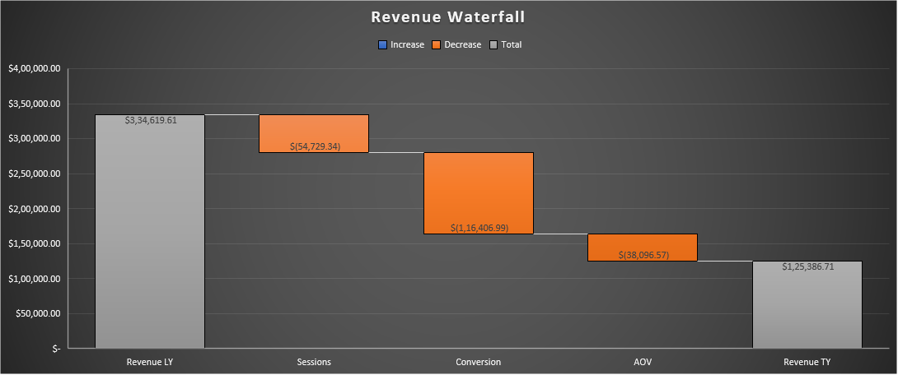
REVENUE WATERFALL TABLE

Slide 11

OUR RECOMMENDATION
We need to focus on conversion the most since it had the largest negative impact on revenue (accounted for 56% of revenue loss). However, improving sessions and AOV are also necessary to support overall recovery.
Increase conversions by streamlining the checkout process and enhancing overall user experience on the website
Reduce the number of steps required to complete a purchase
Offer quicker guest checkout option that does not require a login
Improve sessions by investing in targeted marketing campaigns
Launch pair search and social media campaigns using paid and earned media to target high volume keywords and audiences.
Boost AOC by using bundling, product recommendations, and limited offers
Suggest a related product on cart page that customer would likely be interested in and offer discounts on bundles or high-value purchases.

Slide 12
BOUNCE RATE
The bounce rate increased by 2.29% in January 2025 compared to December 2024
When comparing 2024 to 2025, the bounce rate for customers who use Firefox, chrome and Opera increased by 1.01%, 0.31%, and 2.86% respectively

Slide 13
BOUNCE RATE BY DEVICE AND AGE
From December 2024 to January 2025, bounce rates decreased significantly for the 65+ age group, showing improved engagement.
Most younger age groups saw slight increases, suggesting more consistent user behavior. On the device side, smart TVs had a small drop-in bounce rate, while tablets, mobiles, and desktops showed minor increases. Notably, desktop usage grew, indicating a shift toward traditional browsing platforms.

Slide 14
CART ADDITIONS

Slide 15
OUR RECOMMENDATION
Improve page load speed across all devices for faster access.
Tailor content to user intent and age group preferences.
Enhance mobile and tablet usability with responsive, touch-friendly design.
Optimize landing pages to reduce friction and enhance user experience
Use clear navigation and internal links to guide users deeper into the site.
Create engaging, accessible layouts—especially for older users (65+).
Promoting High-Interest Products: Increasing the marketing efforts for products that are having high cart additions like (e.g., “Google Classic Black Cap")
Cross-Sell/Up-Sell: Encouraging related products recommendations for popular items to drive the additional cart additions.

Slide 16
ENGAGEMENT METRIC ON ENGAGEMENT RATE AND ITEMS PURCHASED PER ITEM VIEWED RATE
Three measures were used to analyze engagement metrics.
Engagement rate (engaged sessions/sessions): it is used to assess the likability of the website.
Organic search and paid channel were the best performing channels of google electronics.
Cross network had the highest positive change in engagement rate, while organic search had the highest negative change in engagement rate.
Itemspurchasedperitemviewed rate (items purchased/ items viewed): it is used to assess the speed of the items purchased to build marketing campaigns.

Slide 17
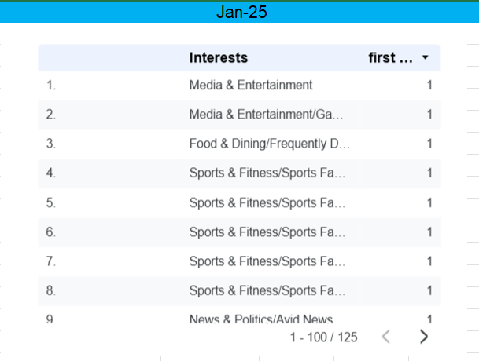
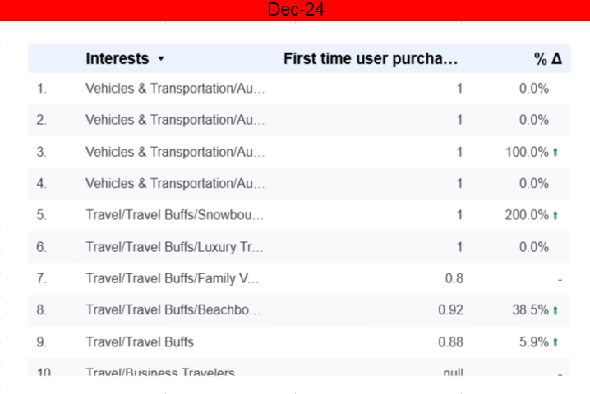
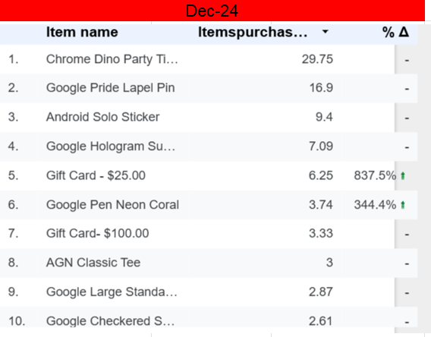
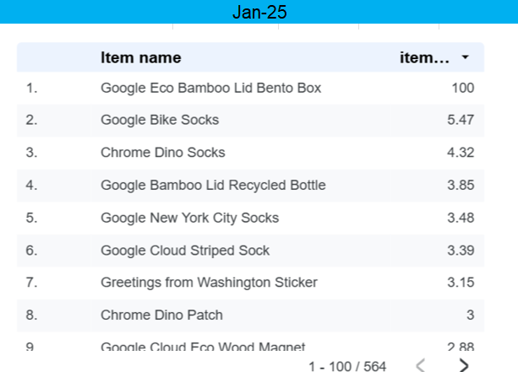
ENGAGEMENT METRIC ON ENGAGEMENT RATE AND ITEMS PURCHASED PER ITEM VIEWED RATE
Google has received many purchases in the accessories section.
The accessories section in google tablets have the highest positive change and accessories section in google watches have the highest negative change.
First time purchaser’s rate(first time purchasers/total purchasers: It helps to assess the likelihood of an object to be purchased.
The entertainment sector has the highest positive change of first-time user purchasers' rate of 1.0 % while the travel sector has the highest negative change of first-time user purchasers' rate of 2%.

Slide 18
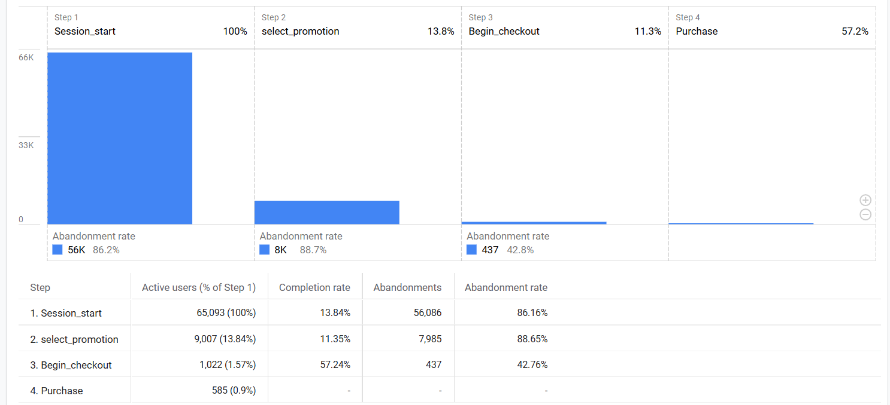
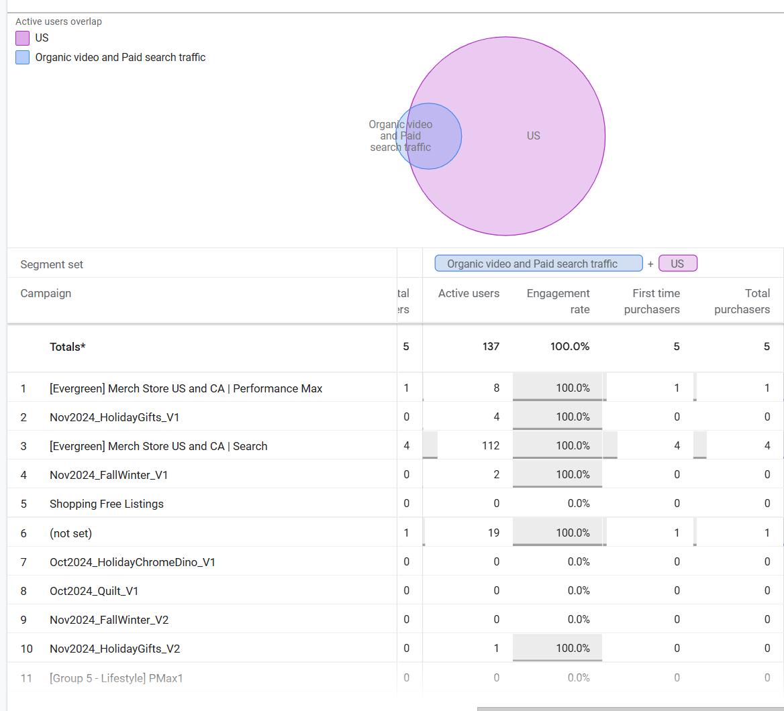

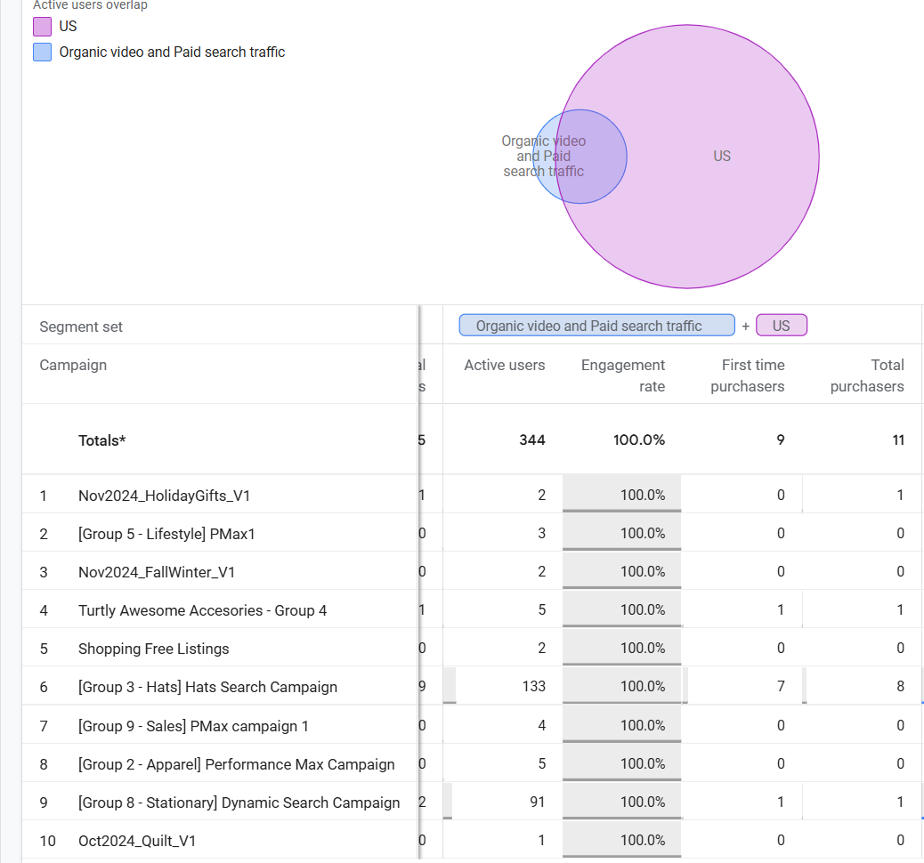
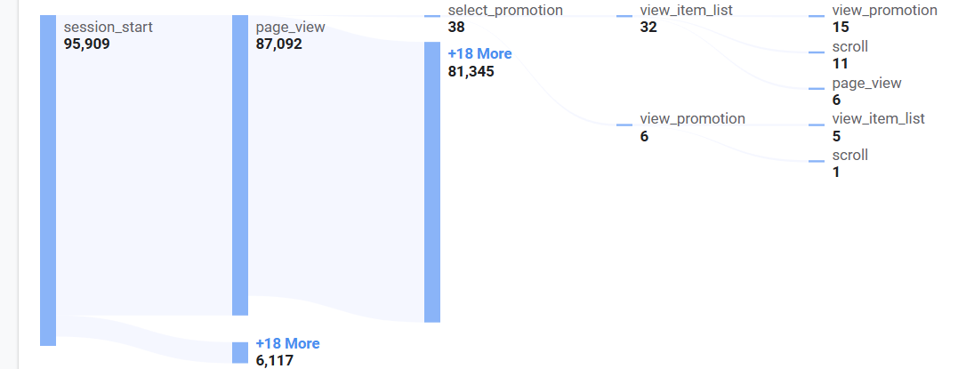
PROMOTION SCORE:
First time purchaser’s promotion rate: It helps to assess the likelihood of an object to be purchased from a promotion.
First time purchasers' promotion rate decreased by 4.17% in January 2025.
Purchase promotion rate: It helps to assess the likelihood of purchases to occur because of promotion.
Purchase promotion rate decreased by 3.72% in 2025 with Google campaigns encompassing lifestyle elements of new Google phones highest negative change.

Slide 19
OUR RECOMMENDATION
Allocate more resources to high-performing channels to maximize engagement and ROI across marketing efforts.
Regularly monitor and optimize underperforming channels by aligning content and user experience with audience intent.
Prioritize high-converting products like the Chrome Dino Party Time Sticker and Bamboo Lid Bento Box in future campaigns, using them as main products in promotions to drive fast conversions.
Investigate the drop-in purchase rate for certain products and adjusting targeting, product presentation, or pricing, while continuing to scale efforts in the Google Tablet accessories category where engagement is increasing.
Examine and optimize the travel sector’s user journey, focusing on the reasons behind the decline in first-time user purchases, such as content relevance, pricing, or user experience, and adjust the strategy accordingly.
Marketing campaigns should be made of new smart phones and tablets that are tailored to the entertainment sector to satisfy the business objectives.
Marketing campaigns should be focused on smart phones and tablets through the video channel by incorporating lifestyle elements to satisfy the business objectives.

Slide 20
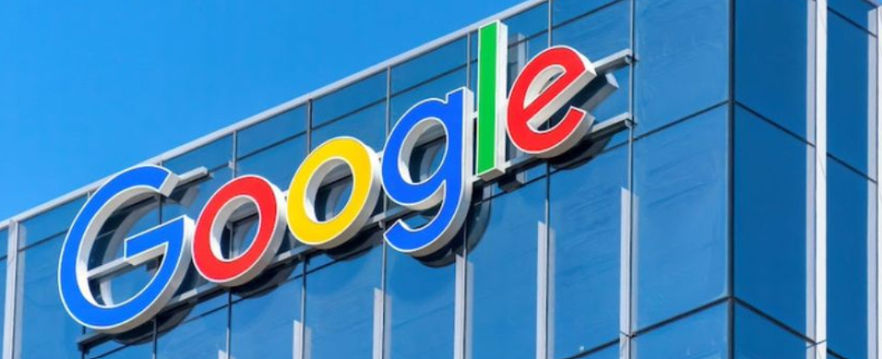
Thank you

