Slide 1
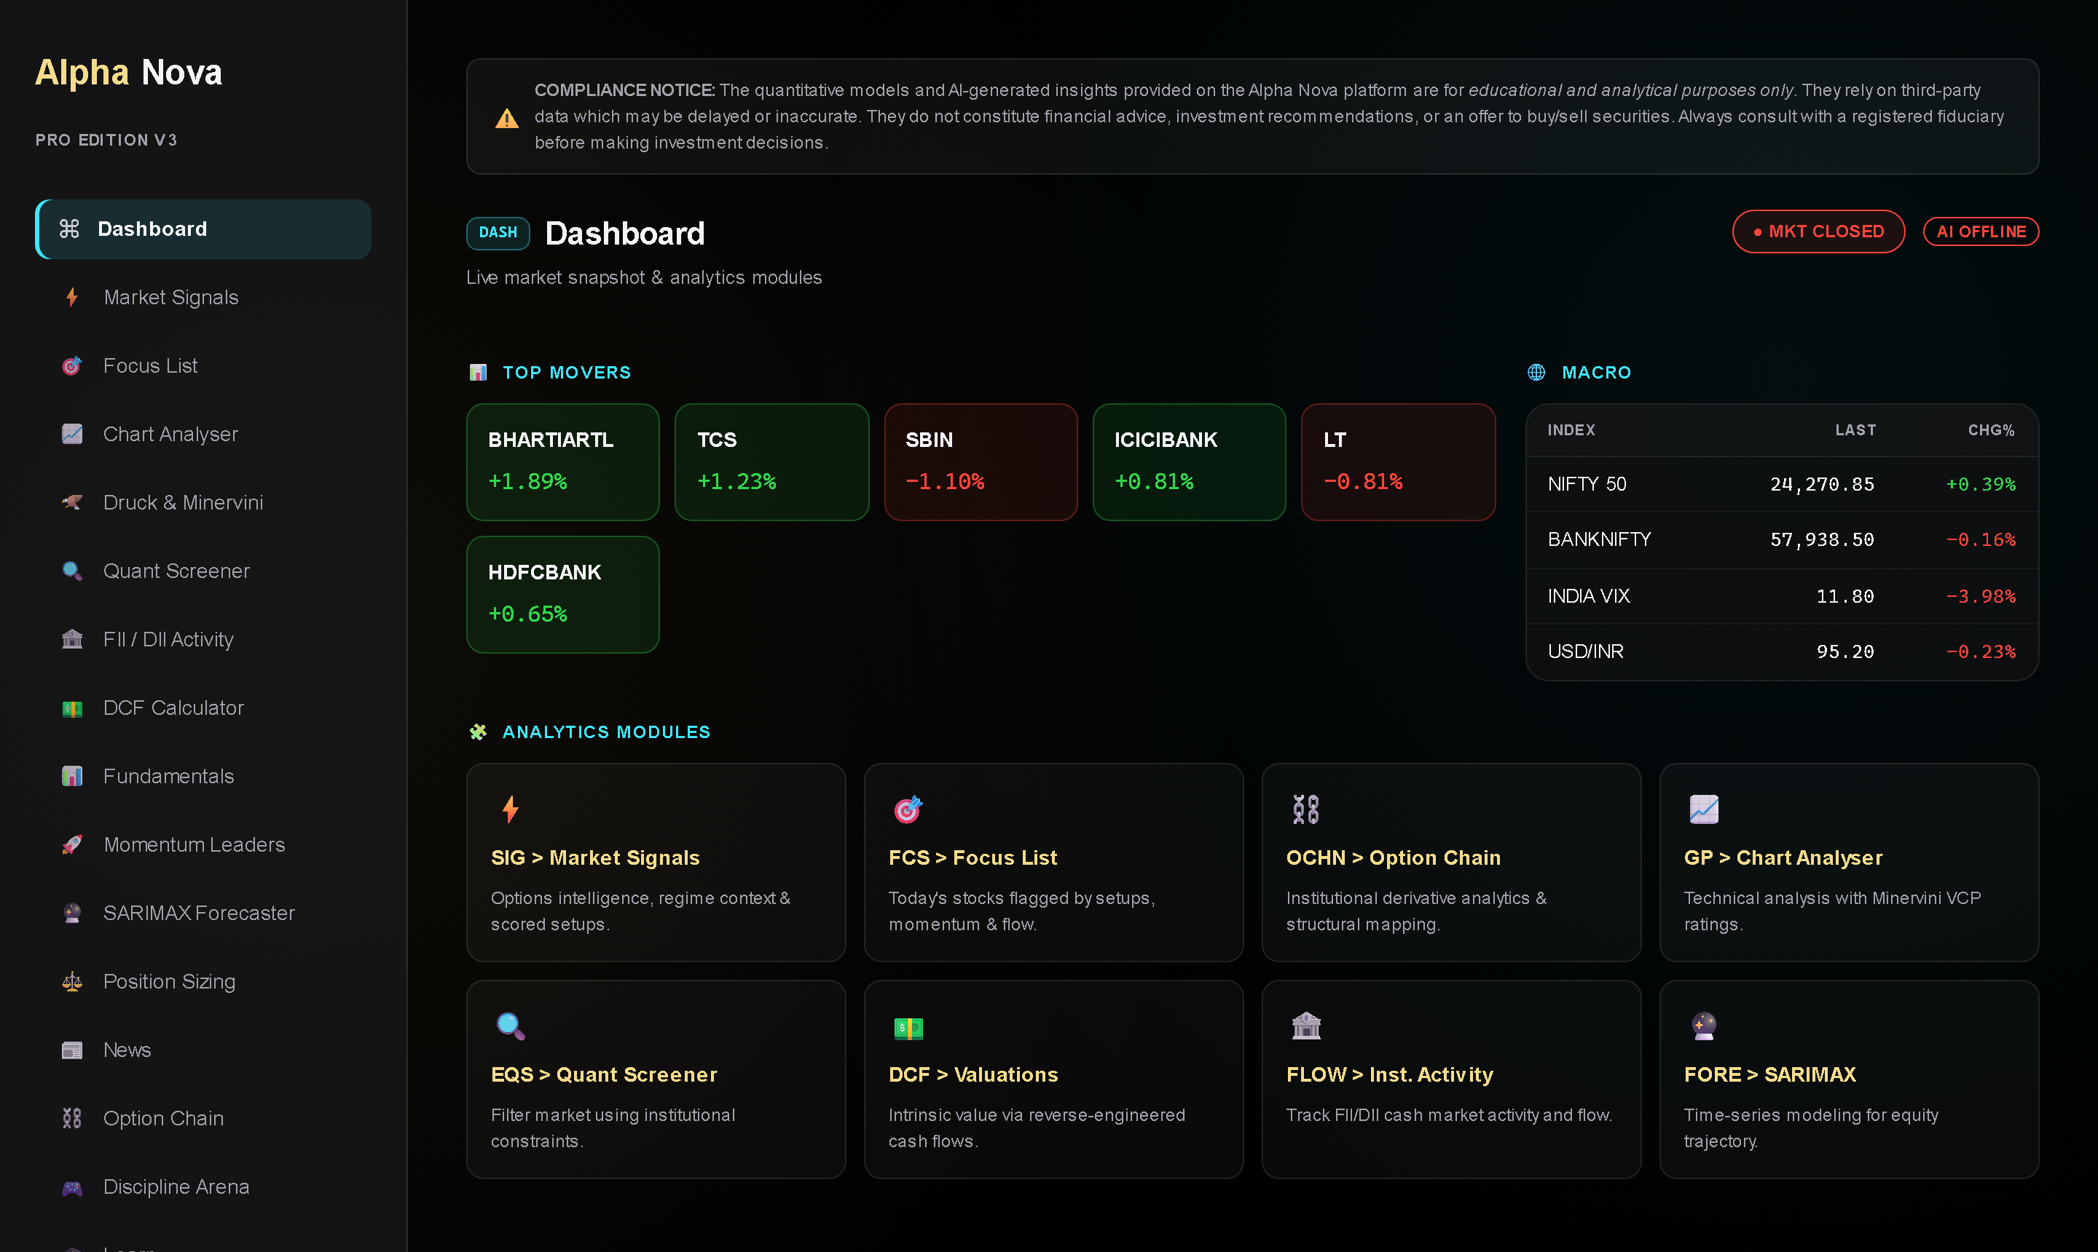
AN
Alpha Nova
Systematic Trading Infrastructure
Platform Masterclass · Live Webinar
5alphav2.vercel.app
01
Notes:
Welcome everyone. Quick framing before we start: this is not a stock-tips session. Over the next 45 minutes I'll walk you through Alpha Nova as infrastructure — the same way an institutional desk thinks about its tooling. Everything you'll see is live production, not mockups.

Slide 2
WHY
THE REFRAME
Tips expire. Systems compound.
THE TIP-CHASING LOOP
THE SYSTEMATIC LOOP
Someone else's conviction, borrowed for free
No entry logic, no exit logic, no sizing logic
“Black-box AI” claims you can't audit
Unmeasurable — you can't improve what you can't replay
Documented factors — every score decomposes
Entry, stop, target and size computed before you act
Risk-adjusted lens: Sharpe / Sortino, not screenshots of wins
Repeatable daily process — measured, journaled, improved
Today: the platform as your analytical engine — data, models, and discipline in one loop.
02
Notes:
Set the narrative here. The left card is how most retail participants operate — someone else's conviction with zero infrastructure. The right card is what we're building toward today. Emphasize: the difference isn't intelligence, it's process.

Slide 3
MAP
PLATFORM ARCHITECTURE
Three layers. One loop.
01
02
03
DATA LAYER
MODEL LAYER
DISCIPLINE LAYER
NSE option chains (live)
Delivery % + CLV (daily EOD)
FII / DII institutional flow
Fundamentals & price history
News + sentiment scoring
Conviction score 0–100 (7 factors)
Alpha Nova Score v2 (4 pillars)
Market regime engine
SARIMAX trajectory bands
Keyless news sentiment
Position sizing (1% rule)
Focus List (signal aggregation)
In-app signal alerts
Discipline Arena journaling
Regime-scaled exposure
→
→
Data feeds models. Models feed discipline. Discipline feeds back into what you watch next.
03
Notes:
Orient the audience: every screen they'll see today lives in one of these three layers. Data is sourced from NSE and public feeds; models turn it into scores with documented weights; discipline turns scores into sized, journaled decisions. The loop is the product.

Slide 4
DASH
WALKTHROUGH 01
Start where the market is.
Top Movers — the day's heavyweight action. Every tile is clickable — it opens the full chart instantly.
Macro strip — NIFTY, BANKNIFTY, VIX, USD/INR. Ten seconds tells you the day's temperature.
Module grid — every engine is one click away. This is your command surface, not a feed to scroll.
BEST PRACTICE Dashboard first, opinions second. Two minutes here before any trade decision.
04
Notes:
Live walkthrough moment #1 — switch to the browser if bandwidth allows. Show the mover click-through into Chart Analyser. Key message: the dashboard is a command surface. You leave it with a hypothesis, not a headline.

Slide 5
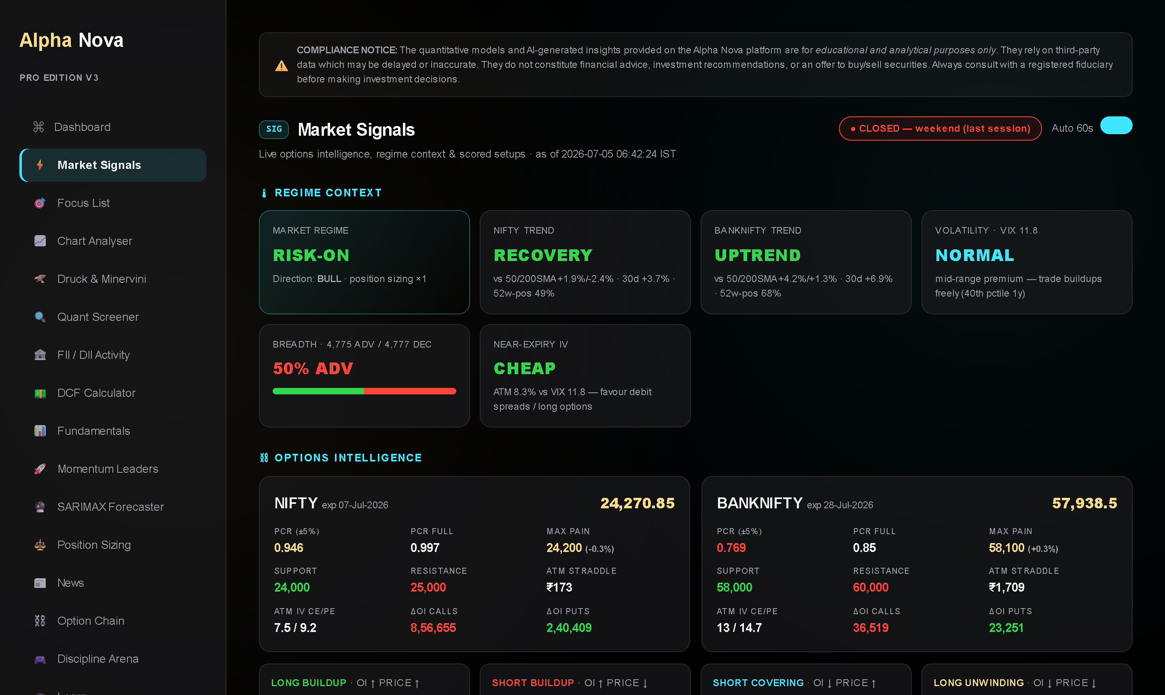
SIG
WALKTHROUGH 02
Signals with a spine: 0–100.
Regime context — risk-on / risk-off, trend, volatility percentile. Sizing multiplier comes from here.
Options intelligence — PCR, max pain, IV, OI buildups — what the derivatives market is actually positioned for.
Scored setups — each carries conviction 0–100 with entry, stop, target and quantity pre-computed.
Pop-up alerts — new setups notify you anywhere in the app — enable the bell for background notifications.
BEST PRACTICE Pick your conviction floor (e.g. 60) and never negotiate with it mid-session.
05
Notes:
This is the heart of the platform. Walk the page top to bottom in the live app: regime first, then options intelligence, then setups. Stress that a 48-score setup and a 75-score setup are different animals, and the engine refuses to show anything below 45.

Slide 6
DOC
FACTOR TRANSPARENCY
No black boxes. Every point documented.
OI intensity
Fresh open-interest thrust in the future
22
Price momentum
Day's directional push
18
Options-flow agreement
Aggressive option buying confirms direction
15
Liquidity
Trade count — can you actually get in and out
10
Index day-bias
NIFTY PCR alignment
10
Intraday trend
Close location in the day's range (CLV)
10
Delivery conviction
Delivery spurt into a directional close
10
Regime direction
Multi-week trend agreement
5
Total = 100. The same breakdown ships in the product and the docs — audit any signal, any day.
06
Notes:
Slow down here — this slide IS the anti-black-box argument. Read two or three factors aloud. The point isn't the specific weights; it's that they exist, they're documented, and they're stable. Contrast with 'proprietary AI secret sauce' marketing.

Slide 7
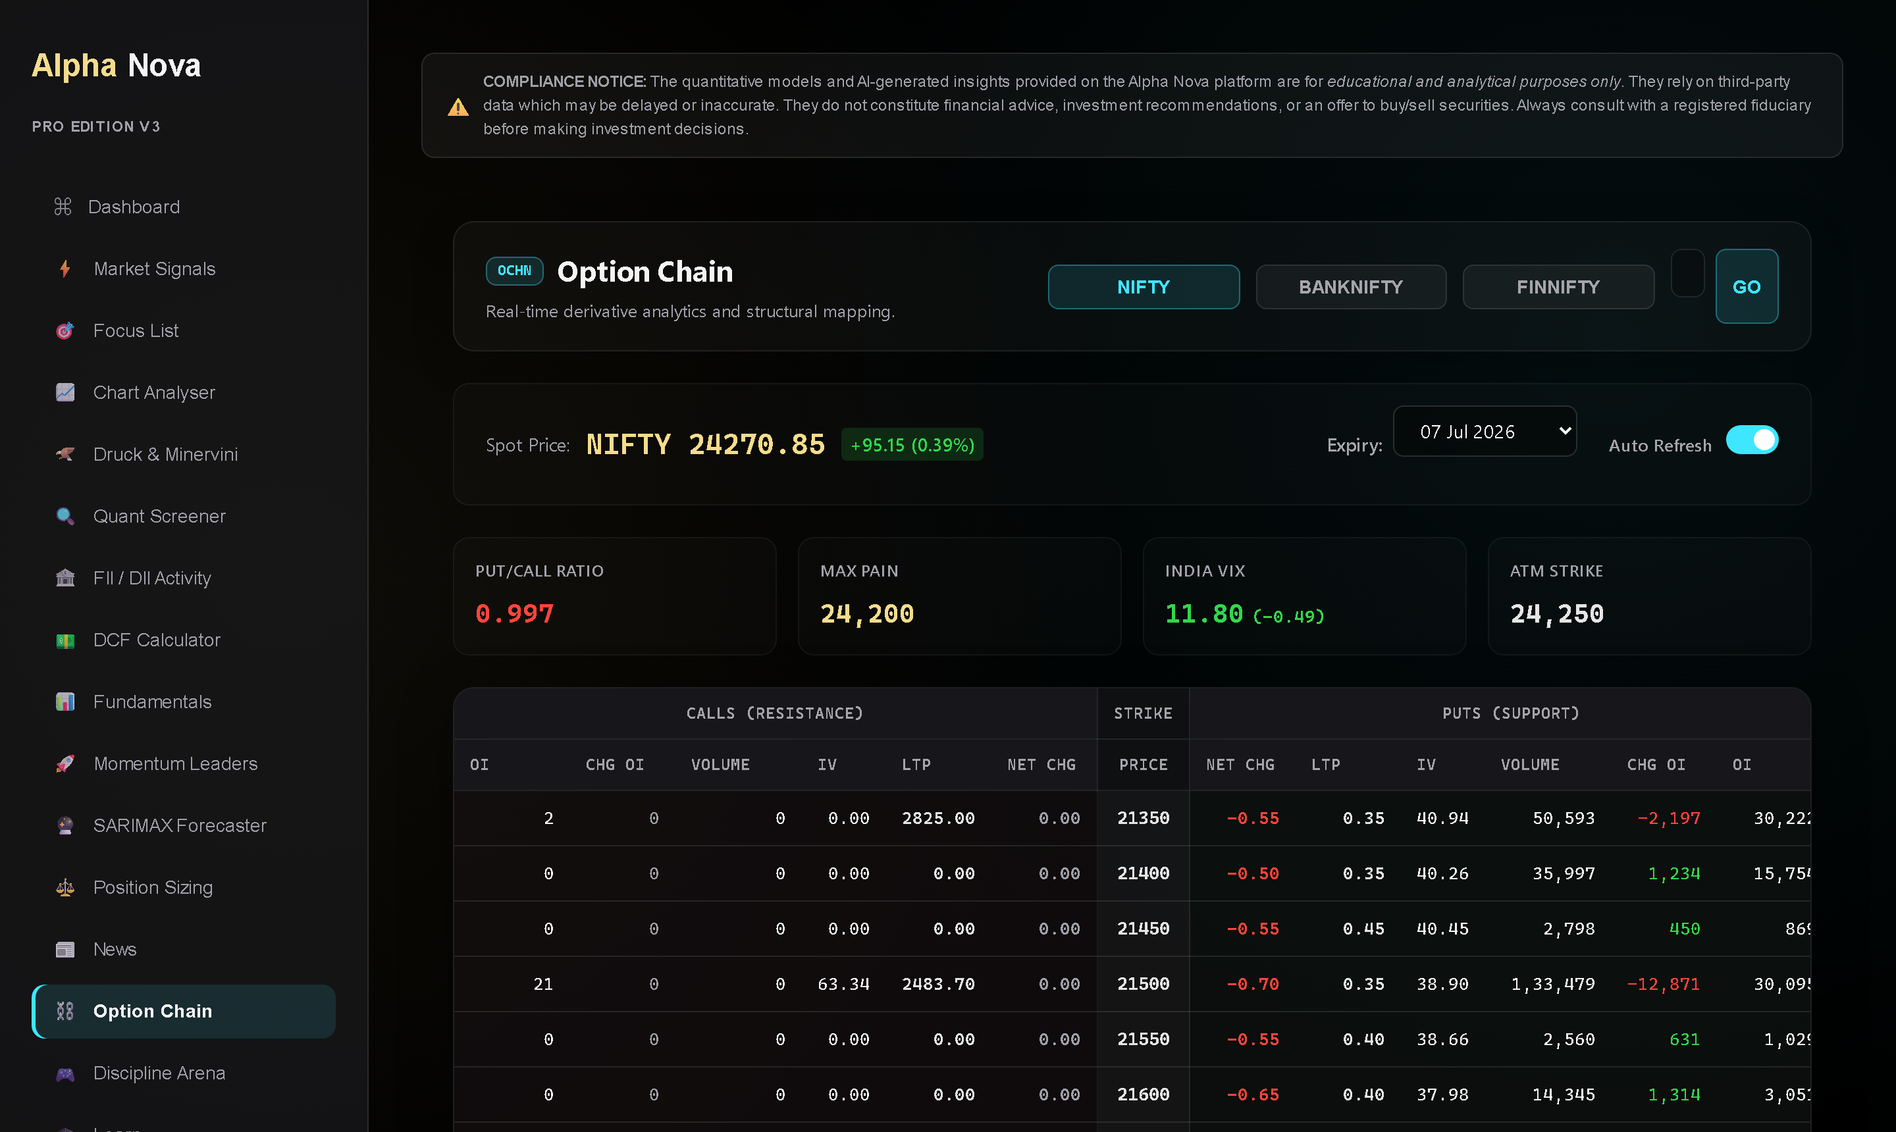
OCHN
WALKTHROUGH 03
Read positioning, not predictions.
PCR & max pain — where option writers expect the index to pin — the market's own consensus.
Support / resistance — the strikes with the heaviest OI walls, refreshed live.
IV context — cheap IV favours buying options; rich IV favours structures that sell premium.
BEST PRACTICE Trade structures, not directions: range days → condors; walls → spreads against them.
07
Notes:
Show NIFTY live: point at max pain vs spot, then the support/resistance strikes. The mental shift: the chain is a positioning map, not a crystal ball. The Signals tab already distills this — the chain is where you verify.

Slide 8
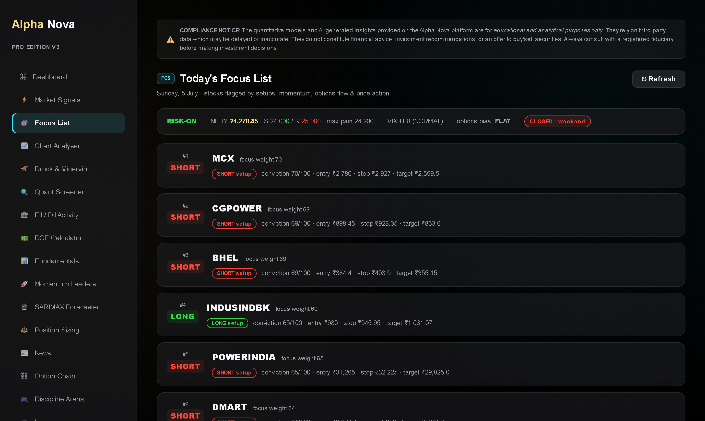
FCS
WALKTHROUGH 04
One list. Every engine's vote.
Focus weight — setups, momentum rank, options flow, delivery spurts and heavyweight moves all add votes.
Side & reasons — each name shows LONG/SHORT and exactly why it was flagged — no mystery entries.
Day context — regime, VIX, index S/R at the top so the list reads with the backdrop, never in isolation.
BEST PRACTICE Your watchlist is built for you by 6 engines. Curate down, don't add up.
08
Notes:
Explain aggregation: a name that's #2 in momentum AND has a delivery spurt AND a fresh long buildup outranks any single-engine flag. This kills the 'what should I watch today' question systematically.

Slide 9
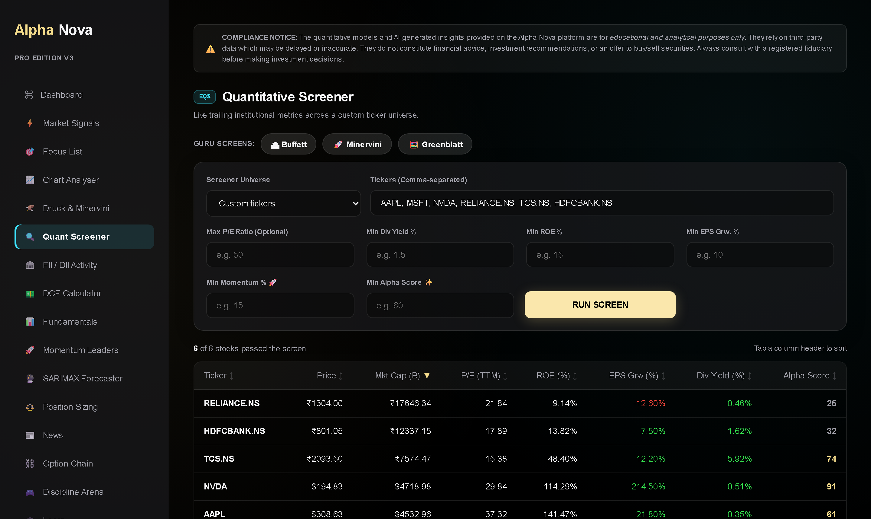
EQS
WALKTHROUGH 05
Screen like the greats — scored.
Guru presets — Buffett, Minervini, Greenblatt — one click applies the filter set.
Universes — Nifty 100/200, S&P 100, Nasdaq 100, or your custom tickers.
Alpha Nova Score — four pillars: Value 30 · Quality 30 · Growth 25 · Yield 15. Missing data renormalizes — a non-payer isn't punished for skipping dividends.
BEST PRACTICE Sort by Alpha Score, then read the raw columns. The score ranks; the columns explain.
09
Notes:
Run the default screen live. Point at NVDA vs a value trap: the old world scores cheapness; the pillar model scores the whole business. Mention the pillars are documented — same transparency story as the conviction score.

Slide 10
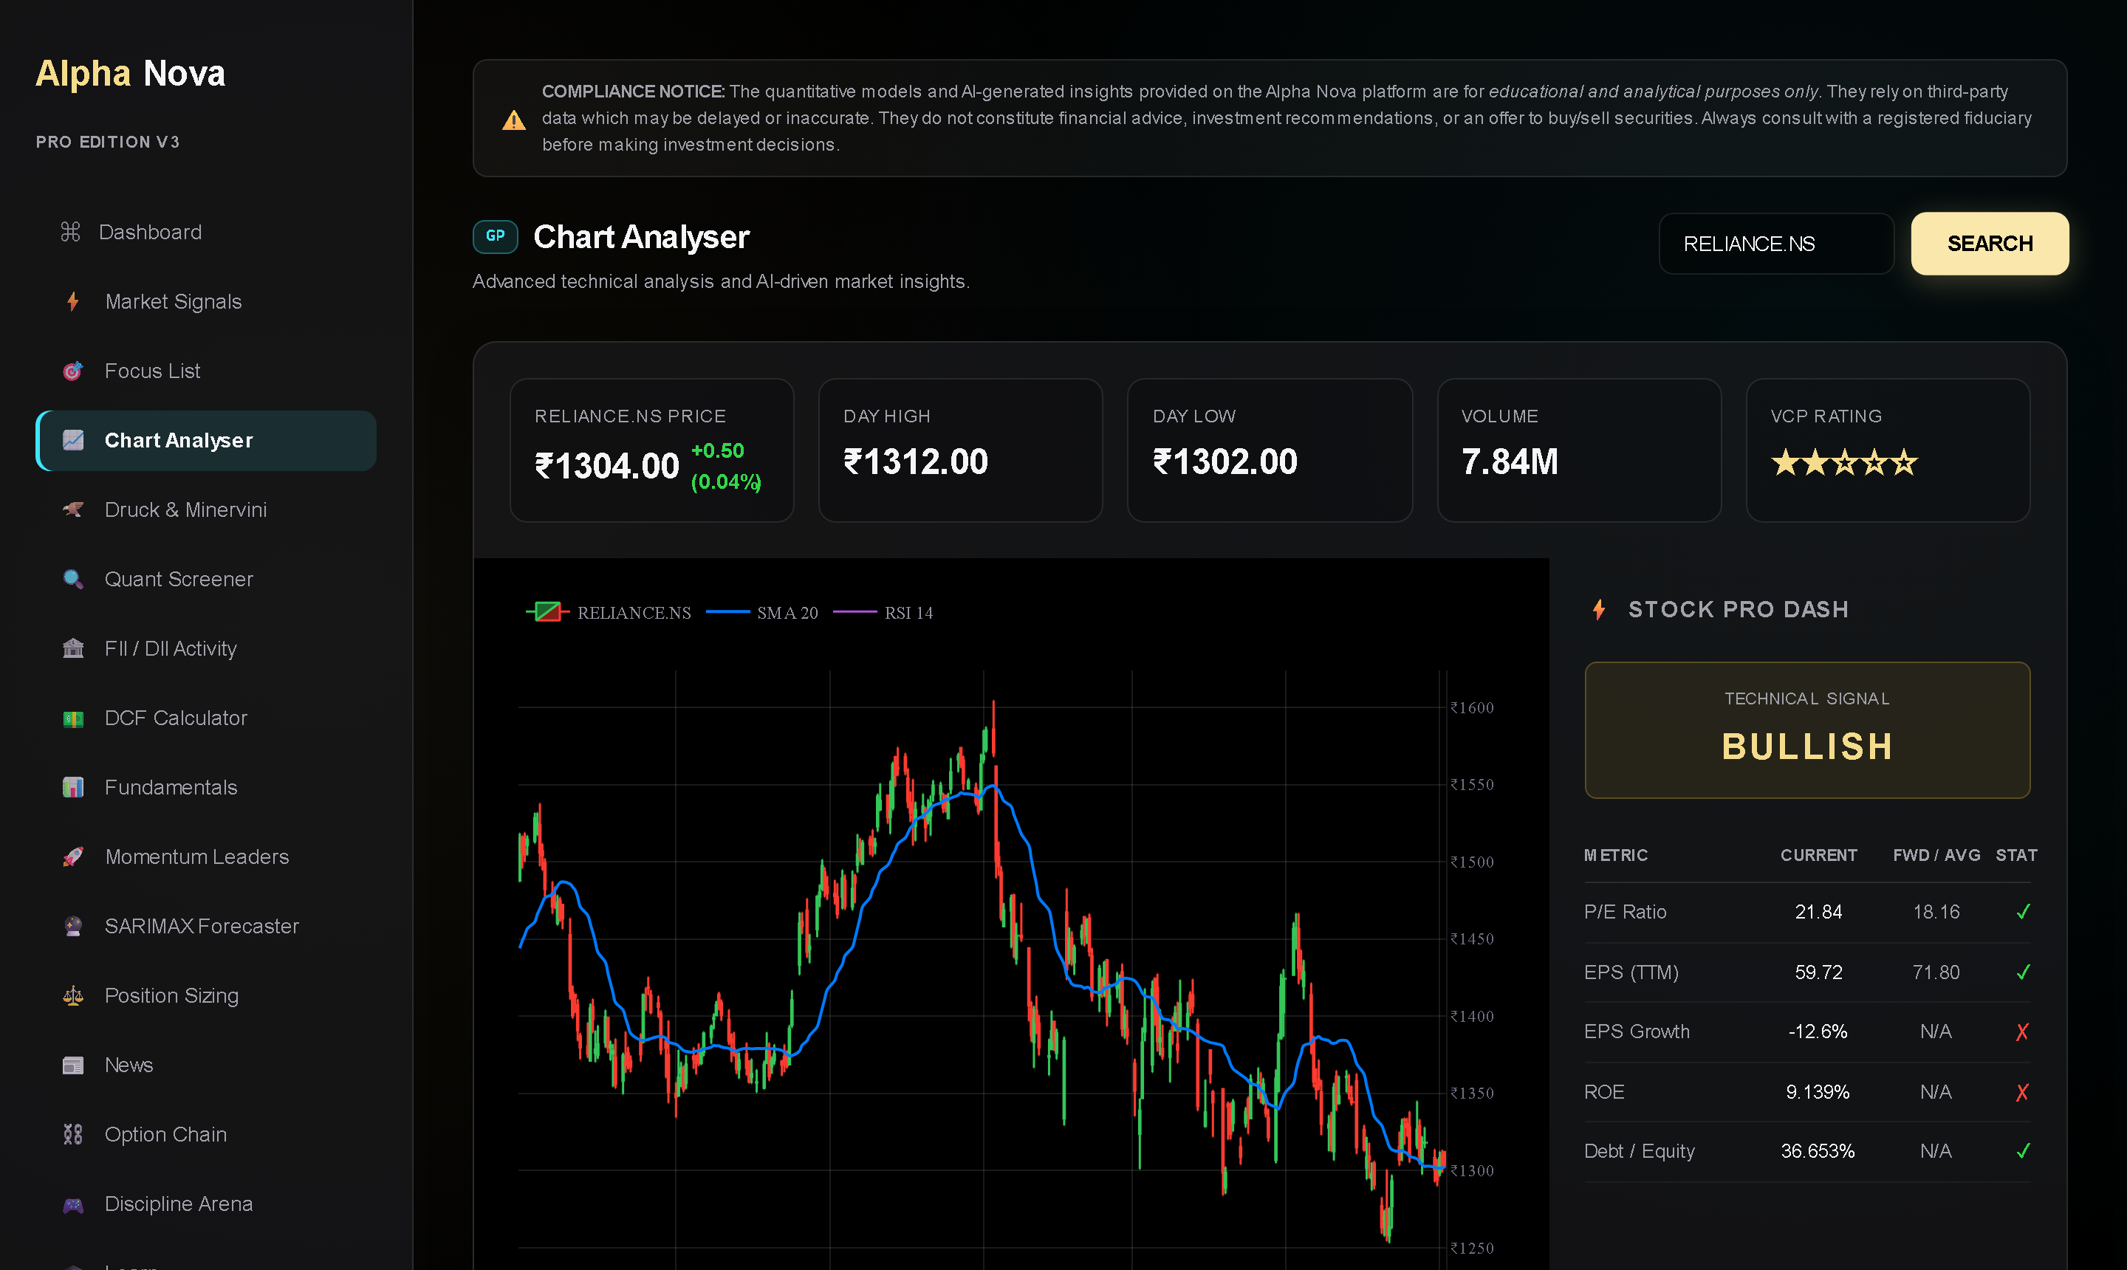
GP
WALKTHROUGH 06
Technicals with a checklist.
One search — price, candles, SMA-20, RSI-14 and fundamentals in a single view. ₹ and $ handled automatically.
VCP rating — Minervini's volatility-contraction pattern scored 0–5 stars — a setup-quality shortcut.
Pro dash — P/E vs forward, EPS growth, ROE, debt — pass/fail ticks against institutional thresholds.
BEST PRACTICE Arrive here FROM a signal (or a dashboard click) — charts confirm ideas, they don't generate them.
10
Notes:
Demo the dashboard mover click-through landing here pre-loaded. The checklist framing matters: VCP stars and the pass/fail ticks turn 'vibes' chart-reading into a repeatable gate.

Slide 11
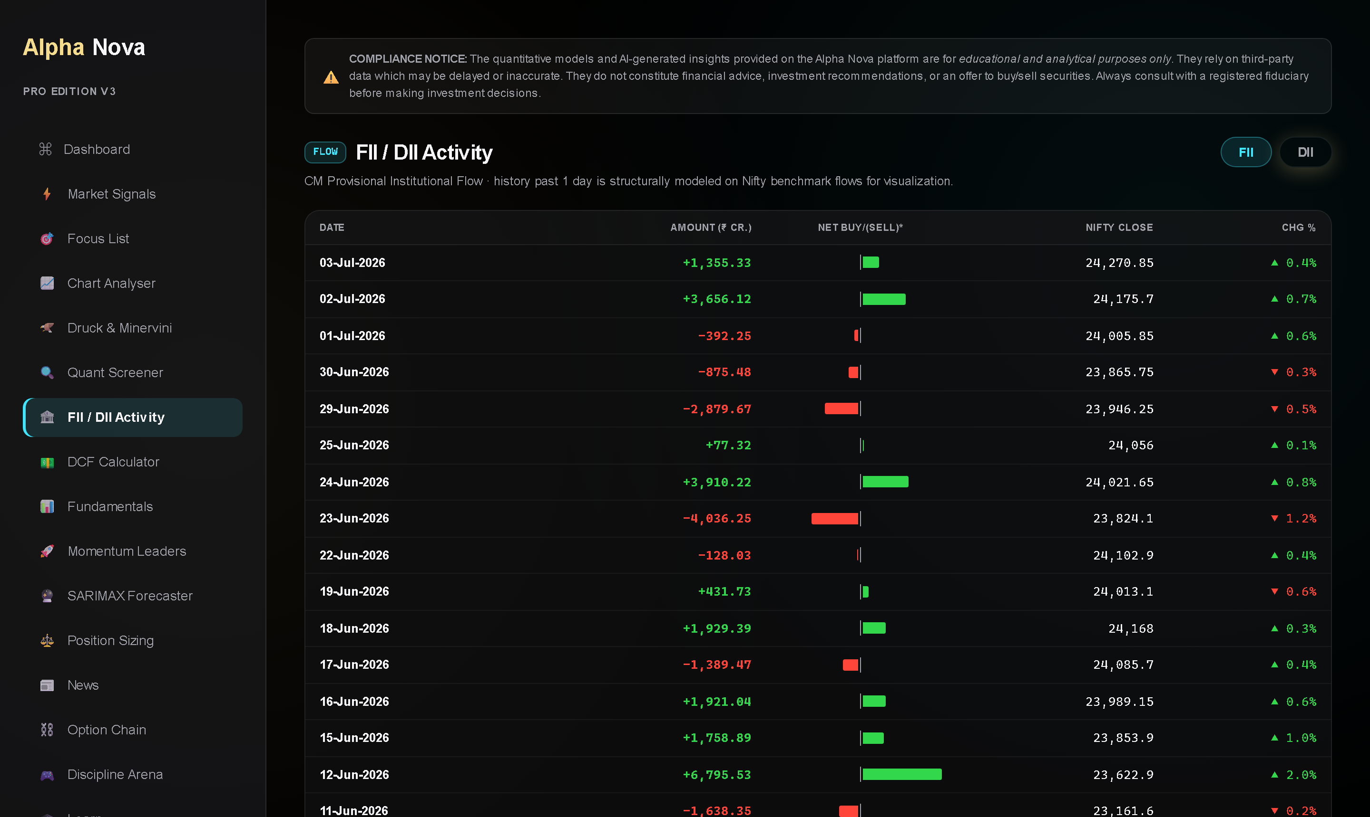
FLOW
WALKTHROUGH 07
Follow the money that settles.
FII / DII cash flows — daily institutional buy/sell with NIFTY context — who is really moving the tape.
Delivery % — auto-fetched from NSE daily. Delivered volume = conviction; intraday churn = noise.
The rule the engine uses — delivery spurt ≥1.3× the stock's own 20-day average INTO a strong close = accumulation. Into a weak close = distribution.
BEST PRACTICE Never read delivery % raw — always vs the stock's own baseline. The engine does this for you.
11
Notes:
This data updates itself daily at ~7:30pm IST via cron — infrastructure, not homework. The CLV+delivery rule is the same one wired into the conviction score's 10 delivery points. One model, everywhere.

Slide 12
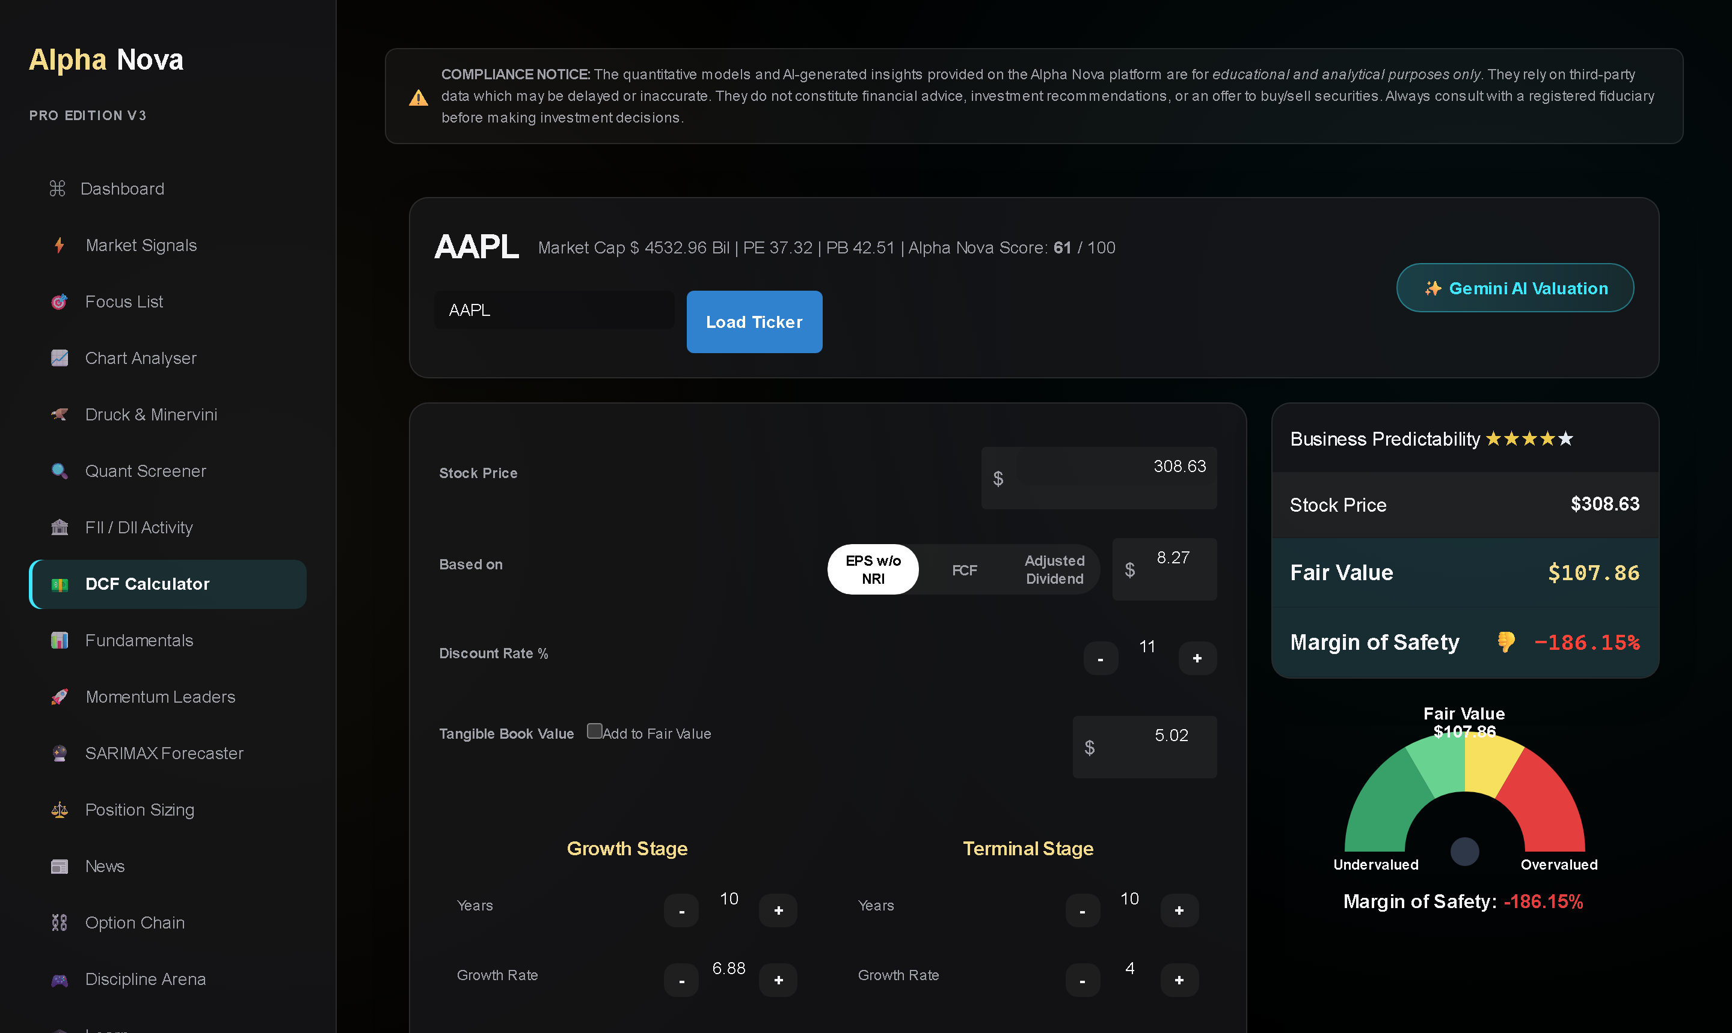
DCF
WALKTHROUGH 08
Value the business. Band the path.
DCF calculator — auto-populated EPS/FCF/dividend bases, two-stage growth, margin-of-safety gauge.
Alpha Score in context — the same 4-pillar score appears here — valuation never floats free of quality.
SARIMAX forecaster — a statistical trajectory with a 95% band. It frames uncertainty — it does not predict.
BEST PRACTICE Demand a margin of safety before the story. If MoS is deeply negative, the burden of proof flips.
12
Notes:
Position SARIMAX carefully for this audience: it's a banding tool, not a prophecy machine. The honest framing builds more trust than any accuracy claim — that's the systematic-infrastructure brand.

Slide 13
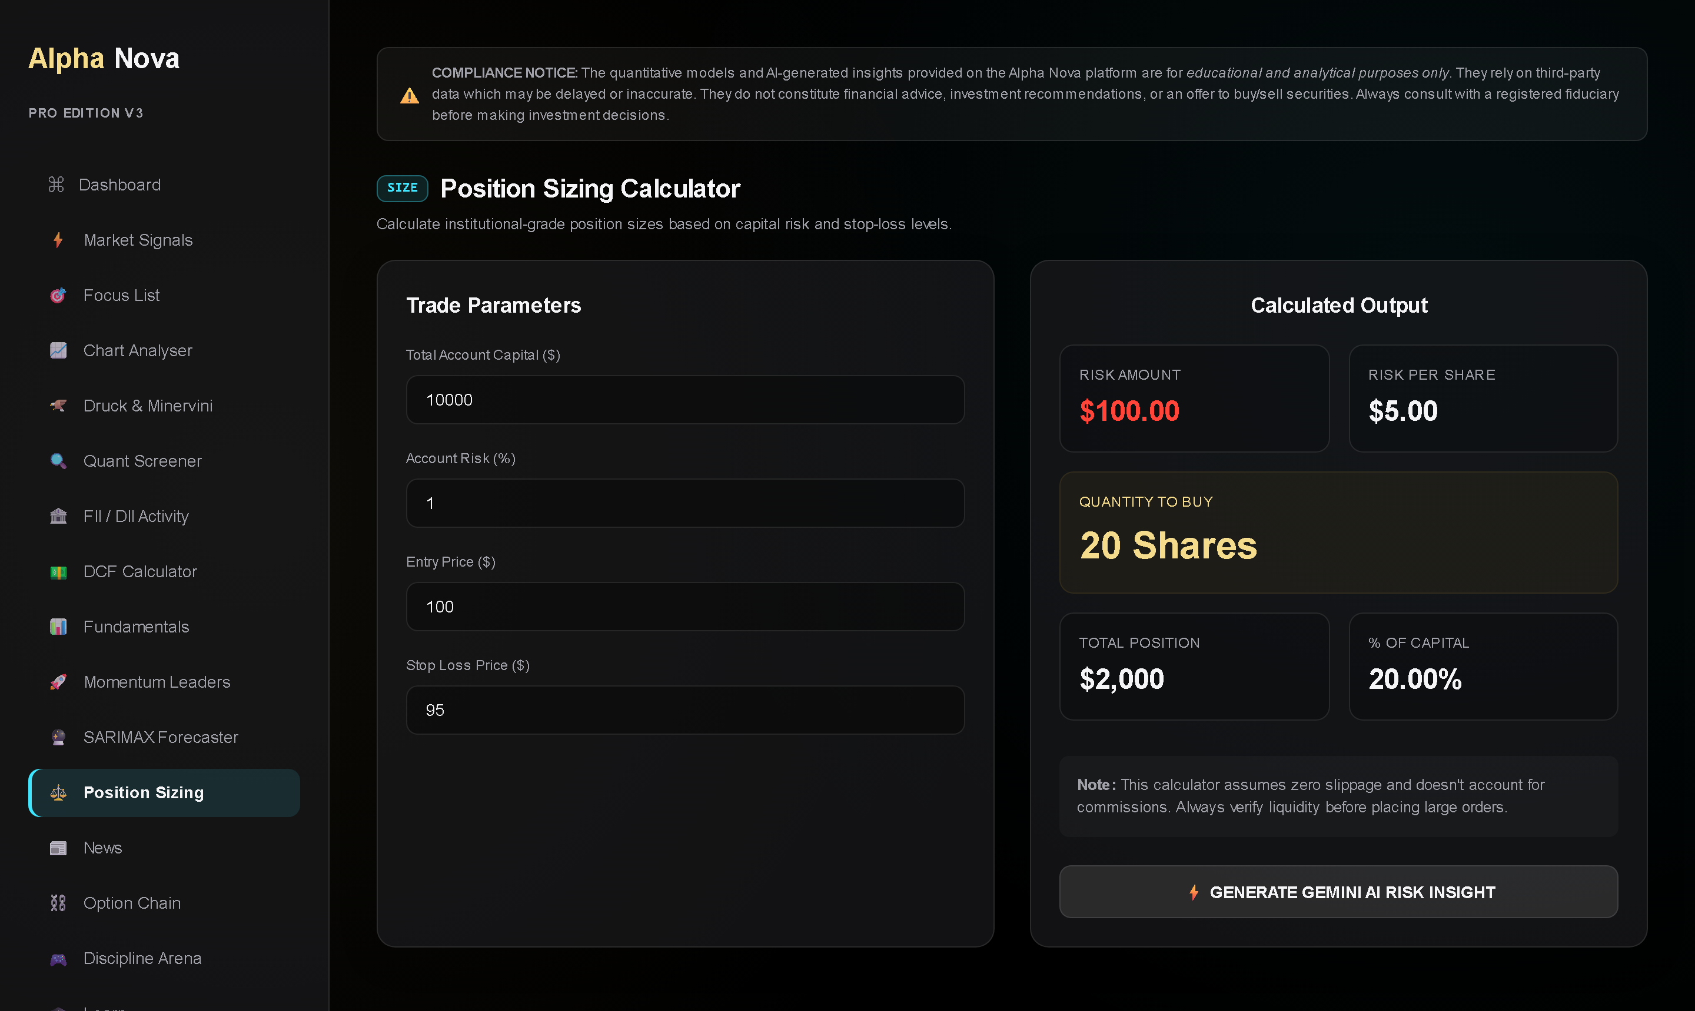
SIZE
RISK DISCIPLINE
Size first. Enter second.
The 1% rule — risk per trade ≤ 1% of capital. The calculator turns entry + stop into an exact quantity.
Regime scaling — elevated volatility automatically scales suggested size down. Respect it.
1.5R minimum — engine targets are set at 1.5× risk — skip anything that can't pay that.
Discipline Arena — journal every trade, tick the discipline quests. The XP is fake; the habit is real.
BEST PRACTICE Your edge is the process surviving 100 trades — sizing is what keeps you in the game that long.
13
Notes:
This is where most retail journeys fail. The platform computes quantity from risk, not from confidence. Tell the story: a 60% hit-rate system with bad sizing still blows up. Arena gamification exists because journaling is the least fun, highest-value habit.

Slide 14
LOOP
BEST PRACTICE
The systematic daily routine.
1
09:00
Dashboard + Signals regime block. Risk-on or risk-off decides your sizing multiplier for the day.
REGIME
2
09:10
Read the Focus List with its reasons. Curate to 3–5 names max. Set your conviction floor.
FOCUS
3
IN-SESSION
Act only on alerted setups above your floor. Size from the calculator. Structures over directions on indices.
EXECUTE
4
15:35
FII/DII + delivery prints after close — did institutions confirm your names?
FLOWS
5
EVENING
Arena: log the trades, tick the quests. Review what the system said vs what you did.
JOURNAL
14
Notes:
The single most actionable slide — encourage screenshots. Five touchpoints, maybe 40 minutes of total attention per day. The platform automates everything between the touchpoints, including the delivery data refresh and the signal alerts.

Slide 15
AN
Trade the process.
Systematic infrastructure — auditable factors, risk-adjusted thinking, daily discipline.
5alphav2.vercel.app
Q & A
Alpha Nova provides analytics for educational purposes only. Nothing on the platform or in this presentation is investment advice, a recommendation, or an offer to buy or sell securities. Data may be delayed or inaccurate. Backtested and illustrative figures do not guarantee future results. Consult a registered adviser before investing.
15
Notes:
Close on the narrative, not on features. One sentence: 'Everything you saw is documented, risk-adjusted, and repeatable — that's the whole pitch.' Then open Q&A. Common questions: data sources (NSE + public feeds), AI usage (user-keyed Gemini, optional), pricing/access.

