Slide 1
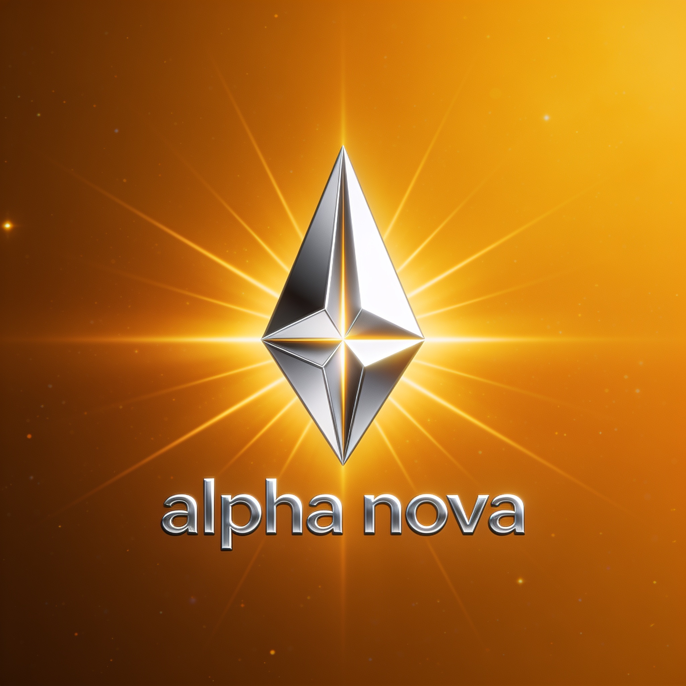
SEED ROUND · 2026
Alpha Nova
The retail trading terminal, rebuilt.
Institutional-grade signals, options intelligence and risk discipline —
for the 19-crore-account generation that just arrived in the market.
NSE + US MARKETS
LIVE IN PRODUCTION
PRE-SEED / SEED
LIVE AT 5ALPHAV2.VERCEL.APP

Slide 2
THE PROBLEM
India trades more derivatives than anywhere on Earth. Retail still loses.
9 in 10
₹1.8 L Cr
5+ apps
individual F&O traders lose money
net retail losses in F&O over just three years
per trading decision — charts, options, news, tips, sizing
SEBI STUDY, FY22–FY24
SEBI, FY22–FY24 AGGREGATE
FRAGMENTED TOOLING, ZERO ACCOUNTABILITY
The tools are fragmented. The advice is unaccountable. The risk is invisible. Nobody sells discipline.
Alpha Nova · Confidential
2

Slide 3
THE SOLUTION
One terminal. Every trade arrives as a plan.
Scored setups, 0–100
A track record kept in public
Every signal ships with entry, stop and 1.5R target — sized by an 8-factor conviction engine across OI, momentum, options flow and regime.
Every published signal is paper-traded into a live model book — wins, losses, win rate, equity curve. Auditable by anyone, any day.
Institutional analytics, free
A discipline layer
True ATM IV solved from straddles, max pain, sector rotation maps, insider and block prints, FII/DII flows — the desk toolkit, in a browser.
Position sizing before entry, streaks and a daily market call — habit loops built around process, not dopamine.
Free to use. Guests get the full terminal — accounts capture watchlists, alerts and the leaderboard.
Alpha Nova · Confidential
3

Slide 4
PRODUCT
22 live modules. Two markets. Zero setup.
Market Signals
Options Intelligence
Sector Rotation
Regime context, OI buildups, scored trade plans — NSE by day, US by night.
Full chain, straddle-solved ATM IV, max pain, PCR, support/resistance walls.
Weekly RRG of 12 sectors vs the index — see money rotate before it's news.
Momentum & Breakouts
Smart-Money Trail
Forecast & Valuation
Fresh 20D / 3M / 52W highs flagged the day they print, with volume context.
FII/DII flows, bulk & block deals, insider prints with true buy/sell direction.
SARIMAX projection bands, DCF, quant screener, guru screens, AI briefs.
WEB + INSTALLABLE PWA
REAL-TIME PUSH ALERTS
GUEST MODE → FREE ACCOUNT
140+ AUTOMATED TESTS
Alpha Nova · Confidential
4

Slide 5
WHY NOW
A generation just arrived in the market — with no tools built for it.
World's largest options market
DEMAT ACCOUNTS IN INDIA (CRORE)
NSE is #1 globally by contracts traded. Retail is the majority of that flow.
Demat accounts tripled in four years
5.5 crore to ~19 crore (FY21 → FY25). First-time traders need process, not more noise.
Regulators are forcing accountability
SEBI is squeezing unregistered tip-sellers. Verified, auditable analytics are the compliant answer.
Source: NSDL + CDSL published totals (approx.)
Alpha Nova · Confidential
5

Slide 6
MARKET
A large, young market — priced for a free-first wedge.
TAM
SAM
SOM
19 Cr
~1.2 Cr
10 L
demat accounts in India — the retail investing population
active derivatives & serious equity traders
registered users within 3 years
every account is a potential terminal user
trade weekly, already pay for data, tips or tools
at 5% Pro conversion ≈ ₹24 Cr ARR
Reference points: TradingView ₹995+/mo · Sensibull ₹800/mo · Trendlyne ₹500+/mo — all partial stacks. Alpha Nova Pro undercuts at ₹399/mo with the full stack.
Internal estimates, 2026. SAM from SEBI active-trader studies; SOM assumes GTM below.
Alpha Nova · Confidential
6

Slide 7
BUSINESS MODEL
Free terminal builds the audience. Pro sells the edge.
FREE
PRO
B2B (LATER)
₹0
₹399/mo
API + referrals
Full terminal — all 22 modules
Delayed signal alerts
Watchlist, leaderboard, community
The funnel: every user compounds the track record's audience
Real-time push the moment a setup scores
Full signal history + performance analytics
AI research briefs on every module
Priority data refresh & early features
Signals & analytics API for brokers, advisors, media
Broker referral revenue per funded account
Embedded 'terminal-as-a-service' for discount brokers
Unit economics: public data sources + serverless infra → >85% gross margin. Entire production stack runs on under ₹10K/month today.
Alpha Nova · Confidential
7

Slide 8
WHY WE WIN
The moat is trust — and trust takes time competitors don't have.
A public, auditable track record
Full-stack quant engine, in-house
Every signal ever published sits in a live model book. A rival can copy features tomorrow; it cannot copy two years of timestamped performance.
8-factor signal scoring, straddle-solved IV, regime detection, RRG rotation, EOD bhavcopy reconstruction — proprietary and battle-tested in production.
Retention by design
A cost structure rivals can't match
Daily call, streaks, leaderboard and push alerts create a morning habit. The product is opened because the market opened.
Serverless + public data = pennies per user. Free tier is sustainable indefinitely — we can wait out anyone who has to charge on day one.
Alpha Nova · Confidential
8

Slide 9
WHERE WE ARE
Product-complete and live. Now we pour fuel on it.
SHIPPED — 2026
Q3 '26
Distribution + Pro tier
Live in production — web + installable PWA
22 modules across NSE & US sessions
Signal engine + public model-book track record
Web push alerts, share cards, guest→signup funnel
140+ automated tests · hardened & edge-cached
8-spot marketing ad set, ready to run
Launch marketing engine, seed communities, ship Pro at ₹399/mo. Target: first 10,000 registered users.
Q4 '26
One tap from plan to order
Broker API integration — execute a scored plan, pre-sized, in one tap. Mobile store wrappers.
H1 '27
Community & B2B
Verified-performance profiles, discipline leagues, signals API pilot with a discount broker.
Honest status: pre-revenue, pre-marketing — the raise funds distribution, not discovery of product-market shape.
Alpha Nova · Confidential
9

Slide 10
GO-TO-MARKET
The product is the content. The users are the channel.
01
Built-in virality
Every chart, forecast and signal exports a branded share card in one tap. Leaderboards and streaks pull friends in — each share carries the URL.
02
The signal feed is a content engine
Daily scored plans + the public track record auto-publish to X, Telegram and Shorts. Performance content that writes itself, every market day.
03
Educator & community seeding
Free Pro for finance educators; the Learn tab funnels their audiences. Terminal embeds for trading Discords and Telegram groups.
04
Broker partnerships
Discount brokers need engagement; we need execution. Referral revenue per funded account, then embedded order routing.
Alpha Nova · Confidential
10

Slide 11
COMPETITION
Everyone owns a slice. Nobody owns the loop.
 | Alpha Nova | TradingView | Sensibull | Screener.in | Telegram tips
Scored trade plans (entry/stop/target) | ✓ | — | ◐ | — | ◐
Published, auditable track record | ✓ | — | — | — | —
Options IV & flow intelligence | ✓ | ◐ | ✓ | — | —
Risk-first position sizing | ✓ | — | ◐ | — | —
India F&O native (NSE live) | ✓ | ◐ | ✓ | — | ✓
Fundamentals + screeners | ✓ | ◐ | — | ✓ | —
Price | Free · ₹399 | ₹995+/mo | ₹800/mo | ₹4,999/yr | 'free' + losses
Assessment: public pricing/features, July 2026. ◐ = partial coverage.
Alpha Nova · Confidential
11

Slide 12
THE ASK
Raising ₹4 Cr seed for 18 months of distribution.
USE OF FUNDS
18-month runway
3 hires — two engineers, one growth lead — plus founder.
100K registered · 5K Pro
≈ ₹2.4 Cr ARR exiting month 18; Pro launches in the first quarter post-close.
Broker integration shipped
Plan-to-order execution — the step that turns analytics into a transactional business.
Compliance pathway
SEBI Research Analyst registration — turning the public track record into a regulated asset.
Alpha Nova · Confidential
12

Slide 13

Alpha Nova
Trade with a plan.
abhishek_sarda@yahoo.com · 5alphav2.vercel.app
This deck contains forward-looking estimates; product metrics are live and verifiable in-app.

