Slide 1
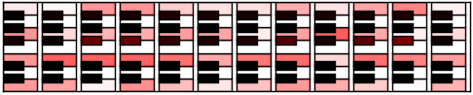
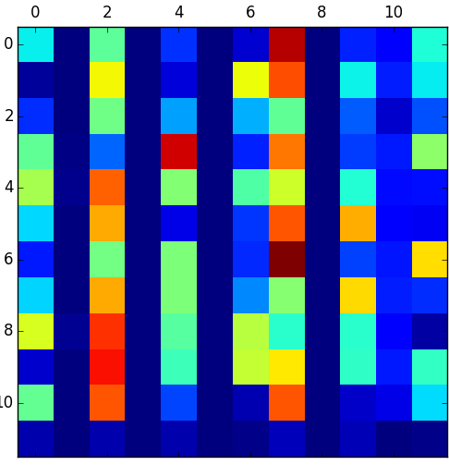
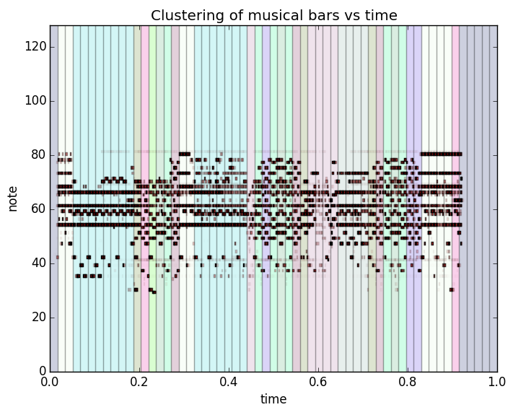
Rechorder: Real Time Prediction of Music Motif Progression.
Yash Savani (ysavani), Wilbur Yang (wilbury), Tommy Li (tommyli)
Stanford University
Abstract
Materials & Methods
Results
Results Cont.
For our term project we decided to use Artificial Intelligence to try and model some of the semantics of music. Music is built up of a repetition of common motifs for a genre. We tried to model these motifs using k-means clustering, where each cluster represented a particular motif of that genre. We then used these motifs as labels for the second part of our project where we used supervised learning to predict cluster / motif progression. For the second part of our project we evaluated multiple supervised learning algorithms including SVMs, logistic regression and naïve bayes, where each learning algorithm used multiple features to predict the next motif of the song. We used k-fold cross validation with ten folds where the learning algorithm was trained on the nine tenths of the input files and tested on the remaining one tenth. For evaluation metric we recorded the total number of correct motif progression predictions and reported them in a confusion matrix.
Methods
For our tests we used midi files from popular contemporary Western music. This is because this genre is known for its simplicity in chord progression and because the midi files are readily and easily available to download. We had a corpus of 60 midi songs that we were evaluating on. For the first part of project, we combined the bar vectors from the 60 midi songs and ran k-means on them. An example of the results from running the k-means algorithm on a single song (Fifteen, Taylor Swift) is as follows.
To better visualize our results we generated a map representing the keys of the piano where the opacity of the red over the keys represents the relative presence of the keys in that cluster i.e. for notes that have a high presence the opacity of the red is lower.
Another visualization for the clusters is given below as heat map of the keys in each cluster.
Finally we can see the midi representation of the song as well as the assigned cluster / motif of the bars.
The silhouette value for this particular clustering was
Here we have a graph showing the silhouette value for song with different values of k. We can see that is the optimal value for k.
Running K-means on all the midi files we get the following silhouette value graph.
We can clearly see that the best value for k is
For the second part of our project, the confusion matrices for each of the different supervised learning algorithms are given below.
Naïve Bayes
SVM
Logistic Regression
Our project is divided into two parts.
The first part is the motif generation, where we used k-means clustering to generate the common motifs for a genre. Each input midi file was separated into bars, where each bar was a group of 4 beats. The bar was represented as a vector in 12 dimensions. Each component of the vector represents the normalized presence of a note in the chromatic scale (all white and black keys of the keyboard) i.e. for a bar where the notes C, E and G have a high presence the values of the C, E and G components of the vector would be high. We combined all the bar vectors and ran k-means on the vectors to give the k defining motifs of the genre. To evaluate the k-means results we used the silhouette values of the clusters. The formula for the silhouette value is as follows.
We picked k to be the value of k that maximized the average silhouette value over five trials. We then stored the best clustering in a .mtf file.
For the second part of our project we applied supervised learning to try and predict motif progression. We used k-fold cross validation with 10 folds. For each input file, we again separated the file into bar vectors. We then found the closest motif to each of the bar vectors and labeled each bar with the corresponding motif number. Using the motif number as the label we evaluated supervised learning algorithms on their effectiveness to predict the next motif. For the features of the supervised learning algorithms we added the motif numbers of the previous 4 bars, we added the notes leading up to the next bar and average note value of the current bar i.e. average length that each note was played for. We then tried to predict the motif progression using a simple naïve bayes algorithm, an SVM and logistic regression. For each predicted motif we evaluated our success by comparing our prediction with the actual motif number of the next bar. We then accumulated all the true motif transitions and the false motif transitions and reported a confusion matrix for our predictions.
Introduction
Music has always fascinated us. What makes it so fascinating is the fact that it is built up of simple motifs that when combined together, like words in a sentence, have an enormous artistic space. Music is defined to be the ordering of tones in temporal space to produce compositions having unity and continuity. Our goal was to use Artificial Intelligence with Machine Learning to try and predict these orderings of tones. Early on we realized that while western music is made up of chords and chord progressions, there are several other types of music, particularly Asian and African music that do not follow the ubiquitous chordal pattern of western music. Nevertheless we wanted to produce a system that would be able to predict music progression regardless of genre. To do so, we finalized on a model where rather than relying on the classic western chords, we would use unsupervised learning in the form of k-means clustering to model the common motifs of a genre of music; for example in the context of western music these motifs would represent chords. Once we had clustered the genre by motifs, where each motif was a common pattern of notes within 1 bar (4 beats), we wanted to use the derived motifs in new songs to predict motif progression. Here we used the closest motif as a label for each bar and by adding additional features we used supervised learning to try and predict the motif progression. Thus by predicting the motif progression we are able to guess the organization of tones in the next four beats that can be used for music accompaniment or composition.
Future and Limitations
There is a vast range of additions we could make to our project that would could improve the prediction rate as well as improve its application. Often music starts with an off-beat where the bar does not start with the first bar. To better model the music we should be able to account for the off-beat. To improve our k-means algorithm we could add additional features such as instrument or tempo that could help better model the semantics of the motif. For the prediction we could use different learning models including a neural network that could potentially learn hidden semantics about music such as interesting patterns that govern more complex music. Finally we only tested the algorithm with one genre of music. We designed it to work with multiple genres so perhaps testing the system on different genres could produce interesting results.
Acknowledgements
Stanford Music Department for helping us understand music

