Slide 1

BT
BREATHETWIN
TEAM MOMENTUM
EARLY WARNING. EASIER BREATHING.
BreatheTwin
A COPD digital twin for India
Warns 1 to 3 days before a flare-up, explains why, and shows what to do
Team MOMENTUM · SDA Bocconi Asia Center, Mumbai
Digital Twin Challenge 2026 · Happiest Health
AT
YS
Anushka Tomar
Team leader
Yash Saxena
Notes:
BreatheTwin is a digital twin of a COPD patient. It learns the patient's own normal, watches their city's air and weather, and warns 1 to 3 days before a likely flare-up.

Slide 2

BT
BREATHETWIN
TEAM MOMENTUM
EARLY WARNING. EASIER BREATHING.
Flare-ups warn days ahead, yet India catches them too late
The Care Gap
India's COPD burden is large
55 million people in India lived with COPD in 2016 (India State-Level Disease Burden Initiative, Lancet Global Health 2018)
Chronic respiratory disease caused 10.9% of all deaths in India in 2016 (same study)
Flare-ups are the dangerous moments
Patients have about 1 to 2 flare-ups a year, more as COPD worsens (ECLIPSE, NEJM 2010)
Warning signs start 5 to 7 days earlier: breathing rises by 4.4 breaths/min the day before (Yañez 2012; Hurst 2010)
Today they are noticed only when the patient is already struggling
Care today | What patients need
Check-ups every few months | A daily watch against their own normal
Acts after symptoms appear | A warning 1 to 3 days ahead
Same alarm limits for everyone | Limits personal to each patient
Ignores city air and weather | Record, body and air in one view
Air makes it worse (real CPCB data, 2019-20)
Delhi PM2.5 averaged 104 µg/m³, about 7× the WHO daily safe level of 15
Winter air was 3× dirtier than monsoon air (104 vs 32 µg/m³)
The opportunity:
Use the days of warning the body already gives: a personal twin that spots a flare-up early, explains why, and tells families what to do.
Notes:
Frame the problem: a huge COPD burden, flare-ups are the dangerous moments, the body warns days earlier, and India's winter air makes things worse. The chart uses real CPCB data from our replay year.

Slide 3
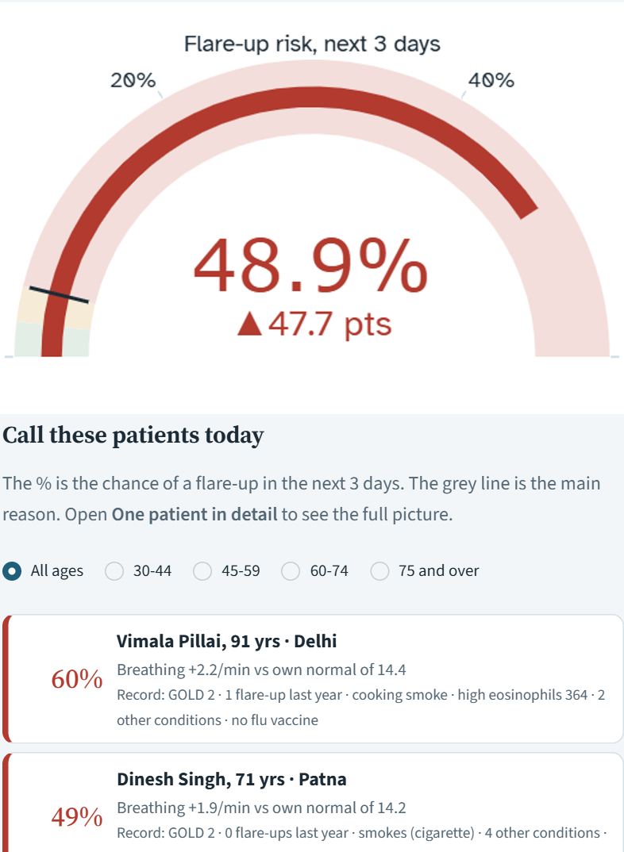
BT
BREATHETWIN
TEAM MOMENTUM
EARLY WARNING. EASIER BREATHING.
BreatheTwin: a twin that warns 1 to 3 days before a flare-up
Core Proposition
3 Data Streams
Tech & Experience
Key Differentiator
A personal twin for every COPD patient that:
Learns each person's own normal
Predicts a flare-up 1 to 3 days ahead
Explains the reasons in plain words
Shows what would lower the risk
Gives families smog warnings and a visit summary for the doctor
Stream | What it adds
Health record (EHR) | Severity, past flare-ups, smoking, blood tests, other illnesses: the starting risk
Wearable + smart inhaler | Daily heart rate, breathing, oxygen, steps, sleep, inhaler use: the early warning
City air + weather | PM2.5, cold snaps, humidity: the seasonal trigger and the advice
Usual care | Wearables | BreatheTwin
Reactive | Raw numbers | Predictive
Textbook limits | Textbook limits | Own normal
No air data | No record | Record + body + air
Doctor only | User only | Doctor + family
Doctor's view: the risk, who to call today, and why
Notes:
Four columns: what it is, the three data streams it fuses, what the doctor sees, and how it differs from usual care and generic wearables.

Slide 4
BT
BREATHETWIN
TEAM MOMENTUM
EARLY WARNING. EASIER BREATHING.
Works with the wearables and IoT devices patients can already buy
Which sensor tracks which signal
Three ways to equip a patient
Signal | Sensor | Devices | Twin uses it as
Resting heart rate | Optical PPG (green light) | Any smartwatch, band, oximeter | Change vs own normal
Breathing rate | PPG + motion, during sleep | Fitbit, Apple, Galaxy, Garmin watch | Change vs own normal
Blood oxygen (SpO2) | Red + infrared light | Fingertip / ring oximeter, watch | Change; urgent below 90%
Steps / activity | Accelerometer | Watch, band or phone | Change vs own normal
Sleep hours | Accelerometer + heart rate | Watch or band | Change vs own normal
Rescue puffs, doses | Clip-on actuation sensor | ADHERO (Lupin), Propeller, Hailie | Puffs vs normal; adherence
Blood pressure | Cuff pressure (oscillometric) | Omron Bluetooth monitor | Shown to the doctor
PM2.5, temperature | CPCB stations, weather API | City networks (no device) | Dose-response, cold snaps
Minimum kit: Any watch that syncs to Health Connect or Apple Health + fingertip oximeter. Gives heart rate, breathing, SpO2, steps, sleep.
Full kit: + smart inhaler clip (ADHERO, launched in India by Lupin) + Omron BP cuff. Adds automatic inhaler tracking.
No-watch kit: Phone + oximeter; the family types SpO2 and a 30-second breathing count. Near-zero cost.
No needle, no blood test, nothing under the skin:
a watch and a clip-on oximeter carry the daily signal; data flows phone → Health Connect / HealthKit → BreatheTwin.
Notes:
This answers which devices the twin plugs into. Left: every signal the twin reads, the sensor that measures it, the devices that carry that sensor, and where it enters the model. Right: three kits, from a full set to a no-watch option. Nothing needs a needle or a blood test. Be clear that in the prototype these readings are simulated or typed in; the device links go through Health Connect, Apple HealthKit and vendor APIs, which is the integration plan. Air and weather are already real.

Slide 5
BT
BREATHETWIN
TEAM MOMENTUM
EARLY WARNING. EASIER BREATHING.
How the twin works: three data streams, one personal model
Data In
The Twin
What Comes Out
Health record (EHR)
400 synthetic patients: Synthea + India overlay
1. Personal baseline
Every reading compared with the patient's own last 4 weeks, not a textbook range
2. Hybrid risk engine
LightGBM learns body signals, inhaler use, weather and record × published PM2.5 effect (DeVries 2017)
Risk of a flare-up in the next 3 days
Reasons, ranked by how much they push risk
Wearable + smart inhaler
heart rate, breathing, SpO2, steps, sleep, puffs, doses
Safety checks against own normal
What-if answers for doctor and family
City air + weather
real CPCB PM2.5 and Open-Meteo, 8 cities
Smog warnings + one-page visit summary
Twin journey
Health record
Daily readings
Own normal
Risk score
Reasons
Action + advice
Why hybrid: the body-signal patterns are complex and best learned from data; the air-pollution effect is small and well measured in large studies, so we take it from the literature.
Notes:
Walk left to right. Each reading is compared with the patient's own last four weeks. A LightGBM model learns from body signals, inhaler use, weather and the record; air pollution uses a published dose-response. The twin then produces five outputs.

Slide 6
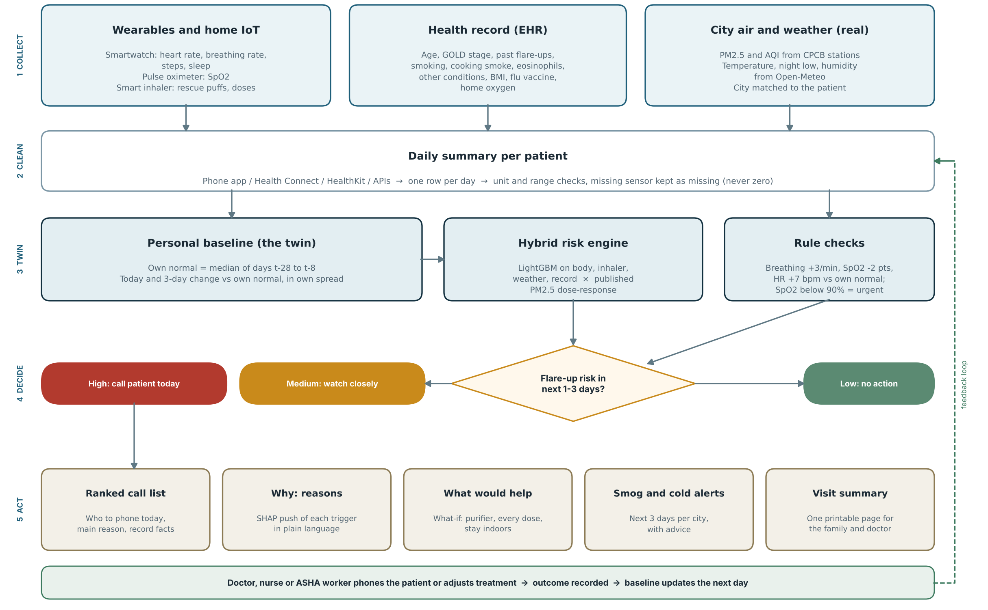
BT
BREATHETWIN
TEAM MOMENTUM
EARLY WARNING. EASIER BREATHING.
Flowchart: what BreatheTwin does for every patient, every morning
1 Collect. Watch, oximeter, inhaler clip; health record; real city air and weather.
2 Clean. One row per patient per day; range checks; missing stays missing.
3 Twin. Today vs own normal (days t-28 to t-8), hybrid risk engine, rule checks.
4 Decide. High: call today. Medium: watch. Low: no action.
5 Act. Call list, reasons, what-if, smog alerts, visit summary; outcome feeds back.
Notes:
Read top to bottom. One: collect the three streams. Two: clean them into one row per patient per day; a missing sensor stays missing, never zero. Three: the twin compares today with the patient's own normal, the hybrid engine scores risk, and rule checks run in parallel. Four: decide high, medium or low. Five: act, with the call list, reasons, what-if, smog alerts and the visit summary. The outcome feeds back so the baseline updates the next day.

Slide 7
BT
BREATHETWIN
TEAM MOMENTUM
EARLY WARNING. EASIER BREATHING.
Open, anonymised or synthetic data, and clear about which
Data Sources
Our Patient Cohort (400)
Stream | Source | Real or synthetic | Licence
Health records | Synthea COPD cohort + our India overlay and younger patients | Synthetic | Apache 2.0
Wearables and flare-ups | Simulated; every effect size from a published study | Synthetic | Ours (MIT)
Air quality | CPCB daily PM2.5, 8 cities (Kaggle 'Air Quality Data in India') | Real | CC0
Weather | Open-Meteo archive: temperature, humidity | Real | CC BY 4.0
Real-data check | MIMIC-IV Clinical Database Demo v2.2 (14 COPD patients) | Real, aggregate only | ODbL 1.0
Severity GOLD 1 / 2 / 3 / 4: 17% / 42% / 29% / 12%
Current smokers 18% · cooking smoke at home 31% · 8 cities
Real-data check: sex mix and heart disease match real patients; heart failure and diabetes are lower in synthetic records.
Honest by design:
Air and weather are real; patients, watch readings and flare-ups are simulated, so the results prove the idea works, not clinical accuracy.
Notes:
Air and weather are real. No open dataset of Indian COPD patients with wearables exists, so patients, watch readings and flare-ups are simulated from published studies. We also checked our record code on real MIMIC-IV demo patients.

Slide 8
BT
BREATHETWIN
TEAM MOMENTUM
EARLY WARNING. EASIER BREATHING.
How much of our data is real, and what each part is used for
Every data stream, real or synthetic
100%
of air and weather data
is real (CPCB, Open-Meteo)
Data | Real? | Size | Used for
City air quality (PM2.5, AQI) | Real | 2,928 city-days, 8 cities (CPCB) | Training + dashboard
Weather (temperature, humidity) | Real | 2,928 city-days (Open-Meteo) | Training + dashboard
Health records | Synthetic | 400 patients (Synthea + India overlay) | Training + dashboard
Watch, oximeter, inhaler readings | Synthetic | 146,400 patient-days, from studies | Training + dashboard
Flare-ups | Synthetic | 473 simulated events | Training labels
Real hospital patients (stress test) | Real | 100 patients, 47,214 vital readings | Testing only
Real COPD records (check) | Real | 14 COPD patients (MIMIC-IV demo) | Testing only
~1%
of all training values
are real; patient data is simulated
100
real patients, 55 women, 45 men
aged 18 to 90, used to stress-test
Why simulate patients at all?
No open dataset links COPD wearable data to labelled flare-ups, so we simulate from published studies and test on real people.
Notes:
Be upfront. All of the environment is real: CPCB air quality and Open-Meteo weather for 8 cities over a full year. Everything about the patients used for training is synthetic, because no open dataset links COPD wearables to labelled flare-ups. By volume that makes about 1% of the training values real. That is exactly why we added a stress test on 100 real, de-identified hospital patients from MIMIC-III, never used for training.

Slide 9
BT
BREATHETWIN
TEAM MOMENTUM
EARLY WARNING. EASIER BREATHING.
AI model: learn the body, borrow published science for the air
What the Model Looks At
Model Details
Data input | Signal the twin uses
Breathing, oxygen, heart rate | Change vs own normal (today, 3-day average, how unusual)
Steps and sleep | Drop vs own normal
Inhalers | Extra rescue puffs; % of daily doses taken this week
Weather | 3-week temperature drop, night low, humid heat
Health record | Age, GOLD stage, past flare-ups, smoking, cooking smoke, eosinophils, other illnesses, BMI, flu vaccine, home oxygen
Air (PM2.5) | Published dose-response, not learned: +2.5% risk per 10 µg/m³
Algorithm | LightGBM (gradient-boosted decision trees)
Predicts | Will a flare-up start in the next 1 to 3 days?
Tested on | 120 patients never seen in training (280 trained)
Safety rules | Warning signs can never lower risk; more inhaler doses can never raise it
Explanations | Per-factor contributions (SHAP values): "what is pushing the risk"
Every number has a source
Breathing rise before flare-ups: Yañez 2012
Flare-up rates by severity: ECLIPSE, Hurst 2010
Eosinophils ≥340/µL: 1.76× flare-ups (Vedel-Krogh 2016)
Still smoking: 1.28× (Au 2009) · PM2.5: DeVries 2017
Anything unsourced is labelled ASSUMPTION in the code
Tech stack: Python · pandas · LightGBM · scikit-learn · Streamlit · Plotly · Synthea (Java)
Open source: MIT licence; whole pipeline rebuilds with one command
Notes:
LightGBM gradient-boosted trees, trained on 280 patients and tested on 120 it never saw. Safety rules stop nonsense answers. Explanations come from per-factor contributions (SHAP values).

Slide 10
BT
BREATHETWIN
TEAM MOMENTUM
EARLY WARNING. EASIER BREATHING.
Results: 2 in 3 flare-ups flagged 1 to 3 days ahead
0.80
Accuracy score (AUROC)
published tools: 0.68 to 0.85
66%
Flare-ups warned
1 to 3 days ahead
0.8
False alerts
per patient per month
120
Unseen test patients
never used in training
What this means:
Body signals carry the early warning; the health record sets each person's starting risk; air and weather explain the seasons.
Notes:
AUROC 0.80 sits inside the published real-world range of 0.68 to 0.85. Body signals carry the 3-day warning; the record sets each person's starting risk. Measured on simulated patients.

Slide 11
BT
BREATHETWIN
TEAM MOMENTUM
EARLY WARNING. EASIER BREATHING.
Stress test on 100 real patients: robust, fair, right direction
75/100
real patients assessed
25 had under 48 h of vitals
0
crashes or invalid risks
incl. missing oxygen sensor
0.71
risk vs real worsening
rank correlation
Pass
worse readings raise risk
8-case edge suite
By sex and age group
What we learned
Group | Patients | Median risk | Alerted
Female | 44 | 0.9% | 30%
Male | 31 | 0.6% | 19%
18-39 | 2 | 20.2% | 50%
40-49 | 6 | 0.6% | 17%
50-59 | 7 | 0.6% | 29%
60-69 | 9 | 0.6% | 0%
70-79 | 18 | 0.6% | 22%
80+ | 32 | 0.8% | 31%
Robust: every real patient with 48 h of data was scored; no crash, no impossible risk.
Right direction: breathing up to 35/min gives High risk; all three signs worse gives 96%.
Age and sex: age 18 vs 90 and switching sex barely change risk; sex is not a model input.
To fix: an SpO2 drop alone barely moves the learned risk (the rule layer still flags it urgent).
Limits: no link with later in-hospital death (AUROC 0.49); women alerted more at equal signs, but groups are 5 to 19 people.
Real people, never used for training:
MIMIC-III demo v1.4 (PhysioNet, ODbL). ICU patients are not a COPD home cohort: a stress test, not validation.
Notes:
We fed the twin 100 real, de-identified ICU patients from the open MIMIC-III demo: 55 women and 45 men, aged 18 to 90. Their real record and real heart rate, breathing rate and oxygen go in exactly like the 'Check a new person' page; air and weather are held fixed so only the person differs. 75 had enough data. No crash, no impossible output, even with a missing oxygen sensor. Risk rises with real worsening signs. Be honest about the limits: an oxygen drop alone barely moves the learned risk, though the rule layer flags it urgent; risk did not predict in-hospital death, which is a different event; and the sex comparison rests on small groups.

Slide 12
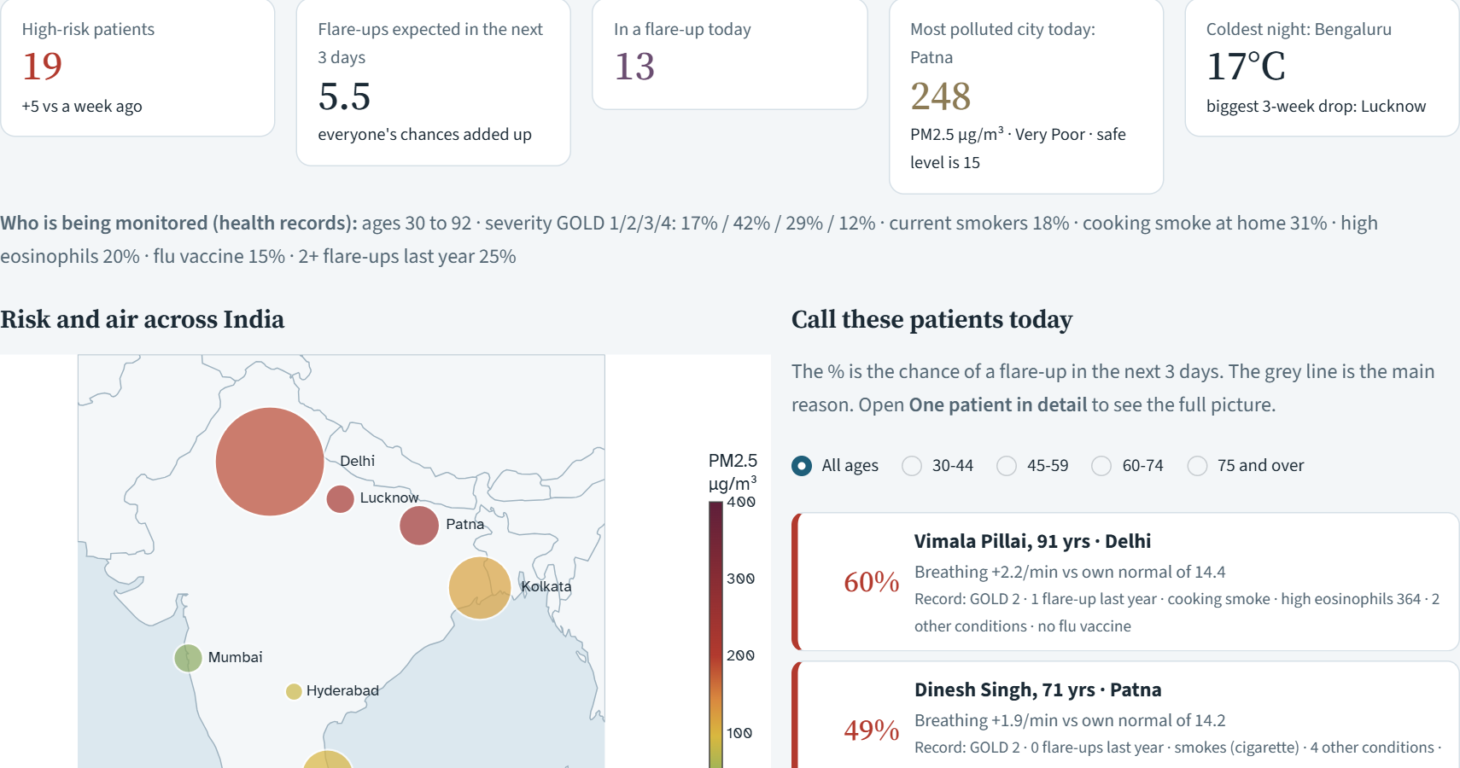
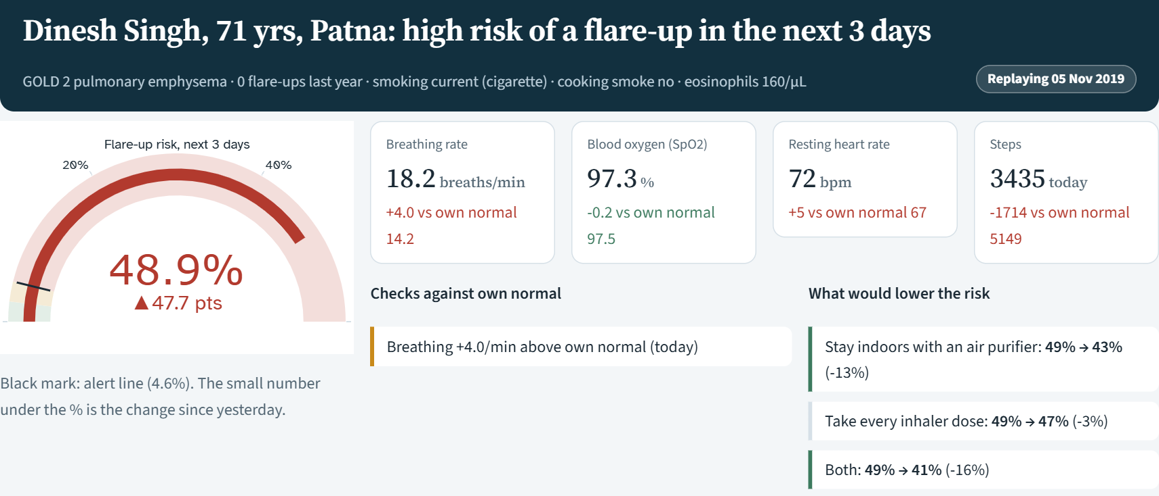
BT
BREATHETWIN
TEAM MOMENTUM
EARLY WARNING. EASIER BREATHING.
The doctor's dashboard: who to call today, and why
Overview: all 400 patients
One patient in detail
Call these patients today: ranked by risk, with the main reason and key record facts
India map of risk and air; filter by age group; plain-language guide on every page
Risk dial with the alert line and the change since yesterday
Today's readings vs own normal: red means worse than usual
What would lower the risk: e.g. air purifier 49% → 43%
Notes:
Overview ranks all 400 patients by risk with the main reason and record facts. The patient page shows the risk dial, today's readings against the patient's own normal, safety checks and what would lower the risk.

Slide 13
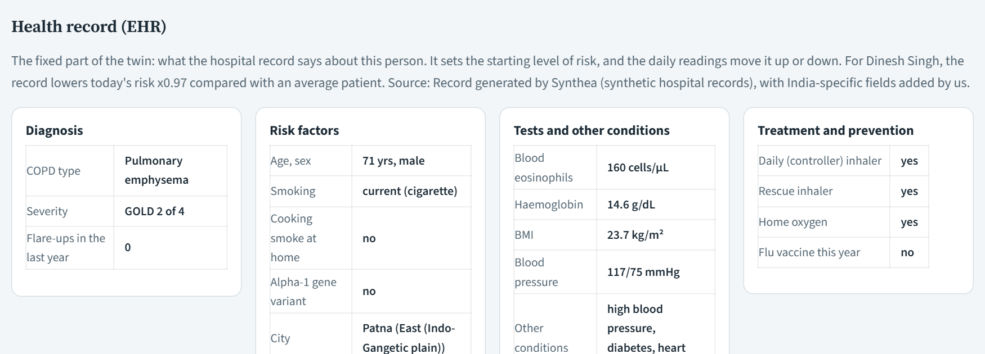
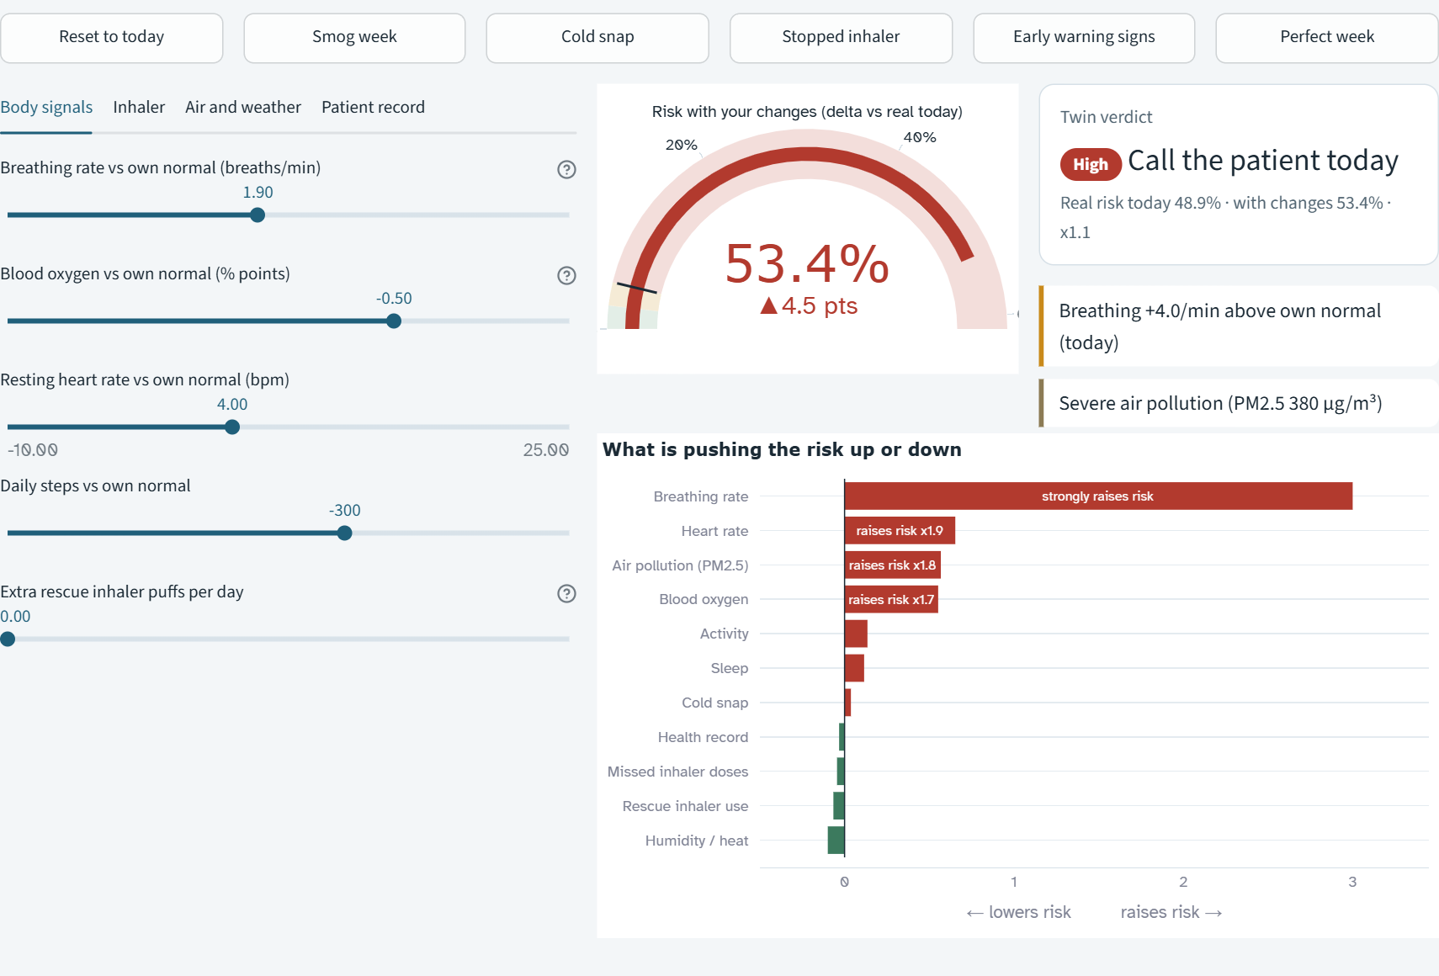
BT
BREATHETWIN
TEAM MOMENTUM
EARLY WARNING. EASIER BREATHING.
Health record in every view, and a lab to test advice before giving it
Health Record (EHR)
What-if Lab
The fixed part of the twin
Diagnosis, risk factors, blood tests, other illnesses, medicines
Shows how much the record raises or lowers today's risk
Record facts also appear on the call list, what-if lab and new-person check
One click scenarios: smog week, cold snap, stopped inhaler, early warning signs, perfect week
Sliders for body signals, inhaler, air, weather and the record; risk re-scores instantly
Notes:
The health record has its own section and shows how much it raises or lowers risk. The what-if lab lets a doctor try a smog week, a cold snap, stopped inhaler, or record changes like eosinophils.

Slide 14
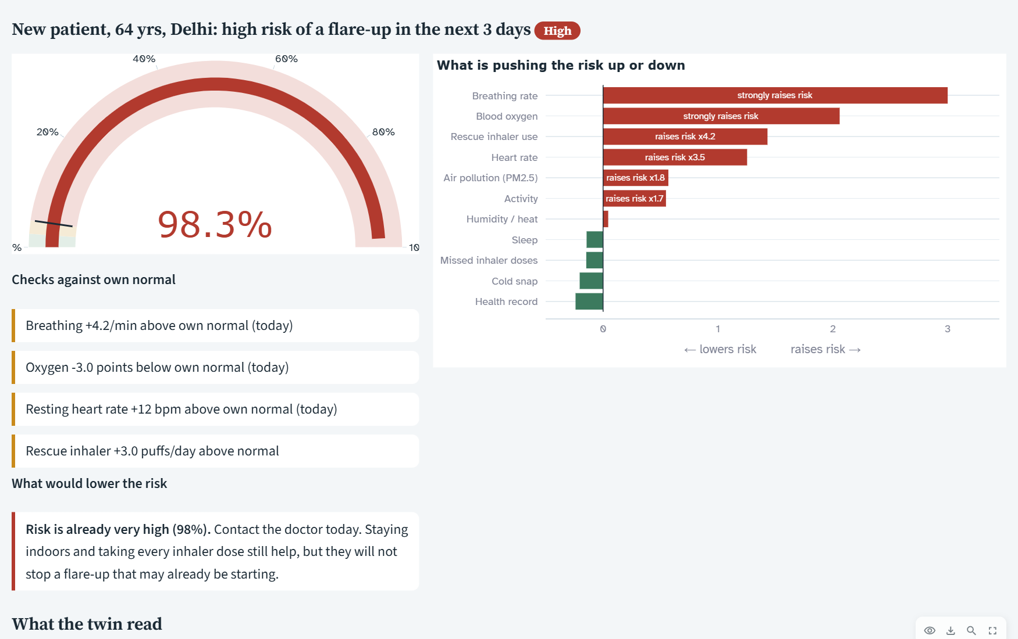
BT
BREATHETWIN
TEAM MOMENTUM
EARLY WARNING. EASIER BREATHING.
Check a new person in minutes, and see every value the twin used
Result for a new person with warning signs
How it works
1. Health record: age, severity, smoking, blood tests
2. Readings usual (a good day) and now (last 3 days)
3. Optional: today's PM2.5 from a CPCB or AQI app
4. Risk, reasons, safety checks and a table of every value used
We tested it
Test case | Result
Readings now = usual | Low, about 0.4%
Faster breathing, lower oxygen, more puffs | High, about 96%
Eosinophils 220 → 520 cells/µL | Risk 0.43% → 0.80%
Notes:
Enter the record, usual readings and readings now, and optionally today's PM2.5 from an AQI app. We tested it: same readings give low risk, warning signs give high risk, higher eosinophils raise it.

Slide 15
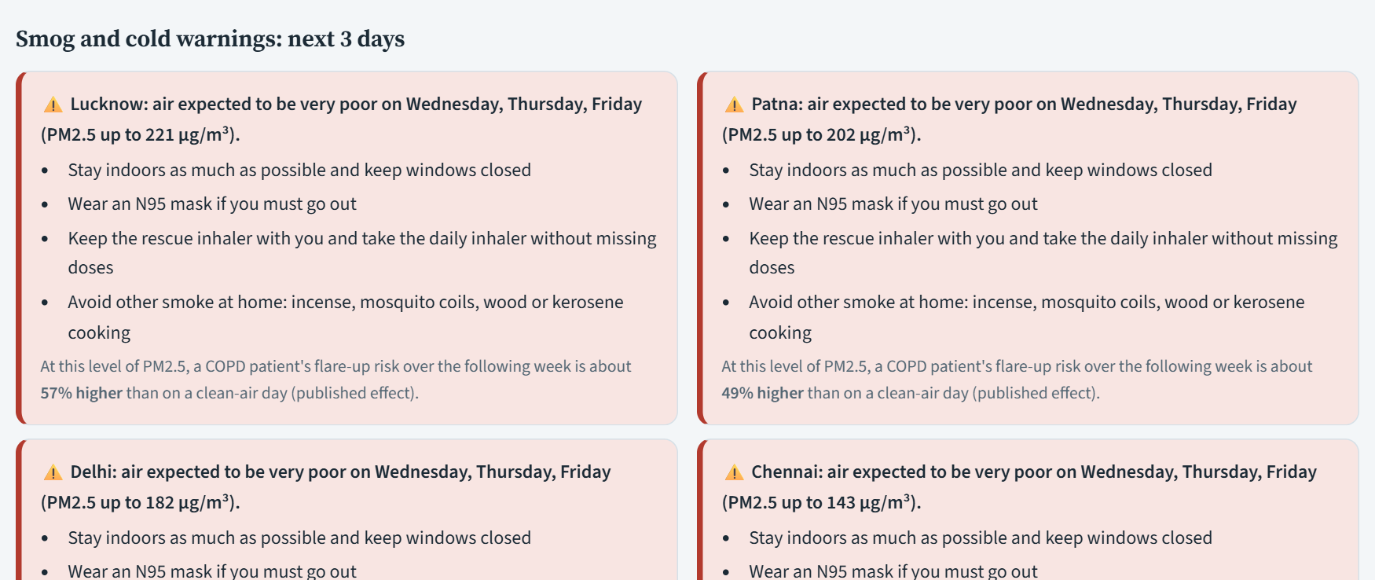
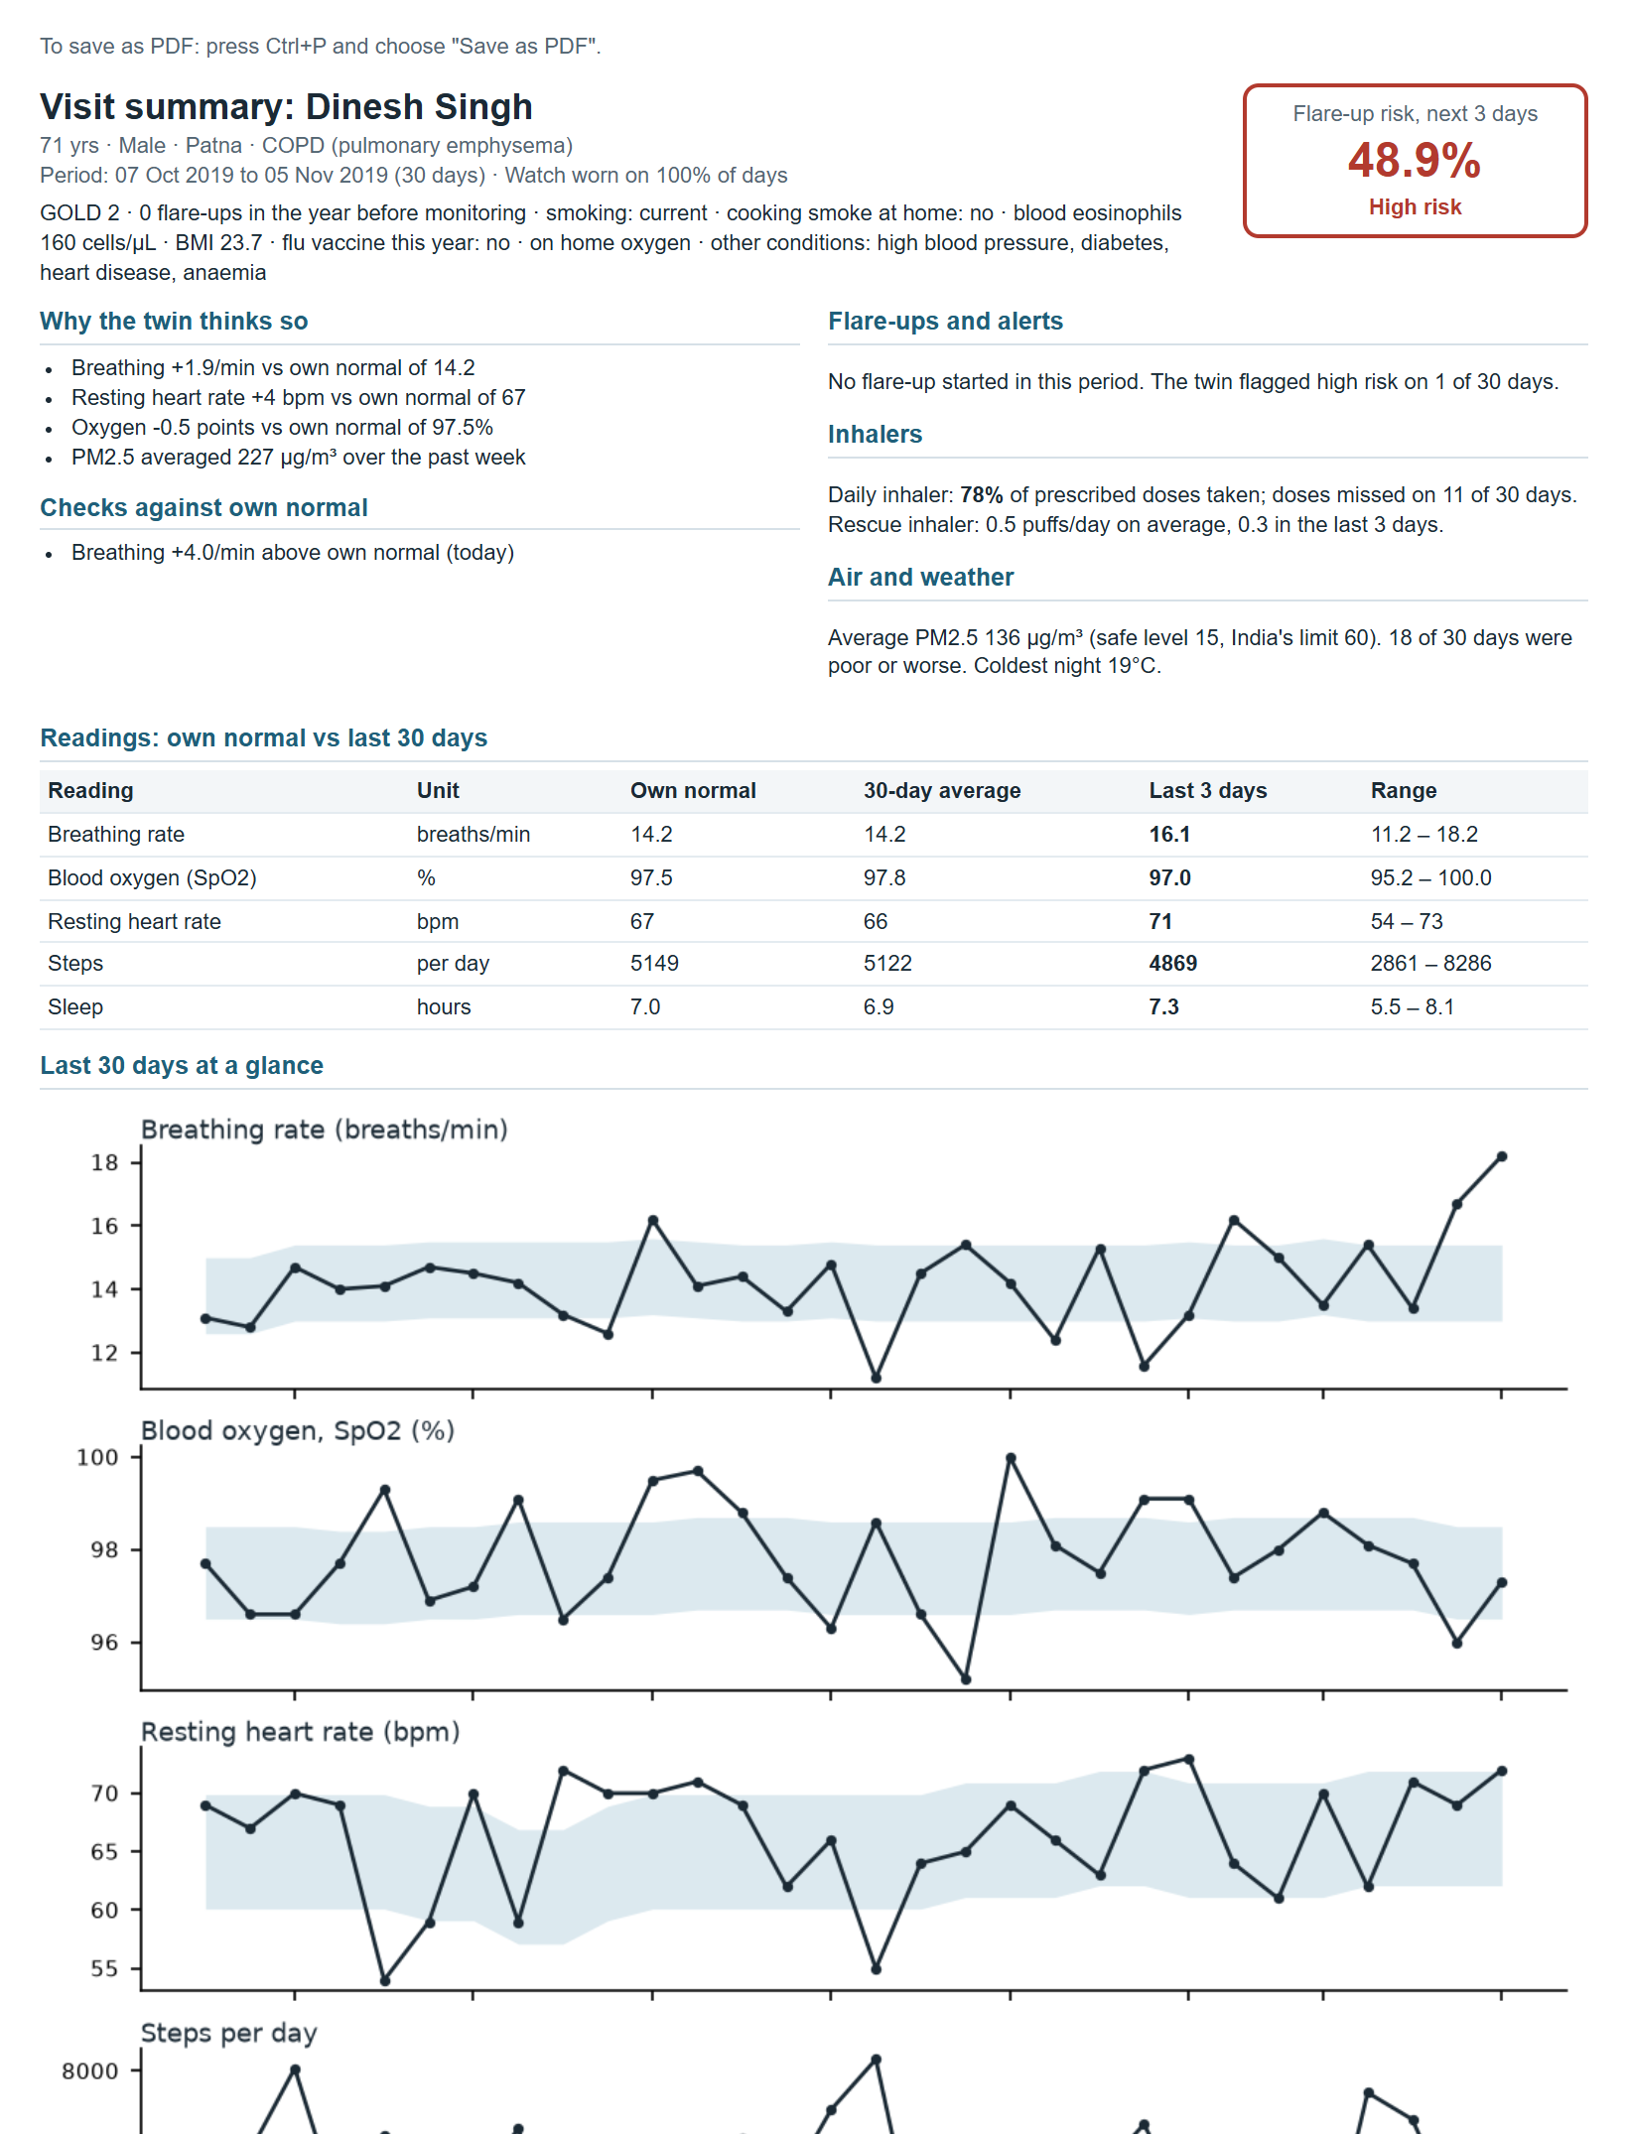
BT
BREATHETWIN
TEAM MOMENTUM
EARLY WARNING. EASIER BREATHING.
From prediction to action: smog warnings and a visit summary
Smog is Coming: next 3 days
One-page Visit Summary
Uses India's official CPCB PM2.5 bands; advice gets stronger as air gets worse
Also warns about cold nights; shows the extra flare-up risk from the published effect
Demo replays real 2019-20 data; a live version would use an air-quality forecast
Notes:
Smog and cold warnings for the next 3 days use India's CPCB bands and give plain advice. The one-page visit summary is what a family can print and take to the doctor.

Slide 16
BT
BREATHETWIN
TEAM MOMENTUM
EARLY WARNING. EASIER BREATHING.
Who it helps: doctors, health workers and families
Value by Stakeholder
Why it fits India
Who | Today | With BreatheTwin
Doctor / clinic | Sees the patient only when they come in sick | A ranked daily list of who to call, with reasons
Community health worker | Visits by rota, not by need | Visits the few patients at highest risk first
Patient and family | Notice a flare-up when breathing is already bad | Early warning, smog advice, a summary to take to the doctor
Health system | Emergency visits in smog season | Aim: fewer emergency visits through early action
Built for Indian triggers: cooking smoke, bidis, winter smog
Covers ages 30 to 92, since COPD starts earlier in India
Plain language on every page, with a glossary
Open source and free to adapt
Planned: low-cost pulse oximeter + phone, Hindi
The care loop
Watch daily
Warn early
Act at home
Visit with summary
Learn and refine
Notes:
Same twin, different views: a ranked list for doctors, a short call list for health workers, plain advice and a printable summary for families.

Slide 17
BT
BREATHETWIN
TEAM MOMENTUM
EARLY WARNING. EASIER BREATHING.
Honest limits, and the road from prototype to real patients
Limitations and How We Handle Them
Roadmap
Limitation | How we handle it
Patients, readings and flare-ups are simulated | Every effect sourced or labelled ASSUMPTION; real air and weather; stress-tested on 100 real patients
No India-specific PM2.5 effect for COPD | Use the global published figure; flag it clearly
Synthetic records differ from real ones | Checked against real MIMIC-IV patients; run on 100 real MIMIC-III patients; gaps reported
Demo replays past air data | Same rules plug into a live forecast
Needs a smartwatch or oximeter | Minimum kit is a watch + oximeter; no-watch kit uses typed readings
Phase 1: Validate
Partner hospital · test on real Indian COPD records · tune alert line
Phase 2: Patient app
"My lungs today" · daily symptom check-in · SMS / WhatsApp alerts · Hindi
Phase 3: Scale
Live air-quality forecasts · link to ABDM health records · health-worker rollout
Next step:
Validate on real Indian COPD patients with a hospital partner before any clinical use.
Notes:
Be upfront about what is simulated and assumed. The roadmap starts with validation on real Indian patients before anything else.

Slide 18
BT
BREATHETWIN
TEAM MOMENTUM
EARLY WARNING. EASIER BREATHING.
Thank You!
Anushka Tomar (Team leader) · Yash Saxena
Team MOMENTUM · SDA Bocconi Asia Center

