Slide 1

CLASSIFICATION MODEL OF HUMAN/BOT THROUGH GAME
MEMBERS:
DURVA VIKAS AGARWADKAR, A001
JINAV DHIREN GALA, A007
YASH RAJESH SHAH, A013
Guided by:
PROF. SHRADDHA SARODE

Slide 2
Overview
Objectives
Battleship
About the Data
ML models
Evaluation summary
Limitations and future scope
Conclusion

Slide 3
OBJECTIVES
Build a classification model of human and bot using a game
Give a gamified alternative to the traditional CAPTCHA.
Notes:
Completely Automated Public Turing test to tell Computers and Humans Apart
challenge-response authentication.

Slide 4
BATTLESHIP
Battleship is a strategy type guessing game which is played on ruled grids where each player's fleet of warships are marked.
The locations of the fleets are concealed from the other player.
Players alternate turns calling "shots" at the other player's ships, and the objective of the game is to destroy the opposing player's fleet.
Notes:
Before play begins, each player secretly arranges their ships on their primary grid. Each ship occupies a number of consecutive squares on the grid, arranged either horizontally or vertically. The number of squares for each ship is determined by the type of ship. The ships cannot overlap (i.e., only one ship can occupy any given square in the grid). The types and numbers of ships allowed are the same for each player.
(RULES)

Slide 5
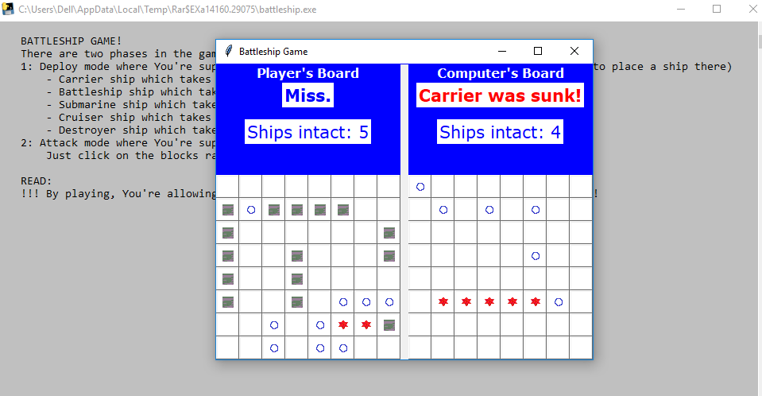
Python implementation
A python GUI (Graphical User Interface) implementation of battleship was developed using ‘Tkinter’ library for collecting data
This single player game features a basic random bot
The Application

Slide 6
PHASES of game
Till either player or bot wins by guessing all the 5 ships
DEPLOY MODE
ATTACK MODE
Player places 5 ships on an 8 by 8 grid
Bot places 5 ships on other 8 by 8 grid
Player guesses bot ship position
Bot guesses Player ship position
Data is pushed to GitHub
Game ends

Slide 7
Data collection
One of the player wins
Data pulled from GitHub
Data appended in form of text
Text file pushed and committed to the GitHub

Slide 8
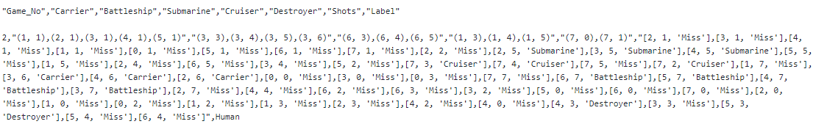
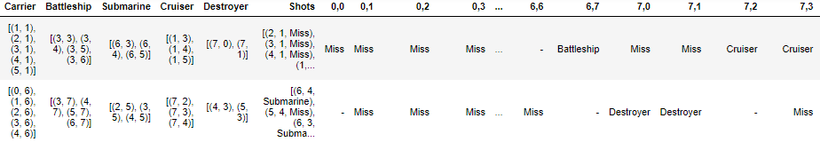
Dataset
A sample data point as stored in GitHub:
Dataset after data preparation and manipulation:
Game played -> Data stored on GitHub -> CSV -> Python
Notes:
How the string text data is converted to csv using excel

Slide 9
Block Diagram
Data Collection
Data preparation
Performing PCA
Split data for train/test
Labeling
Model Training

Slide 10
Data Pre-processing
Principal Component Analysis (PCA)
It is a dimensionality-reduction method that is often used to reduce the dimensionality of large data sets, by transforming a large set of variables into a smaller one that still contains most of the information in the large set.

Slide 11
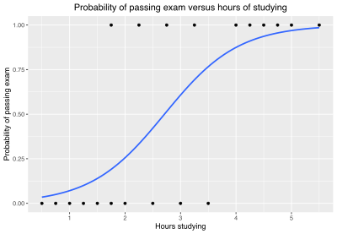
MODEL Building using Logistic Regression
Logistic regression is a powerful supervised ML algorithm used for but not limited to binary classification problems
It uses logit function

Slide 12
MODEL Building using Bernoulli Naïve Bayes
Bernoulli Naive Bayes is a part of the family of Naive Bayes.
Based on Bayes theorem
A special case of Naïve Bayes where labels are of binary values.

Slide 13
MODEL Building using Decision Tree (C4.5)
A decision tree is a flowchart-like structure in which each internal node represents a "test" on an attribute, each branch represents the outcome of the test, and each leaf node represents a class label
C4.5 is an algorithm used to generate a decision tree
Gain Ratio is used as split criteria

Slide 14
MODEL Building using Random Forest
Random forests or random decision forests is an ensemble method for classification
Constructing a multitude of decision trees at training time
The output of the random forest is the class selected by most trees

Slide 15
Pre-processing Result
Applying PCA resulted in reducing the dimension from 64 to 44
44 components explain 95.1% of the variability in the original data.

Slide 16
Evaluation of classification models
Dataset contained 130 data points (65 human & 65 bot).
104 data points (80%) of data points were used for training and 26 data points (20%) of data points was used for testing the model.
Model | Accuracy | Precision | Recall
Logistic Regression | 0.73 | 0.77 | 0.71
Bernoulli NB | 0.57 | 0.53 | 0.67
Random Forest | 0.89 | 0.86 | 0.92
Decision Tree | 0.85 | 0.9 | 0.75
Notes:
Data points and train test split

Slide 17
Conclusion
Among the classifiers evaluated, Random Forest Classifier turns out to give the best accuracy
The concept of game based human-bot classification can be considered as fun but time-consuming alternative to CAPTCHAs

Slide 18
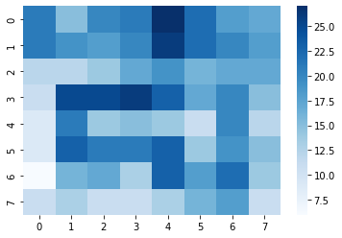
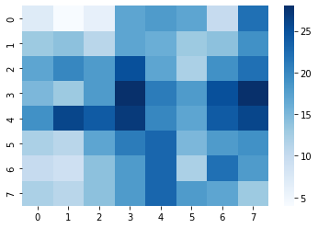
Ship placing Heatmaps
Humans
Bots

Slide 19
Limitations and Future Scope
Diagonal placement of ships was not allowed
Bot moves are random and not fully optimal
Downloading the local game application was a hassle resulting in less data points
Model can be scaled to classify with just few clicks on the screen
Deep learning model for pattern recognition on images can be used for improving the classifiers

Slide 20
THANKYOU

