Slide 1

EXPERTS IN TURNKEY PROJECTS OF
ARTIFICIAL GRASS LANDSCAPING AND
SPORTS TURFS,

Slide 2
SPECIALITY.
INHOUSE TECHNICAL AND DESIGN TEAM.
INHOUSE INSTALLATION TEAM.
READY STOCK AVAIBILITY.
BEST QUALITY WITH FARE PRICING.

Slide 3
SPORTS TURFS.
FOOTBALL
CRICKET
LAWN TENNIS
BASKETBALL
BOXING
BADMINTON.

Slide 4
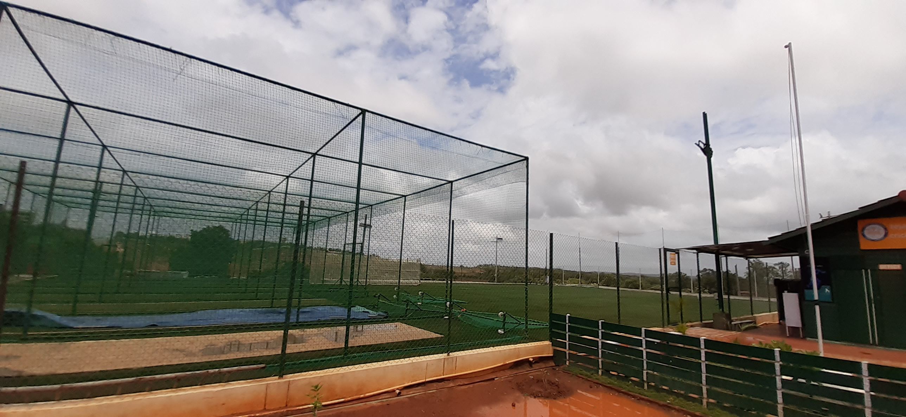
FOOTBALL AND CRICKET.

Slide 5
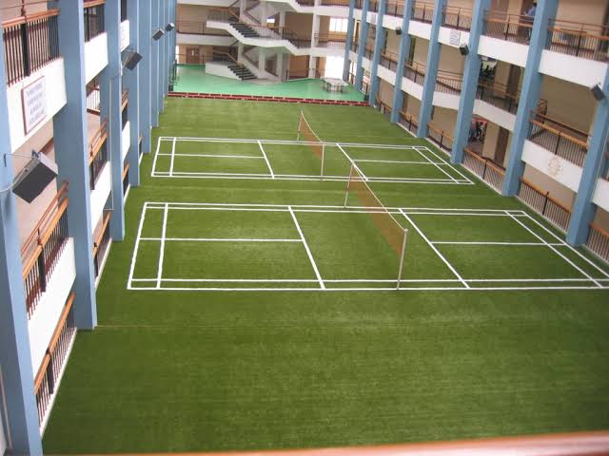
TENNIS AND BADMINTON.

Slide 6
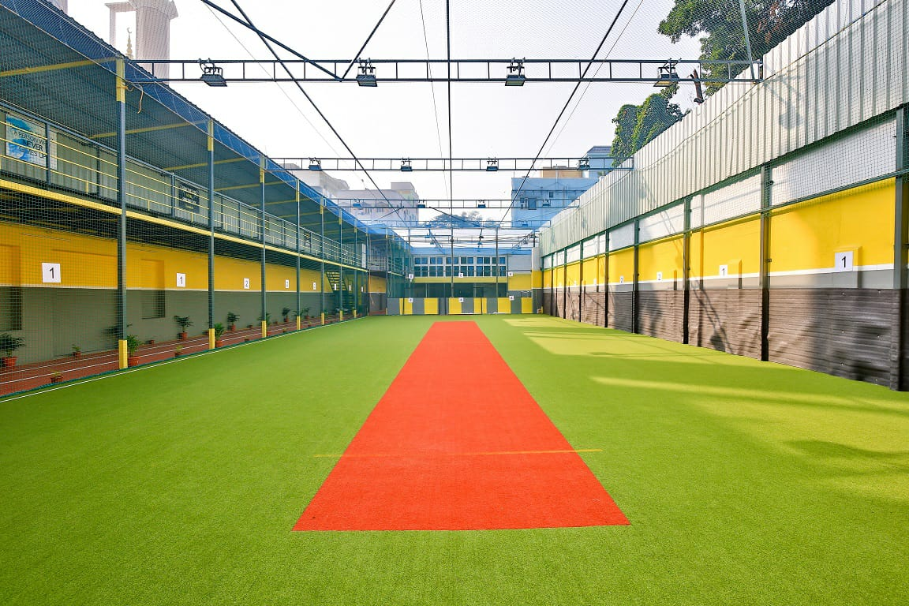
MULTI SPORTS ( MULTI SPORTS GROUND)

Slide 7
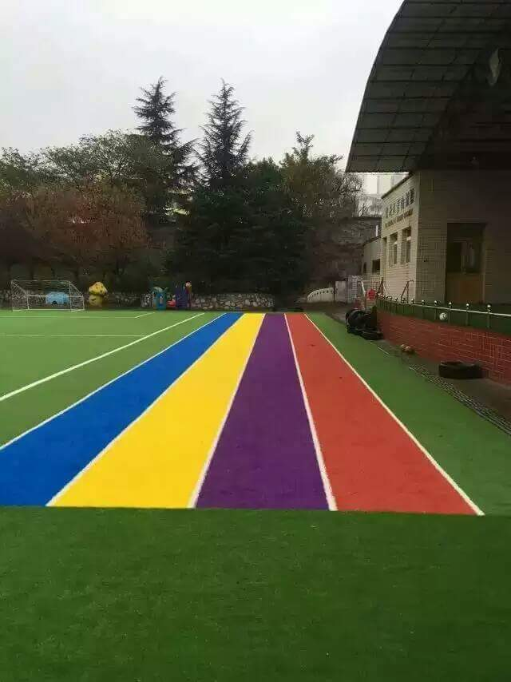
RUNNING PATHWAY.

Slide 8
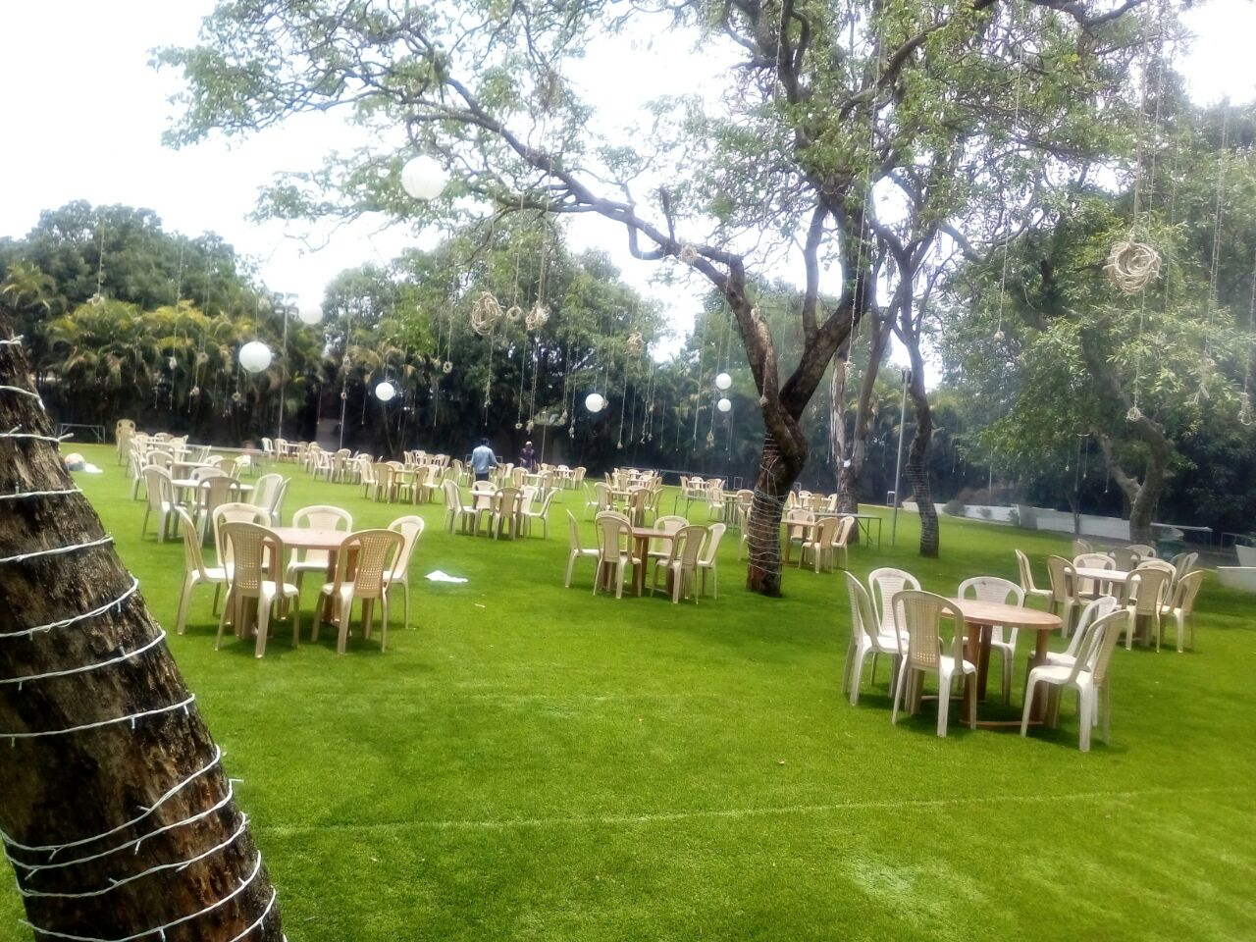
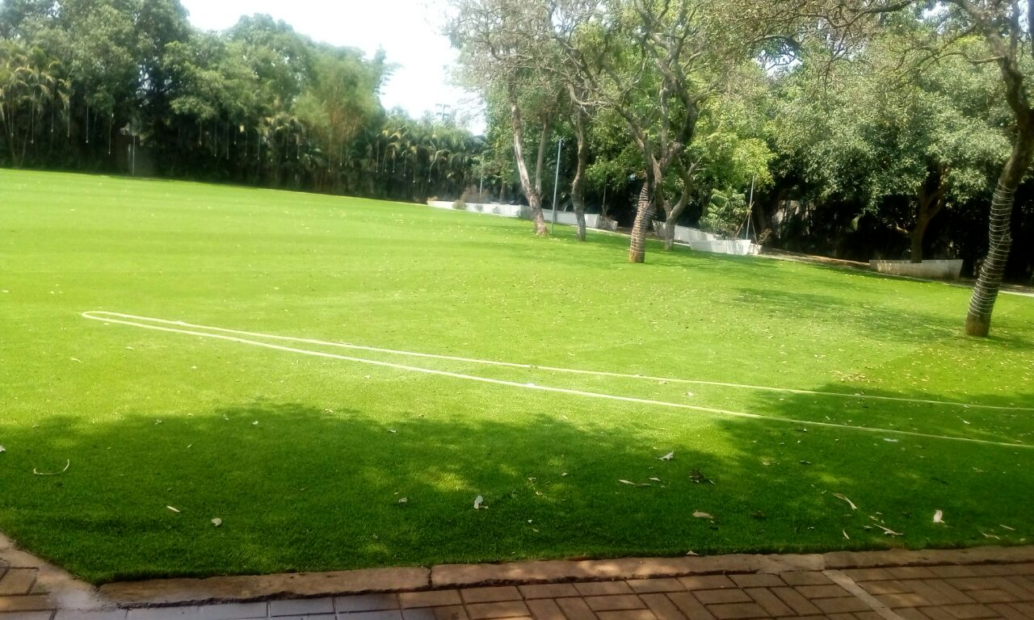
COMMERCIAL SITES.

Slide 9
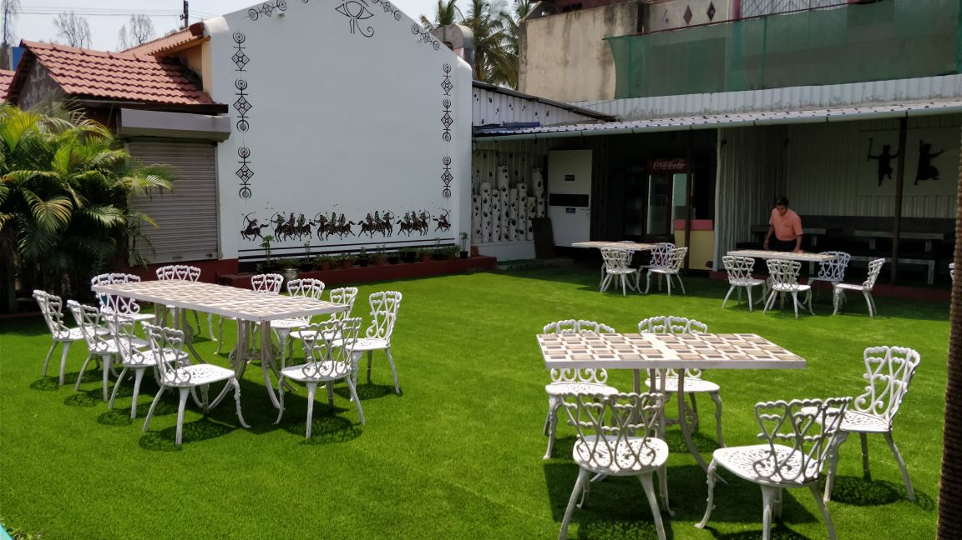
HOTELS

Slide 10
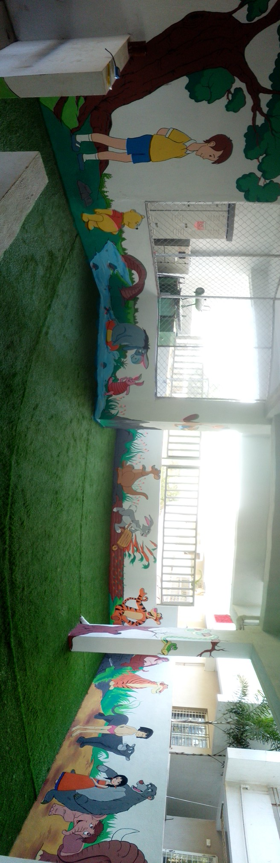
PLAY AREAS

Slide 11
THANKING YOU
REGARDS –
PARTH DEWANI.
9480332831.

