Slide 1

Demand Forecasting
By Multivariate Time Series Analysis

Slide 2

Technology Used
Python 3.x
Multivariate Time series analysis

Slide 3
What is Demand?
Demand is a buyer's willingness and ability to pay a price for a specific quantity of a good or service. Demand refers to how much (quantity) of a product or service is desired by buyers at various prices. The quantity demanded is the amount of a product people are willing to buy at a certain price; the relationship between price and quantity demanded is known as the demand.

Slide 4
What is demand forecasting?
“The science and art of the converting the Qualitative understanding of a market into Quantitative data.”
Demand forecasting is the activity of estimating the quantity of a product or service that consumers will purchase. Demand forecasting involves techniques including both informal methods, such as educated guesses, and quantitative methods, such as the use of historical sales data or current data from test markets. Demand forecasting may be used in making pricing decisions, in assessing future capacity requirements, or in making decisions on whether to enter a new market.

Slide 5
Importance of demand forecasting
Distribution of resources
Helps in avoiding wastages of resources
Serves as a direction to production
Pricing
Helps in devising sales policy
Decrease of business risk
Inventory management

Slide 6
Level of Demand Forecasting used
Micro level or firm level This refers to the demand forecasting by the firm for its product. The management of a firm is really interested in such forecasting. Generally speaking, demand forecasting refers to the forecasting of demand of a firm.

Slide 7
MY Workspace:
I had chosen Long Short-Term Memory (LSTM) recurrent neural networks model LSTM model for multivariate time series forecasting

Slide 8
Steps followed:
Converted the data in to time series form.
Data Pre-processing and cleaning:
1.Filling Null values.(using most confident value from a corresponding feature).
2.Catagorical data handling.
Label encoding and dummy variable formation.
Converted the data into supervised learning model.
Train test splitting.
Model fitting.

Slide 9
outputs

Slide 10
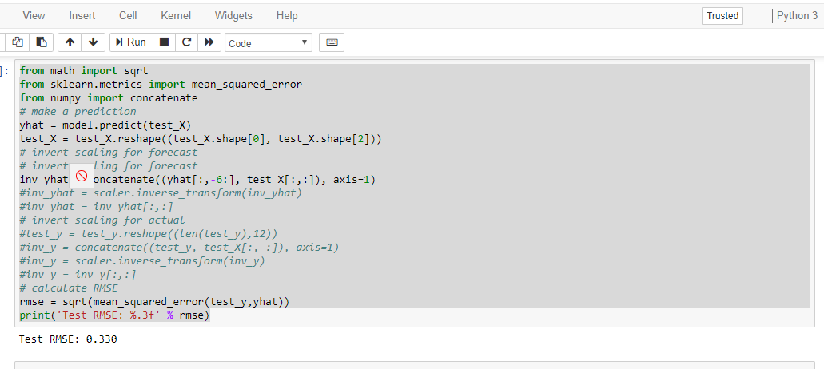
Total RMSE(Root mean square error)

Slide 11
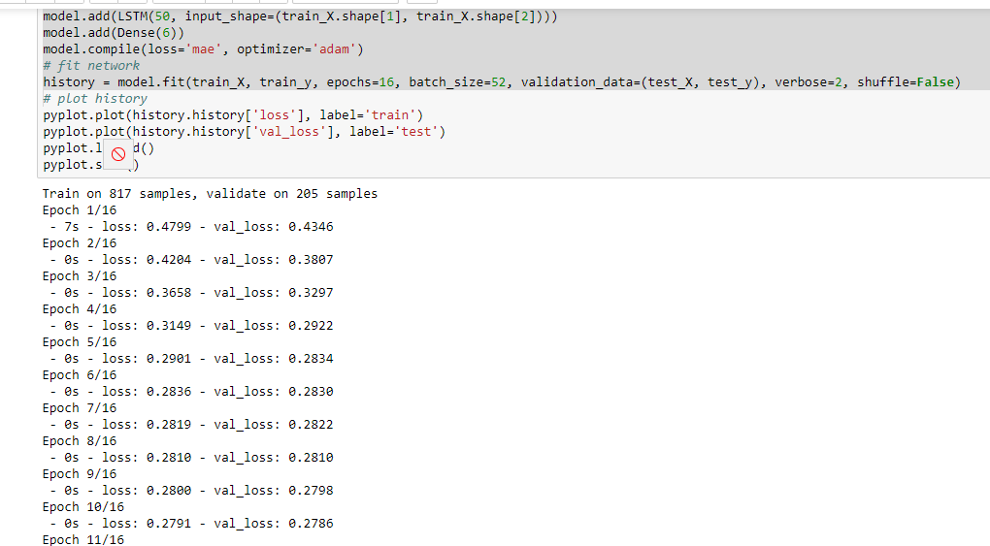

Slide 12


Thank You
Yashshavi kashyap
yashshavikashyap@gmail.com

