Slide 1
EMPLOYEE MANAGEMENT PORTAL (CRUD)
--by Yashshree Rasal(20230804001)
&
Shruti Hole (20230804017)

Slide 2
MCA – FY ADVANCE PROGRAMMING

Slide 3
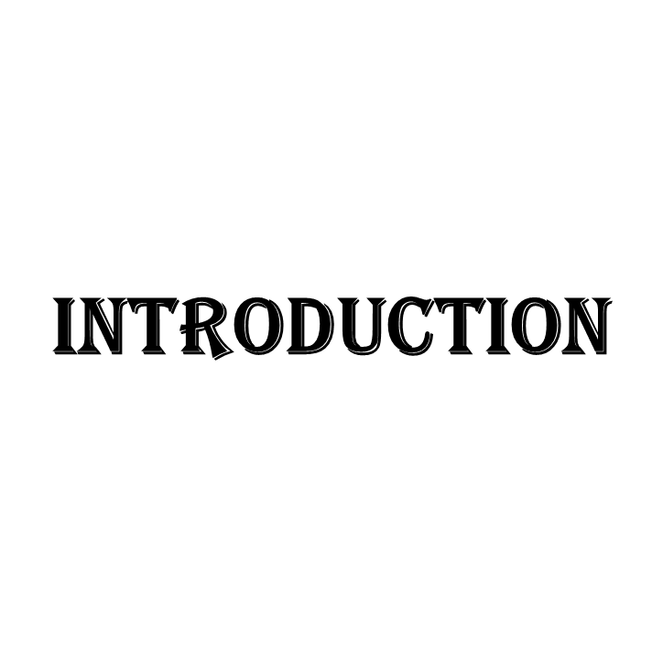
The task is to create a Database-driven Employee Management System in Python that will store the information in the Database. The script will contain the following operations :
Add Employee
Remove Employee
Update Employee
Display Employees
This System works on the concepts of taking the information from the database making required changes in the fetched data and applying the changes in the record.

Slide 4
OBJECTIVE
To perform different changes in our Employee Record by using different functions for example
Add Employee will insert a new row in our Employee
Delete Employee Function which will delete the record of any particular existing employee in our Employee table.
The main advantage of connecting our program to the database is that the information becomes lossless even after closing our program a number of times.

Slide 5
TECHNOLOGIES USED
Python
Tkinter(GUI)
Sqlite3(Database)

Slide 6
FEATURES (CRUD)
CREATE
CREATE EMPLOYEE TABLE
LIST
LIST OF THE EMPLOYEE TABLE
UPDATE/SAVE
UPDATE/SAVE ALL RECORDS
INSERT
INSERT NEW ENTRY
UPDATE
UPDATE EXISTING ENTRY
DELETE
DELETE THE ENTRY

Slide 7
DATABASE QUERIES
CREATE DB
CONNECT DB
SQLITE
CREATE TABLE
GUI
INSERT DATA
DATABASE
UPDATE DATA
DATABASE SYSTEM
DELETE ENTRY

Slide 8

CODE &
OUTPUT

Slide 9

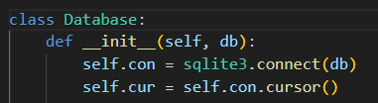
Importing necessary modules .
For creating the Employee Management Portal in Python that uses sqlite database we need to connect Python with sqlite3.

Slide 10
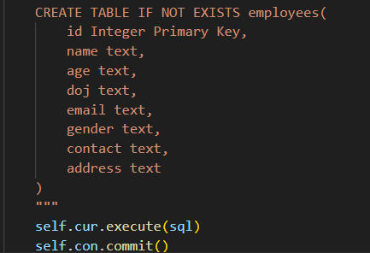
CRUD OPERATIONS ON TABLE
Create the Table

Slide 11

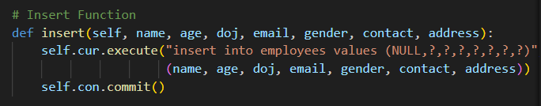
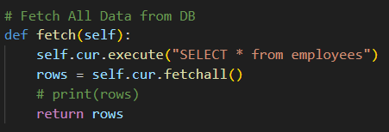
Fetch All data from DB

Slide 12
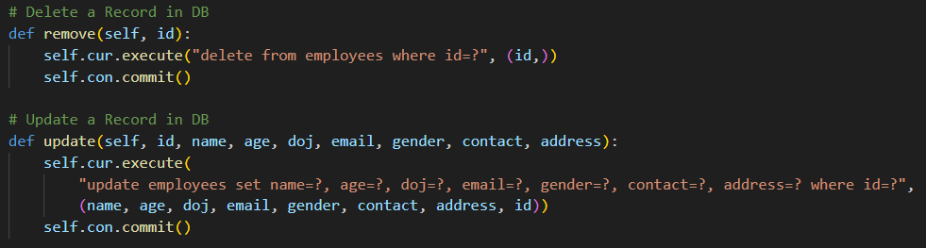
DELETE RECORD FROM TABLE
UPDATE A RECORD FROM TABLE

Slide 13
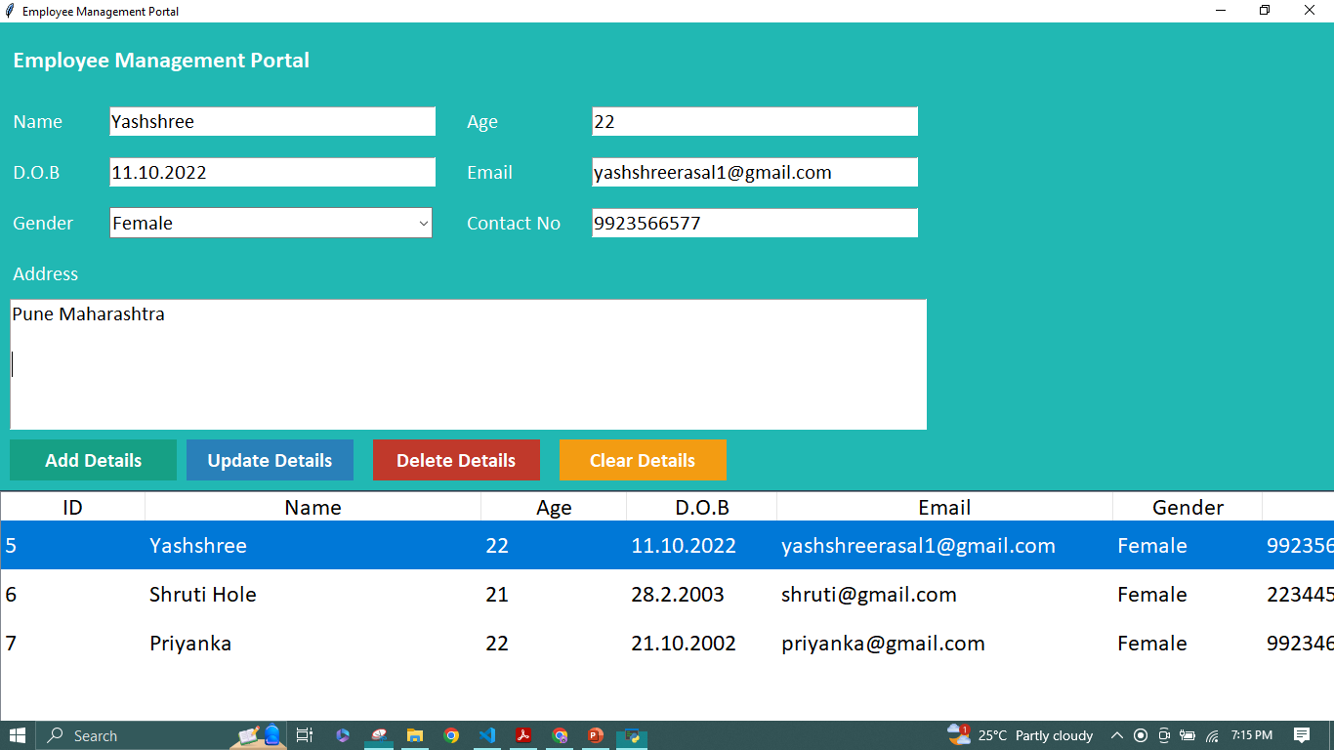

Slide 14

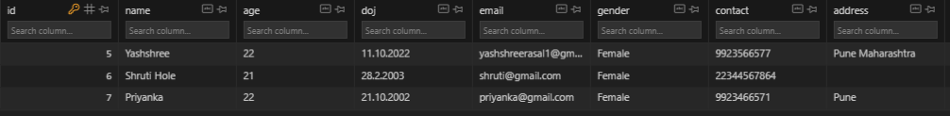
CRUD OPERATIONS :

Slide 15

THANK YOU !

