Slide 1


Slide 2
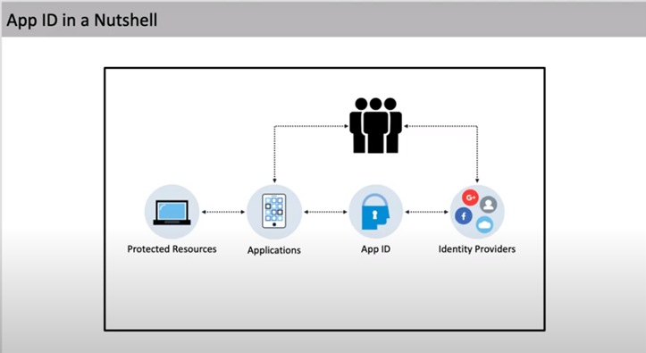

Slide 3
Definition
App ID is a service that helps you to connect your Applications and Identity Providers.
Basically this is a service that allows to easily add user authentications to your applications as well as manage the access control.
It makes use of Outh2.0 for authorization.
OAuth 2.0 is the industry-standard protocol for authorization. OAuth 2.0 focuses on client developer simplicity while providing specific authorization flows for web applications, desktop applications, mobile phones, and living room devices.

Slide 4
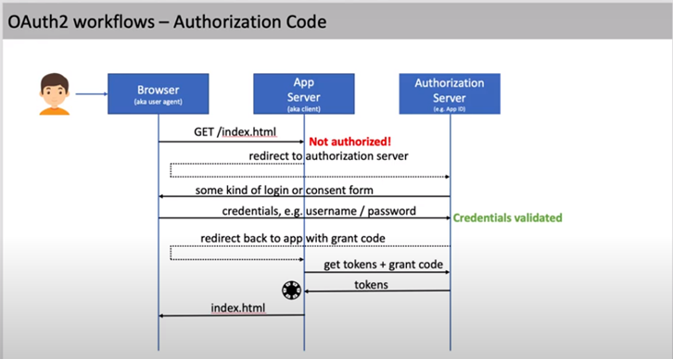

Slide 5
Steps
Create AppID service instance through IBM cloud
Customize the AppID instance according to requirements
Bind application with AppID service.
Add Code to Node JS Application to configure App ID use.

Slide 6
Express-session
HTTP is stateless; in order to associate a request to any other request, you need a way to store user data between HTTP requests.
Cookies and URL parameters are both suitable ways to transport data between the client and the server. But they are both readable and on the client side.
Sessions solve exactly this problem. You assign the client an ID and it makes all further requests using that ID. Information associated with the client is stored on the server linked to this ID.
We will need the Express-session

Slide 7
Session middle ware
The session middleware handles all things for us, i.e., creating the session, setting the session cookie and creating the session object in req object.
Whenever we make a request from the same client again, we will have their session information stored with us (given that the server was not restarted). We can add more properties to the session object.

Slide 8
EXPLANATION
resave: It basically means that for every request to the server, it reset the session cookie. Even if the request was from the same user or browser and the session was never modified during the request.
saveUninitialized: When an empty session object is created and no properties are set, it is the uninitialized state. So, setting saveUninitialized to false will not save the session if it is not modified.
The default value of both resave and saveUninitialized is true

Slide 9
Overall
Uninitialised = false It means that Your session is only Stored into your storage, when any of the Property is modified in req.session
Uninitialised = true It means that Your session will be stored into your storage Everytime for request. It will not depend on the modification of req.session.
resave = true It means when the modification is performed on the session it will re write the req.session.cookie object.
resave = false It will not rewrite the req.session.cookie object. the initial req.session.cookie remains as it is.

Slide 10
Passport
passport.session() acts as a middleware to alter the req object and change the 'user' value that is currently the session id (from the client cookie) into the true deserialized user object.

Slide 11
Session cookie
Session cookies are cookies that last for a session. A session starts when you launch a website or web app and ends when you leave the website or close your browser window. Session cookies contain information that is stored in a temporary memory location which is deleted after the session ends.

Slide 12
Serialize and Deserialize
The user information (you provide as the second argument of the cb function) is saved in the session and is later used to retrieve the whole object via the deserializeUser function.
serializeUser determines which data of the user object should be stored in the session. The result of the serializeUser method is attached to the session as req.session.passport.user = {}. Here for instance, it would be (as we provide the user as the key) req.session.passport.user = {complete user information}

